Slide 1
Optimize: UI Performance
By: Jagadeesh Palaniappan

Slide 2
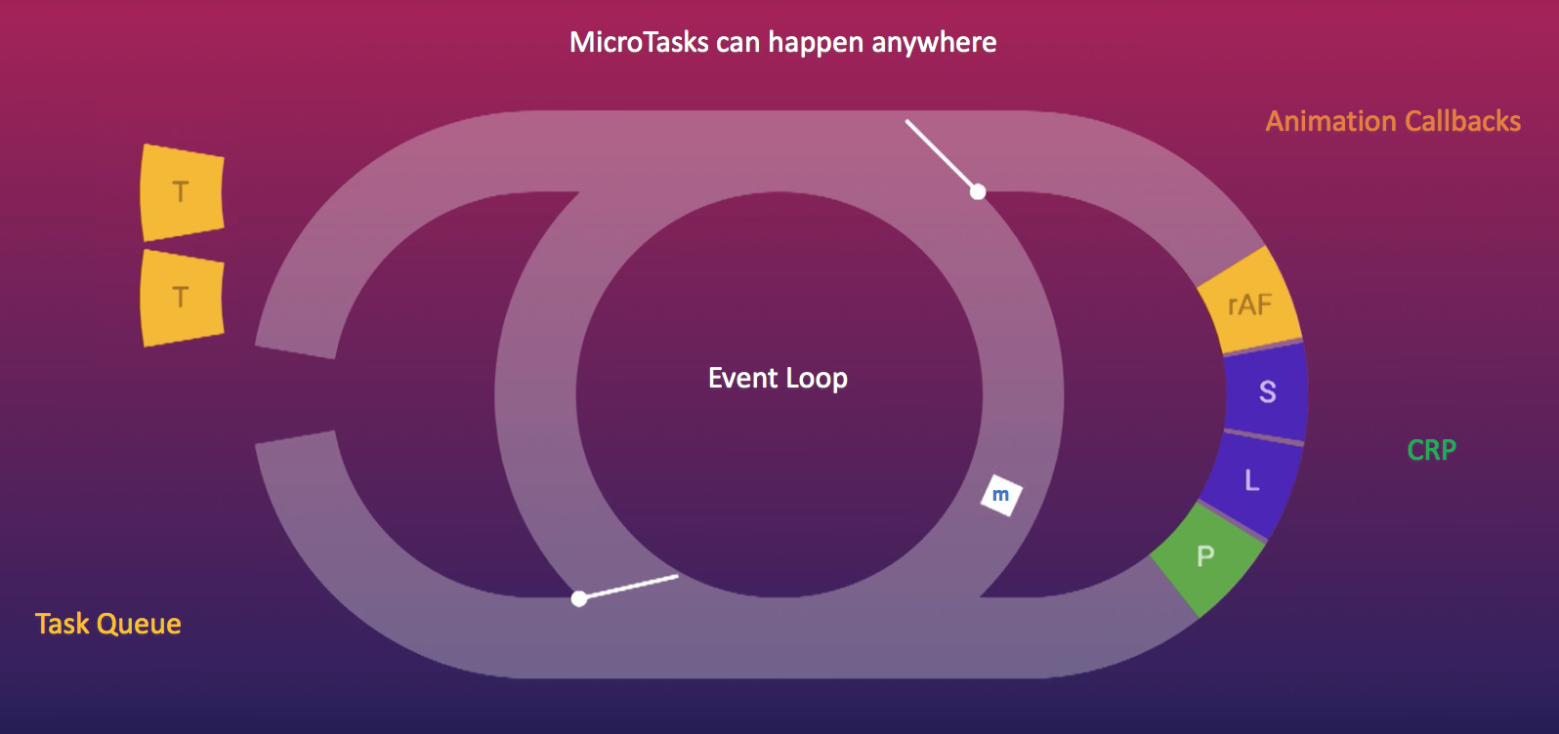

Slide 3
rAF
Animation Callbacks
Event Loop
T4
T3
T2
T1
Call Stack
DOM Tree + CSSOM + JS
Task Queue
Render Tree
m
(CRP)
Critical Rendering Path
Layout
Paint

Slide 4
Three main pillars of a “Web Page”
3
2
1
DOM Tree + CSSOM + JS
T2
T1
Event Loop
Render Tree
(CRP)
Critical Rendering Path
Task Queue
Layout
m
Paint
Improving these 3 main pillars, improves the Web Page Performance

Slide 5
Optimize: CRP (Critical Rendering Path)
Optimize: Render-Blocking CSS and JavaScript
1. Do not `Load`: unnecessary critical resources (CSS, JS) (during CRP)
Why?
reduce the (no. of external critical resources)
that will reduce the (blocking time - of DOM Tree construction)
How?
Load Only “Required” (critical resources) - for that page
Lazy Load other resources (CSS/ JS)
Load <script> tag Asynchronously // <script … async></script>
Defer <script> tag //<script … defer></script>
Load CSS On-Demand
<link media="print" / media="orientation:portrait" / media="(min-width: 40em)” ..>
2. Reduce `Bytes`: of the Critical Resource (CSS, JS)
Why?
reduce the size will reduce (number of roundtrips to get full file)
that will reduce the (blocking time - of DOM Tree construction)
How?
minify: css/js
remove: white space, comments
compress: text (gzip)
Use Build Tools: to automate all these steps (Build Tools: WebPack, Gulp)
3. Cache: the ‘Critical Resources’ (CSS / JS)
4. Use CDN: (Content Delivery Network)
Why?
To avoid network latency
that will reduce the (blocking time - of DOM Tree construction)
5. Pre-Fetch: the ‘Critical Resources’ (CSS / JS)
6. Optimize the Order – of critical resources
7. Do NOT write unnecessary HTML elements
1
DOM Tree + CSSOM + JS
Render Tree
Layout
Paint
Browser does Paint & Layout (nothing much we can improve)
Optimize : Building the “Render Tree”
To-do that,
Optimize :: Building the DOM Tree
To-do that, Optimize :: Render-Blocking CSS and JavaScript

Slide 6
Optimize: ‘Event Loop’ & ‘Call Stack’
Optimize: JavaScript Code
Do not `Block`: main thread
Why?
Blocking the main thread
will increase the (blocking time - of DOM Tree construction)
Freeze the User Interaction
How?
Do NOT keep `Long Running Scripts` (it blocks the Main Thread)
Split them into small small asynchronous tasks
Or Ask `WebWorker` to run parallel.
Note: Keeping `Long Running Scripts` in asynchronous tasks also (blocks the Main Thread)
Split them into small small individual asynchronous tasks.
For… Loop (Length Caching)
Memoize Fn (Cache the fn results)
Optimize: Events
Use: Debounce & Throttle
Optimize: HTTP Response:
Cache HTTP response
Pre-Fetch (most wanted) HTTP response
Load `On-Demand` (less wanted)
Optimize: DOM (Add more elements) (Append Child):
Use: documentFragment (for adding multiple items)
Or remove parent element and append all child and attach back the parent element.
2
Event Loop
Call Stack
m
3
T2
T1
Task Queue

Slide 7
JavaScript Runtime Engine (V8)
JavaScript is a single threaded - single concurrent language
which means it can handle only one task or piece of code at a time.
Then, How can it execute asynchronous code? such as setTimeout()
The answer is that JavaScript runs within a browser and browsers do a lot more than just execute code.
Browser has (four main distinct parts)
JavaScript Runtime Engine (V8)
Web APIs
provided by the browser like the DOM, setTimeout, AJAX,.. etc.
Callback Queue
for events with callbacks like onClick and onLoad
Event Loop
Web APIs are provided to us -- by the Browser (Not V8 or JavaScript Engine)
include methods like setTimeout().
console.log(window);
we can see long list of APIs included by default.
These APIs are run independently,
in a separate process, by the browser.
This is how Asynchronous JavaScript happens!!!
It’s not that JavaScript itself is doing multiple things at once;
instead the browser can run multiple different processes for us.
How do the runtime engine and the Web API interact?
The answer is the Callback Queue and the Event Loop.
The Callback Queue is just that, a queue of callback functions
that need to execute
once there’s a break in the JavaScript runtime engine.
The Event Loop is a constantly running loop
- that connects the stack with the “callback queue”

Slide 8
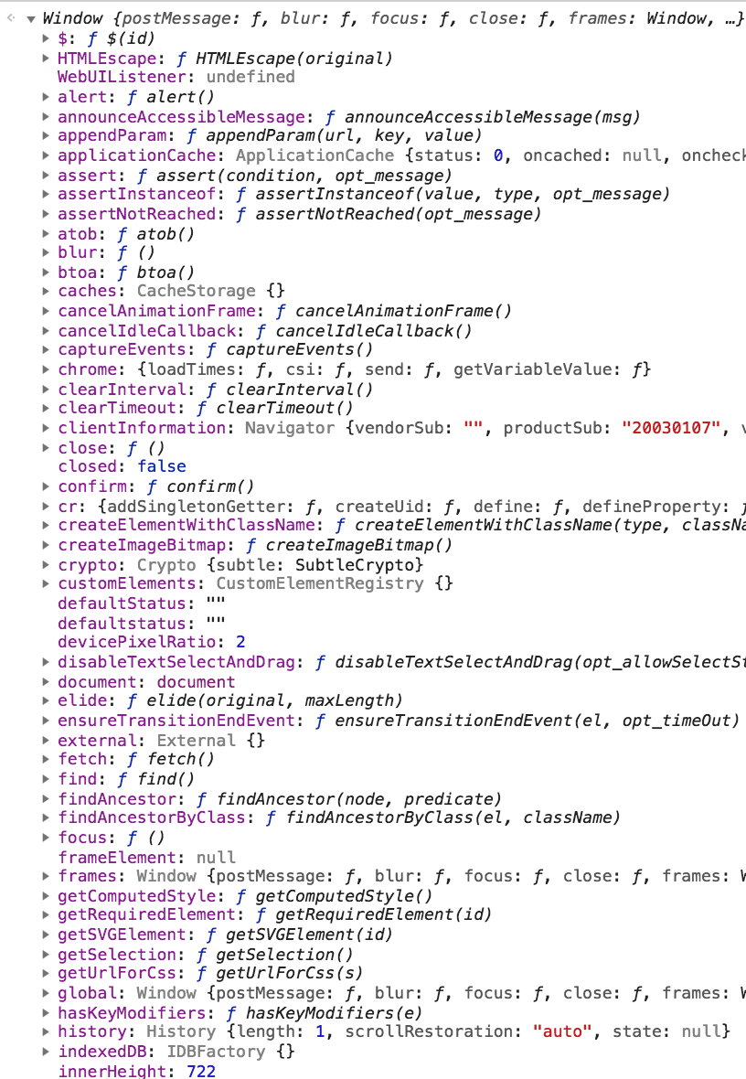
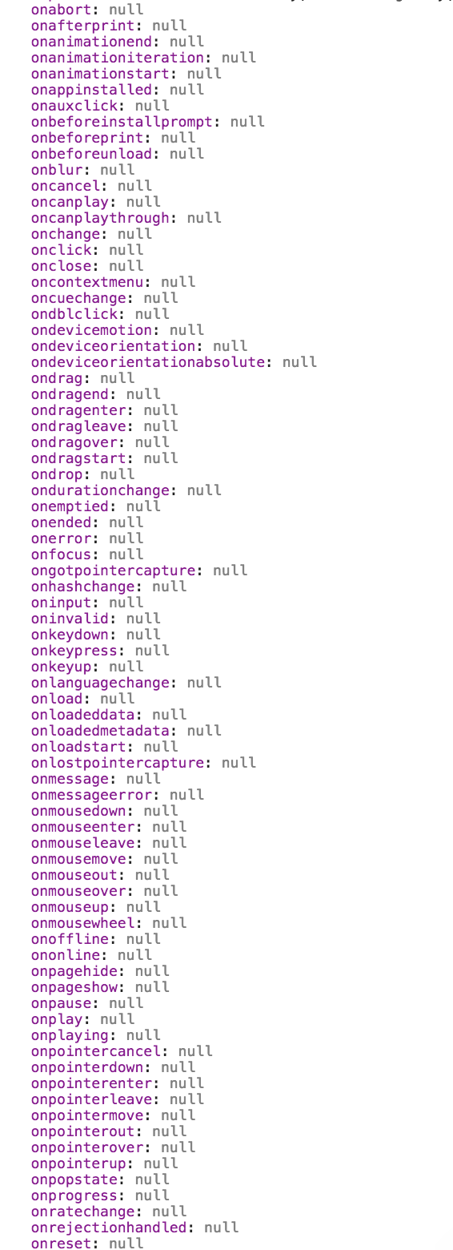
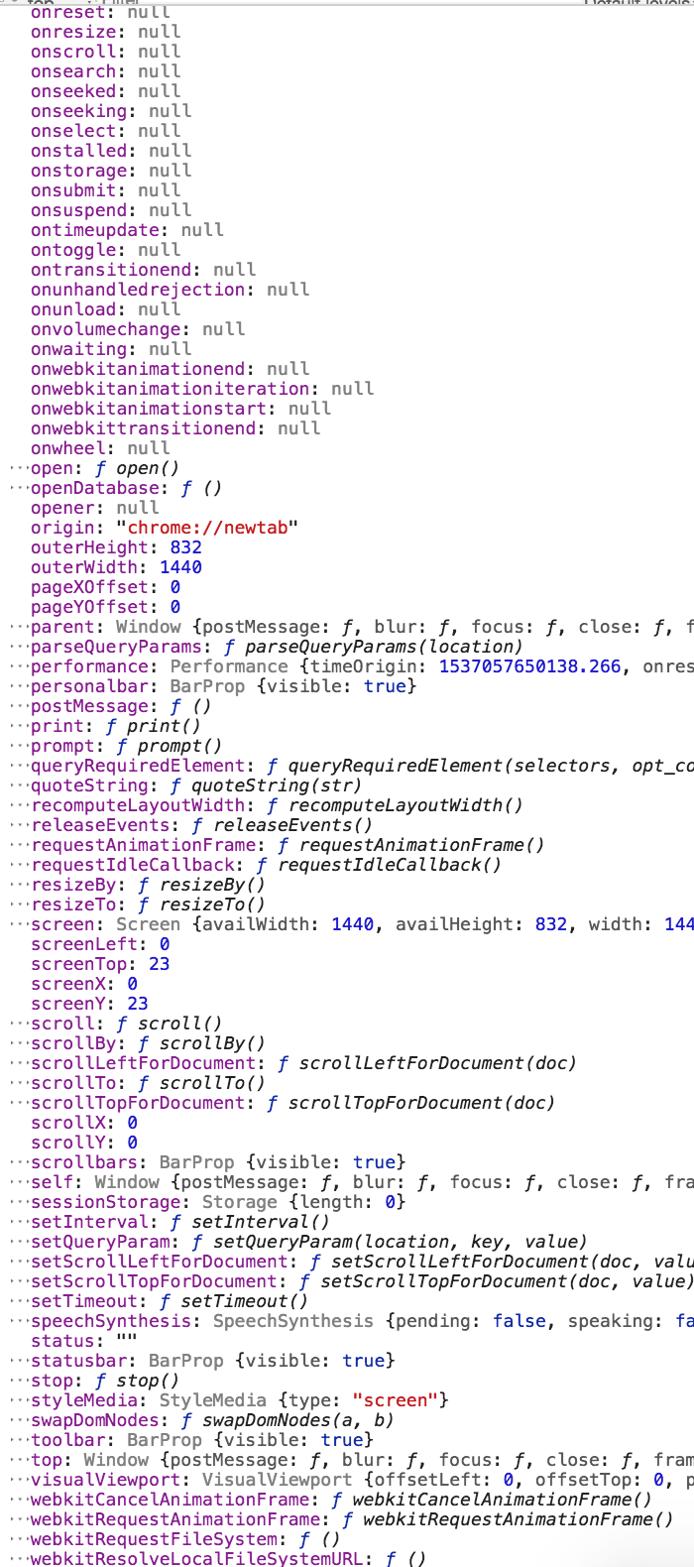
Web API

Slide 10
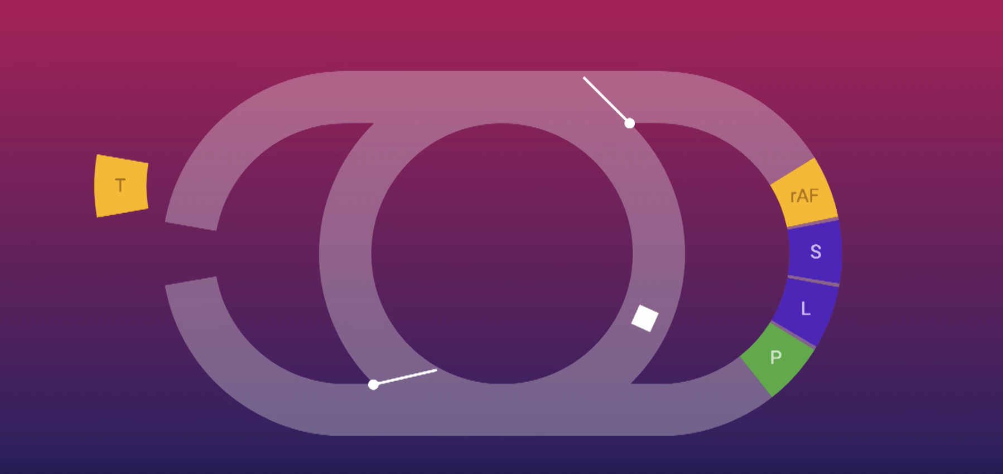

MicroTasks can happen anywhere
Animation Callbacks
Event Loop
CRP
m
Task Queue

