Slide 1
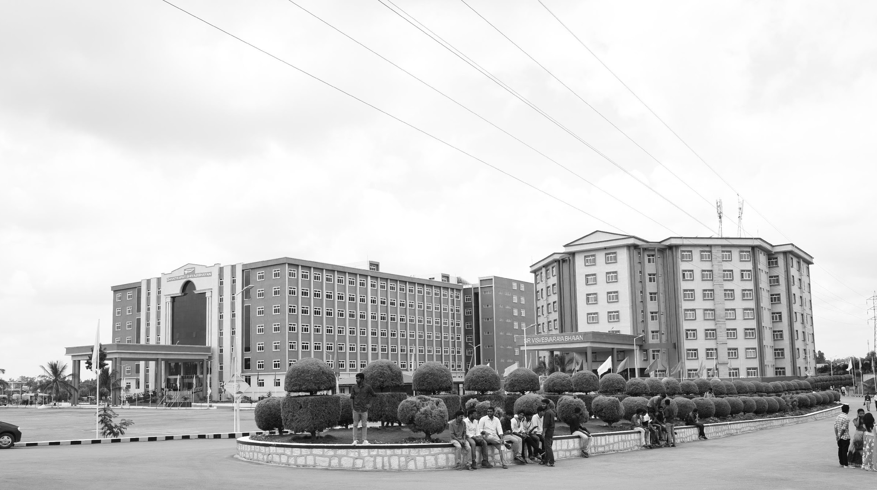

Power-Efficient BIST Design with Fault Coverage
AY 2021-25
GITAM UNIVERSITY
Major Project
Project ID: V4
A University should be a place of light, of liberty, and of learning.
Department of Electrical Electronics and Communication Engineering
Project Team:
JAGADEESHWAR REDDY BUSIREDDY
NAVEEN BADDILA
VAMSI KOPPALA
Project Mentor:
KARTHICK S
www.gitamedu.com

Slide 2

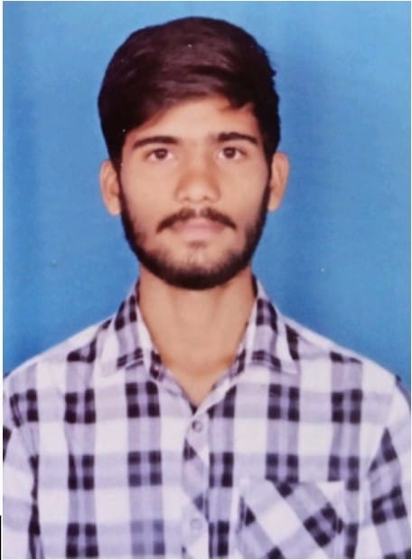


Project Group – Details
Photo
Track
Roll No
Name
Photo
EECE AI/ML
BU21EECE0100177
JAGADEESHWAR REDDY BUSIREDDY
Photo
EECE AI/ML
BU21EECE0100412
NAVEEN BADDILA
Photo
EECE AI/ML
BU21EECE0100085
VAMSI KOPPALA

Slide 3
Objective and Goals
Objective
Brief Description
Objective:
Implementing BIST for digital circuits.
Analyse different types of LFSR for fault coverage.
To design power efficient VLSI circuit design.
.
Goals
Main Goals:
Bring fault reduction.
Testing the implemented BIST for various Combinational circuits to know the accuracy of fault reduction.
Additional Goals:
Trying to implement algorithms for BIST to measure accuracy.

Slide 4
Project Plan
Gant Chart - Milestones and Activities
Resources : https://www.officetimeline.com/gantt-chart/how-to-make/excel & https://www.teamgantt.com/
BIST VALIDATIONAL - Gantt | TeamGantt

Slide 5
Literature Survey
Key Publications
Google scholar research best 3-5 papers
Design and Implementation of Power Efficient Logic BIST With High Fault Coverage Using Verilog – 2018 - Akhila K UG Student, Department of ECE BNM Institute of Technology Bengaluru, India akhilarao1996@gmail.com
Design and Implementation of BIST Architecture for low power VLSI Applications using Verilog – 2023 - Mr. Aadesh Gonda VLSI and Embedded Systems 2111706@reva.edu.in REVA University, Bangalore
VLSI Implementation of Linear Feedback Shift Register (LFSR) based Test Pattern Generator for Pseudo Exhaustive Testing – 2020 - S. Sridhar, K. Mounika, M. Anjali, G. Venkatesh, M. Murali Krishna
BIST (Built-In Self Test) Memory by Using VERILOG -2023 - B. Hanumanthu1, N. Sathvika2, A. Manikanta3, A. Praveen4, Ch. Abhiram5
Key Resources – Whitepaper| Application Notes | Datasheet| Others
https://youtu.be/IRSwVbKPrZU?si=gBUWw9370TdIGZvE , test pattern generation.
https://youtu.be/dVdnFQvHJ74?si=CoWy0CKppY8QetQJ, https://youtu.be/sfxtYY-PpiA?si=NljJIHef9N3I3BX4 , BIST.
https://youtu.be/4Q8AaevnAaU?si=mpO_wImfbKWVrhYX , https://youtu.be/lb0lwriIMjw?si=3PL9oIa3JJXP4mYq , fault-simulation.
Existing Implementations – Products| Opensource| GitHub etc
https://github.com/nihargowdakm/BIST-Design
XX

Slide 6
Analysis - SWOT
Strengths
Weaknesses
W1. Complexity:
BIST can be very technical requiring much planning and oversight and as such, both the design and the process of undertaking it may present a challenge.
W2. Resource Consumption:
W3. Initial Cost:
Design and development costs are inevitably higher in the case of green buildings.
S1. Efficiency
S2. Autonomy: Offers a single, closed, self-contained solution for testing the circuit.
S3. Accuracy: High accuracy in detecting faults and its most useful application is in ascertaining the correct functioning of digital circuits.
Threats
Opportunities
T1. Technological Changes: Rapid advancements in technology may require continuous updates and improvements to BIST systems.
T2. Competition: Other testing methodologies might evolve, posing a threat to the adoption of BIST.
O1. Reliability:
02. Scalability:
O3. Energy Efficiency:

Slide 7
Analysis – 4W1H
Why: We’re aiming to ensure digital circuits work correctly by detecting faults early. Faulty circuits can lead to bigger problems, so catching these issues during testing helps maintain reliability and performance.​
​
What: Our project focuses on implementing a Built-In Self-Test (BIST) approach. This method allows circuits to test themselves, aiming for efficient fault detection while also trying to keeping power consumption low.​
​
Where: The techniques we’re developing can be used in any environment where VLSI circuits are tested and designed, from labs to manufacturing facilities.​
​
When: This testing approach is applied during the testing phase of circuit development, right before finalizing the design to ensure everything functions as intended.​
​
​
​
How: We’ll be using Linear Feedback Shift Registers (LFSRs) to generate test patterns for checking the circuits. These patterns help identify faults effectively, and we’ll analyze different LFSR types to find the best fit for our needs.​
​

Slide 8
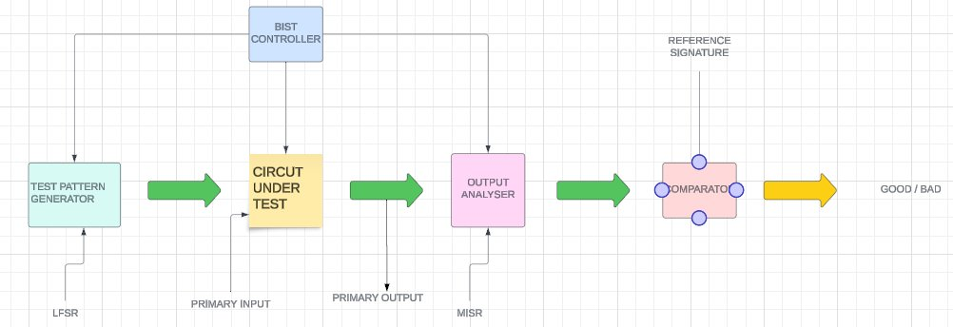
Architecture
Structural Diagram
Block Diagram/Pin Diagram
Resource - https://www.lucidchart.com/pages/examples/uml_diagram_tool
Blank diagram: Lucidchart
https://lucid.app/lucidchart/99ea20b8-f402-482a-8cec-2dbe0558ca97/edit?viewport_loc=-770%2C-212%2C3139%2C1310%2C0_0&invitationId=inv_d976e95b-a0c2-479a-adca-2efe95a2f822
Behaviour Diagram
Flow chart/ State machine
Resource - https://www.lucidchart.com/pages/examples/uml_diagram_tool

Slide 9
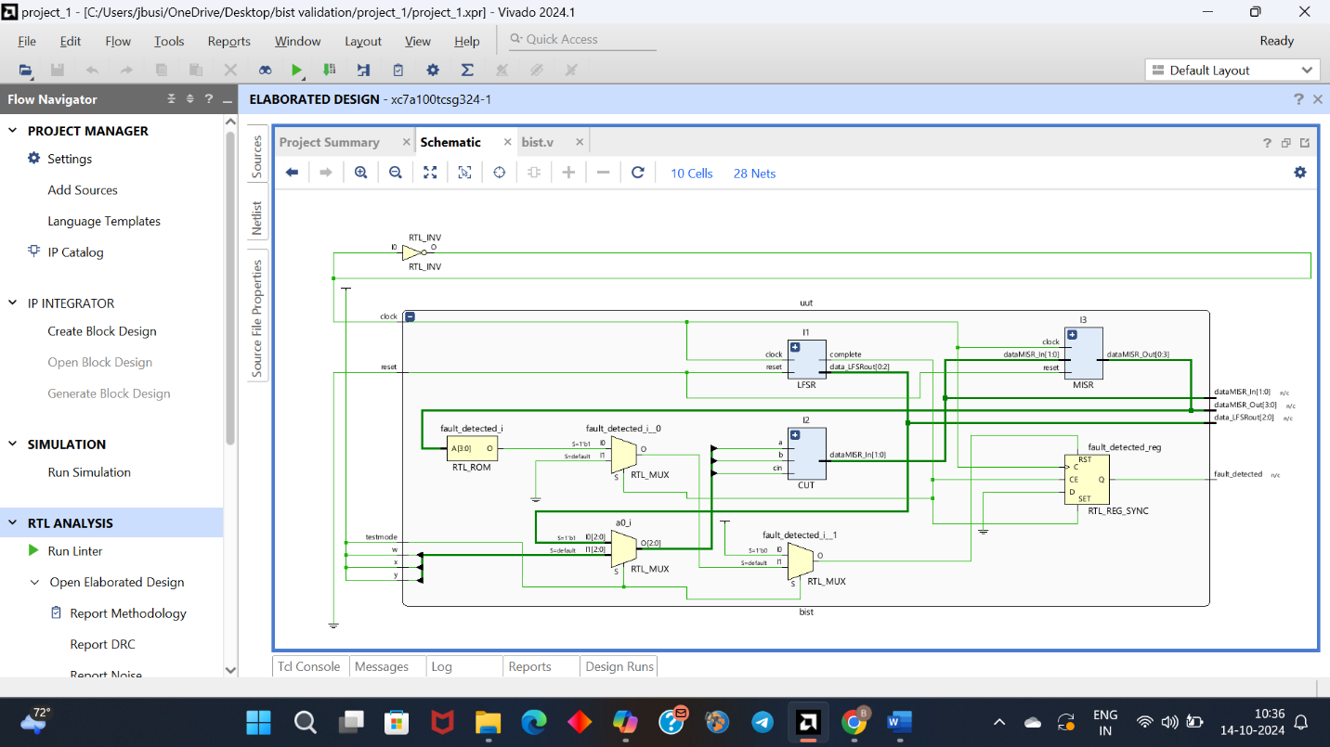

Slide 10
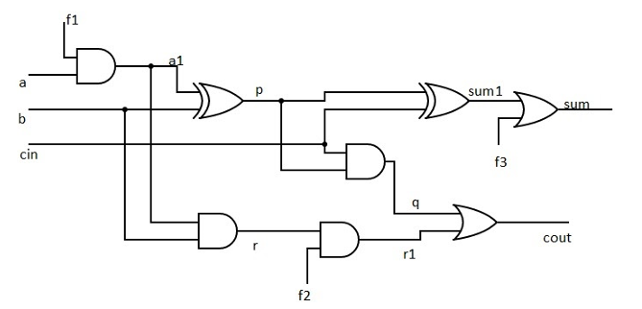
CUT Integration:
Integrated the Circuit Under Test (CUT), which is the full adder. The CUT was designed to receive inputs from either the LFSR (in test mode) or normal inputs. The CUT is a 1- bit full adder. Faults have been injected at 3 points in the design i.e. a@0, sum@1, r@0. The response from the MISR is compared with the golden signature to check whether the fault is detected or goes undetected.

Slide 11
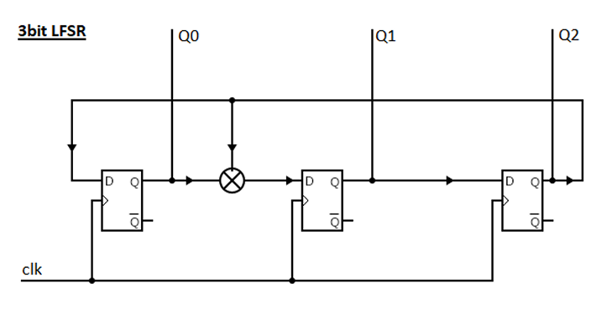
The LFSR has been seeded to 001. The LFSR has period of 7 (= 2³-1)
Next State Equations:
Q0* = Q2
Q1* = Q0 + Q2
Q2* = Q1

Slide 12
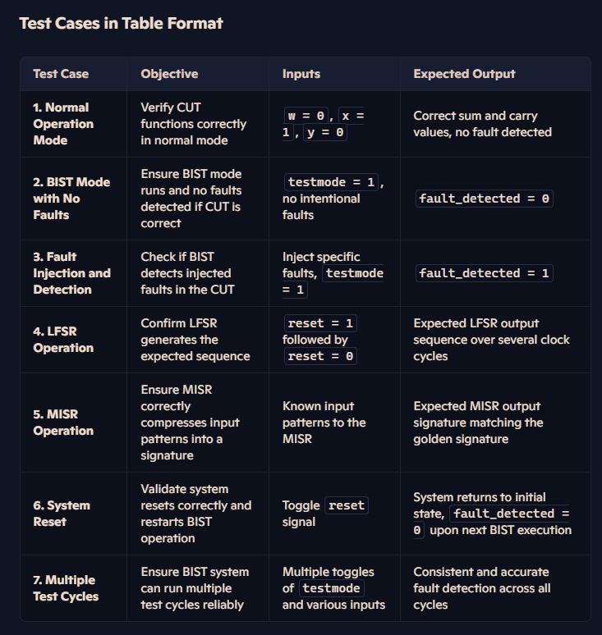
Use Cases & Testing
Use Cases
Consumer Electronics.
Medical Devices.
Aerospace and Defence.
Test Cases

Slide 13
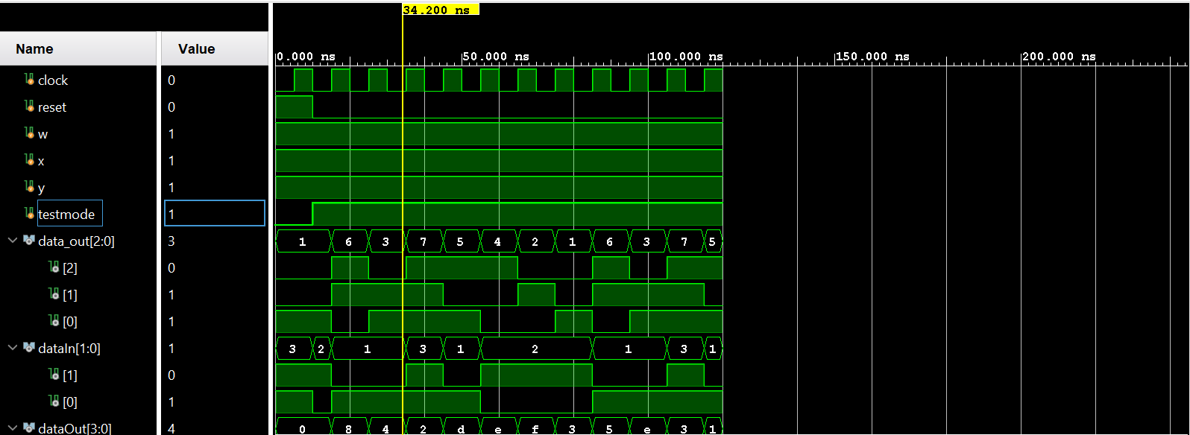
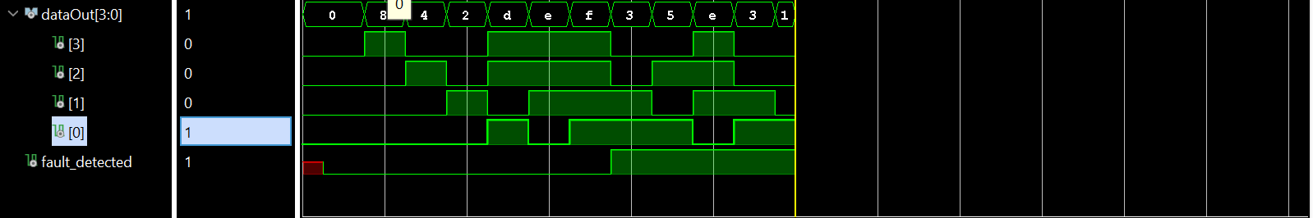
Implementation and Results – Iteration 1
Iteration 1 : Results

Slide 14
Contribution
Individual Contribution
Key contributions: JAGADDESHWAR REDDY
Architecture
STRUCTURE DIAGRAMS
Key contributions: K.VAMSI
ANALYSIS
DOCUMENTATION
Key contributions: B.NAVEEN
LITERATURE SURVEY
EXTERNAL WORKS
TEAM PROGRESS AND MOVEMENT
DETAILED THE DESIGN AND IMPLEMENTATION OF EACH BIST
COMPONENT: LFSR, CUT, AND MISR.
PREPARING DETAILED DOCUMENTATION AND REPORTING FOR THE PROJECT.
COLLABORATION WITH MENTORS AND EXPERTS TO GAIN INSIGHTS
AND FEEDBACK.
WEEKLY TEAM MEETINGS TO DISCUSS PROGRESS, CHALLENGES, AND UPCOMING TASKS
IMPLEMENT REAL-TIMEMONITORING AND SELF- HEALING CAPABILITIES.

Slide 15
Conclusion & Future Work
Summary and Conclusion ​
​
Detected faults in a circuit​
We have used a module:​
TPG​
CUT​
SIGNATURE ANALYSIER​
BIST CONTROLLER​
​
​
​
Future Work​
We are going to work on different digital circuits.​
We will try to implement the algorithms for circuits.​
We will use different equation for LFSR.

Slide 16

THANK YOU

