Slide 1
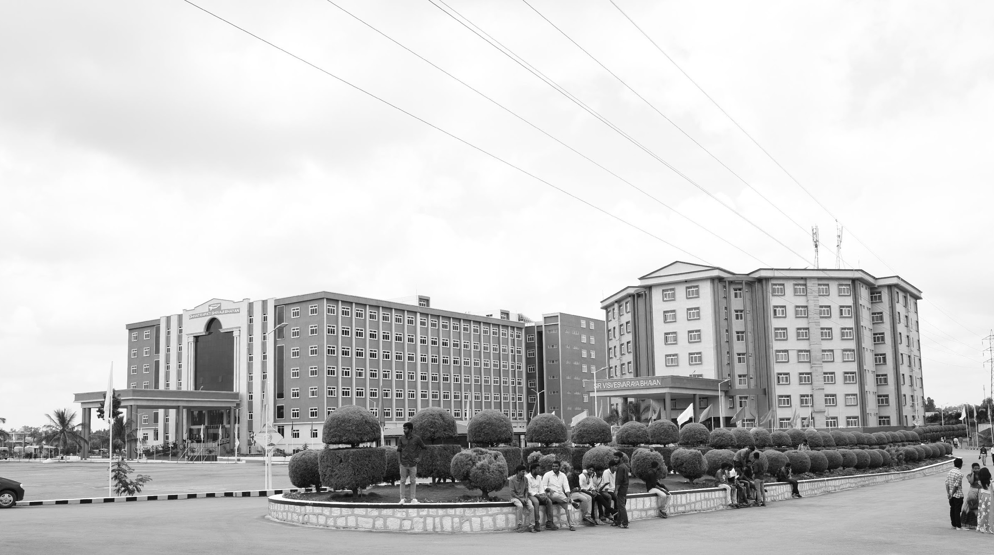

Power-Efficient BIST Design with Fault Detection
Mid-Review 3
Major Project
Project ID: V4
AY 2021-25
GITAM (Deemed-to-be) University
Project Team:
B. JAGADEESHWARREDDY
K.VAMSI
B.NAVEEN
Department of Electrical Electronics and Communication Engineering
Project Mentor:
Dr.Karthick.S
www.gitam.edu

Slide 2
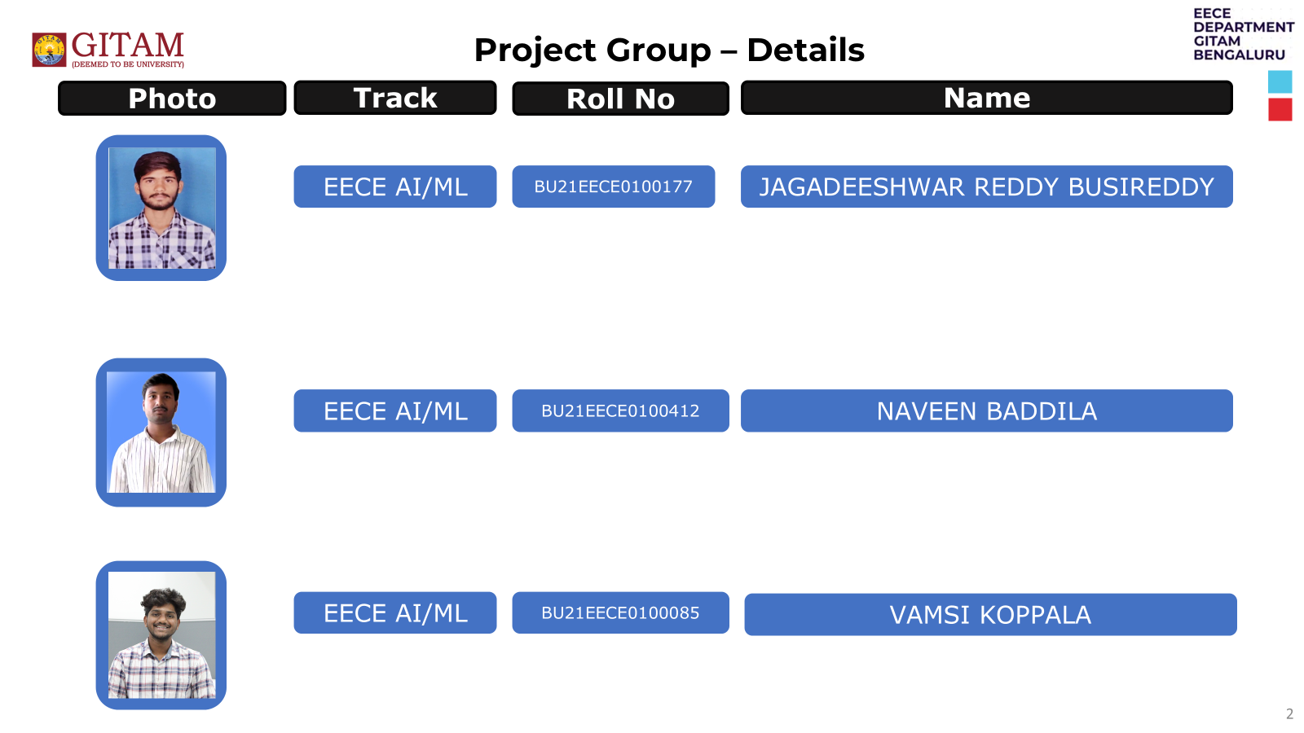

Slide 3
Objective and Goals
Objective
Brief Description
Implementing BIST for digital circuits.
Analyse different types of LFSR for fault coverage.
To design power efficient VLSI circuit design.
Goals
Main Goals
Bring fault reduction.
Testing the implemented BIST for various Combinational circuits to know the accuracy of fault reduction.
Additional Goals
Trying to implement algorithms for BIST to measure accuracy

Slide 4
Project Plan (Clearly mention milestone for objectives under each reviews)
Gant Chart - Milestones and Activities
Resources : https://www.officetimeline.com/gantt-chart/how-to-make/excel & https://www.teamgantt.com/
BIST VALIDATIONAL - Gantt | TeamGantt

Slide 5
Literature Survey (Improved post minor project)
Key Publications
Google scholar research best 3-5 papers
Design and Implementation of Power Efficient Logic BIST With High Fault Coverage Using Verilog – 2018 - Akhila K UG Student, Department of ECE BNM Institute of Technology Bengaluru, India akhilarao1996@gmail.com
Design and Implementation of BIST Architecture for low power VLSI Applications using Verilog – 2023 - Mr. Aadesh Gonda VLSI and Embedded Systems 2111706@reva.edu.in REVA University, Bangalore
VLSI Implementation of Linear Feedback Shift Register (LFSR) based Test Pattern Generator for Pseudo Exhaustive Testing – 2020 - S. Sridhar, K. Mounika, M. Anjali, G. Venkatesh, M. Murali Krishna
BIST (Built-In Self Test) Memory by Using VERILOG -2023 - B. Hanumanthu1, N. Sathvika2, A. Manikanta3, A. Praveen4, Ch. Abhiram5
Key Resources – Whitepaper| Application Notes | Datasheet| Others
https://youtu.be/IRSwVbKPrZU?si=gBUWw9370TdIGZvE , test pattern generation.
https://youtu.be/dVdnFQvHJ74?si=CoWy0CKppY8QetQJ, https://youtu.be/sfxtYY-PpiA?si=NljJIHef9N3I3BX4 , BIST.
https://youtu.be/4Q8AaevnAaU?si=mpO_wImfbKWVrhYX , https://youtu.be/lb0lwriIMjw?si=3PL9oIa3JJXP4mYq , fault-simulation
Existing Implementations – Products| Opensource| GitHub etc
https://github.com/nihargowdakm/BIST-Design

Slide 6
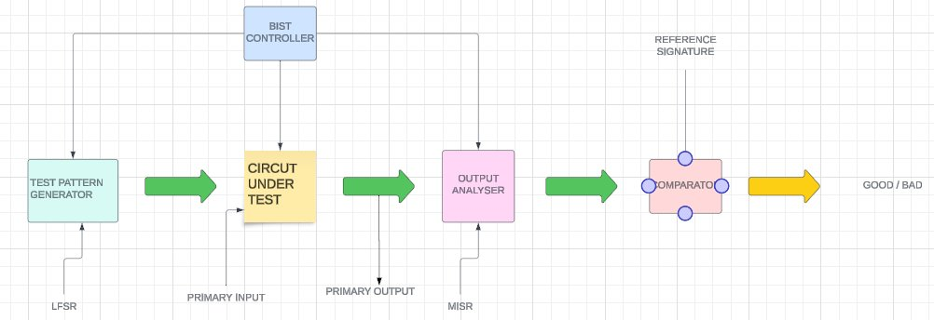
Architecture
Structural Diagram
Block Diagram/Pin Diagram
Resource - https://www.lucidchart.com/pages/examples/uml_diagram_tool
Behaviour Diagram
Flow chart/ State machine
Resource - https://www.lucidchart.com/pages/examples/uml_diagram_tool

Slide 7
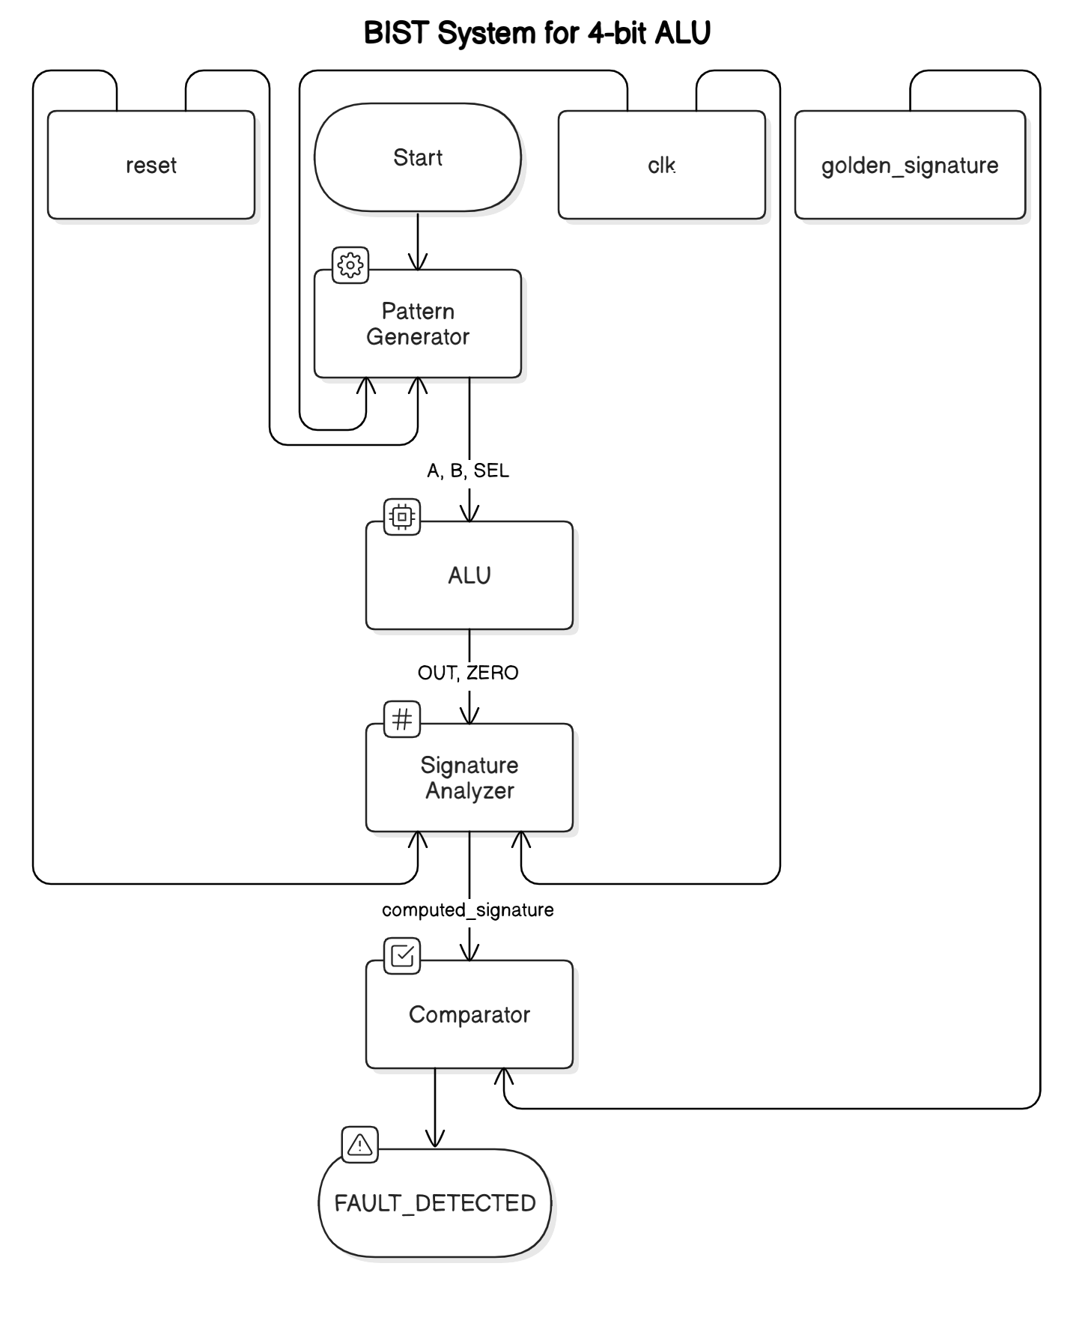
Architecture

Slide 8
Use Cases & Testing
Use Cases
Consumer Electronics.
Medical Devices.
Aerospace and Defence.
Test Cases
Functional Test Cases: Test ALU operations using controlled patterns.
Pseudo-Random Test Cases: Validate behavior with LFSR-generated patterns.
Fault Injection Tests: Demonstrate fault detection capabilities.
Use a bulleted list to explain each briefly.

Slide 9
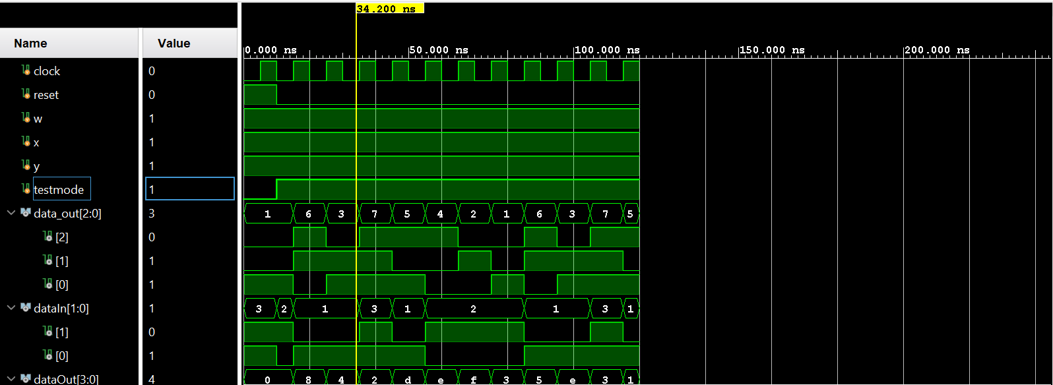
Implementation and Results – Iteration 1
Iteration 1 : Results

Slide 10
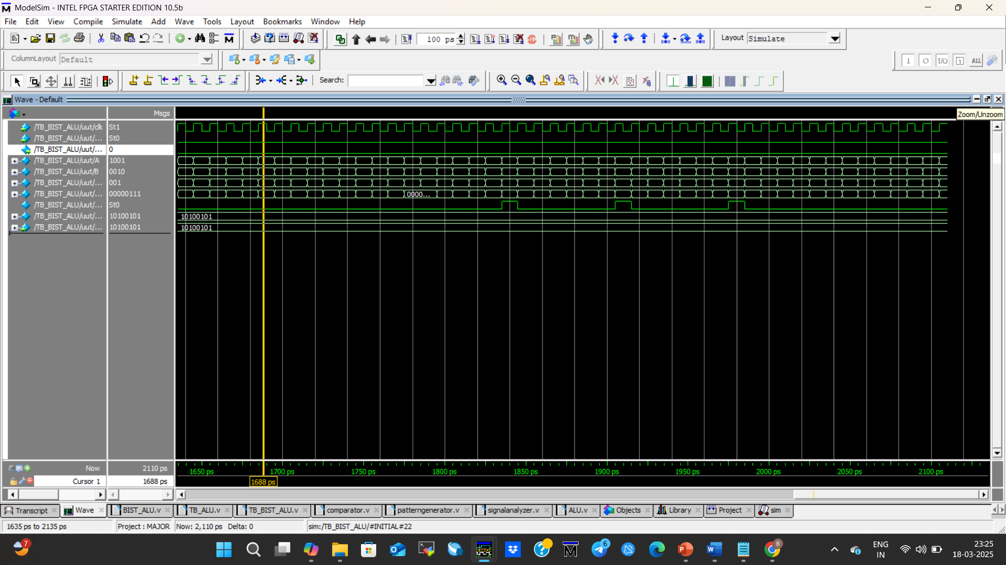
Implementation and Results – Iteration 2
Iteration 2 : Results

Slide 11
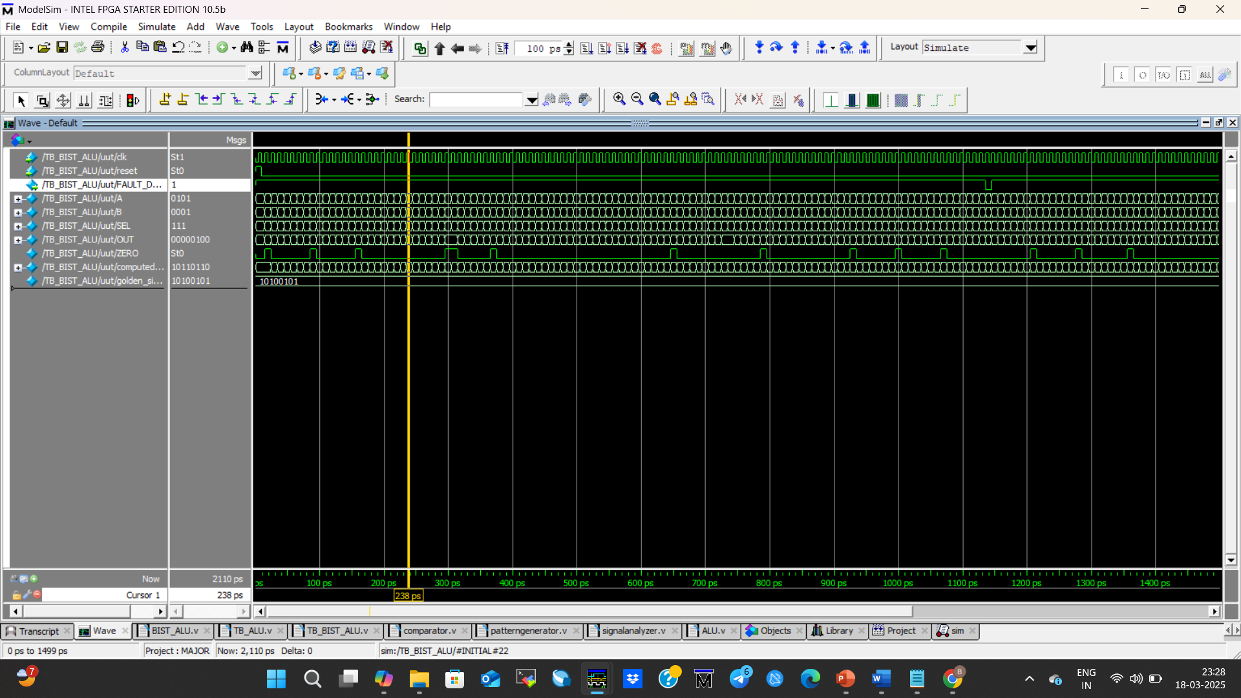
Implementation and Results – Iteration 2
Iteration 2 : Results

Slide 12
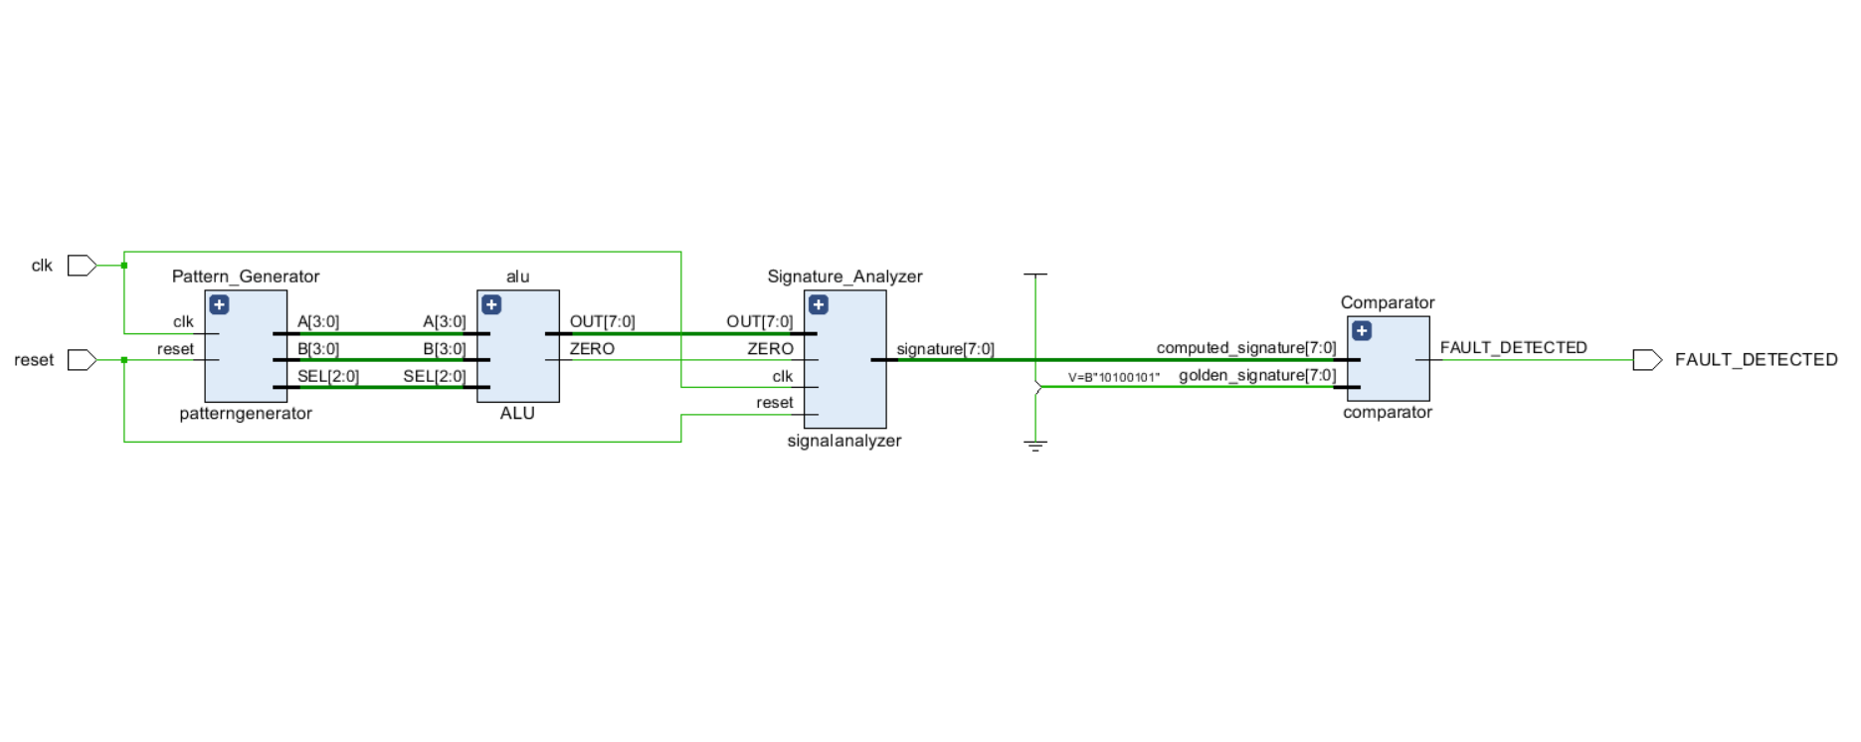
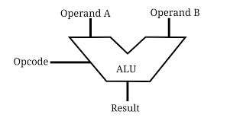
Implementation and Results – Iteration 2
Iteration : Results + Validation against the use cases and test cases
Implementing ALU DESIGN.
Injecting Faults in it.
Implementing it on ZUC102 Board.

Slide 13
Design the BIST Logic
Compile modules
Simulate the Design
Synthesize and Implement the Design
Analyze the Results
STEPS TO FOLLOW

Slide 14
Contribution
Team Progress and Movement
DETAILED THE DESIGN AND IMPLEMENTATION OF EACH
BIST
COMPONENT: LFSR, CUT, AND MISR.
PREPARING DETAILED DOCUMENTATION AND REPORTING FOR THE PROJECT.
COLLABORATION WITH MENTORS AND EXPERTS TO GAIN INSIGHTS AND FEEDBACK.
WEEKLY TEAM MEETINGS TO DISCUSS PROGRESS, CHALLENGES, ANDUPCOMING TASKS
IMPLEMENT REAL-TIMEMONITORING AND SELF- HEALING CAPABILITIES.
Individual Contribution
Key contributions: JAGADDESHWAR REDDY
ARCCHITECTURE
STRUCTURE DIAGRAMS
Key contributions: K.VAMSI
ANALYSIS
DOCUMENTATION
Key contributions: B.NAVEEN
LITERATURE SURVEY
EXTERNAL WORKS

Slide 15
Conclusion & Future Work
Summary and Conclusion
Detected faults in a circuit​
We have used a module:​
TPG​
CUT​
SIGNATURE ANALYSIER​
Comparator
BIST CONTROLLER​(top module)
Future Work
Research on BIST technology.
Implementing new methodology.

Slide 16
THANK YOU
Have a Great Day !

