Slide 1
Story 1 Kids Are
**Title: The Colors of Kindness**
In a vibrant village, the air buzzed with excitement as children

Slide 2
**Title: The Colors of Kindness** In a vibrant village, the air buzzed with excitement as children prepared for Holi. Three friends, Rohan, Aisha, and Karan, eagerly gathered their colors and sweets. As they played, they noticed some poor children watching from a distance, their eyes wide with longing. Rohan whispered, "Look, they want to join but can't." Aisha nodded, and Karan suggested, "Let's share our colors and sweets!" They approached the poor children, offering them the festive treats. Just then, a gentle voice spoke, "Your hearts are as colorful as the Holi hues." It was Lord Rama, appearing with a warm smile. "Kindness is the greatest virtue," he said. "Remember, sharing brings joy to all." The children beamed, learning that true happiness comes from kindness. From that day on, they celebrated Holi with everyone, spreading joy and colors to all. **Moral:** Kindness and sharing bring the greatest joy, as taught by Lord Rama.

Slide 3
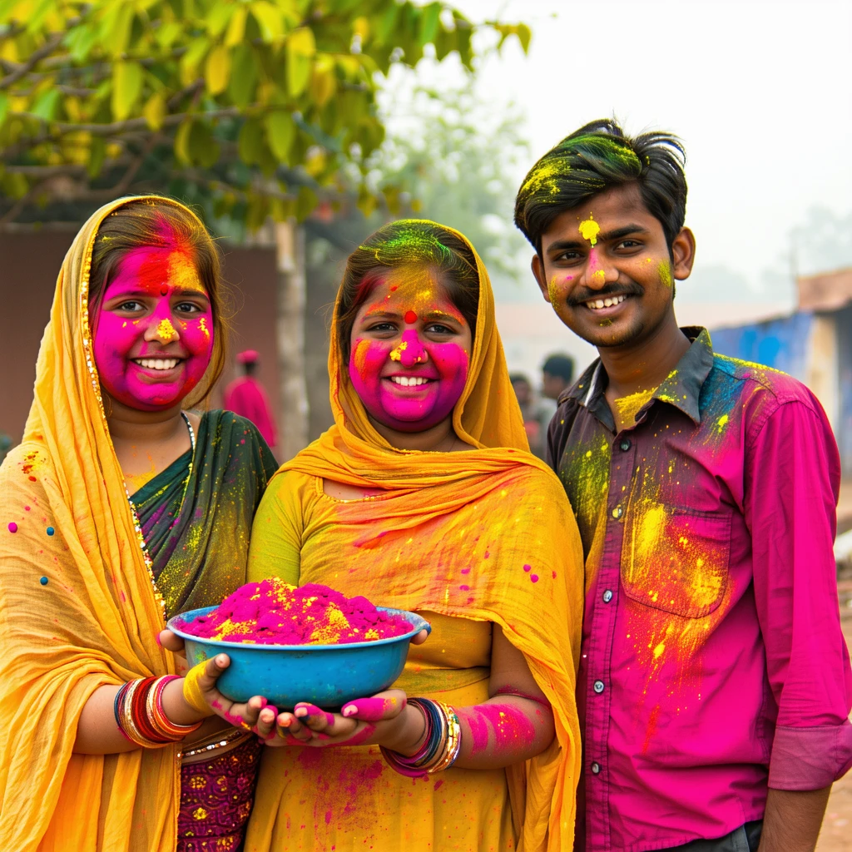

Slide 4
Story 2 Children E
**The Magical River Stone**
On a sunny day, in a small village, three friends—Ravi, Leela, and Kish

Slide 5
**The Magical River Stone** On a sunny day, in a small village, three friends—Ravi, Leela, and Kishan—played by the riverside. The clear water sparkled, and the warm sun shone through the trees. They skipped stones and built sandcastles, laughing joyfully. While Ravi waded through the shallow water, he found a shiny object. "Look!" he exclaimed, holding up a glowing stone. As they gathered around, the stone began to glow, and a gentle breeze rustled the trees. Suddenly, Hanuman, the mighty monkey god from the Ramayana, appeared before them. "Hello, young friends," he said with a smile. "I have been watching you. You have kind hearts, and this stone has chosen you to share a special message." Hanuman explained, "Courage is not just about strength; it's about helping others. Remember, true strength lies in kindness and support." Inspired, the children decided to help an elderly neighbor who struggled with chores. Together, they carried firewood and fetched water, making her day brighter. As the sun set, Hanuman reappeared, proud of their actions. "You have learned the true meaning of courage. Always remember to help one another." From that day on, Ravi, Leela, and Kishan spread joy and kindness throughout their village, proving that courage and compassion go hand in hand.

Slide 6
