Slide 1
Story 1 Hanuman’S Bravery In Finding Sita
Of course! Here is a short story for children about Hanuman's bravery.
***
### Hanuman's Great Lea

Slide 2
Of course! Here is a short story for children about Hanuman's bravery. *** ### Hanuman's Great Leap Prince Rama’s heart was heavy. The wicked demon king Ravana had kidnapped his beloved wife, Sita, and hidden her on the island of Lanka. The mighty Hanuman, son of the Wind God, stepped

Slide 3
forward. "Do not worry, my Lord! I will find Mother Sita," he promised. But a vast, roaring ocean stood between him and Lanka. Hanuman smiled, remembering his divine powers. Chanting "Jai Shri Ram!", he grew bigger and bigger until he was as tall as a mountain! With a mighty push,

Slide 4
he leaped into the air. He soared through the clouds like a golden arrow, flying over the giant waves. On reaching Lanka, he shrank back to the size of a small monkey and searched for Sita. He found her in a beautiful garden, the Ashoka Vatika, looking sad. Hanuman gently

Slide 5
gave her Prince Rama’s ring. Seeing it, Sita’s eyes filled with hope. Hanuman promised that Rama would come to rescue her soon. *** **Moral of the story:** True bravery isn't just about being strong, but about using your courage and skills to help others and never giving up, no matter

Slide 6
how big the obstacle.

Slide 7
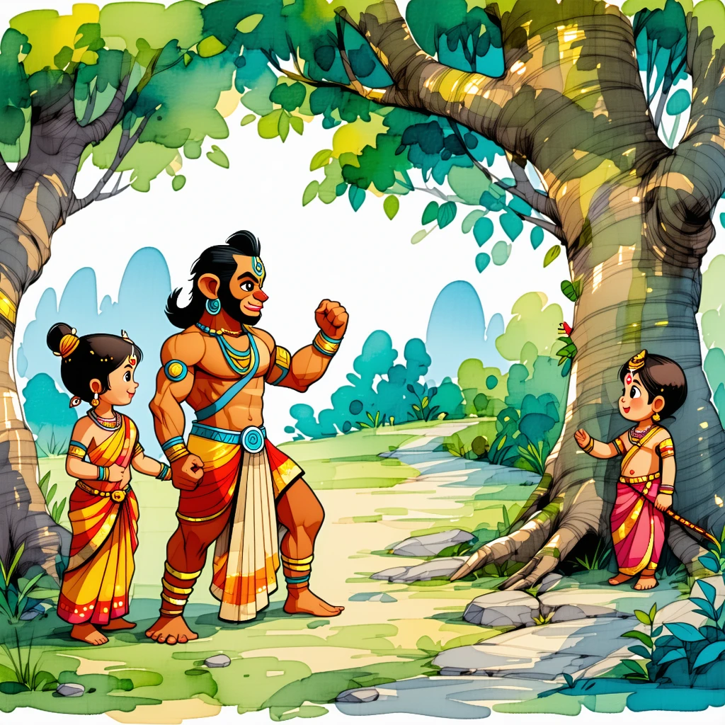

Slide 8
Story 2 The Pandavas’ Teamwork In Building The Indraprastha Palace
Of course! Here is a short story for children about the Pandavas building Indraprastha.
***
### Th

Slide 9
Of course! Here is a short story for children about the Pandavas building Indraprastha. *** ### The Magical Palace of Teamwork The five Pandava brothers—Yudhishthira, Bhima, Arjuna, and the twins Nakula and Sahadeva—were given a dry, barren land. But they didn't see a wasteland; they saw a dream called Indraprastha.

Slide 10
To help them, the magical architect Maya Danava appeared. “I can provide the magic,” he said, “but you must provide the teamwork!” The brothers agreed. Wise Yudhishthira drew the master plan for the city. Mighty Bhima, strong as ten elephants, lifted giant rocks and heavy wooden beams. *Wham! Thud!* Skillful

Slide 11
Arjuna used his arrows to clear thorny bushes and keep the workers safe. The gentle twins, Nakula and Sahadeva, planted beautiful gardens and lovingly cared for all the animals. Working together, they built a breathtaking palace of illusions. Its shiny floors looked like pools of clear water, and its walls

Slide 12
sparkled like diamonds. It was the most wonderful palace in the world! The brothers stood back, proud of what their teamwork had created. **Moral of the story:** Just as Lord Rama’s Vanara Sena worked together to build a bridge to Lanka, the Pandavas showed that when everyone combines their unique

Slide 13
talents, they can turn an empty land into a paradise.

Slide 14
