Slide 1
Story 1 Kids Are
**Title: Rohan, Aisha, and the Joy of Sharing Holi**
In a vibrant village, the air buzzed with exci

Slide 2
**Title: Rohan, Aisha, and the Joy of Sharing Holi** In a vibrant village, the air buzzed with excitement as Holi approached. Rohan and Aisha were eager to celebrate, preparing colorful powders and sweet treats. Their laughter echoed as they anticipated the festival of colors. As they played, they noticed some children watching from a distance, dressed in worn clothes. Rohan and Aisha exchanged glances, their joy momentarily dimmed by the sight. Determined to share their happiness, they invited the children to join. With open hearts, they offered colors and sweets, transforming the onlookers into participants. The group played together, their laughter mingling in the air. Suddenly, a gentle voice praised their kindness. It was Lord Rama, appearing with a warm smile. He commended Rohan and Aisha for understanding that true joy comes from sharing. The children celebrated together, their bond strengthened by kindness. As the day ended, they learned that sharing happiness brings the greatest joy. **Moral:** Kindness and sharing bring true happiness, as taught by Lord Rama.

Slide 3
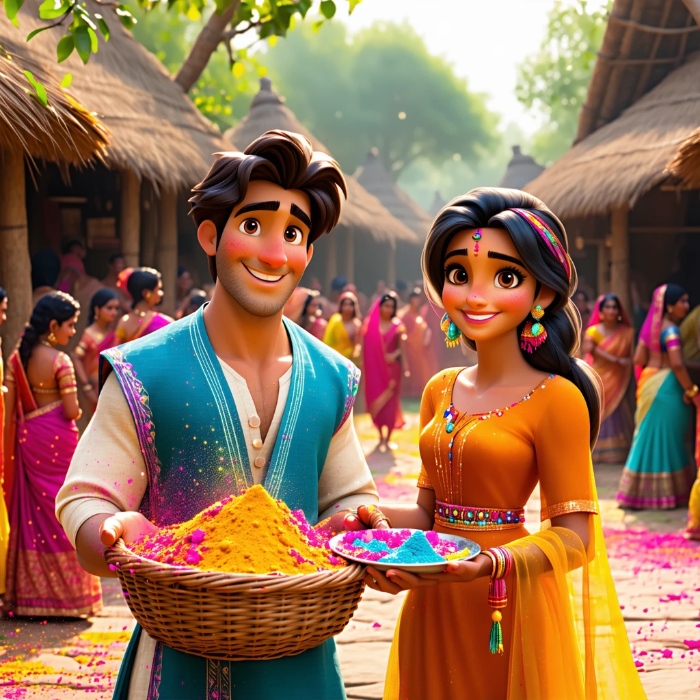

Slide 4
Story 2 Children E
Once upon a time, in a small village nestled between green hills, there was a sparkling river that f

Slide 5
Once upon a time, in a small village nestled between green hills, there was a sparkling river that flowed gently through the heart of the village. During the dry season, the river bed became a vast, sandy playground where children loved to gather. One sunny afternoon, Rohan and Aisha, along with their friends, were playing on the river bed. They skipped stones across the water, built tall sandcastles, and laughed as the warm breeze carried their giggles. The river's edge was alive with their joy. As they played, Rohan spotted something shiny buried in the sand. Excited, he brushed away the grains and found a small, glowing stone. It sparkled like the stars in the night sky. "Look what I found!" Rohan exclaimed. Aisha's eyes widened with curiosity. "It's magical!" she whispered. The children gathered around, eager to see the stone's magic. Rohan held it up, but nothing happened. Aisha suggested, "Maybe it needs all of us to make it work." Reluctantly, Rohan handed the stone to Aisha. She smiled and said, "Let's share it." The children formed a circle, each taking a turn to hold the stone. As they shared, the stone began to glow brighter, and a soft hum filled the air. Suddenly, the stone rose into the air, creating a dazzling light show. The children gasped in delight. The stone spoke, "The true magic lies in sharing and working together." From that day on, Rohan, Aisha, and their friends learned that when they shared and cooperated, they could achieve anything. And so, they played together, their bond stronger than ever, with the magical stone reminding them of the power of teamwork and kindness. The end.

Slide 6


