Slide 1

Build Microservices with Spring Boot

Slide 2


Spring Boot
Spring Boot is an open source Java-based framework
create stand-alone Spring applications
embedded Server
configures Spring and 3rd party libraries automatically
opinionated 'starter' dependencies
production-ready features such as metrics, health checks and externalized configuration
no code generation and no requirement for XML configuration
reduces the development time

Slide 3
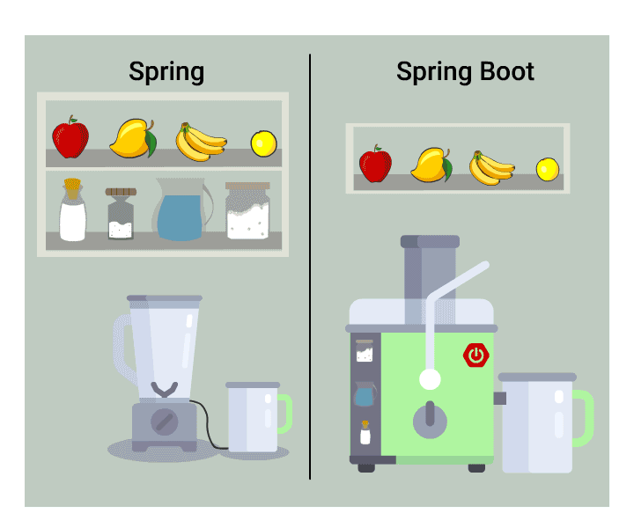

Slide 4
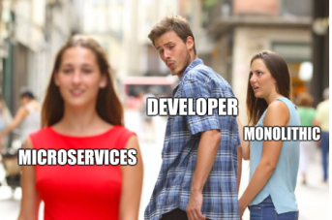
Microservices
Small autonomous services that work together
architectural style that structures an application as a collection of loosely coupled services, which implement business capabilities.
Easy deployment
Simple scalability
Compatible with Containers
Minimum configuration
Reduced deployment time
Faster release cycles

Slide 5
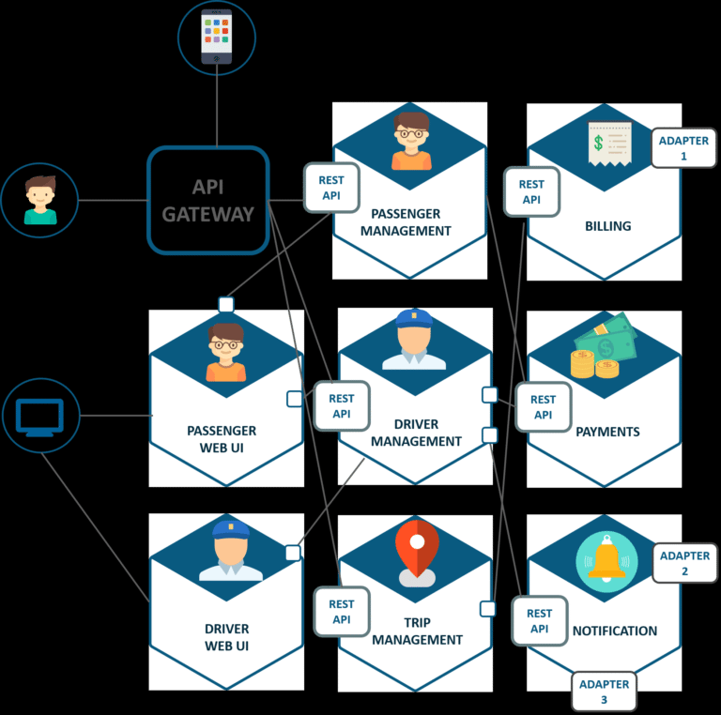
Uber-usecase-microservices architecture

Slide 6
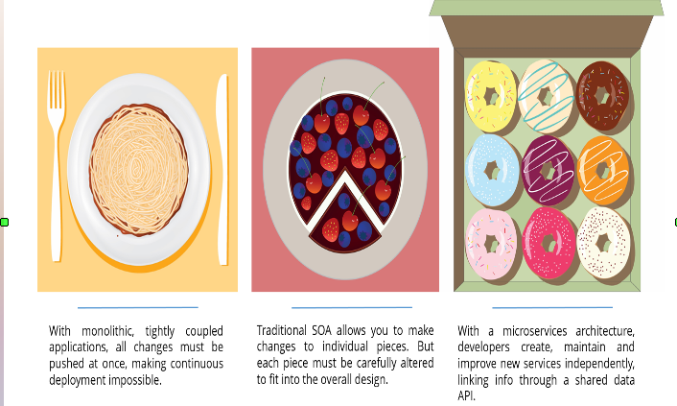

Slide 7
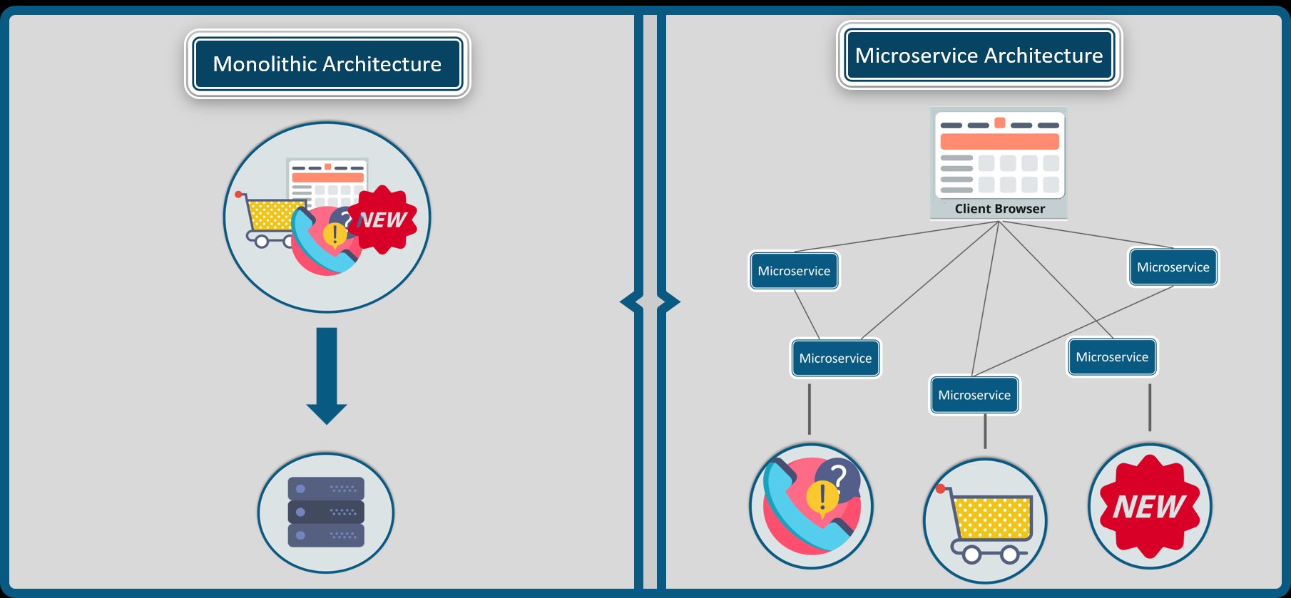

Slide 8
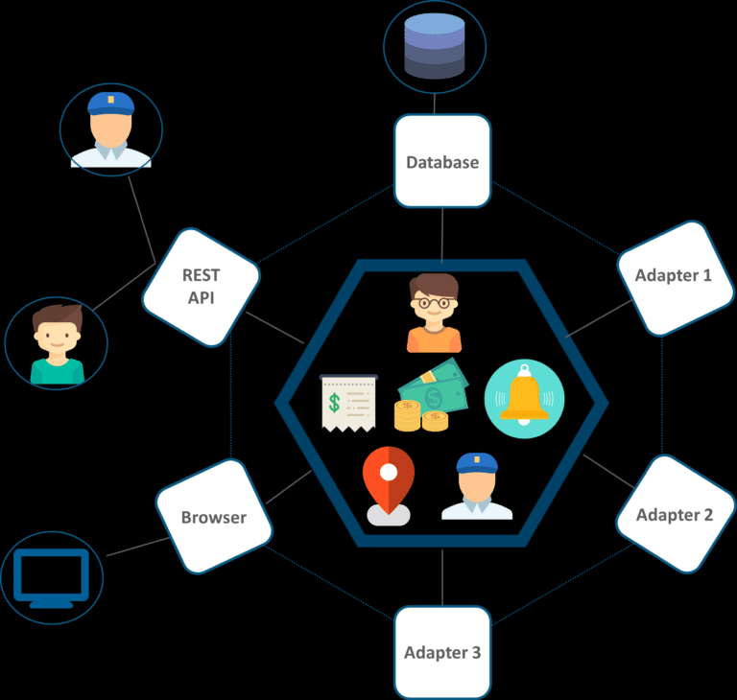
Uber -usecase-monolithic architecutre

Slide 9
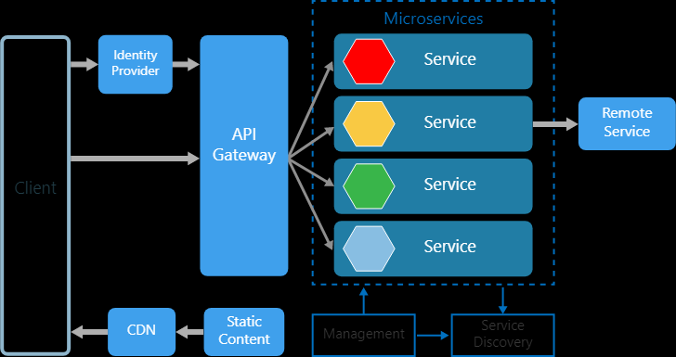
Demo Architecture

Slide 10
        DEMO
Tech stack and runtime
Java1.8
EclipseIDE(Spring Tool Suite) plugin
Spring cloud(Eureka server)
Springboot
Spring rest
Maven

Slide 11

Thank You

