Slide 1

“Object Detection and Identification using CNN”
KLE Society’s
KLE College of Engineering & Technology, Chikodi
Department of Computer Science and Engineering
Major project Presentation on
Presented by,
Mr. Anupam Naragunde 2KD21CS013
Mr. Hrutik Kamble 2KD21CS031
Mr. Jagadish Dhabade 2KD21CS032
Mr. Ravindranath Vajire 2KD21CS072
Under the Guidance of,
Dr. Shilpa B. Hosagoudra

Slide 2
Vision & Mission of CSE Dept.
Vision:
To produce globally acceptable young minds with technical competency in Computer Science and Engineering for the betterment of society.
Mission:
Adopt modern teaching and learning processes with emphasis on leadership.
Strengthen academic and research activities in the emerging domains of Computer Science and Engineering for life-long learning.
Encourage students to acquire interdisciplinary Engineering knowledge and work collaboratively to meet global challenges.
Empower student’s employability and entrepreneurship skills in association with alumni, institute and industry with a sense of social responsibility.
10-02-2025

Slide 3
CONTENTS
INTRODUCTION
OBJECTIVES
PROBLEM STATEMENT
LITERATURE SURVEY
OVERVIEW OF PROPOSED SYSTEM
DATA FLOW DIAGRAM
METHODOLOGY
SYSTEM REQUIREMENTS
SNAPSHOTS
CONCLUSION
REFERENCE

Slide 4
INTRODUCTION
Object Detection and Identification is an advanced system designed to detect and classify objects, providing detailed information about them. The project consists of two main modules:
Object Detection using image– Processes images and video streams to identify objects instantly.
Real-Time Object Detection –Detects objects in a live video feed.
The system is built using Django, a Python-based web framework, for handling the user interface and database management, while SQLite is used for efficient storage of detection results. It also integrates powerful machine learning and deep learning libraries, including:
TensorFlow & Keras – For building and training deep learning models.
NumPy & Pandas – For efficient data processing.
Matplotlib & Seaborn – For data visualization and model performance analysis.
Additionally, the system features an audio-based output option, enhancing accessibility for users.
The system uses advanced machine learning models and integrates object classification algorithms to identify the specific characteristics of objects, including their dimensions, material composition, and more. The system aims to be lightweight, making it deployable on systems with moderate computational power while still achieving high accuracy.

Slide 5
OBEJECTIVES
Develop a robust object detection system capable of identifying and classifying objects across multiple real-world applications. In e-commerce, the system can automate product recognition and categorization, improving search accuracy, inventory management, and personalized recommendations. In self-driving cars, it enhances autonomous navigation by detecting pedestrians, traffic signs, obstacles, and other vehicles, ensuring safer and more efficient transportation. it can be applied in surveillance and security for real-time monitoring, detecting suspicious activities, and preventing unauthorized access. In healthcare, object detection can assist in analyzing medical images, such as X-rays and MRIs, to detect abnormalities and improve diagnostic accuracy.
Develop a system for real time object identification and detection system for identifying and detecting object with the help of live camera.
Visually impaired individuals have difficulty identifying objects around them, which affects their ability to navigate and interact with the world. There is a need for a system that can detect objects and give clear audio descriptions to assist them in real time.

Slide 6
PROBLEM STATEMENT
Object detection systems face multiple challenges, including high computational costs, real-time efficiency, and hardware limitations. There is a need for an advanced system that can efficiently detect multiple objects in real-time while being lightweight enough to operate on moderately powered devices.
Visually impaired individuals have difficulty identifying objects around them, affecting their ability to navigate and interact with their environment. A system that can detect objects and provide clear audio descriptions in real time is essential for improving accessibility and independence.

Slide 7
LITERATURE SURVEY
Sl. No. | Paper Title | Author(s) | Year | Advantages | Disadvantages | Future Scope | Address
1 | Deep Learning for Object Detection | Girshick et al. | 2014 | Introduced R-CNN | High computational cost | Development of Faster R-CNN | www.ieee.com/deeplearning2014
2 | YOLO: Real-Time Object Detection | Redmon et al. | 2016 | Real-time detection | Accuracy trade-offs | Improved YOLO versions | www.ieee.com/yolo2016
3 | Optimizing Neural Networks with Adam | Kingma and Ba | 2015 | Adaptive learning rate | Prone to overfitting | Enhanced optimizers | www.ieee.com/adam2015
4 | Robustness in CNNs | He et al. | 2016 | Residual networks improve accuracy | Complexity in design | Further optimization of residual blocks | www.ieee.com/robustness2016
5 | Faster R-CNN: Towards Real-Time Detection | Ren et al. | 2015 | Improved speed and accuracy | Complex training pipeline | Simplification of pipelines | www.ieee.com/fasterrcnn2015

Slide 8
6 | SSD: Single Shot MultiBox Detector | Liu et al. | 2016 | High-speed detection | Lower accuracy for small objects | Enhanced small-object detection | www.ieee.com/ssd2016
7 | MobileNet: Lightweight CNN | Howard et al. | 2017 | Optimized for mobile devices | Lower accuracy than standard CNNs | Improved lightweight architectures | www.ieee.com/mobilenet2017
8 | YOLOv4: Optimal Speed and Accuracy | Bochkovskiy et al. | 2020 | Optimized performance for real-time tasks | Complex parameter tuning | Refinement of YOLOv5 | www.ieee.com/yolov42020
9 | Feature Pyramid Networks for Detection | Lin et al. | 2017 | Multi-scale feature extraction | Increased computational cost | More efficient multi-scale frameworks | www.ieee.com/featurepyramid2017
10 | Mask R-CNN for Instance Segmentation | He et al. | 2017 | Combines detection and segmentation | High resource requirements | Resource-efficient segmentation models | www.ieee.com/maskrcnn2017

Slide 9
OVERVIEW OF PROPOSED SYSTEM
Object Detection and Identification, is to develop an efficient and scalable system for real-time object recognition and classification. By integrating CNN-based classification, YOLOv5 for object detection, real-time video processing, and advanced optimizers like Adam, AdamW, and RMSProp, the project aims to provide an optimized solution that balances accuracy, speed, and computational efficiency.
Key Components of the System:
CNN-based Classification for Object Identification.
YOLOv5 for Real-time Object Detection and Localization.
Real-time Video Processing.
Optimizers (Adam, AdamW, and RMSProp) for Enhanced Training Efficiency.

Slide 10
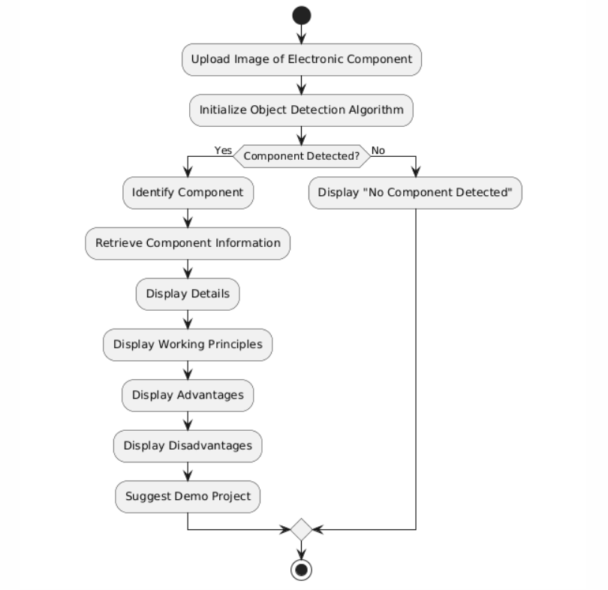
DATA FLOW DIAGRAM FOR IMAGE DETECTION

Slide 11
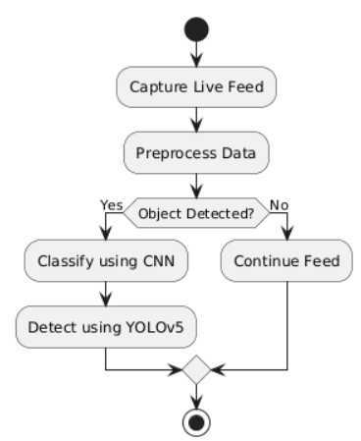
DATA FLOW DIAGRAM FOR LIVE DETECTION

Slide 12
METHODOLOGY
1. Data Preprocessing
Data Collection: Gather images from datasets like COCO, Pascal VOC.
Normalization: Scale pixel values for consistency.
Data Augmentation: Apply techniques like flipping, rotation, scaling, and mosaic augmentation.
Dataset Splitting: Divide data into training, validation, and test sets.
Annotation: Label images using tools like LabelImg for YOLOv5-compatible formats.
2. Model Training
CNN Training: Train ResNet, MobileNet, or EfficientNet with optimizers (Adam, AdamW, RMSProp).
Hyperparameter Tuning: Optimize learning rate, weight decay, and momentum.
YOLOv5 Training: Fine-tune YOLOv5 with pretrained weights and anchor box optimization.
Early Stopping: Prevent overfitting by monitoring validation loss.

Slide 13
3. Integration of CNN with YOLOv5
Feature Extraction: Replace YOLOv5’s backbone with a trained CNN.
Feature Fusion: Enhance detection with FPN and PAN structures.
Pipeline Workflow: Process input images, extract features, and predict object locations.
Optimization: Quantize the model for efficient deployment on edge devices.
4. Evaluation
Performance Metrics: Measure accuracy using Mean Average Precision (mAP).
Speed Testing: Assess real-time capability with Frames Per Second (FPS).
User Testing: Evaluate accessibility features like auditory feedback.

Slide 14
REQUIREMENTS
Hardware Requirements
Processor: Intel Core i5/higher or AMD Ryzen equivalent (Recommended: Intel i5 minimum)
RAM: 16GB (Minimum: 8GB)
Storage: 256GB SSD (Minimum: 128GB HDD)
GPU: NVIDIA RTX 3080 or higher (Minimum: NVIDIA GTX 1060)
Camera: High-resolution live camera
Keyboard & Mouse: Standard Windows keyboard, Two/Three-button mouse
Monitor: Any compatible display
Internet Connectivity: Required for remote monitoring
Client Devices: Computers, Laptops, or Tablets with a modern web browser (Chrome, Firefox, Safari, Edge)

Slide 15
.
Software Requirements
Operating System: Windows 7/8/10/11, macOS, or Linux
Frontend: HTML, CSS, JavaScript, Bootstrap
Server side: DJANGO
Database: SQLite
Frameworks & Libraries: TensorFlow, Keras, NumPy, Matplotlib, Seaborn ,OpenCV.
Development Tools & IDEs: Visual Studio Code (VS Code
Client-side Software Requirements: Modern Web Browser (Chrome, Firefox, Safari)

Slide 16
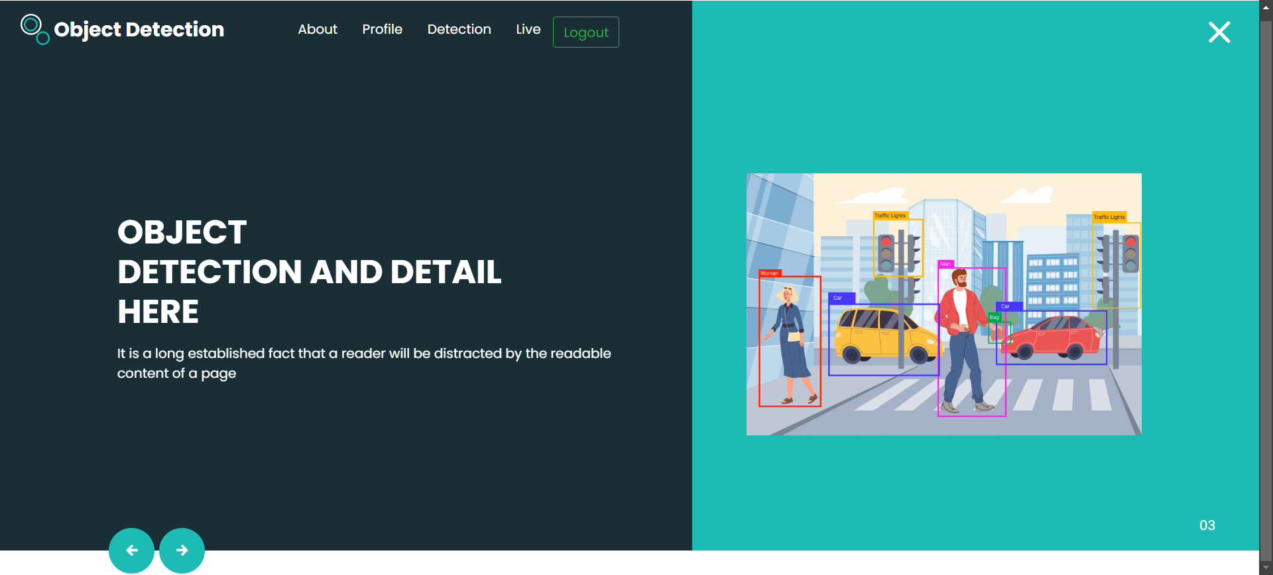
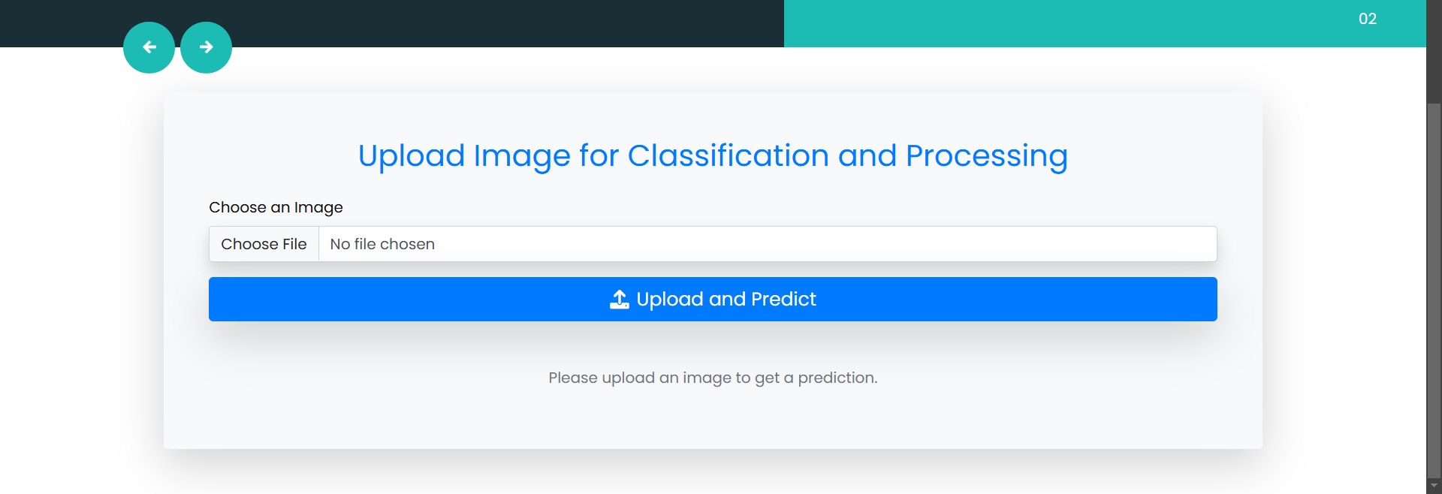
SNAPSHOTS
Home Page
Input For Object Detection And Identification Using Image

Slide 17
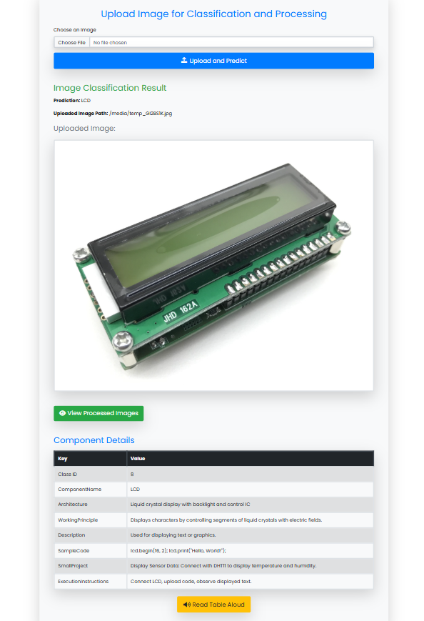
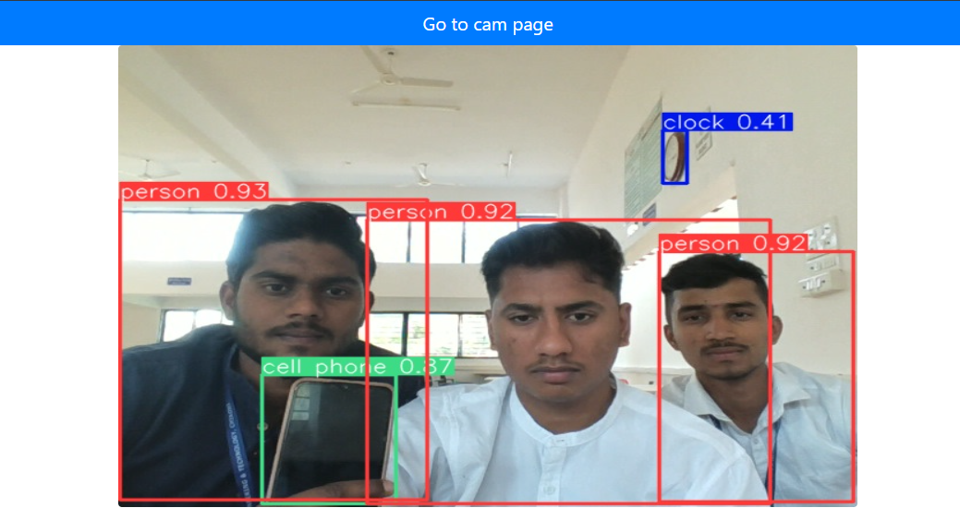
Real Time Object Detection
Result Of Image Detection

Slide 18
CONCLUSION
This project successfully developed a robust object detection system with YOLOv5 with CNN-based feature extraction. By evaluating different optimizers and utilizing data preprocessing techniques, the system achieved high accuracy and low latency, making it suitable for real-time applications such as surveillance, autonomous vehicles, and robotics. Performance metrics like Mean Average Precision (mAP) and FPS demonstrated its efficiency. Additionally, the user-friendly interface and accessibility features enhance usability. This work contributes to advancements in real-time object detection, offering practical solutions for research and industry applications.

Slide 19
REFERENCES
Redmon, J., Divvala, S., Girshick, R., Farhadi, A. (2016). You Only Look Once: Unified, Real-Time Object Detection. IEEE Conference on Computer Vision and Pattern Recognition. URL: https://arxiv.org/abs/1506.02640
Ren, S., He, K., Girshick, R., Sun, J. (2015). Faster R-CNN: Towards Real-Time Object Detection with Region Proposal Networks. IEEE Transactions on Pattern Analysis and Machine Intelligence. URL: https://arxiv.org/abs/1506.01497
Sandler, M., Howard, A., Zhu, M., Zhmoginov, A., Chen, L. (2018). MobileNetV2: Inverted Residuals and Linear Bottlenecks. Proceedings of the IEEE Conference on Computer Vision and Pattern Recognition. URL: https://arxiv.org/abs/1801.04381
Huang, G., Liu, Z., Van Der Maaten, L., Weinberger, K. Q. (2017). Densely Connected Convolutional Networks. IEEE Conference on Computer Vision and Pattern Recognition. URL: https://arxiv.org/abs/1608.06993
Bochkovskiy, A., Wang, C., Liao, H. M. (2020). YOLOv4: Optimal Speed and Accuracy of Object Detection. arXiv preprint arXiv:2004.10934. URL: https://arxiv.org/abs/2004.10934
He, K., Zhang, X., Ren, S., Sun, J. (2016). Deep Residual Learning for Image Recognition. Proceedings of the IEEE Conference on Computer Vision and Pattern Recognition. URL: https://arxiv.org/abs/1512.03385
Lin, T. Y., Goyal, P., Girshick, R., He, K., Dollar, P. (2017). Focal Loss for Dense Object Detection. IEEE Transactions on Pattern Analysis and Machine Intelligence. URL: https://arxiv.org/abs/1708.0200

Slide 20
THANK YOU

