Slide 1


Amazon Sales Data Overview: 2010-2017
This presentation provides an in-depth analysis of Amazon's sales data from 2010 to 2017. We'll examine key trends, profitability, product performance, geographical distribution, and customer insights. We'll also delve into the competitive landscape and provide actionable recommendations for future growth.
Mandla Jagadish
Notes:
1

Slide 2
Data Cleaning and Transformation
Data Cleaning:
Removed Duplicates: Ensured each sales entry is unique.
Handled Missing Values: Imputed or removed records with missing data to maintain dataset integrity.
Standardized Formats: Ensured consistency in date, region, and item type formats.
Data Transformation:
Added Columns:
Month: Extracted from the date field to analyze monthly trends.
Year: Extracted from the date field to analyze yearly trends.
Month-Year: Combined month and year to create a 'Month-Year' column for detailed trend analysis.
New Measures:
Total Sales by Month: Aggregated sales data to understand monthly performance.
Total Sales by Year: Summarized sales data for yearly comparison.
Total Sales by Month-Year: Detailed measure to observe sales patterns over specific periods.
Notes:
3

Slide 3
Introduction
Objective :
Provided a comprehensive analysis of Amazon’s sales data from 2010 to 2017.
Key Metrics :
Total Sales: $137.35M
Total Profit: $44.17M
Total Cost: $93.18M
Notes:
2

Slide 4
Sales Channels Breakdown
Channels:
Offline
Online
Analysis Period:
2010 - 2017
2017
39%
12%
Notes:
4

Slide 5


Regional Sales Distribution
Major Regions:
North America
Europe
Asia
Africa
South America
Australia
Key Insights:
Highest sales: North America
Notable performance in Europe and Asia
Emerging markets in Africa and South America
Notes:
6

Slide 6
Item Type Sales Breakdown
Top Item Types:
Office Supplies: $36.6M (26.65%)
Household: $30.59M (22.27%)
Personal Care: $29.89M (21.76%)
Clothes: $10.35M (7.54%)
Cosmetics: $3.09M (2.25%)
Hobbyists
Specialized purchases, prioritize product quality and variety, value customer service and product information.
Notes:
7

Slide 7
Monthly Sales Trends
High Sales Months:
February
November
April
Low Sales Months:
June
September
December
Notes:
8

Slide 8


Annual Sales Trends
Peak Year: 2012 (Over $30M in sales)
Sales Performance: Steady growth from 2010 to 2012, followed by fluctuations.
Notes:
9

Slide 9
Sales Analysis by Year, Quarter, Month, and Day
Detailed Trends :
Yearly trends: Peaks and valleys indicating seasonal fluctuations.
Quarterly trends: Higher sales in Q1 and Q4.
Monthly and daily trends: High variability indicating promotions or events.

Slide 10
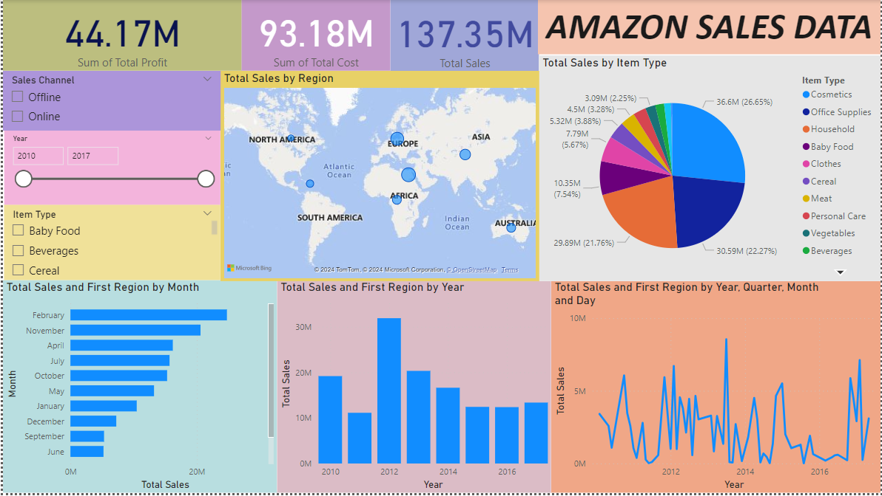

Slide 11
Conclusion
Summary:
Significant sales in North America, Europe, and Asia.
Office Supplies and Household items are top sellers.
Notable sales peaks in 2012 and during certain months.

Slide 12
Thank You

