Slide 1

ANALYSIS ON CRICKET BATSMAN
PERFORMANCE ACROSS ALL FORMATS
BY:
K. KRANTHI KUMAR
VIJAY
M. JAGADISH

Slide 2


Problem Statement:
"To undertake a comprehensive evaluation of cricket batsmen's effectiveness and influence in modern cricket by examining their performance across a spectrum of formats, including Test matches, One Day Internationals (ODIs), and Twenty20 Internationals (T20Is)."
Objective:
The objective of the statement is to conduct a complete assessment of cricket batsmen's performance and impact in contemporary cricket. This involves analyzing their effectiveness across various formats such as Test matches, One Day Internationals (ODIs), and Twenty20 Internationals (T20Is).

Slide 3
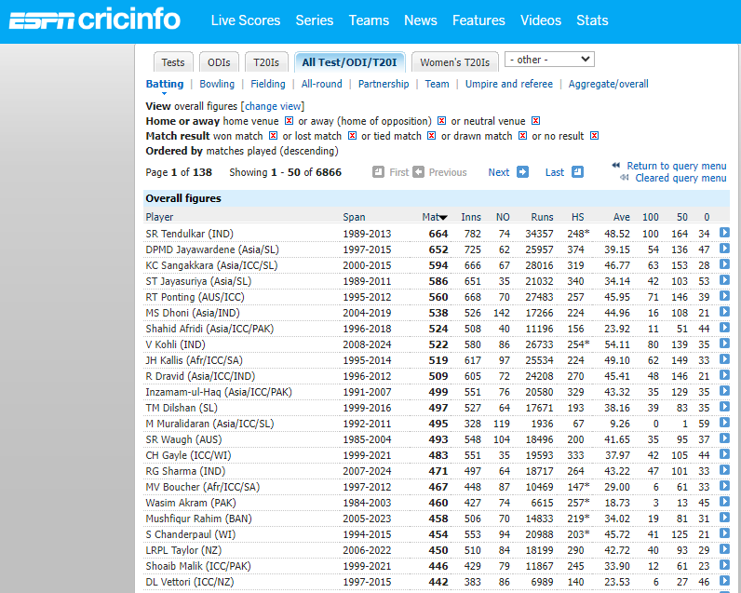
WEB SCRAPPING
Data collected from espncricinfo.
Website:
https://stats.espncricinfo.com/ci/engine/stats/index.html?class=11;home_or_away=1;home_or_away=2;home_or_away=3;orderby=matches;result=1;result=2;result=3;result=4;result=5;template=results;type=batting
Sent request for the URL’s.
Scrapped the data which accepted the URL request.(status code=200)

Slide 4
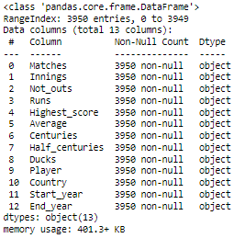
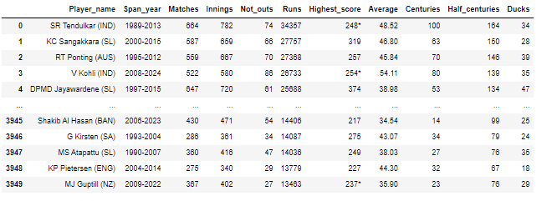
Raw Data :
The above one is the raw data which is collected from the web using the method called web scraping.

Slide 5
DATA CLEANING:
Created columns based on the players' country names enclosed in brackets.
Converted the "span_year" column to "Start_year" and "End_year".
Changed the data type of the "Average" column from object to float, and
converted other numerical columns from object to integer.
There are outliers present in the columns HS, Runs, Ave, 100s, and 50s, which are marked as True values.

Slide 6
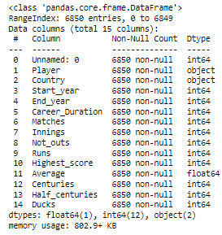
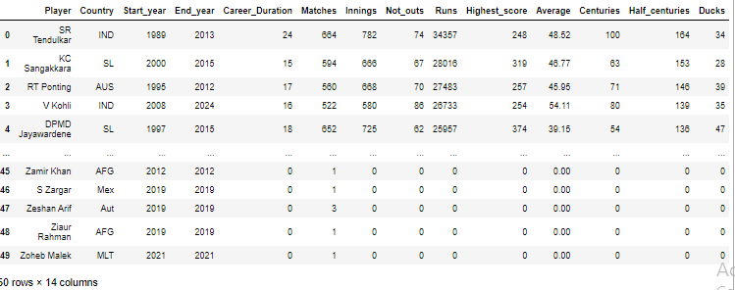
POST DATA CLEANING

Slide 7
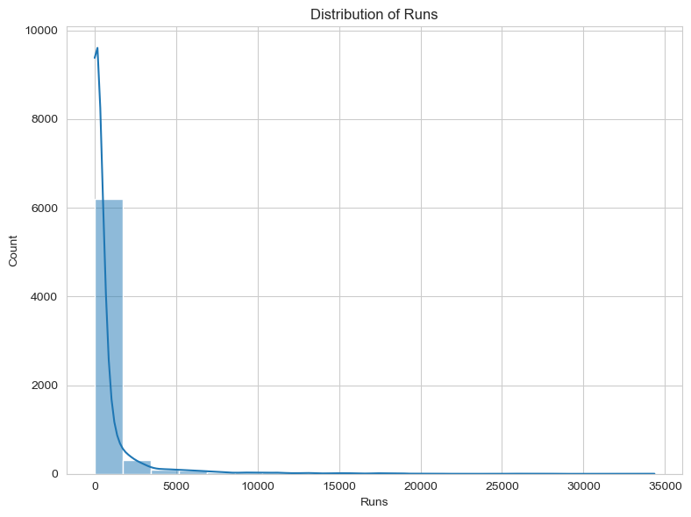
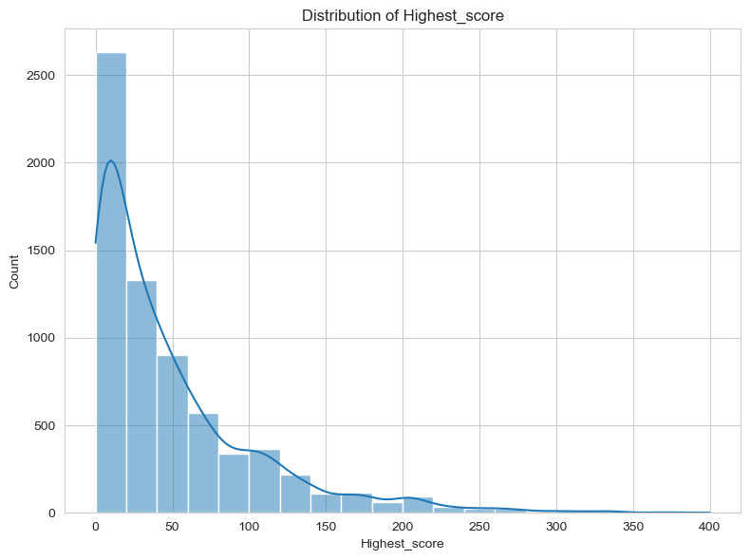
Distribution Analysis on the Numerical Data
Continuous variables are typically characterized by numerical data.
The x-axis represents the variable types, while the y-axis depicts the probability count function.

Slide 8
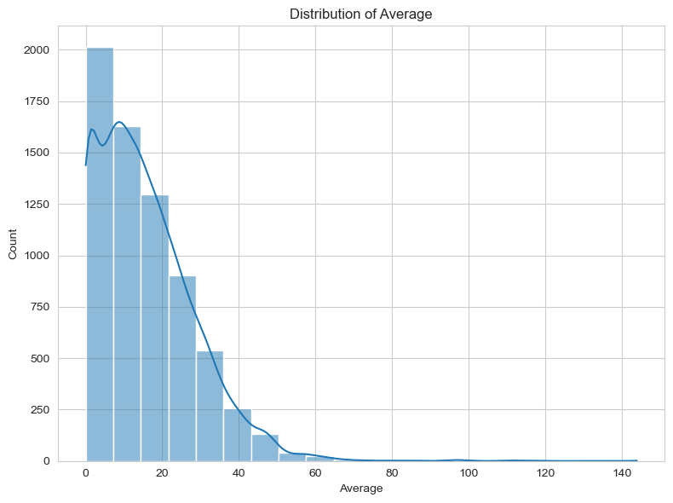
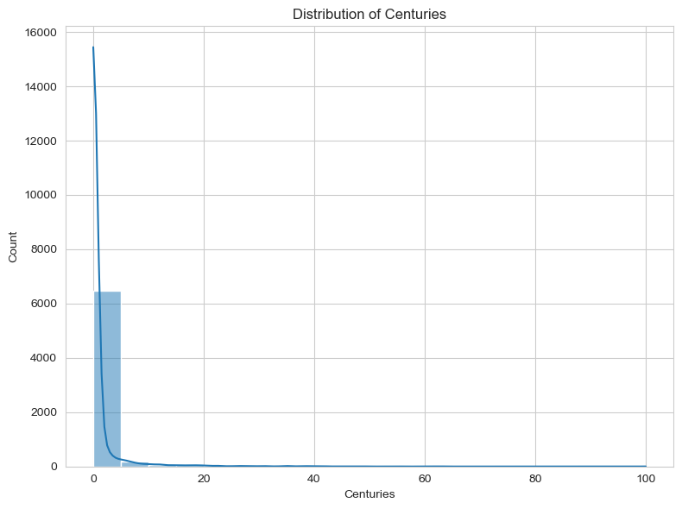
There is no variable that follows a normal distribution.
The curves for all distributions skew towards the right.

Slide 9
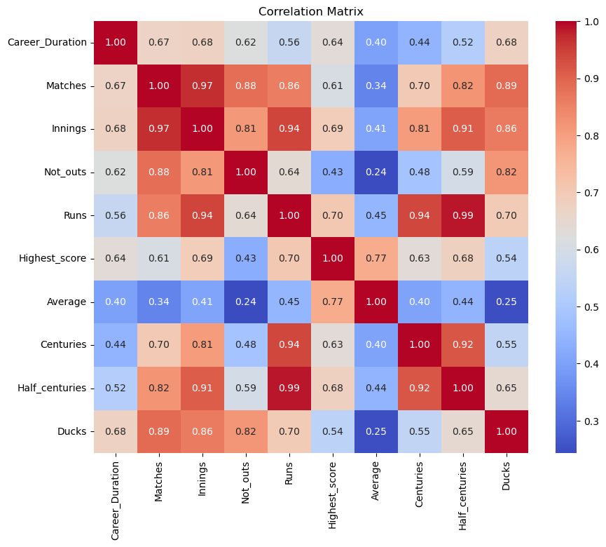
Correlation for Numerical data
Strong correlation between Runs with Half centuries and Matches with Innings.
Weak correlation between Average with Not outs and Average with Ducks.
All the variables are positively correlated.

Slide 10
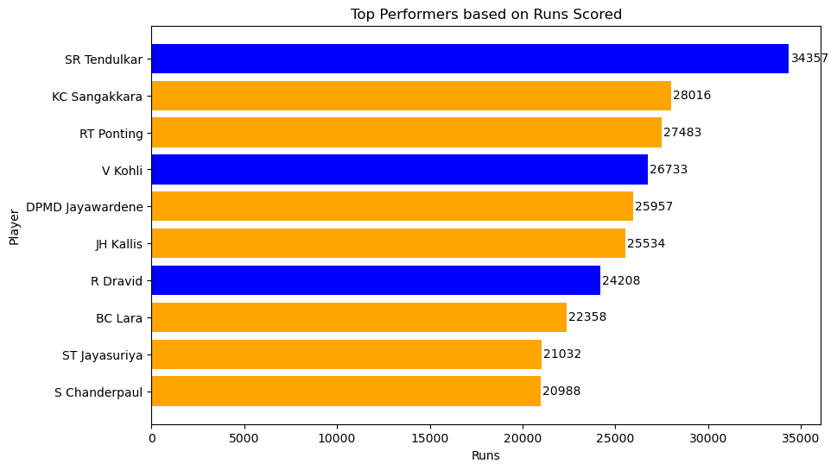
Overall Top 10 Highest Runs Scored ?
Sachin Tendulkar holds the record for the highest number of runs, totaling 34,357 across all international formats.

Slide 11
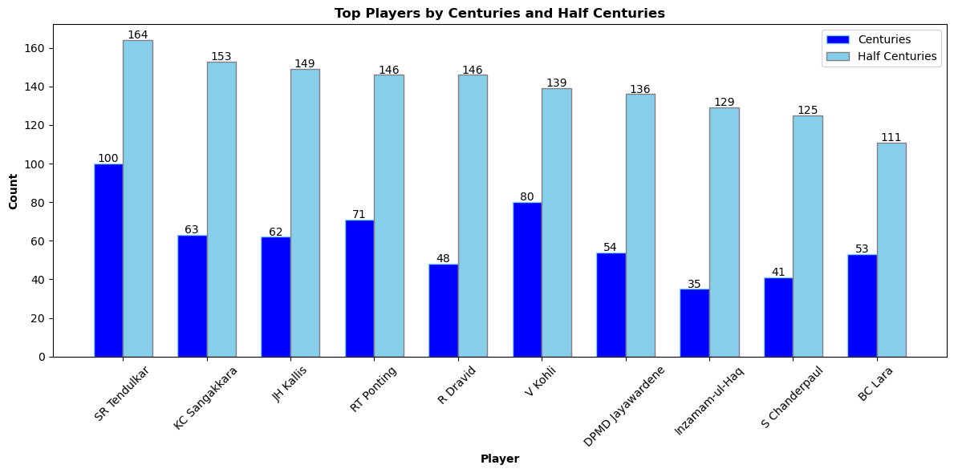
Overall Top 10 Players by Centuries and Half Centuries?
Sachin Tendulkar is the player with the highest number of centuries and half-centuries scored.

Slide 12
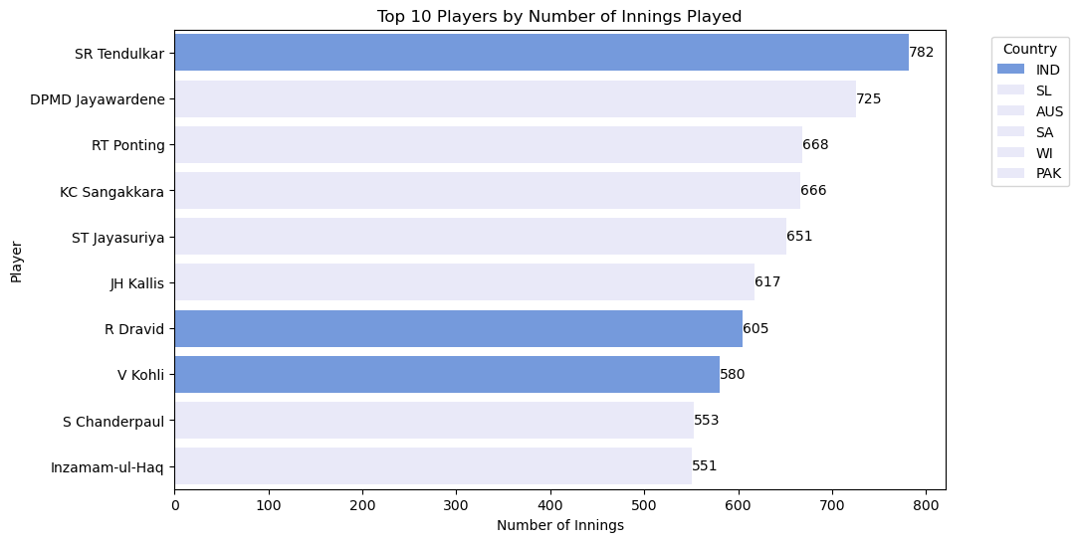
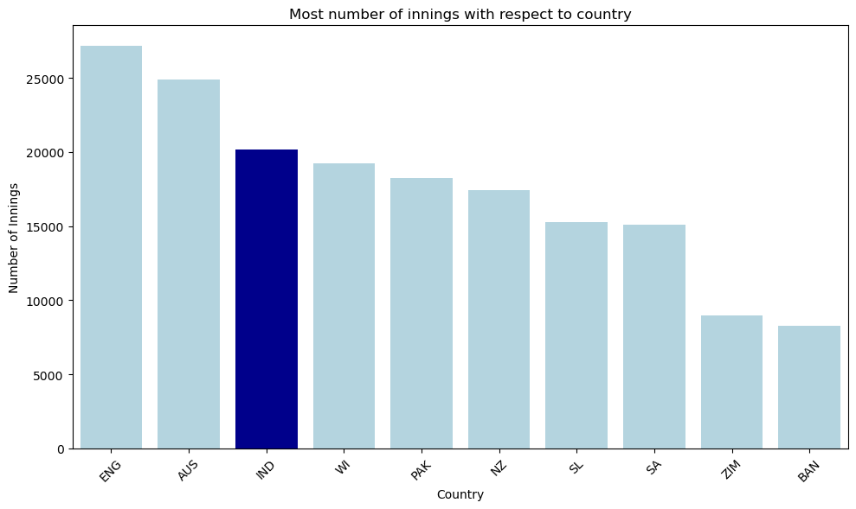

Overall Top 10 Most Innings played ?
Sachin Tendulkar ranks among the top 10 players with the highest number of innings played.
England has the highest number of innings played among all countries.

Slide 13
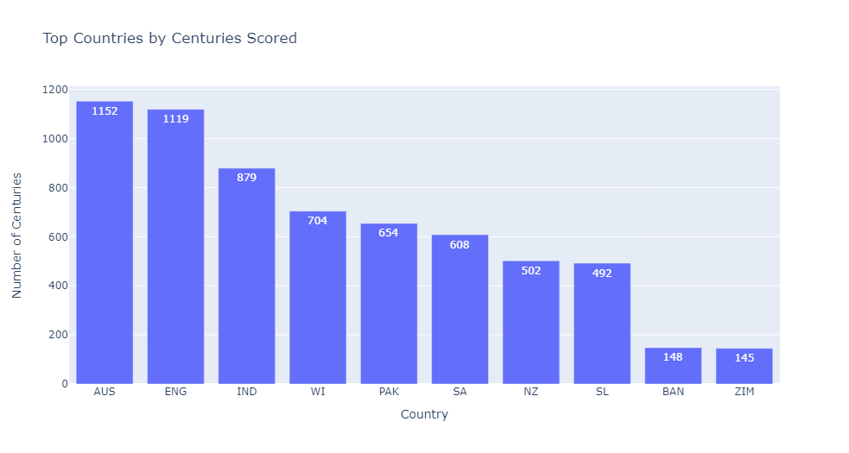
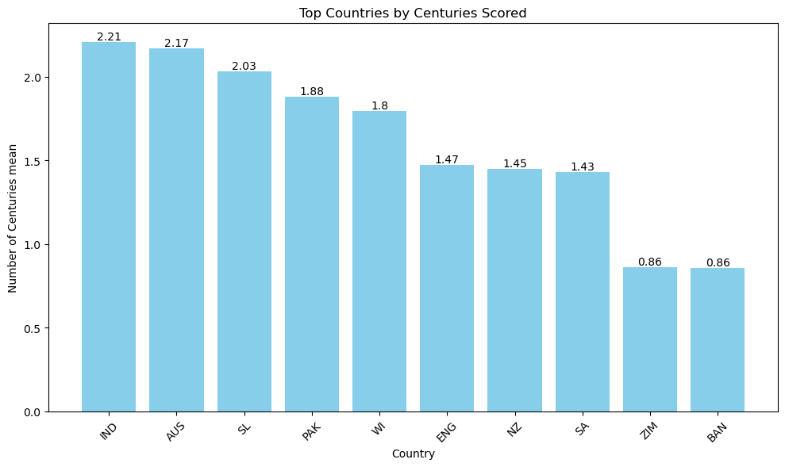
Top 10 Countries who scored highest number of Centuries ?
Australia holds the record for the highest number of centuries scored by its players.
India ranks first in terms of the average number of centuries scored by its players among all countries.

Slide 14
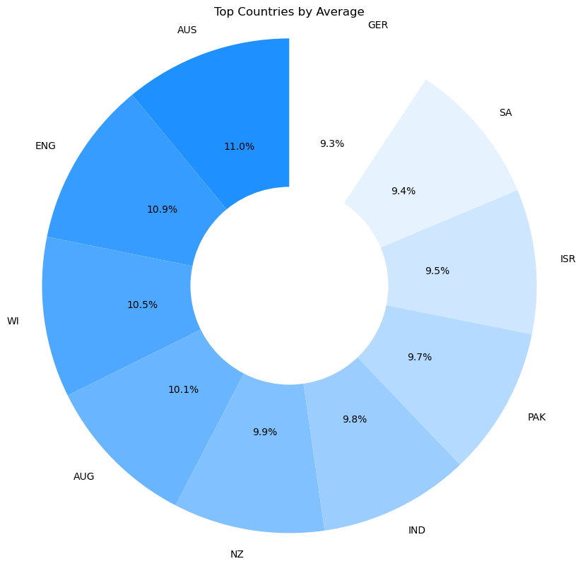
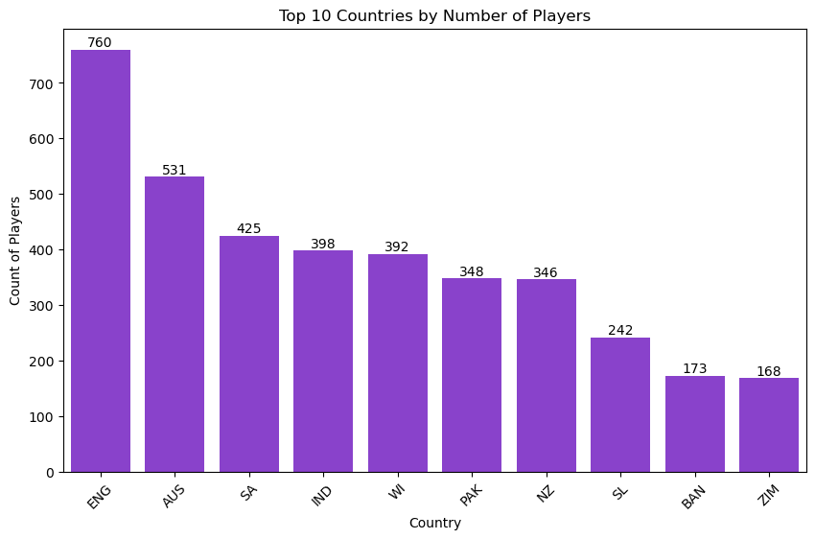
Top Countries Average by over all average of player ?
Australia ranks first in terms of the highest average among top countries.
England has the highest number of players who have played internationally.

Slide 15
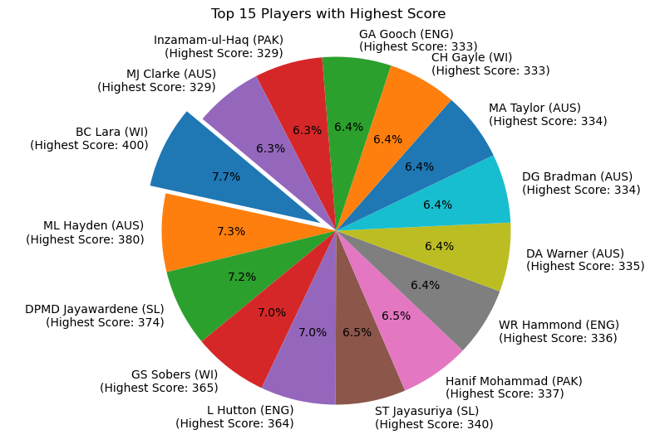
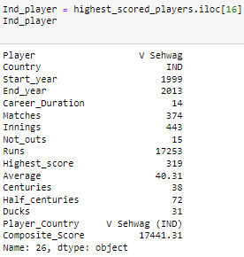
Over all Top 15 Players who Scored Highest Score?
West Indies player Brian Lara holds the record for the highest score, with 400 runs.
Australia's Mathew Hayden holds the second position with a score of 380 runs.

Slide 16
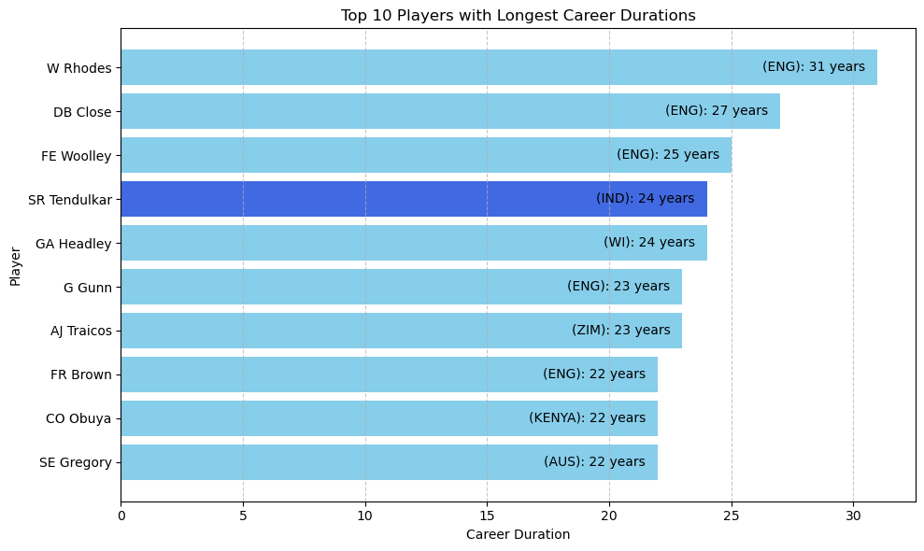
Top 10 Player with Longest career duration ?
The player with the longest career duration is Wilfred Rhodes from England, who holds the first position.
Among the top 10 players with the longest careers, five are from England.

Slide 17
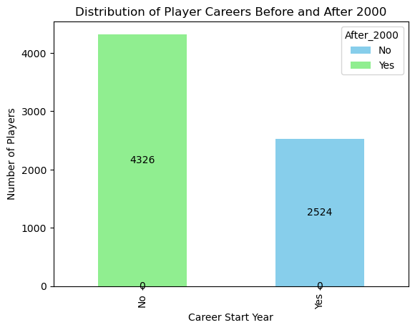
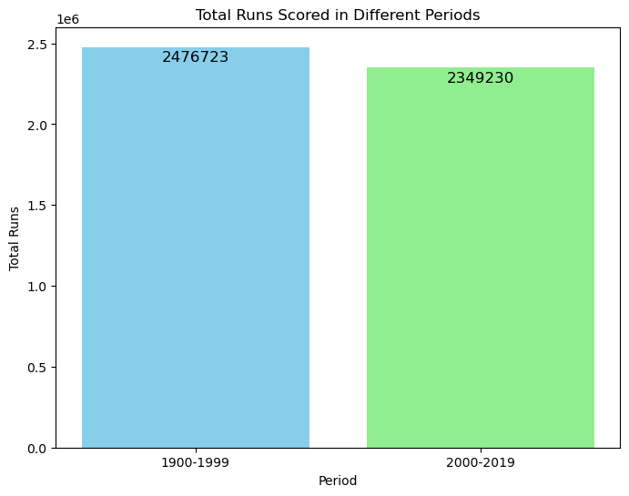
Distribution of Player Careers Before and After 2000 ?
The distribution of player careers that began before the year 2000 includes 2524 players.
There are 4326 players whose careers began after the year 2000.
The total runs scored across all formats from the period spanning 1900 to 1999, as well as from 2000 to 2024.

Slide 18
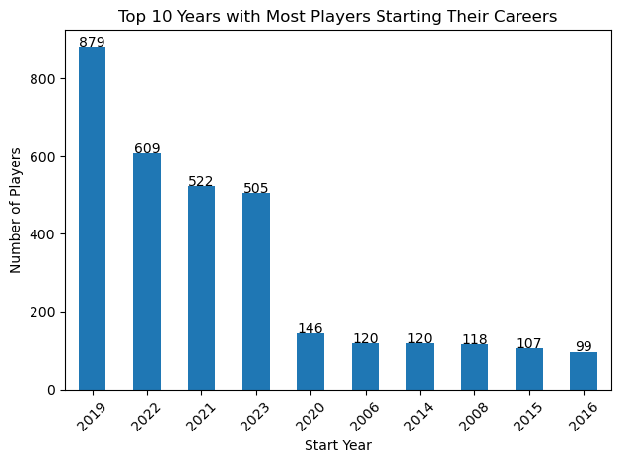
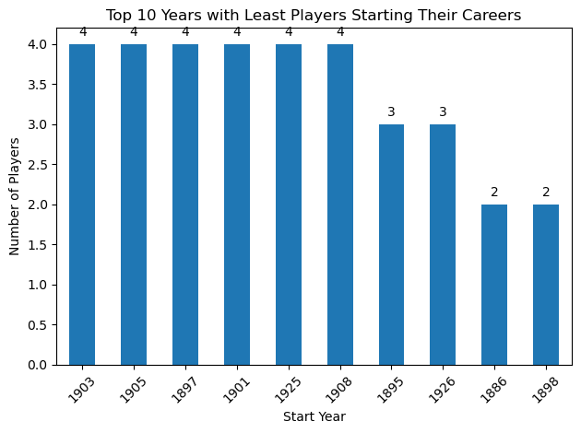
Most and least players starting their career in years ?
In the year 2019, the highest number of players started their international cricket careers from all countries, totaling 879.
Only 4 players started their international cricket careers from all countries in the year 1903.
We can observe that the highest number of players started their careers between 2019 and 2023.

Slide 19
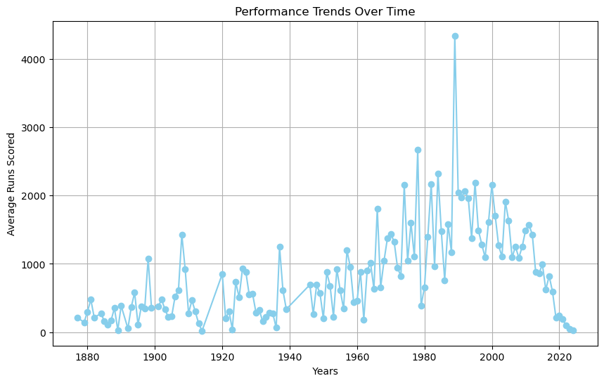
Performance Trends Over Time based on runs and years ?
Trends in player performance based on the highest runs scored each year.
The year 1989 witnessed the highest average runs scored.

Slide 20
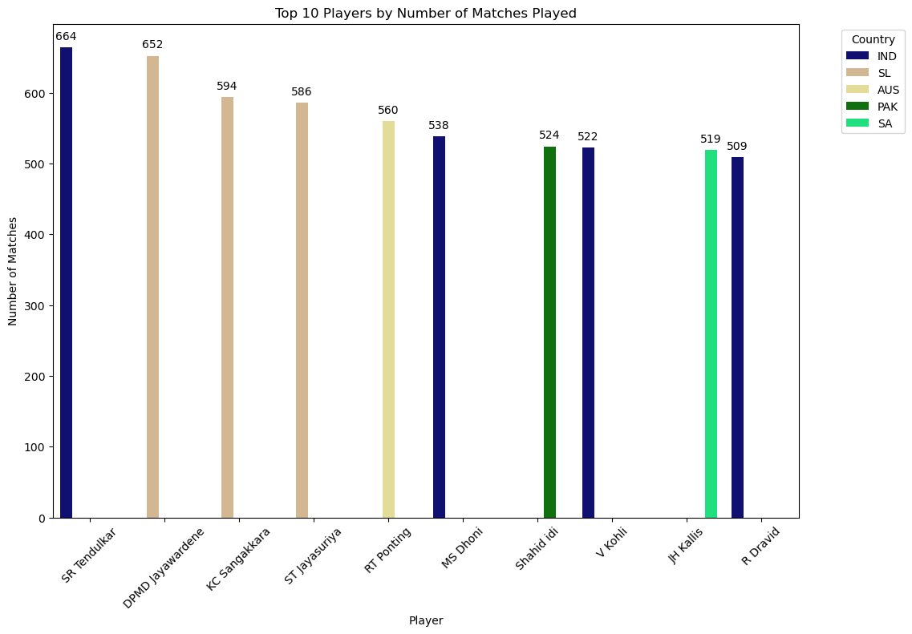
Overall Top 10 Most matches played ?
Sachin Tendulkar holds the record for the most number of matches played, with 664 matches, securing the first place.

Slide 21
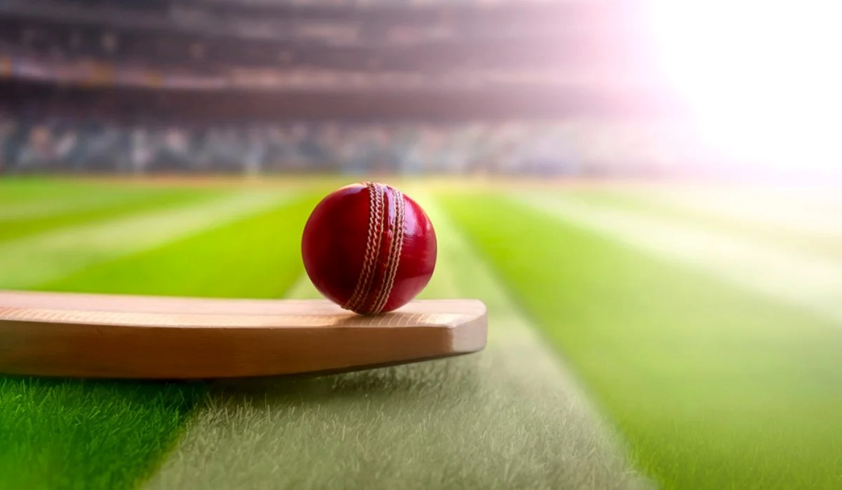
Conclusion:
When considering all formats combined, Sachin Tendulkar emerges as the preeminent performer.
A notable observation would be that the majority of players have entered their respective careers after the year 2000.
Virat Kohli's presence is not only prominent across all cricket formats but also within the top 10 ranks individually in both T20s and ODIs.
India boasts three players within the top 10 highest run-scorers, reflecting a strong performance in cricket.
By emulating the skills, adaptability, consistency, fitness, and mental toughness demonstrated by these top Indian players, junior cricketers can enhance their own abilities and increase their chances of success in cricket.

Slide 22

I wanted to express my sincere gratitude for your invaluable guidance and support throughout the project. I truly appreciate the time and effort you've dedicated to helping me. Thank you for being an exceptional mentor.
@Innomatics @ BhanuPrakash Pujala

