Slide 1
Jewellery ERP — Image App & Scheme App
License-Key Activation + Multi-Branch Migration
Prepared for review — 30 July 2026

Slide 2
Where We Started
Two satellite mobile apps, two different problems
Image App — single build meant for every store, but still used a device-license server + per-store IP address + a legacy PHP backend (test_android1/index.php).
Scheme / Savings App — needed per-tenant, per-branch signup, but branches could only ever be created automatically (one head-office branch) — no way to add more.
Super Admin dashboard — could create a tenant's first license key, but had no way to issue a new/replacement key for an existing tenant, and no branch management UI at all.
Goal — one license key activates a mobile app straight to its tenant's own ERP database — no signup, no login, no per-store IP configuration.

Slide 3
What We Found Already Built
Less new backend work than expected
Product Catalog module — server/src/routes/productCatalog.js already replicates the PHP backend's search, image upload, exhibition, and order-lifecycle features.
Scheme App auth flow — License Key → Branch Picker → Signup/OTP was already fully wired end-to-end, just missing a way to create additional branches.
Tenant-DB resolver — the auth middleware already resolves each tenant's own database connection straight from the JWT — exactly the mechanism “license key → their database” needed.
License backend — POST /api/license/create already existed and worked — it just had no button anywhere in the UI.

Slide 4
What Was Built — Foundation
Super Admin dashboard
Branch CRUD — new POST / PUT /api/tenant/branches endpoints, plus an “Add Branch” flow in the tenant detail drawer. Unblocks real multi-branch use for the Scheme App.
Issue New License Key — wired the existing license backend to a real UI action — generates a key, shows it copyable, immediately supersedes the tenant's old key.

Slide 5
What Was Built — Image App Auth
License key = the entire authentication
New endpoint — POST /api/mobile/license-login validates the key and mints a tenant-scoped JWT directly — no username, no password, no OTP.
New TenantContext — activates the license, persists it on-device, and silently re-validates on every app start — so a revoked license locks the app out within a week, with zero user action required otherwise.
New LicenseActivation screen — replaces the old IP-address entry screen entirely.
Legacy device-license system removed — the old per-store-IP / device-registration flow (AppContext.jsx) has been fully retired.

Slide 6
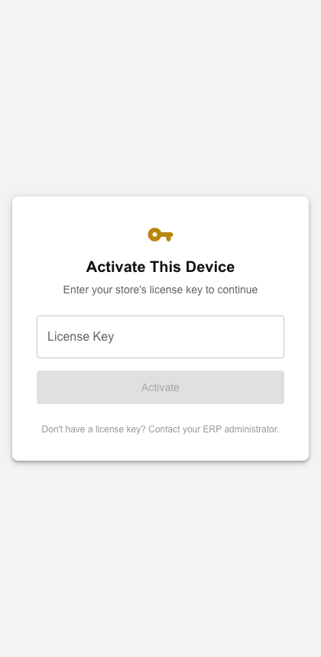
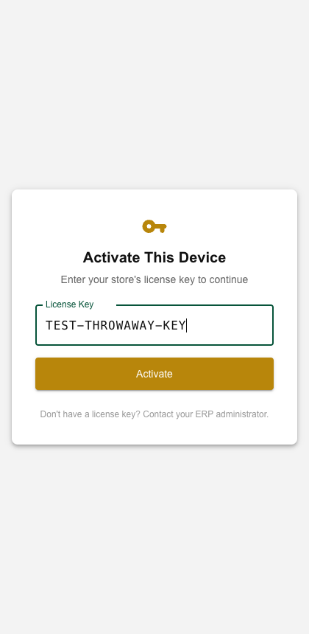
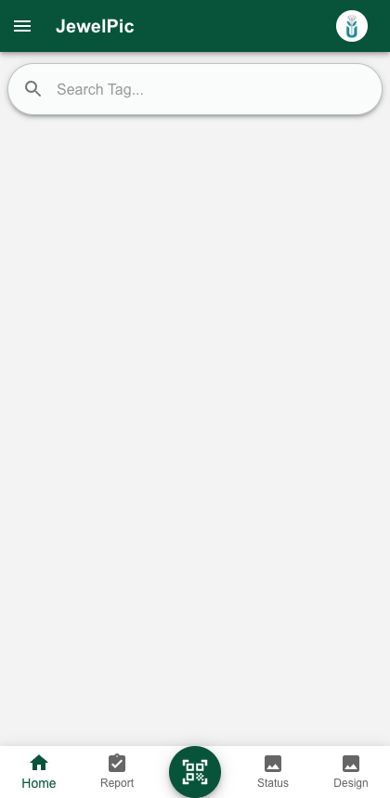
Image App — Live Screens
Captured from a real run against the dev database (tenant: Test Tenant / TEST_TENANT)
1. Activation screen
2. License key entered
3. Activated → home screen

Slide 7
Data Layer Migration
~20 screens moved off the legacy PHP backend
Search & browse, sold report, design views — now call the ERP's real catalog API (GET /api/catalog/search, /designs, /sold-report).
Image management — list / set-primary / delete now hit real endpoints (rename & bulk-delete have no server equivalent yet — flagged, not invented).
Exhibition, quotation & billing — bridged to /api/catalog/orders and /api/sales/create — this bridge is best-effort and should get real device testing before being trusted with live sales.
Dead code removed — MultiImage_old.jsx deleted (confirmed unused).

Slide 8
Decisions Made
Resolved during this pass
Sold Report admin gate — now checks a real ERP login, restricted to Client Admin / Super Admin roles (was previously tied to a legacy floor_id concept that no longer exists).
Known, documented gaps — no metal-type master, no batch tag lookup, no savings-scheme group/member lookup endpoint, design filtering now done client-side. These are flagged in code comments rather than silently guessed at.

Slide 9
Run It — Backend Server
server/ (Node.js + Express + PostgreSQL)
cd server
npm install
cp .env.example .env # edit DB credentials if needed
npm run migrate # creates/updates all tables
npm run seed # master data + super admin (first time only)
npm run dev # starts on http://localhost:5001
Default DB: PostgreSQL "JewelleryERP" on localhost:5432 — see server/.env

Slide 10
Run It — ERP Client (Super Admin Dashboard)
client/ (React + Vite)
cd client
npm install
npm run dev # starts on http://localhost:5173
# Login
# Tenant ID: SA_MASTER
# Username: superadmin
# Password: SuperAdmin@2026
Use the Super Admin dashboard to Add Branch / Issue New License Key for any tenant.

Slide 11
Run It — Image App (Dev / Browser Preview)
Image_App/ (React + Capacitor)
cd Image_App
npm install --legacy-peer-deps
npm start # starts on http://localhost:3000
# .env must point at the ERP server:
# REACT_APP_ERP_API_URL=http://localhost:5001/api
# Activate with a license key issued from the Super Admin dashboard
# (e.g. one generated via "Issue New License Key")
--legacy-peer-deps works around a pre-existing Capacitor plugin version conflict.

Slide 12
Build For Android / iOS (Capacitor)
Image_App/ — production build + native sync
cd Image_App
npm run build # production web build (react-scripts build)
npx cap sync # copies web build into android/ and ios/ projects
# Android
npx cap open android # opens Android Studio -> Build > Generate Signed Bundle/APK
# iOS
npx cap open ios # opens Xcode -> Product > Archive
The Savings App (savings_app/frontend) follows the same npm install / start / build / cap sync pattern.

Slide 13
Next Steps
Test the billing bridge — run a real quotation → bill flow on a device before relying on it for actual sales.
Decide on scheme-group / old-gold-exchange mapping — no safe automatic mapping exists between the legacy weight-based model and the ERP's own scheme tables.
Ship-readiness — production build now compiles cleanly after fixing an unrelated pre-existing dependency conflict (@awesome-cordova-plugins/core version mismatch).
Jewellery ERP — Image App & Scheme App Migration

