Slide 1
Project #2: User Program (2)
[CSE4070]
Instructors
Prof. Youngjae Kim and Prof. Sungyong Park
Teaching Assistants
Hyeongu Kang
Suyeon Lee
Fall 2020

Slide 2
Contents
What to do?
Base File System
File System Call Implementation
Evaluation and Submission

Slide 3
What to do?
Implement system calls about file system
System calls
create, remove, open, close, filesize, read, write, seek, tell
See Pintos manual p.29~32 for system call implementation.

Slide 4
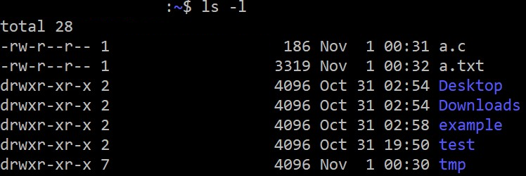
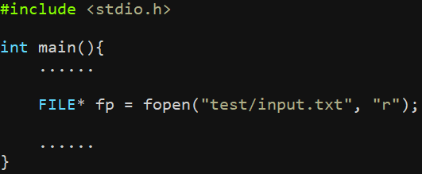
What is File system?
ext4
User
HDD
010101011101001010010
Access

Slide 5
Base File System

Slide 6
Base File System
To implement system call about file system, we need to understand base file system of Pintos
We need to interface to the file system code. So, we need to know API usage.
Pintos provides simple but complete file system. (Look filesys.h and file.h at filesys/)
Don’t need to understand whole structure of file system.
No need to modify the file system code for this project.

Slide 7
Base File System
Limitation of Base File System (See also p.23-24):
No internal synchronization
File size is fixed at creation time
File data is allocated as a contiguous range of sectors on disks
No subdirectories
File name length limitation (up to 14 characters)

Slide 8
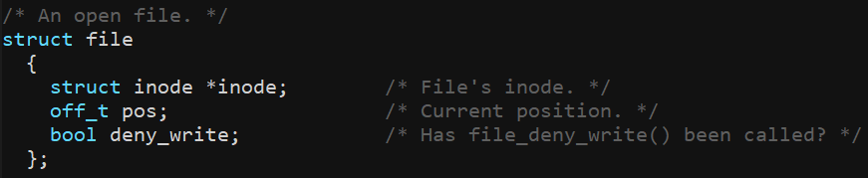
Base File System
Usage about file system on project 2
There is no sub-directories.
We assume that we work on root directory ( / ) of file system.
File access at Kernel
Can access through struct file (See filesys/file.c)
(At this project, it doesn’t need to access on inode level)

Slide 9
File System Call Implementation

Slide 10
File System Call Implementation
Basic file system usage interfaces:
fopen(…) / open(…)
Call fopen(or open) at user program
Interrupt 0x30 and call system call handler
Call open system call
At internal implementation of open, it calls filesys_open function and open that file
User
Kernel
Interrupt & System call handling
We need to implement
open(…)
filesys_open(…)

Slide 11
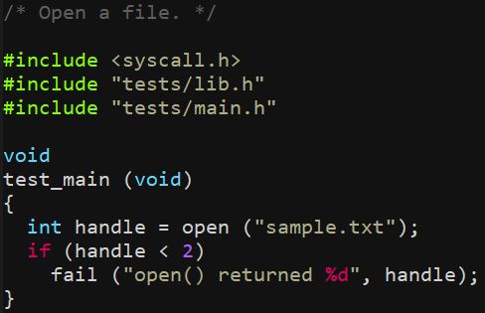
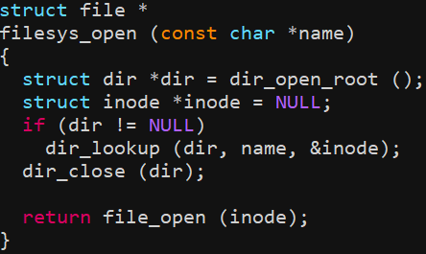
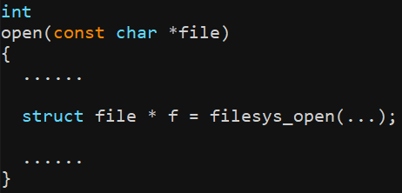
File System Call Implementation
Example in Pintos
System call acts like interfaces for calling file_xxx

Slide 12
File System Call Implementation
File Descriptor (Similar to FILE * of standard C)
Return value of open, create
At Pintos, each thread get and manage independent file descriptor.
File descriptor of STDIN, STDOUT, STDERR
STDIN = 0
STDOUT = 1
(At Linux or other OSes, STDERR = 2)

Slide 13
File System Call Implementation
read and write with stdin/stdout
Read from stdin – read(0)
Use uint8_t input_getc(void) (devices/input.c)
Write to stdout – write(1)
Use void putbuf(…) (lib/kernel/console.c)

Slide 14

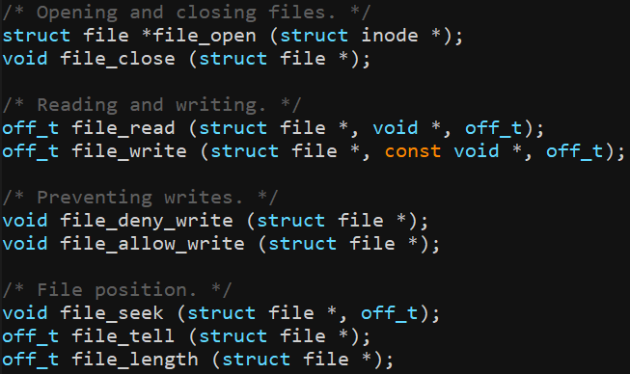
Useful APIs
filesys/filesys.h
filesys/file.h
Kernel Functions

Slide 15
Denying Writes to Executable files
Process is executed after load to memory.
So, removing executable file may not be a problem after executed.
But Pintos doesn’t want to delete executable file of running program.
These file system function may be useful for this problem:
void file_deny_write(struct file *) (filesys/file.c)
void file_allow_write(struct file *) (filesys/file.c)

Slide 16
Protect Critical Section
Critical Section
N Processes all competing to use some shared data
Each Process has a code segment, called critical section, in which the shared data is accessed
Problem: Ensure that when one process is executing in its critical section, no other process can execute in its critical section
Using test case of Pintos, check code segment that should be considered as critical section
Protect this code segment using synchronization APIs.
ex) syn-read, syn-write

Slide 17

Critical Section – Example in Pintos
thread 1
thread 2
User
read
write
Kernel
Need synchronization
syscall_handler
read
write
file_read
file_write
/foo.txt
Notes:
file_write should not be performed.

Slide 18
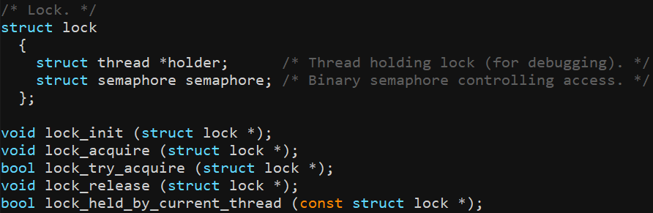
Synchronization APIs (See also p.67-68)
Lock

Slide 19
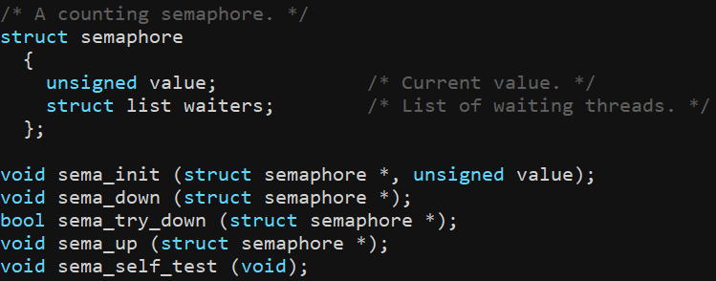
Synchronization APIs (See also p.67-68)
Semaphore

Slide 20
Evaluation and Submission

Slide 21
Evaluation
Rest of 76 tests remained from project 1 will be graded. (Total 55 of 76 tests)
Refer to the test case list in the next slide
Total score is 100 which consists of 80 for test cases and 20 for documentation
Grading script provided by Pintos will be used.
make grade or make check in src/userprog
Refer to “grade” and “results” files in src/userprog/build after grading
“grade” file is only created when you use make grade
Test cases are classified in functionality / robustness / base file system (filesys base)
Refer to the followings for checking each test case’s point based on the test type
tests/userprog/Rubric.functionality
tests/userprog/Rubric.robustness
tests/filesys/base/Rubric

Slide 22
Evaluation: Test Cases (55 tests)
User Program
Functionality
No. | Name | Point
1 | create-empty | 3
2 | create-long | 3
3 | create-normal | 3
4 | create-exists | 3
5 | open-missing | 3
6 | open-normal | 3
7 | open-twice | 3
8 | read-normal | 3
9 | read-zero | 3
10 | write-normal | 3
Functionality
No. | Name | Point
11 | write-zero | 3
12 | close-normal | 3
13 | rox-simple | 3
14 | rox-child | 3
15 | rox-multichild | 3
Total Score |  | 45

Slide 23
Evaluation: Test Cases (55 tests)
User Program
Robustness
No. | Name | Point
1 | close-stdin | 2
2 | close-stdout | 2
3 | close-bad-fd | 2
4 | close-twice | 2
5 | read-bad-fd | 2
6 | read-stdout | 2
7 | write-bad-fd | 2
8 | write-stdin | 2
9 | multi-child-fd | 2
10 | create-bad-ptr | 3
Robustness
No. | Name | Point
11 | exec-bad-ptr | 3
12 | open-bad-ptr | 3
13 | read-bad-ptr | 3
14 | write-bad-ptr | 3
15 | create-bound | 3
16 | open-boundary | 3
17 | read-boundary | 3
18 | write-boundary | 3
19 | create-null | 2
20 | open-null | 2
Robustness
No. | Name | Point
21 | open-empty | 2
22 | bad-read | 1
23 | bad-read2 | 1
24 | bad-write | 1
25 | bad-write2 | 1
26 | bad-jump | 1
Total Score |  | 56

Slide 24
Evaluation
User Program
Filesys
No-vm
No. | Name | Point
1 | multi-oom | 1
Total Score |  | 1
Base
No. | Name | Point
1 | sm-create | 1
2 | sm-full | 2
3 | sm-random | 2
4 | sm-seq-block | 2
5 | sm-seq-random | 3
6 | lg-create | 1
7 | lg-full | 2
8 | lg-random | 2
9 | lg-seq-block | 2
10 | lg-seq-random | 3
Base
No. | Name | Point
11 | syn-read | 4
12 | syn-write | 4
13 | syn-remove | 2
Total Score |  | 30
# of Total Tests |  | 55

Slide 25
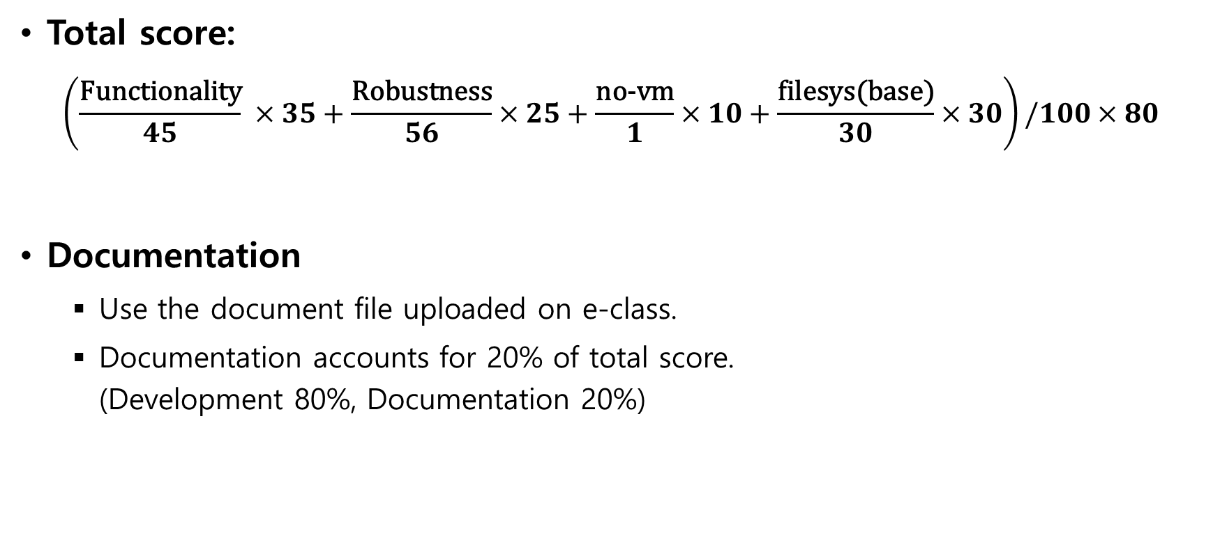
Evaluation
Total score: $\left(\frac{\text{Functionality}}{45} ×35+\frac{\text{Robustness}}{56}×25+\frac{\text{no}\text{−}\text{vm}}{1}×10+\frac{\text{filesys}\text{(}\text{base}\text{)}}{30}×30\right)/100×80$
Documentation
Use the document file uploaded on e-class.
Documentation accounts for 20% of total score. (Development 80%, Documentation 20%)

Slide 26
Submission
Make 'ID' directory and copy 'src' directory in the pintos directory and the document file ([ID].docx).
Compress 'ID' directory to 'os_prj2_[ID].tar.gz'.
We provide the script 'submit.sh' to make tar.gz file which contains 'src' directory and document file. 학생들의 편의를 위해 pintos 디렉토리 내 submit.sh 스크립트를 제공합니다. 이 스크립트는 src 디렉토리와 document file을 포함한 tar.gz 파일을 생성합니다.
Disclaimer
Any result produced from the 'submit.sh' script is at your own risk.
You must check the contents of the tar.gz file before submission.
'submit.sh' 스크립트로 생성된 결과의 모든 책임은 사용자에게 귀속됩니다.
제출하기 전, tar.gz 파일의 내용물을 반드시 다시 한 번 체크하기 바랍니다.

Slide 27
Submission
Notice – ‘submit.sh’
The ‘submit.sh’ script should be executed on a directory where ‘src’ folder is located.
submit.sh 스크립트는 src 폴더가 위치한 디렉토리에서 실행되어야 합니다.
‘ID’ folder should not be in the directory.
해당 디렉토리에 ‘학번’ 폴더가 없어야 합니다.
‘ID.docx’ file should be located in the directory.
Also, report file with extensions other than ‘docx’ will not be compressed.
해당 디렉토리에 ‘학번.docx’ 파일이 있어야 함께 압축됩니다.
또한 ‘docx’ 이외의 확장자를 가진 보고서 파일은 압축되지 않습니다.
Be sure to backup your code in case of an unexpected situation.
만일의 경우를 대비해 반드시 코드를 백업하여 주세요.

Slide 28
Submission
It is a personal project.
Due date : 2020. 11. 15 23:59
Submission
The form of submission file is as follows:
No hardcopy.
Copy will get a penalty (1st time: 0 Point and downgrading, 2nd time: F grade)
Name of compressed file | Example (ID: 20189999)
os_prj2_[ID].tar.gz | os_prj2_20189999.tar.gz

Slide 29
Submission
Contents
Pintos source codes (Only 'src' directory in pintos directory) 최소한의 용량을 위해 src 디렉토리만 압축파일에 포함합니다.
Document: [ID].docx (e.g. 20189999.docx; Other format is not allowed such as .hwp)
How to submit
Make tar.gz file.
Copy the document file ([ID].docx) to pintos directory.
Execute submit.sh script in the pintos directory and follow the instructions of the script. pintos 디렉토리 내의 submit.sh 스크립트를 실행하고 스크립트의 지시를 따르십시오.
Check that os_prj2_[ID].tar.gz is created.
Decompress os_prj2_[ID].tar.gz and check the contents in it. ($ tar -zxf os_prj2_[ID].tar.gz) (Only [ID].docx and src directory should be contained in the tar.gz file.)
For example, if your ID is 20189999, os_prj2_20189999.tar.gz should be created. To decompress the tar.gz file, execute tar -zxf os_prj2_20189999.tar.gz
Please check the contents of tar.gz file after creating it.
Upload the os_prj2_[ID].tar.gz file to e-class.
5% of point will be deducted for a wrong form and way to submit.
Late submission is allowed up to 3 days (~11/18) and 10% of point will be deducted per day.

