Slide 1
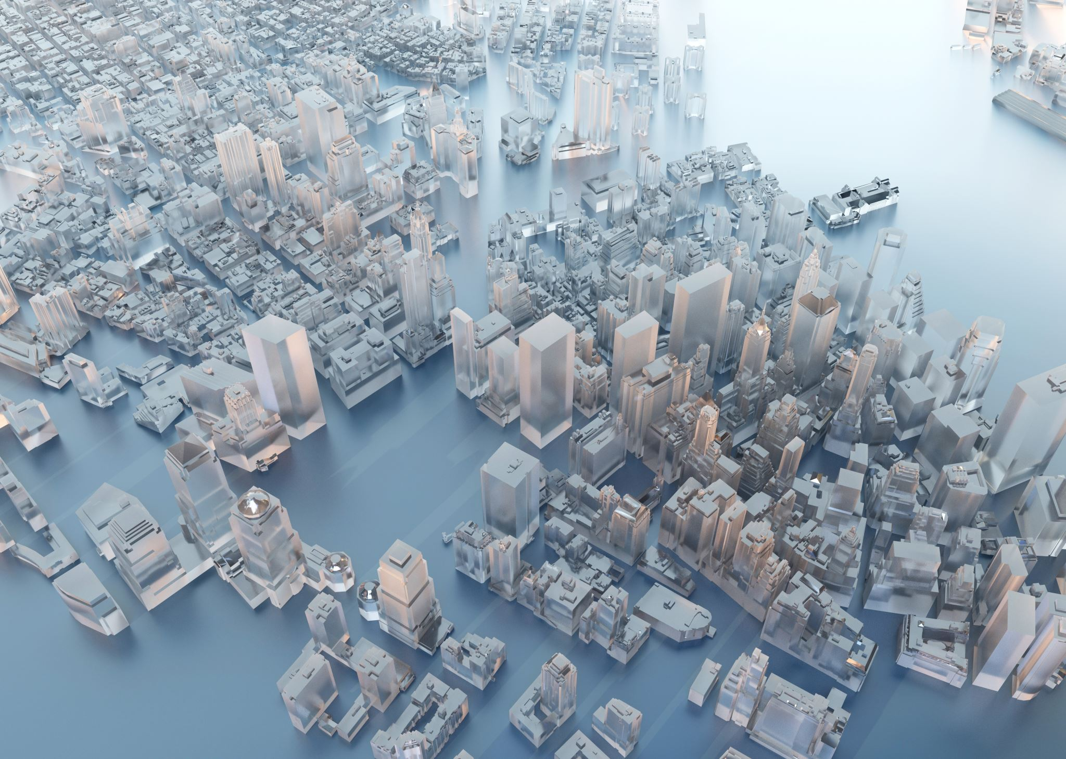
How cities change?
Migration and rapid urbanisation
Urban dynamics: urban sprawl, gentrification and urban decay

Slide 2
Key terms: migration
Migration > movement of people.
Different reasons: for work, for family, for the chance of a better life.
Different ways: we move around the block, to the next town, to a different state, or even to the other side of the world.
Internal migration > movements within the same country.
International migration > different countries.
Emigrate > to leave one's country to live in another.
Immigrate > to come into another country to live permanently.

Slide 3
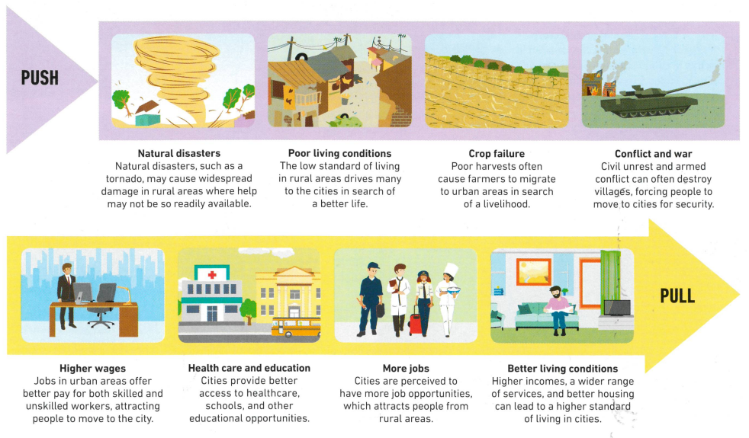
Push and pull factors
The movement of people from rural to urban areas is caused by push and pull factors.
These factors may be stronger in LICs (low – income countries) than in HICs (high – income countries).

Slide 4
Quick think:
Categorise each of the push and pull factors into political, social, economic and environmental factors of migration to cities.
Political | Social | Economic | Environmental

Slide 5
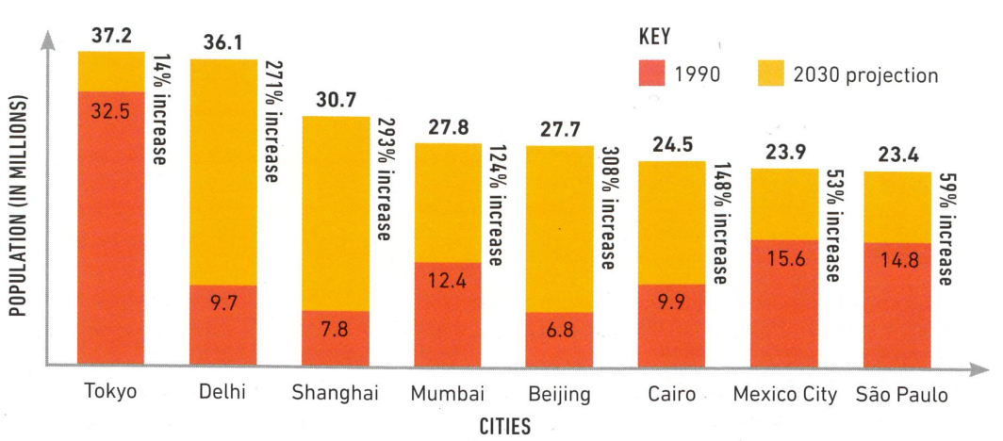
Rapid urbanisation
It is estimated that by 2050 more than two-thirds of the world’s population will be living in urban areas. This rapid increase will take place mainly in developing countries. Africa and Asia will have the fastest urban growth rates.
Carefully examine the graph:
Identify the SALTS. Which are missing?
Where are these cities located? (Continent / region / country)
Which are the three top cities that will experience the highest increase in population by 2030?
Brainstorm advantages and disadvantages of rapid population growth in cities. How would these cities change?

Slide 6
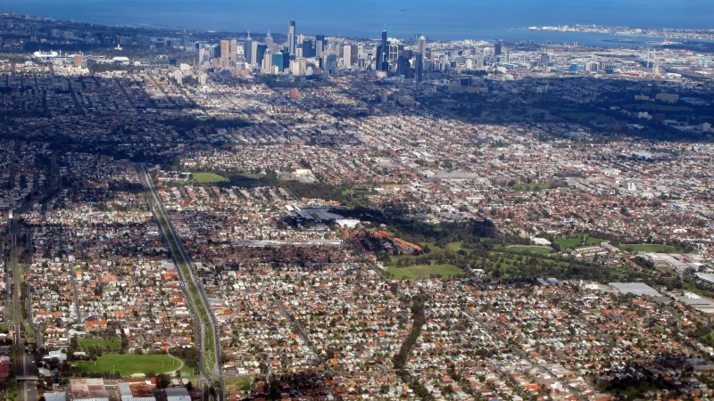
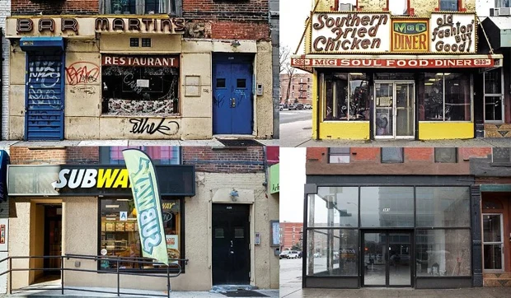
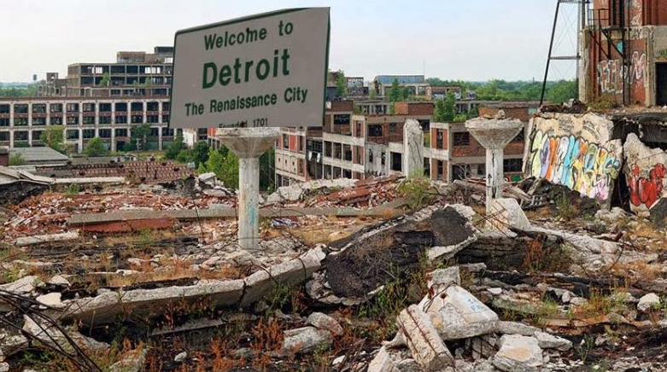
Urban Dynamics
Cities are dynamic landscapes.
Their shape and character experience constant change. Overtime, they respond to a range of economic, political, social and technological changes.
Sometimes these changes initiate growth (such as urban sprawl), revival (such as gentrification) or decline (such as urban decay).
Urban sprawl | Gentrification | Urban decay
Urban sprawl refers to the rapid expansion of the geographic extent of cities, often characterized by low-density housing and increased reliance on cars for transportation. Urban sprawl is caused in part by the need to accommodate a rising urban population, as well as from a desire for increased living space, as exemplified by the growth of Melbourne. | Gentrification refers to the process whereby the character of a poor urban area is changed by wealthier people moving in, improving housing, and attracting new businesses, often displacing current inhabitants in the process changing the character of a suburb or street as shown in the changes of shop fronts in New York (USA). | Urban decay involves the deterioration of the parts of a city, with infrastructure falling into disrepair and buildings abandoned for long periods of time. Reasons for urban decay include the decline in manufacturing, like in the case of Detroit (USA) which experienced significant decay following the closure of car manufacturing.

