Slide 1
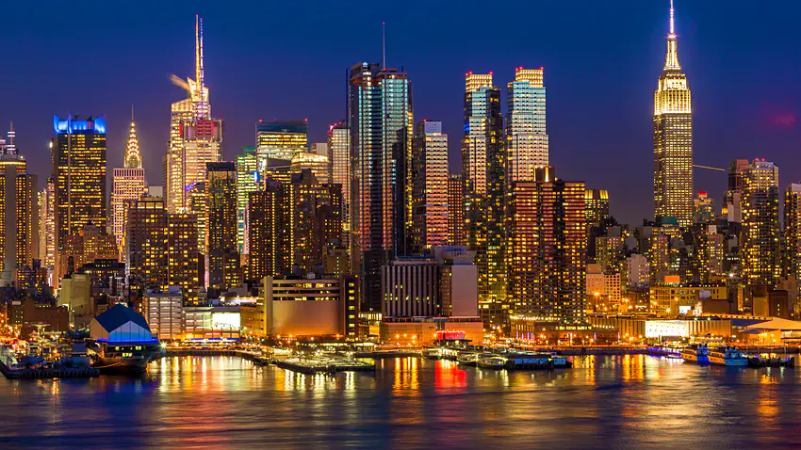
Human Landscapes: Cities
What are cities and how are they organised?

Slide 2
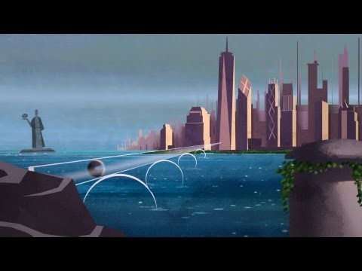
As you watch:
Why do people live in cities?
What are the challenges facing future cities?
Urbanisation and Future Cities
Urbanisation:
an increase in the proportion of people living in urban areas (towns and cities).

Slide 3
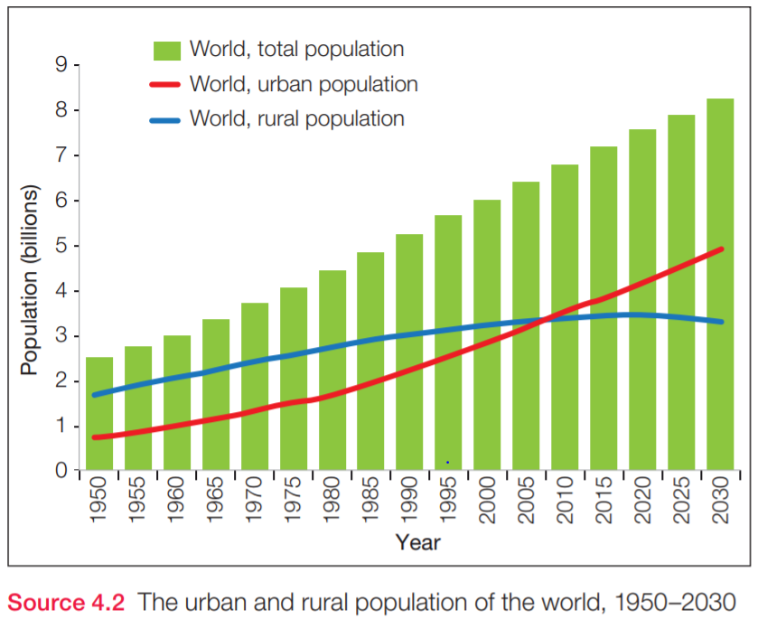
Urban Explosion
1950 | 2021
World population: 2.5 bln Seven cities with more than 5 mln population Largest city: New York (12 mln) | World population: 7.9 bln 34 megacities > population over 10 mln Largest city: Tokyo (37.3 mln)
Quick think: Why did the world experience an “urban explosion” in the past 80 years?

Slide 4
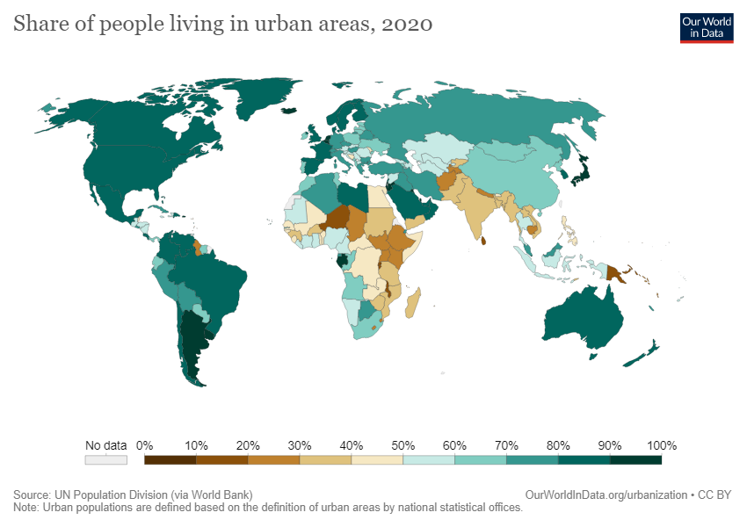
Pattern:
Quantification:
Exception:

Slide 5
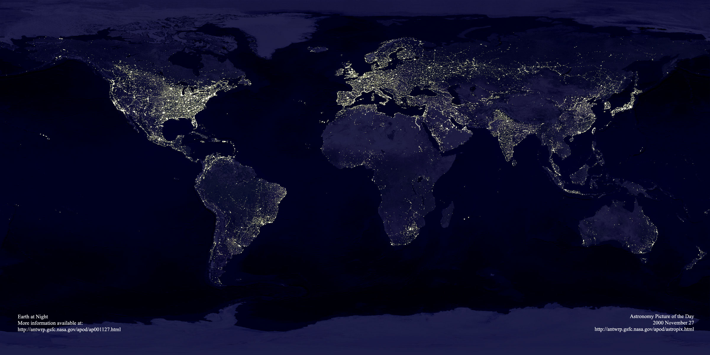
Why are cities located where they are?

