Slide 1
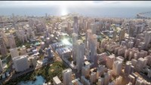
Future Cities
While you watch this short documentary on future cities, think which of these solutions will lead to cities to become more:
Accessible
Efficient
Ethical

Slide 2
Efficient
Ethical
Accessible
Sustainable Cities:
Solutions

