Slide 1
Groovy On Rails

Slide 2
What is Grails?
Grails (previously known as «Groovy on rails» is a programming framework based on Groovy and inspired by ruby on rails).
Grails promotes «codding by convention», developing web practices and is meant to be higly productive.
Grails
Groovy
On rails (ruby on rails inspiration)

Slide 3
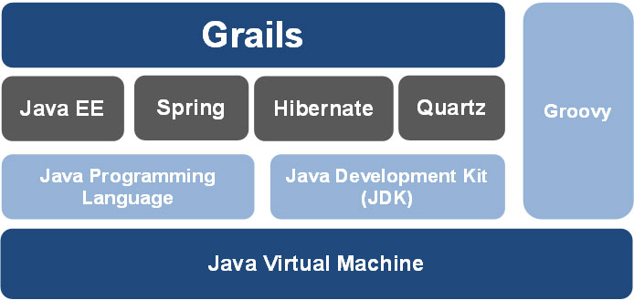
Grails architecture

Slide 4
Groovy

