Slide 1

The Rough Guide to GnRH Neurons, Ephrin Signaling and Neural Migration
or .....
Disruption of Ephrin Signaling Associates with Disordered Axophilic Migration of the Gonadotropin-Releasing Hormone Neurons.
J. Neurosci. March 23, 2005 25(12): 3142-3150

Slide 2
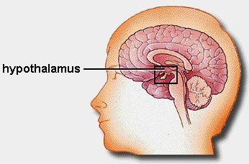
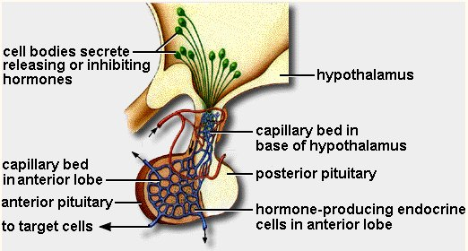
GnRH Neurons Regulate Fertility
FSH = follicle stimulating hormone
LH = luteinising hormone
GnRH = gonadotrophin releasing hormone
GnRH neurons: ~ 1000 located in hypothalamus
Primary neural regulators of fertility
Ovaries: follicle growth, oocyte maturation, oestrogen production, ovulation
Testes: production / release of testosterone, spermatogenesis

Slide 3
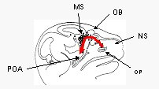
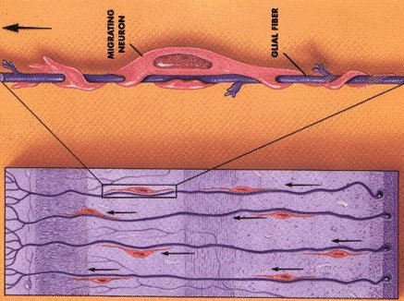
Development of GnRH Neurons
Axophilic migration
Appear at E11 in olfactory placode.
Axophilic migration along vomeronasal nerve from nose into brain.
Final position in basal forebrain by E17 – diffuse continuum.

Slide 4
Conditional Ablation of GnRH Neurons
Bacterial Nitroreductase gene
Driven by 5.5kb of GnRH promoter
Specific expression in GnRH neurons
5.5kb
NR
NR
CB1954
Prodrug activated by NR
CB1954
NR
Dna alkylation and cross-linking
Cell death

Slide 5
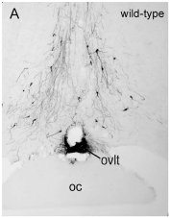
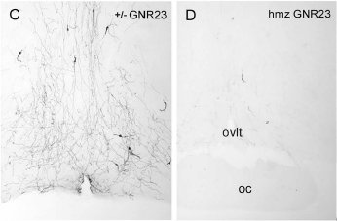
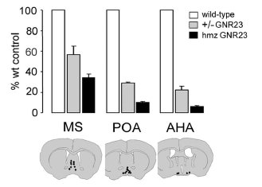
Reduced Numbers of GnRH Neurons in GNR23 Mouse Brains
WT
HTZ
HMZ
Coronal section: pre-optic area
Transgene is NOT expressed in GNR23 mice.
< 40% fewer neurons in heterozygotes
< 15% fewer in homozygotes
Fewer neurons further into brain
Nose
Brain

Slide 6
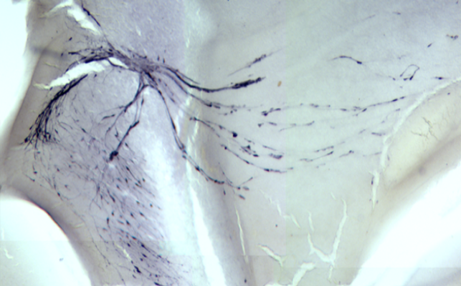
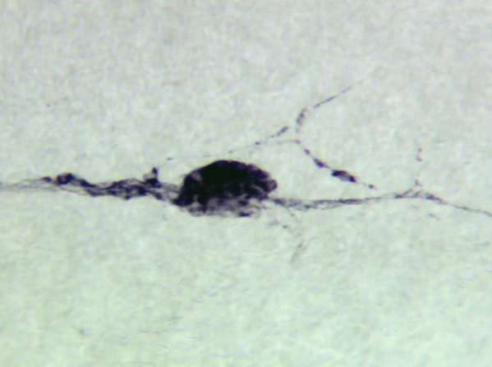
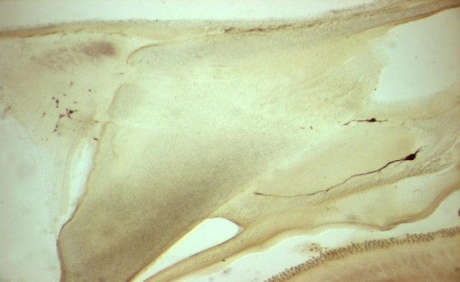
GnRH Neurons Fail to Migrate into the Brain of GNR23 Mice
Most GnRH neurons fail to migrate out of the nose
Remain clumped in the nose
Large “cannonball” structures
MS
vno
E14.5 wild-type
E18.5 GNR 2300
MS
Brain
Nose

Slide 7
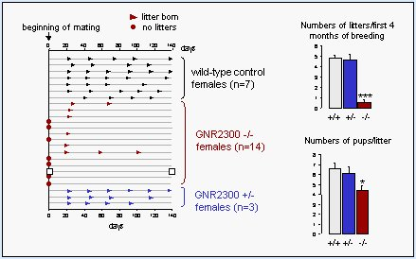
Reduced Fertility in GNR23 Mice
Males exhibit normal fertility – even with only 70 GnRH neurons.
Heterozygous females have normal fertility.
Homozygous females are either infertile, or exhibit much reduced fertility.

Slide 8
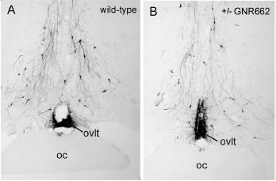
GNR23 Mice: Cause of Phenotype?
Defective migration of GnRH neurons during embyonic development
- neurons remain (mostly) stuck in the nose
- effects on fertility in homozygous females
- other neuron types unaffected
Phenotype NOT due to:
- Tg expression (see GNR662 line)
- integrated GnRH sequences (previous work)
WT
GNR662
Has Tg insertion disrupted gene(s) essential for neural migration?

Slide 9
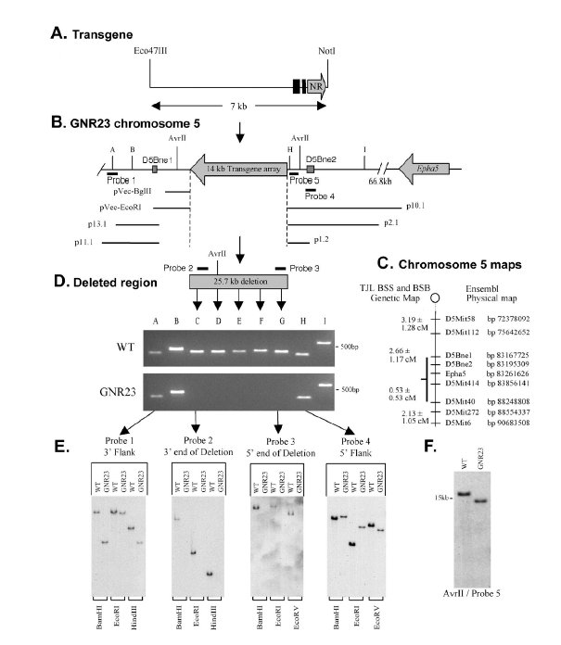
Identification and Characterization of Transgene Integration Site
Tg integrated into anti-sense strand of chromosome 5.
Integration site mapped to 67kb proximal to Epha5 gene.
Resulting deletion of 25.7kb of genomic DNA.
Approx. 14kb of Tg-specific DNA integrated
No other genes located / predicted 500kb on either side of integration site.

Slide 10
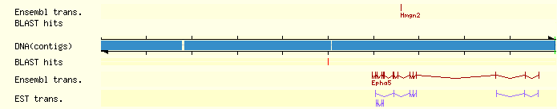
Ensembl View: Transgene Integration Site on Mouse Chromosome 5
Transgene integration site
1 MB

Slide 11
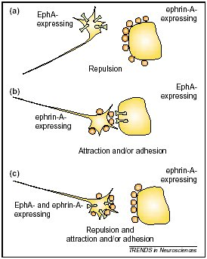
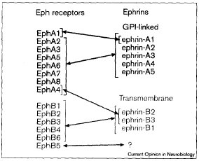
Eph / Ephrin Family: Cell Contact-Dependent Signaling During Nervous System Development
Eph receptors : receptor tyrosine kinases
Bi-directional signalling: both receptor and ligand
Repulsive and attractive interactions mediate cell-boundary formation and axon guidance in neural development

Slide 12
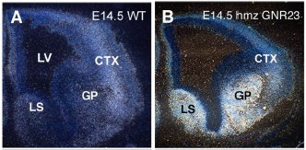
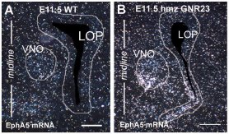
EphA5 is upregulated in GNR23 brain and in migrating GnRH neurons
Coronal view of E14.5 brains.
Substantial upregulation of Epha5 in GNR23 lateral septum (LS) and globus palidus (GP).
mRNA (ISH)
Coronal view of E11.5 nose.
Increased Epha5 expression in developing GnRH neurons
mRNA (ISH)

Slide 13
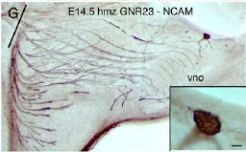
How Does Upregulated EphA5 Affect GnRH Neuron Migration?
Mechanism unclear at present.
Increased EphA5 signaling leads to increased adhesiveness
GnRH neurons in GNR23 mice express high levels of PSA-NCAM
Possible mechanism?

Slide 14
Deregulated Eph / Ephrin Signaling: a Possible Cause of Human Infertility?
GnRH neurons regulate fertility
Defective GnRH neuron migration can cause infertility in humans
Kallman's Syndrome:
olfactory nerve fails to enter brain
GnRH neurons also cannot enter brain
KAL-1 gene (anosmin-1)
FGFR1 (fibroblastic growth factor receptor-1)
Eph/ephrin signaling defects may underlie some cases of human infertility

Slide 15
Could Deleted DNA Cause Epha5 Upregulation?
Integration site mapped to 67kb proximal to Epha5 gene.
Resulting deletion of 25.7kb of genomic DNA.
Transcriptional repressor element removed?

Slide 16
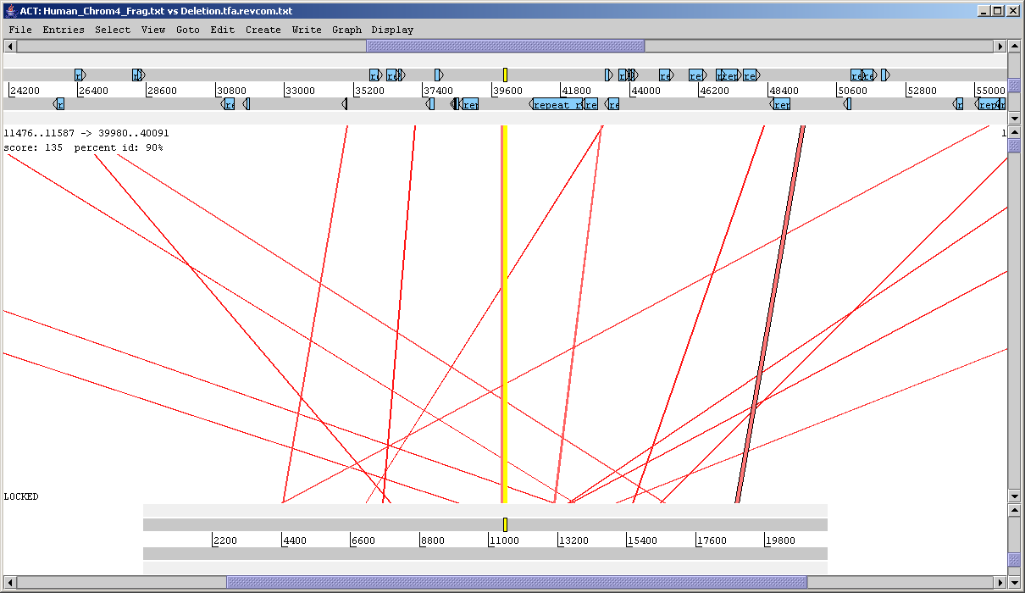
Identification of Conserved Non-Coding Sequences
25.7kb deletion located 67kb 3’ (proximal) of Epha5
Transcriptional repressor element removed?
Human
Cross – Species Sequence Comparison
Conserved Non-coding Sequences – putative long range regulatory elements
Typically > 100bp and > 70% identity (Loots et al. Science 288, April 2000, 136-140.
Mouse
CNS-111: 90% identical, over 111bp
CNS-152: 87% identical over 152bp
Synteny plot (ACT): compares deleted mouse DNA with corresponding human DNA.
Sequence identity threshold set at 70%.

Slide 17
Transcription Factor Binding Sites in CNS-111 and CNS-152 (TESS)
CNS-111
RAR-gamma * (6-mer) activator/repressor
GR (6-mer)
NF-1 * (6-mer) activator (?)
CNS-152
HES-1 * (6-mer)
PU.1 (6-mer)
GR (6-mer)
PEA3 * (6-mer) activator
NF-ATp * (6-mer) DNA bdg.
NF-A3 (9-mer)
Oct-6 * (9-mer) activator
Oct-4 * (8-mer) activator
Transcription Element Search System (TESS)
(http://www.cbil.upenn.edu/tess/)
Searched only for mouse TFs
Only highest scoring hits shown
Mostly short sequences
Significance …..?
* = found in brain

Slide 18
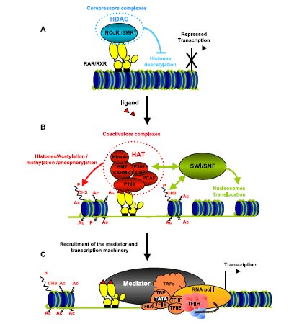
Retinoic Acid Receptor-Gamma (RAR-γ) Can Function as a Transcriptional Repressor
RARs dimerised, bound to DNA and co-repressor proteins
Actively repress transcription
Retinoic Acid
Conformation change
Dissociation of co-repressors
Binding of co-activators
PolII transcription
Schematic illustration of transcriptional regulation by RAR receptors (Bastien. 2004. Gene 328: 1-16).

Slide 19
Experiments In Vitro
Reporter gene experiments in transfected neural cells.
Luc
Transfect and assay expression levels of Luciferase
+/- RA
Luc
Luc
Nuclear extracts from neural cells +/- retinoic acid
- band-shift assays (identifies regions bound by TFs)
- add antibody → supershift on gel (identity of TF)

Slide 20
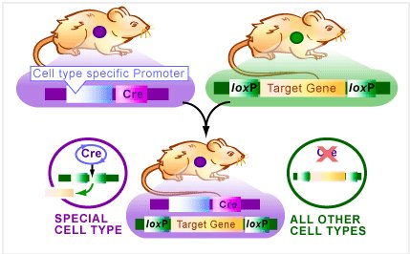
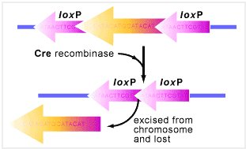
Tissue-Specific Deletion Using Cre-LoxP Transgenics
Fig.1
Region of interest is flanked with loxP sites
Cre recombinase excises region between two loxP sites
Fig.2
Mice expressing Cre under control of GnRH promoter → only expressed in GnRH neurons
Breed Cre mice with "floxed" mice
Specific deletion only in GnRH neurons

Slide 21
Summary….
Non-expressing transgene
Integrated 67kb downstream of Epha5
Caused deletion of 25.7kb DNA
Epha5 expression levels increased in nascent GnRH neurons
GnRH neurons unable to migrate normally into brain
Possible deletion of tissue-specific repressor element(s)

Slide 22
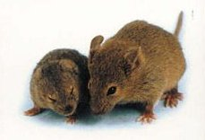
A Cautionary Note…..
Correlation – not proof….
GnRH promoter
Recreate phenotype with GnRH – Epha5 transgenic mouse
Epha5

Slide 23
The GNR23 Mouse Project
John Gamble
Delicia Karunadasa
Jean-Remi le Pape
Mike Skynner
Martin Todman
John Bicknell
Jeremy Allen
Allan Herbison

