Slide 1
RouTING
Presented by:
S.Jagannathan,
ME-VLSI & Embedded,
MIT, Anna University

Slide 2
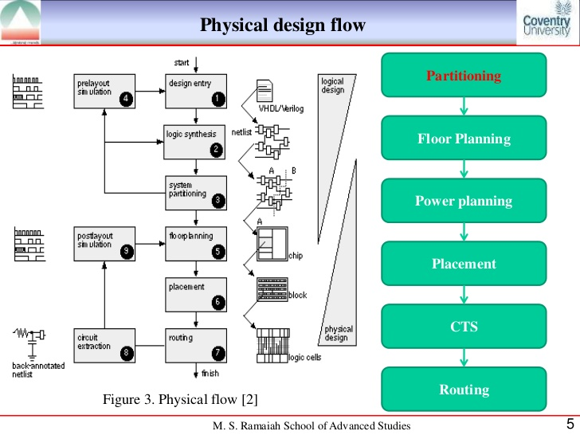
Physical Design flow of ASIC

Slide 3
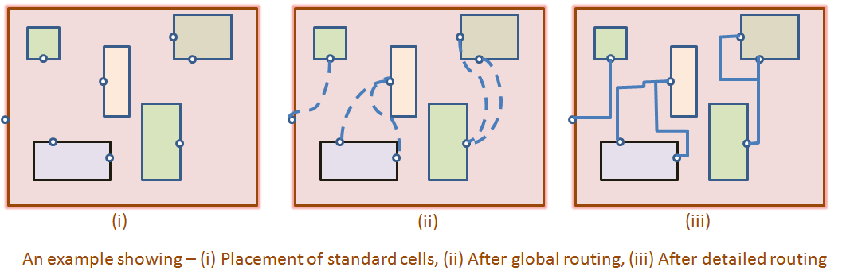
What is Routing?
Routing is the process of selecting the route or path for connecting the two nodes or cells.
The routing is to locate a set of wires in the routing space that connect all the nets in the net list.
The capacities of channels, width of wires, and wire crossings often need to be taken into consideration

Slide 4
Overview of Routing
Detailed Routing
Find the actual geometry of each net within the assigned routing regions.
Circuit Extraction
Floorplan
Global Routing
Netlist contains details about
Locations of all fixed and flexible blocks.
placement information for flexible blocks
Locations of all the logic cells.
Generate a rough route for each net without specifying actual layout of the wires.
23

Slide 5
Global Routing
Objectives of Global Routing:
Minimize the total interconnect length.
Maximize the probability that the detailed router can complete the routing.
Minimize the critical path delay.
When Placement is Given
Region assignment: All routing region is partitioned into simpler regions.
Routing Graph: A routing graph can be defined.
Global Routing took place.
Detailed Routing took place.

Slide 6
Region assignment
Here routing region is assigned to each net.
How to define these regions?
Partition the routing area into a set of non-intersecting rectangular regions.
Types of routing regions:
Horizontal channel: Parallel to the x-axis with pins at their top and bottom boundaries.
Vertical channel: parallel to the y-axis with pins at their left and right boundaries.
Switchbox : rectangular regions with pins on all four sides.

Slide 7
Grid Graph Model : Illustration
Define a graph:
– Each cell c_{i} is represented as a vertex v_{i}.
– Two vertices v_{i} and v_{j} are joined by an edge if the
corresponding cells c_{i} and c_{j} are adjacent.
– A terminal in cell c_{i} is assigned to the corresponding vertex v_{i}.
– The occupied cells are represented as filled circles,
whereas the others as clear circles.
– The capacity and length of each edge is set to one.

Slide 8
Sequential Approaches
Nets are routed sequentially, one at a time.
First an ordering of the nets is obtained based on:
Number of terminals
Bounding box length
Each net is then routed as dictated by the ordering.
Most of these techniques use variations of maze running or line search methods

Slide 9
Hierarchical Approaches
Use the hierarchy of the routing graph to decompose a large routing problem into sub problems of manageable size.

Slide 10
Global Routing Between Blocks
Global routing for a cell-based ASIC
A cell-based ASIC
with numbered channels.
The channels form
the edges of a graph.
The channel-intersection graph

Slide 11
Example: global routing for a net with five terminals
Terminals in cell based
ASIC
A minimum-length tree
for the nets
A minimum-delay tree
for the nets
The global router can allocate as many interconnects to each channel as it likes, but there is a maximum number of interconnects that each channel can hold.
If the global router needs more room, even in just one channel on the whole chip, the designer has to repeat the placement-and-routing steps and try again

Slide 12
Global Routing Inside Flexible Blocks
Global Routing Inside Flexible Blocks is illustrated in Sea of gates.
The Sea of gates consist of
gate array base cells are arranged in 36 blocks.
Each block consist of an array of 8-by-16 gate-array base cells.
Hence a a total of 4068 base cells

Slide 13
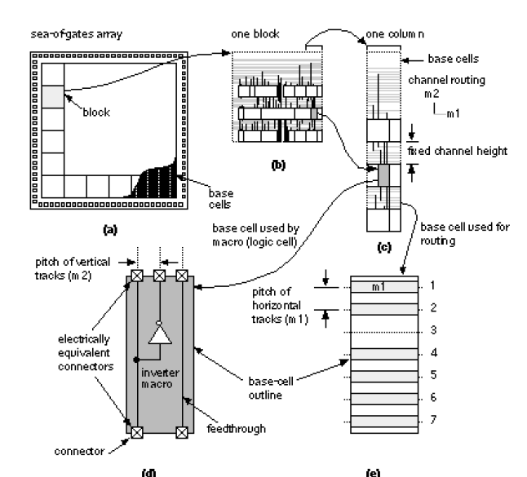
Global Routing in sea of gates
In sea of gates,
Top channel - array of 3 gate array base cells.
7 horizontal wiring tracks in single row of gate array base cells.
Thus, channel capacity is 7.

Slide 14
Back annotation
After global routing is complete it is possible to accurately predict,
what the Length and Size of each interconnect in every net.
Resistance and Capacitance of each path in each net.
But only after detailed routing only we will exactly tell about the length and size of the interconnect.
We can back-annotate this net delay information to the synthesis tool for in-place optimization or to a timing verifier to make sure there are no timing surprises.

Slide 15
Thank you

