Slide 1
Energy Efficient mac protocol
Presented by
S.Jagannathan
MIT,chennai

Slide 2
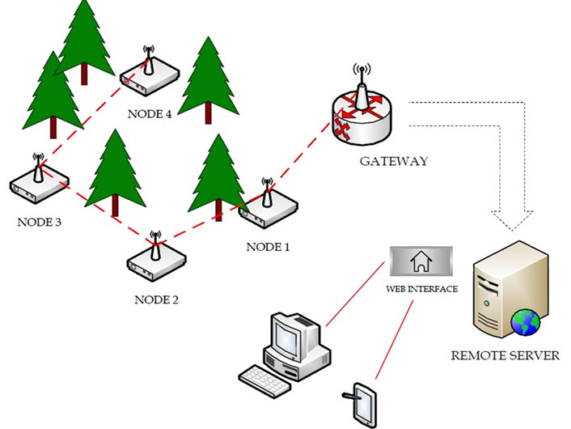
What is wireless sensor network
Network of devices that can communicate the information gathered from a monitored field through wireless links.

Slide 3

Some Applications of Sensor Networks
Data Collection Networks
Sensing Movement of Glaciers
Environment Monitoring
Event Triggered Networks
Military Applications
Environment Monitoring
Poisonous gas, pollutants etc.
National Asset Protection
Border Patrol,Oil/gas pipelines.

Slide 4
Evolution
Adaptive Rate Control
ARC
IEEE 802.3
IEEE 802.11
CSMA/CD
CSMA/CA
SMAC
TMAC
Carrier Sense Multiple Access with Collision Detection
Carrier Sense Multiple Access with Collision Avoidance
Fixed duty cycle
Adaptive duty cycle
DMAC/
MMAC
Directional Antennas

Slide 5
Medium Access Control in Sensor Nets
Important attributes of MAC protocols
Collision avoidance
Energy efficiency
Scalability in node density
Latency
Fairness
Throughput
Bandwidth utilization
^{Primary}
^{Secondary}

Slide 6
Reason of Energy Waste
Major sources of energy waste (cont.)
Idle listening
Long idle time when no sensing event happens
Collisions
Control overhead
Overhearing
We try to reduce energy consumption from all above sources
Combine benefits of TDMA + contention protocols
^{Dominant in sensor} ^{nets}
Common to all wireless networks

Slide 7
Existing MAC Protocols
Sensor-MAC (S-MAC) : Listen-sleep
Timeout-MAC (T-MAC) : Activation event
WiseMAC : Preamble Sampling

Slide 8
Sensor-MAC (S-MAC) Design
Tradeoffs
Major components in S-MAC
Periodic listen and sleep
Collision avoidance
Overhearing avoidance
Massage passing
^{Latency}
^{Fairness}
^{Energy}

Slide 9
Periodic Listen and Sleep
Problem: Idle listening consumes significant energy
Solution: Periodic listen and sleep
Turn off radio when sleeping
Reduce duty cycle to ~ 10% (200ms on/2s off)
listen
sleep
listen
sleep
^{Latency}
^{Energy}

Slide 10
Periodic Listen and Sleep
Schedules can differ
Prefer neighboring nodes have same schedule
— easy broadcast & low control overhead
^{Node 1}
listen
sleep
listen
sleep
^{Node 2}
listen
sleep
listen
sleep
^{Schedule 1}
^{Schedule 2}
1
2

Slide 11
Overhearing Avoidance
Problem: Receive packets destined to others
Solution: Sleep when neighbors talk
Basic idea from PAMAS (Singh, Raghavendra 1998)
But we only use in-channel signaling
Who should sleep?
All immediate neighbors of sender and receiver
How long to sleep?
The duration field in each packet informs other nodes the sleep interval

Slide 12
Message Passing
How to efficiently transmit a long message?
Single packet vs. fragmentations
Single packet: high cost of retransmission if only a few bits have been corrupted
Fragmentations: large control overhead (RTS & CTS for each fragment), longer delay
Problem: Sensor network in-network processing requires entire message

Slide 13
Message Passing
Solution: Don’t interleave different messages
Long message is fragmented & sent in burst
RTS/CTS reserve medium for entire message
Fragment-level error recovery — ACK
— extend Tx time and re-transmit immediately
Other nodes sleep for whole message time
^{Fairness}
^{Energy}
^{Msg-level latency}

Slide 14
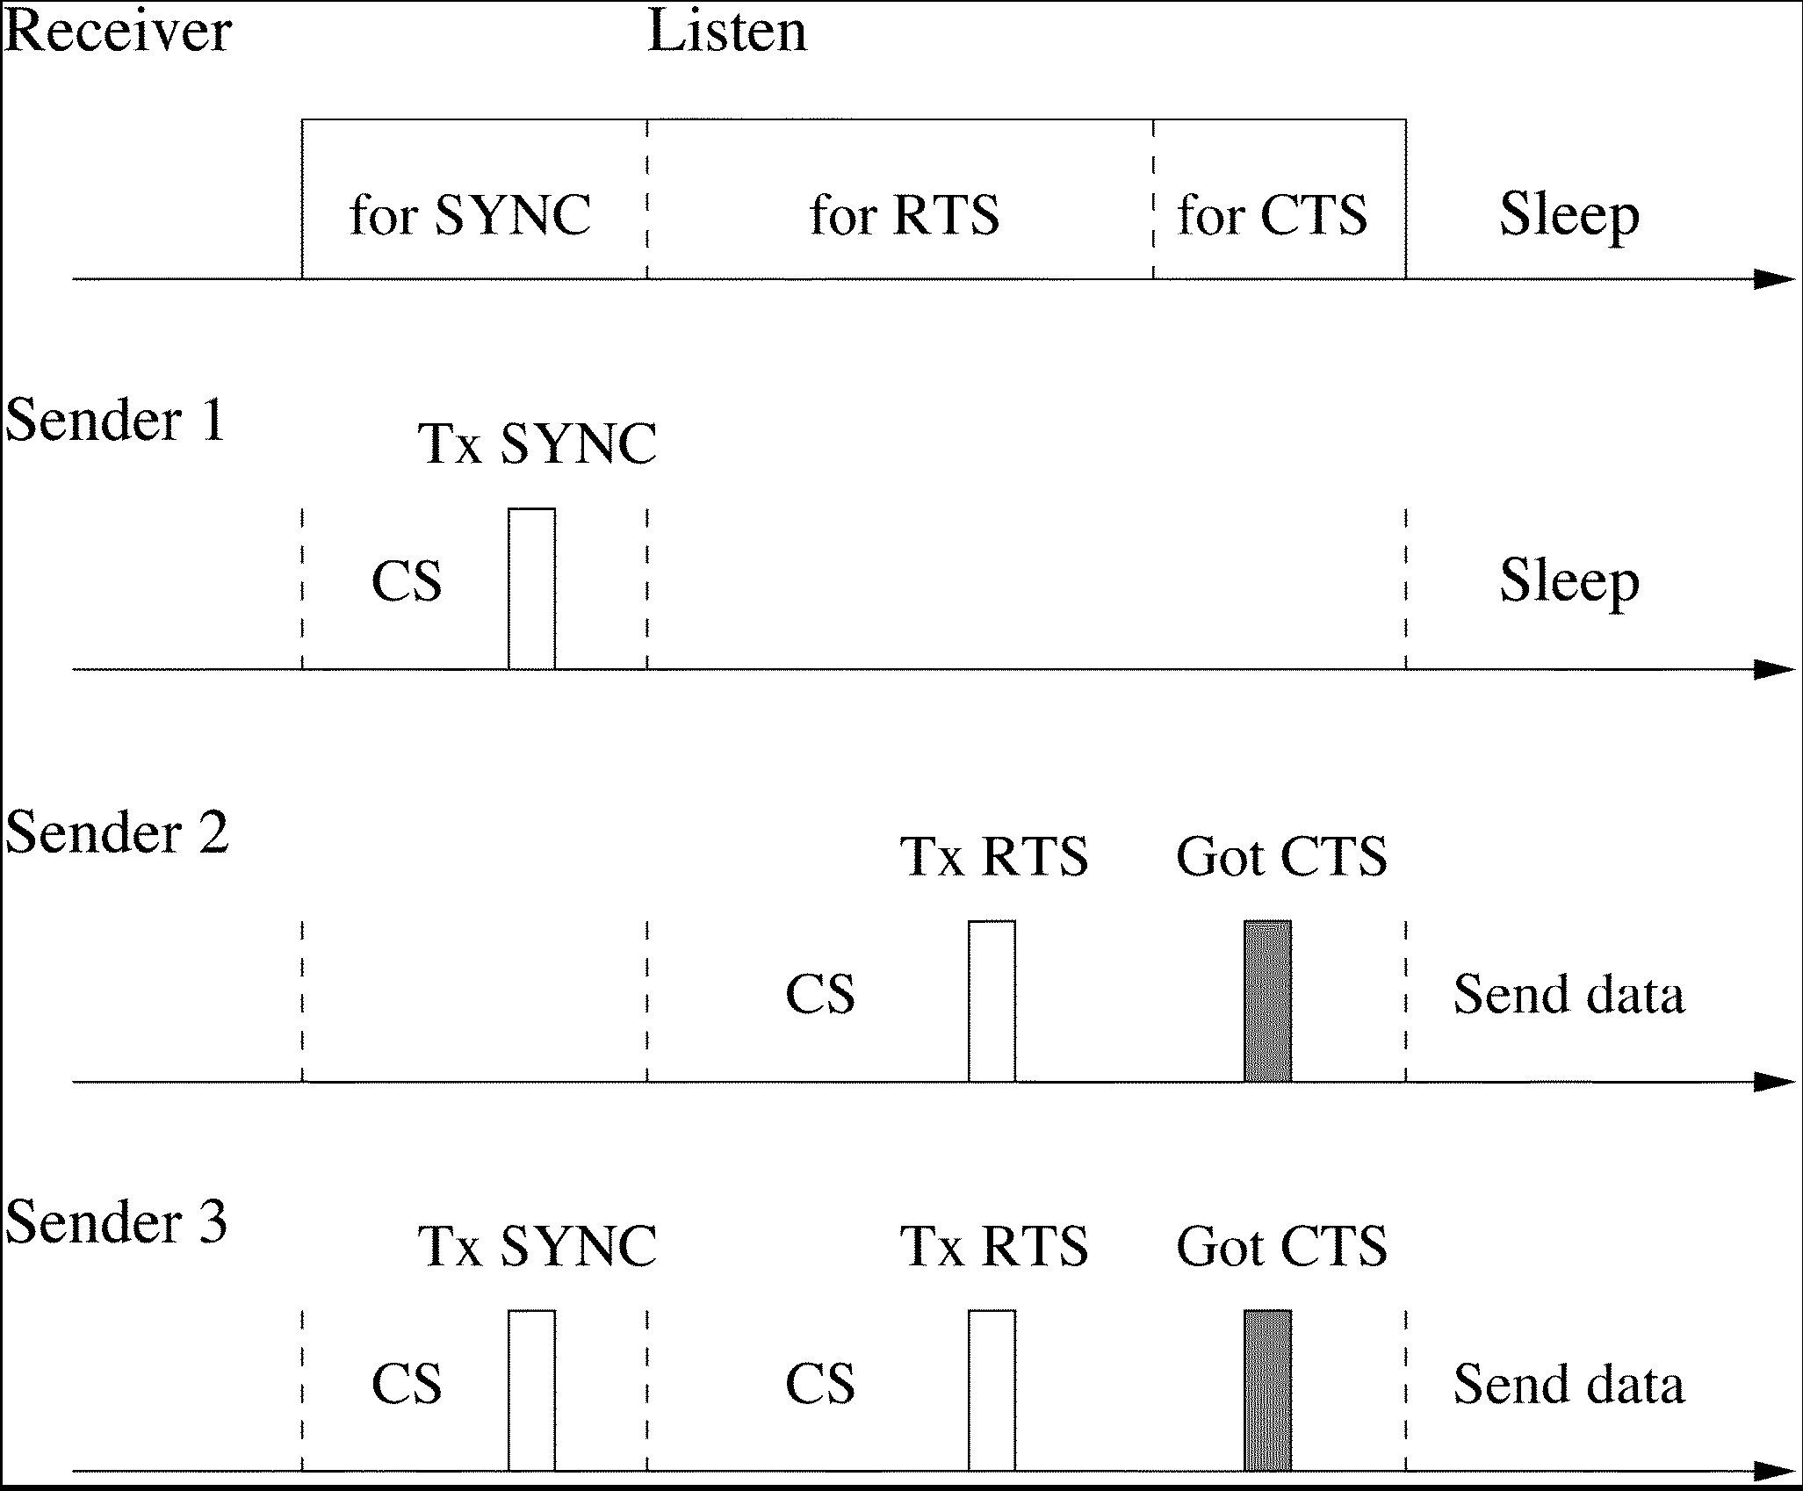
S-MAC

Slide 15
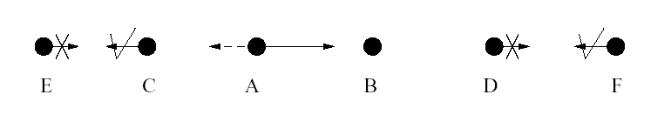
Example
Who should sleep when node A is transmitting to B?
All immediate neighbors of both sender & receiver should go to sleep

Slide 16
Experiment Result
Average energy consumption in the source nodes
1800
Average source nodes energy consumption
S-MAC consumes much less energy
than 802.11-like protocol w/o sleeping
At heavy load, overhearing avoidance is
the major factor in energy savings
At light load, periodic sleeping plays the key role
1600
1400
802.11-like protocol
without sleep
1200
1000
Energy consumption (mJ)
800
Overhearing
avoidance
600
400
S-MAC w/o adaptive listen
200
0
2
4
6
8
10
Message inter-arrival period (second)

Slide 17
S-MAC Conclusions
Advantages:
S-MAC offers significant energy efficiency over always-listening MAC protocols.
S-MAC can function at 10% duty cycle.
Disadvantage
Sleep and listen periods are predefined and constant which decreases the efficiency of the algorithm under variable traffic load.

Slide 18
Timeout-MAC (T-MAC) Protocol
Proposed to enhance the poor results of S-MAC protocol under variable traffic load.
Listen period ends when no activation event has occurred for a time threshold TA.
Reduce idle listening by transmitting all messages in bursts of variable length, and sleeping between bursts.
times out on hearing nothing.

Slide 19
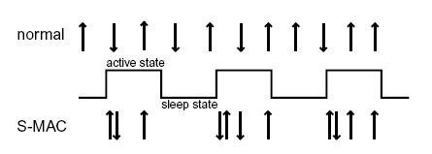
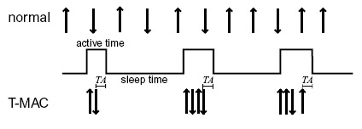
S-MAC Vs T-MAC

