Slide 1
Brain Tumor Detection
By: Jagandeep Singh

Slide 2

Why is it Important?
Brain Tumors are complex. There are a lot of abnormalities in the sizes and location of the brain tumor.
A professional Neurosurgeon is required for MRI analysis.
In developing countries, the lack of skillful doctors and lack of knowledge about tumors makes it challenging and time-consuming to generate reports from MRI. So, an automated system on Cloud can solve this problem.

Slide 3
Deep Learning Techniques
CNN (Convolutional Neural Network)
TL (Transfer Learning)

Slide 4
Dataset

Slide 5
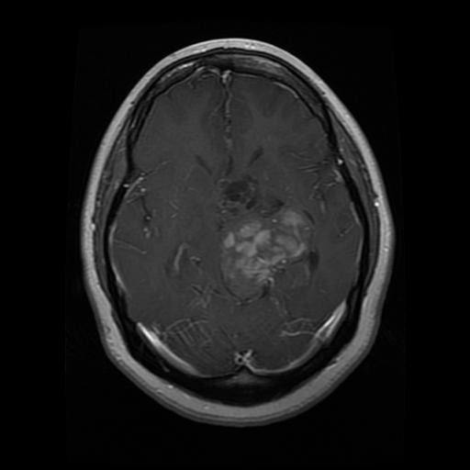
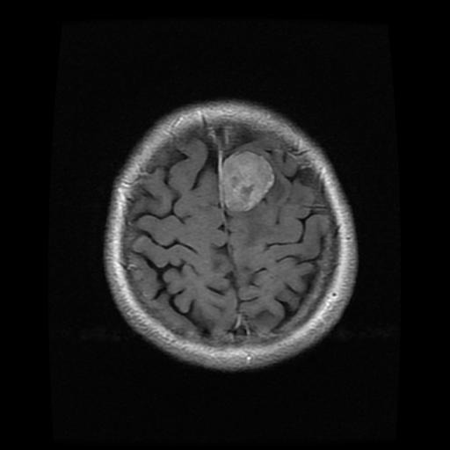
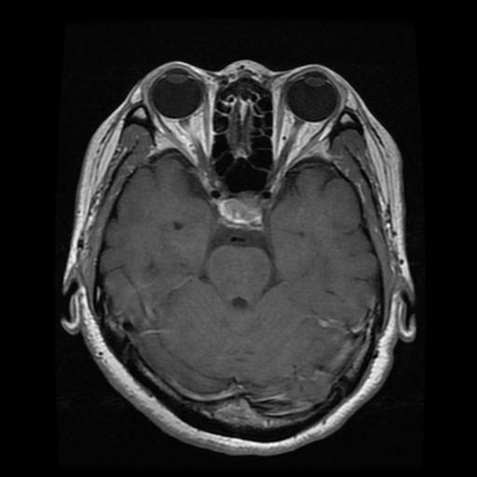
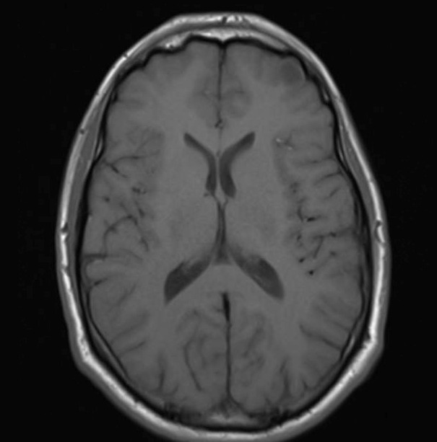
MRIs
Glioma Tumor
Meningioma Tumor
Pituitary Tumor
No Tumor

