Slide 1
GLAUCOMA DETECTION FROM RETINAL FUNDUS IMAGES USING TRANSFER LEARNING WITH PRETRAINED CNN MODELS
PROJECT GIUDE:
Ms.M.Thilagarani.,M.E.,
AP/CSE
TEAM MEMBERS:
Dhanasekaran K E (20CSR019)
Methini K (20CSR055)
Sadhana S (20CSL004)

Slide 2
ABSTRACT
Glaucoma, a progressive optic neuropathy, is a leading cause of irreversible blindness worldwide, emphasizing the need for early detection and treatment to prevent vision loss.
This project focuses on developing a Glaucoma detection system using deep learning techniques, involving preprocessing of retinal fundus images and associated clinical data. Images are standardized through resizing and augmentation.
Various pre-trained convolutional neural network (CNN) models, including ResNet50, VGG16, and MobileNetV2, are evaluated.
MobileNetV2 is selected for its efficiency, achieving a better accuracy. Integration with clinical features further enhances classification accuracy.
A comprehensive classification report assesses the effectiveness of the approach in Glaucoma detection, ensuring timely management and preservation of vision, ultimately improving patient outcomes.

Slide 3
INTRODUCTION
Glaucoma is a group of eye diseases characterized by damage to the optic nerve, leading to irreversible vision loss and, if untreated, blindness.
It is often asymptomatic in its early stages, earning it the moniker "the silent thief of sight." Traditional diagnostic methods may fail to detect glaucoma early, emphasizing the need for advanced screening approaches.
The proposed one aims to develop a sophisticated glaucoma detection system using deep learning techniques.
By integrating retinal fundus images and clinical data, the system seeks to enhance diagnostic capabilities for early detection and personalized treatment.

Slide 4
OBJECTIVE
Develop a glaucoma detection system using deep learning and transfer learning for accurate classification of fundus images.
Leverage transfer learning to establish a hierarchical structure for differentiating patterns in fundus images related to glaucoma conditions.
Evaluate the proposed model's effectiveness in distinguishing between healthy and glaucomatous eyes based on fundus image analysis.
This model is to evaluate the effectiveness of our model in glaucoma detection, highlighting its potential for improved diagnostic accuracy compared to standalone image-based models.

Slide 5
MODULES DESCRIPTION
MODULE 1: DATASET LOADING
This initial step involves sourcing and loading the dataset containing information relevant to glaucoma diagnosis.
The dataset typically comprises image data along with associated non-image data such as patient demographics, clinical features, etc.
This step ensures access to the necessary data for subsequent processing and analysis.

Slide 6
MODULE 2: PREPROCESSING
The preprocessing step is crucial for ensuring the dataset's readiness for model training.
It involves various data preprocessing techniques such as handling missing values, encoding categorical variables, and normalizing numerical data.
Additionally, for image data, preprocessing tasks include loading images, resizing them to a standardized format, and also splitting the dataset into 80% training and 20% testing portions ensures models are evaluated on unseen data, preventing overfitting.
These preprocessing steps are essential for enhancing data quality and facilitating effective model training.

Slide 7
MODULE 3 : PRE-TRAINED CNN MODELS TRAINING AND EVALUATION
In the Pre-trained CNN Model Training & Evaluation phase, pre-trained Convolutional Neural Network (CNN) models like ResNet50, VGG16, and MobileNetV2 are employed to extract features from image data.
These models, trained on extensive image datasets, effectively capture complex image features.
The extracted features are then utilized to train and evaluate the CNN models' performance in classifying glaucoma-positive and glaucoma-negative images.
This comprehensive evaluation aids in identifying the optimal pre-trained model for accurate glaucoma classification, ensuring robust performance in real-world scenarios.

Slide 8
MODULE 4 : PROPOSED MODEL TRAINING AND EVALUATION
The Proposed Model Training & Evaluation module integrates non-image data, such as patient demographics and clinical features, with extracted image features to develop a comprehensive classification model.
This involves designing a combined model architecture that incorporates both types of data as input, recognizing the multi-modal nature of the dataset. Subsequently, the module identifies MobileNetV2 as the optimal model, balancing accuracy, and performance across classes.
This model is then trained with non-image data to further enhance its accuracy.
The combined model is then evaluated using standard classification metrics like accuracy, precision, recall, and F1-score.This evaluation provides insights into the model's effectiveness in glaucoma detection, showcasing its potential for improved diagnostic accuracy compared to standalone image-based model.

Slide 9
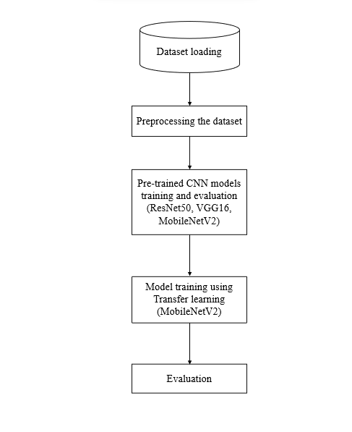
ARCHITECTURE DIAGRAM

Slide 10
REFERENCES
[1] | Ricardo Leonardo, Joao Gonçalves, André Carreiro, Beatriz Simoes, Tiago Oliveira, Filipe Soares, “Impact of Generative Modeling for Fundus Image Augmentation With Improved and Degraded Quality in the Classification of Glaucoma”,IEEE,2022.
[2] | Danilo Motta , Wallace Casaca , and Afonso Paiva ,“Vessel Optimal Transport for Automated Alignment of Retinal Fundus Images”,IEEE,2019.
[3] | Silvia OVREIU, Irina CRISTESCU, Florian BALTA, Alina SULTANA, Elena OVREIU, “Early Detection of Glaucoma Using Residual Networks”, IEEE, 2020.
[4] | Faizan Abdullah, Rakhshanda Imtiaz, Hussain Ahmad Madni, Haroon Ahmed Khan, Tariq M. Khan, Mohammad A. U. Khan, Syed Saud Naqvi, “A Review on Glaucoma Disease Detection Using Computerized Techniques”,IEEE,2021.
[5] | Ankita Ghorui, Subhasri Chatterjee, Roshan Makkar, Arulmozhivarman Pachiyappan, Balamurugan S, “Deployment of CNN on colour fundus images for the automatic detection of glaucoma”,2023.

