Slide 1
Cost-Aware, Calibrated, and Explainable Prediction of Credit Card Default
Name (Student ID) - MSc Data Science
Supervisor: Dr.
Github Repo:

Slide 2
Motivation & Problem Context
Default risk drives write-offs, capital allocation, and customer policy; even small lifts in early identification create meaningful cost savings.
Gap in many projects, Reporting AUC alone doesn’t translate to decisions. Lenders need calibrated probabilities, cost-aware thresholds, and clear reasons behind risk.
Our aim is to build a lightweight, reproducible pipeline that outputs trustworthy risk and a decision rule with business trade-offs made explicit.
Predict next-month default for credit card clients using the UCI dataset; move beyond accuracy to actionability and responsibility.

Slide 3
Research Questions
How accurately and calibrated can we predict default next month?
What probability threshold minimizes expected business cost (FN ≫ FP)?
Which features drive risk globally, and what are the customer-level reasons (SHAP)?
How stable is performance under missing data and across simple demographic slices?

Slide 4
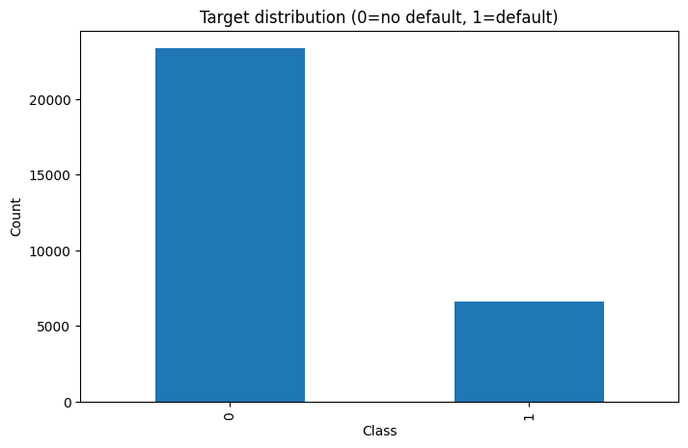
Dataset Overview
N = 30,000 clients (Taiwan, 2005).
Target: default_payment_next_month (0/1).
Feature families:
  Demographics: sex, education, marriage, age
  Credit: limit_bal
  Behaviour: pay_0..pay_6 (delinquency codes, −1 = pay duly, 1..9 = months late)
  Balances: bill_amt1..6
  Payments: pay_amt1..6
Class balance: Moderately imbalanced (baseline PR-AUC ≈ prevalence). (Insert your exact % from EDA.)
Split: Stratified 80/20 train/validation with a fixed random seed (reproducible).

Slide 5
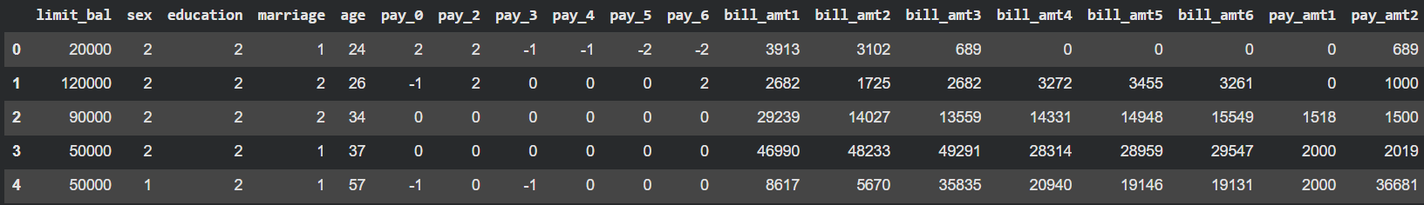
Data Preparation & Feature Engineering
Code hygiene: education {0,5,6→4}, marriage {0→3}; clip all pay_* codes to [−1, 9].
Behaviour signals:
  Utilization_k = bill_amtk / limit_bal (k=1..6) captures revolving intensity.
  Pay_Ratio_k = pay_amtk / |bill_amtk| (safe-divide) captures recent repayment effort.
  Recency features: utilization_recent_mean, pay_ratio_recent_mean (months 1–2) emphasize latest behaviour.

Slide 6
Methods — Models & Training
Models:
  Logistic Regression (class_weight='balanced'; standardized features) — interpretable baseline.
  XGBoost (handles non-linearity; scale_pos_weight for imbalance) — strong tabular learner.
Evaluation focus: ROC-AUC for separability, PR-AUC for imbalanced positives, plus Brier score and reliability curves after calibration.
Reproducibility: Fixed random seeds; clear preprocessing; versioned notebook.

Slide 7
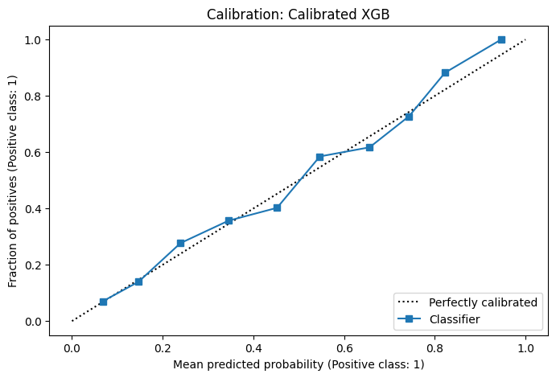
Results
Logistic Regression (baseline): ROC-AUC ≈ 0.731, PR-AUC ≈ 0.500.
XGBoost: ROC-AUC ≈ 0.774, PR-AUC ≈ 0.550 — ~2–2.5× baseline prevalence; clear lift over Logistic.
Calibrated XGB: Similar ROC/PR (ROC-AUC ≈ 0.776, PR-AUC ≈ 0.554), better calibration.

Slide 8
Contributions
Decision-focused: not just accuracy — we select a business-aligned threshold that minimizes expected loss.
Trustworthy risk: calibrated probabilities (isotonic).
High-signal but simple features: utilisation and payment ratios + recency give interpretable lift.
Reproducible baseline: clear preprocessing, fixed seed, and hold-out validation.

Slide 9
What's Next ?
Explainability: SHAP global & per-customer case studies (turn risk into levers).
Light fairness & robustness: slice by SEX/EDUCATION/MARRIAGE; stress test with missingness.
Cost-Aware Policy calculation, Converts a score into a decision rule with an explicit business trade-off.
Introducing Deep Learning Models and comparing them with the previous models.

Slide 10
References
Yeh, I-C., & Lien, C.-H. (2009). The comparisons of data mining techniques for the predictive accuracy of probability of default of credit card clients. Expert Systems with Applications, 36(2), 2473–2480. (Source of the UCI dataset)
Chen, T., & Guestrin, C. (2016). XGBoost: A scalable tree boosting system. In KDD ’16 (pp. 785–794).
Lundberg, S. M., & Lee, S.-I. (2017). A unified approach to interpreting model predictions. In NeurIPS ’17 (pp. 4765–4774). (SHAP)
Niculescu-Mizil, A., & Caruana, R. (2005). Predicting good probabilities with supervised learning. In ICML ’05 (pp. 625–632). (Probability quality)

Slide 11
Thanks!

