Slide 1
A Scalable Big Data Platform for Real-Time Urban Air Quality Tracking and Public Safety Alerting
Final Project Review | 23AID302 — Big Data Analytics | Group A14
Team member | Register number
Sangeeth S | CB.AI.U4AID24050
Jaganath R | CB.AI.U4AID24021
Niranjan S | CB.AI.U4AID24035
PL Kowshik | CB.AI.U4AID24036
Faculty:
Sreeja B P
Notes:
(1 min) Introduce the team and the one-line goal: forecast each city's PM2.5 one hour ahead on a distributed platform and warn people before it arrives. Fill in the faculty name on this slide before presenting.

Slide 2
Problem Statement, Objectives and Why Big Data
Problem
Objectives
Why big data is needed
• Air-quality models run on one machine — they cannot hold a city-wide, multi-year history in memory
• Batch reports arrive after the fact; a pollution spike is a health event happening now
• Published frameworks stop at prediction — none turn a forecast into a public warning
• Fault-tolerant HDFS lakehouse (4 DataNodes, 3× replication)
• Distributed cleaning and feature engineering in Scala on Spark/YARN
• Gradient-boosted forecaster that must beat the persistence baseline
• Structured Streaming speed layer, 10 s micro-batches
• Alert engine: warn when forecast AQI > 150, one hour ahead
• Serve results through Hive and a public warning board
154.6 M
33 GB
rows
on disk
• Volume: 33 GB vs 15.7 GB RAM on the host — only partitioned, distributed processing fits
• Velocity: live feed scored every 10 s
• Variety: flat CSV and nested JSON on one schema
• Veracity: 88.9 % synthetic rows must be validated, not trusted
Notes:
(1.5 min) Three gaps: scale, latency, automation. Then the objectives and the numbers that make this a big-data problem: 154.6 M rows and 33 GB on a host with 15.7 GB RAM; a 10-second streaming requirement; two data models.

Slide 3
Dataset — Source, Size and the Five V's
Layer | Source | Format | Rows | Size | Period
Structured | CPCB stations (+ validated synthetic expansion) | Flat CSV | 146,276,379 | 27.5 GB | 2010 – 2023
Semi-structured | CAMS reanalysis via Open-Meteo (history) | Nested JSON | 8,263,440 | 458 MB | 2022-08 → 2026-09
Semi-structured | CAMS + weather, live (keyless API, CC-BY 4.0) | Nested JSON | 82,800 per refresh | ≈ 20 MB | 1–15 Oct 2026
Unified table: 154,583,979 rows · 33 GB · 241 cities / 4,077 stations · one 17-column schema
Volume
Variety
Velocity
Veracity
Value
154.6 M rows, 33 GB
CSV + nested JSON + live API
10 s micro-batches
88.9 % synthetic, validated
R² 0.8910 vs 0.8587
Far more than the 15.7 GB RAM of one machine; HDFS splits it into 128 MB blocks, 3× copies
Flat structured tables and nested semi-structured JSON, read by native Spark readers into one schema
Live feed scored by Structured Streaming, ≈ 7 s latency; hourly alert loop
5 paired tests, independent CPCB-vs-CAMS check, 11 defects fixed, every filled value flagged
12.18 % lower error; 27,543 warnings in Oct, delivered one hour ahead with health advice
Key attributes
Identity / time: station_id, city, state, hourly timestamp · Pollutants: pm25, pm10, no2, so2, co, o3, nh3 (→ CPCB AQI, T+1 label) · Weather: temperature, humidity, wind, pressure, rain, solar · Context: traffic_index, urbanization_index, climate_type · Provenance: data_source, *_was_imputed · Model input: 54 numeric + 32 one-hot = 86 features
Notes:
(1.5 min) Three data layers with three jobs: structured CPCB trains, semi-structured CAMS history validates, live data alerts. Then the five V's with one measured fact each. Be upfront that 88.9 percent of structured rows are synthetic and that accuracy is quoted on real rows.

Slide 4
System Architecture
1 DATA SOURCES
2 INGEST
3 STORAGE
4 PROCESSING
5 SERVE / ALERT
CPCB stations CSV
2010–2023 · 146.3 M rows
Python fetchers
00e / 00f / 00g
HTTP, no API key
run_daily_live_cycle
run_hourly_cycle
upload to HDFS
HDFS lakehouse
Apache Spark 3.5.6 on YARN (1 RM + 4 NM)
Hive
external tables
raw (CSV / JSON)
BATCH LAYER — trains on 13 years of history
CleanSelect
(Scala)
clean + impute
Feature-
Extraction
(Scala) 86 feat.
GBT training
(PySpark MLlib)
300 trees
CAMS history JSON
2022–26 · 8.3 M rows
clean (Parquet, by city)
Warning board
(HTML / Pages)
features (86-dim)
model
CAMS + weather APIs
live · 230 cities (keyless)
unified table
SPEED LAYER — scores live data every 10 s
LiveEnrichment
(Scala)
CAMS+weather+profile
AirQualityStream (Scala)
foreachBatch: features → GBT
→ AQI → alerts
Alert engine
AQI > 150
stream: input · history
city_profiles.csv
traffic, urbanization
models: GBT + pipeline
1 NN + 4 DN
128 MB · 3×
state: 30 h history + checkpoint (HDFS)
Telegram
Docker Compose · 11 containers
HDFS 128 MB blocks · 3× replication
Parquet (snappy), partitioned by city
Scala 2.12.18 = Spark 3.5.6 build
Lambda: batch + speed over one lakehouse
Blue = storage · light = Scala jobs · maroon = ML model / alert logic · teal = live path. Arrows show data flow; the model is read from HDFS by the streaming job.
Notes:
(1.5 min) Left to right: sources are fetched by Python scripts and land in HDFS; Spark on YARN runs the batch layer (Scala cleaning and features, PySpark GBT training) and the speed layer (live enrichment and the streaming scorer); the trained model is loaded by the stream; the alert engine feeds Hive, the warning board and Telegram.

Slide 5
Spark Workflow — How the Data Flows
The feature-engineering job as a chain of steps (Spark builds this DAG)
1 Read
→
2 Remove
duplicates
→
3 Add history
→
4 Add the label
→
5 Pack features
→
6 Write
Parquet from HDFS
232 parallel tasks
one row per
station + hour
rolling averages,
lag, trend
next-hour PM₂.₅
(only if exactly 1 h later)
86 numbers
per row
one folder
per city (241)
Orange = shuffle (data moves between machines, a new stage). Blue = runs inside one stage. Measured: 146.3 M → 128.7 M → 93.2 M rows in 73.5 min.
DataFrames, not RDDs
Partitioning — how data is cut
Caching — what we keep in memory
• We work with DataFrames (tables); Spark turns them into RDDs inside.
• Window functions give every station its own history.
• Small lookup tables are broadcast to all machines — no shuffle needed.
• HDFS stores 128 MB blocks → 232 tasks read in parallel.
• Results are saved one folder per city (241), so one city reads one folder.
• Shuffle partitions tuned per job (from 16 up to 400).
• cache() keeps a table in memory when it is used more than once.
• We cache: the cleaning table, the training data, the stream predictions.
• unpersist() frees the memory when we are done.
Notes:
(1.5 min) Keep it simple. The job is a chain of six steps; Spark builds this chain as a DAG and splits it into stages wherever data must move between machines (a shuffle, shown in orange). Partitioning decides how the data is cut up; caching keeps a table in memory when it is reused.

Slide 6
Scala Implementation — Project Structure and Key Code
Project structure
FeatureExtraction.scala — dedupe + gap-safe rolling window
val dedupW = Window.partitionBy("station_id","variation_bucket","ts_unix")
.orderBy(col("pm25").desc_nulls_last)
df = df.withColumn("_rn", row_number().over(dedupW)).filter(col("_rn")===1)
def hoursBack(n: Int) = Window.partitionBy("station_id","variation_bucket")
.orderBy("ts_unix").rangeBetween(-(n-1).toLong * Hour, 0L) // value-based:
df = df.withColumn(s"${p}_avg${h}h", avg(col(p)).over(hoursBack(h))) // gap-safe
scala/streaming/
build.sbt Scala 2.12.18
Spark 3.5.6 (provided)
src/main/scala/
CleanSelect.scala 344
10-step clean, 3-tier
impute, write by city
FeatureExtraction.scala 377
86 features, T+1 label
LiveEnrichment.scala 324
CAMS+weather+profiles
AirQualityStream.scala 491
streaming + alert engine
sbt package -> jar
spark-submit --class <Job>
--master yarn
scripts/03_train_gbt.py
PySpark MLlib GBT
CleanSelect.scala — broadcast joins for the 3-tier median imputation
val t1 = df.groupBy("station_id","month","hour").agg(med(c).as(s"${c}__t1"))
val t2 = df.groupBy("city","month").agg(med(c).as(s"${c}__t2"))
df = df.join(broadcast(t1), Seq("station_id","month","hour"), "left")
.join(broadcast(t2), Seq("city","month"), "left")
df = df.withColumn(c, coalesce(col(c), col(s"${c}__t1"), col(s"${c}__t2"), lit(t3(c))))
AirQualityStream.scala — Structured Streaming speed layer
val raw = spark.readStream.schema(InputSchema).option("header","true")
.option("maxFilesPerTrigger","1").csv(StreamInput) // HDFS file source
raw.writeStream.option("checkpointLocation", CheckpointDir)
.foreachBatch { (batch: DataFrame, id: Long) =>
// union with 30 h history -> features -> GBT -> AQI -> alerts.write.partitionBy("city")
}.trigger(Trigger.ProcessingTime("10 seconds")).start()
Notes:
(1.5 min) 1,536 lines of Scala across four jobs. Scala 2.12.18 is pinned because Spark 3.5.6 is built against it. Show the three snippets: the gap-safe rolling window, the broadcast imputation join, and the streaming skeleton with foreachBatch.

Slide 7
Spark ML Pipeline — Features, Algorithm, Tuning
Features
(Parquet)
→
StringIndexer
+ OneHot
→
VectorAssembler
54 + 32 = 86
→
Chronological
split (not random)
→
GBTRegressor
300 trees
→
Model on HDFS
→ stream
Features (86)
Algorithm — GBTRegressor
Tuning — controlled experiments
• Current: pm25, pm10, no2, so2, co, o3, nh3
• History: lag_1h, rolling 3/6/24 h means, std_6h, delta_1h, surge_ratio
• CPCB AQI sub-indices, AQI rolling
• Weather: temperature, humidity, wind, pressure, rain, solar
• Time: hour_sin / hour_cos, rush hour
• Context: traffic, urbanization, climate (one-hot)
• Provenance: *_was_imputed flags
Parameter | Value
maxIter | 300
maxDepth | 6
stepSize η | 0.08
subsamplingRate | 0.8
featureSubset | sqrt
maxBins | 64
Target | PM₂.₅(t+1) − PM₂.₅(t)
Experiment | RMSE gain vs persistence
20 trees (plan default) | too few
19 cities, 120 trees | 5.67 %
Level target (local repro) | 5.6 %
Delta target (local repro) | 11.3 %
241 cities, 300 trees | 12.18 %
Split by time, never at random: consecutive hours correlate ≈ 0.81 → a random split leaks the answer.
Trained on 10 M rows (seeded sample; RAM ceiling), tested on all 18.7 M hold-out rows.
Notes:
(1.5 min) Pipeline from indexers to the GBT. We tuned by controlled experiments: tree count 20 to 120 to 300, and level target versus delta target, plus a chronological split. Persistence is the baseline and a built-in gate fails the run if the model does not beat it.

Slide 8
Results — Metrics, Model Comparison, Business Insight
Metric table | Persistence | GBT | Gain
R² (real rows) | 0.8587 | 0.8910 | + 0.0323
RMSE (real) | 24.831 | 21.806 | − 12.18 %
MAE (real) | 9.937 | 8.926 | − 1.011
R² (all 18.7 M) | 0.8563 | 0.8884 | + 0.0321
RMSE (all) | 25.443 | 22.429 | − 11.85 %
Business insight — Oct 2026 live run
27,543
221/230
warnings
cities warned
• 32 cities forecast Severe (AQI > 400); worst: Hisar, Bhiwani, Fatehabad — the Haryana–Punjab dust belt
• Cause mix: ozone 44 %, coarse dust 36 % → different advice: avoid midday exertion vs wear a mask
• A warning reaches residents one hour ahead, with CPCB health advice
• Delhi PM₂.₅ swings 5.5× (Aug 38.8 → Nov 213.6) — why 13 years of history matters
Model comparison | RMSE gain
Persistence (next hr = this hr) | baseline
GBT pilot (19 cities, 120 trees) | 5.67 %
GBT, level target (local) | 5.6 %
GBT, delta target (local) | 11.3 %
GBT full (241 cities, 300 trees) | 12.18 %
RMSE µg/m³ (lower is better), real rows n = 2,074,569
Top features: pm25, pm25_delta_1h, pm25_surge_ratio — and pm25_was_imputed ranks 6th of 86: the model learned to distrust filled-in values.
Notes:
(2 min) Real-rows figure first: R-squared 0.8910 vs 0.8587, RMSE down 12.18 percent. Then the business result from the October live run: 27,543 warnings, 221 of 230 cities, a dust belt in Haryana and Punjab. Switch to the website demo here.

Slide 9
Challenges, Limitations, Conclusion and Future Work
Challenges (found by running, then fixed)
Limitations
• Spark could not write to HDFS from the host → run Spark inside the cluster network
• Full-scale write died: DataNodes starved → driver 7→5 GB, replication 2, timeouts
• YARN executors OOM-killed (exit 137) on a 15.7 GB host → Phase 4 local mode; YARN proven by enrichment job
• 11 defects found (2 silent wrong answers) → reconcile every count
• 88.9 % of structured rows synthetic — results quoted on real rows only
• Trained on a 10 M-row sample of 74.5 M (RAM); evaluation not sampled
• CAMS is a model product, not a sensor feed; SO₂ agreement with CAMS is poor (0.083)
• October page is a snapshot; SMS needs a paid gateway; 230 of 241 cities
Conclusion
Future work
• A fault-tolerant 4-node HDFS + YARN + Spark platform processing 154.6 M rows
• GBT forecaster 12.18 % better than the honest baseline on real rows
• Live data scored in the stream and turned into 27,543 warnings with health advice
• Hive serving, public warning board, de-duplicated Telegram alert loop
• Hourly scheduler + SMS gateway; push via Telegram bot at scale
• Random Forest / XGBoost comparison
• Neighbour-station features (GraphX station network)
• Multi-host cluster to train on all 74.5 M rows; real-time CPCB feed with an API key
Notes:
(1.5 min) Name two real challenges and how they were solved, state the limitations before being asked, then conclude and point to the next steps.

Slide 10
References and GitHub
[1] Air Quality Prediction using Multi-Source Remote Sensing Data Integration with Hybrid Deep Learning Framework (MAST-Net). Nature, Scientific Reports, Dec 2025.
[2] Apache Hadoop 3.3.6 Documentation. hadoop.apache.org/docs/r3.3.6/
[3] Apache Spark 3.5.6 Documentation (SQL, MLlib, Structured Streaming). spark.apache.org/docs/3.5.6/
[4] Central Pollution Control Board. National Air Quality Index — Report of the Expert Group, 2014.
[5] Zaharia, M. et al. Resilient Distributed Datasets. NSDI, 2012.
[6] Shvachko, K. et al. The Hadoop Distributed File System. IEEE MSST, 2010.
[7] Friedman, J. H. Greedy Function Approximation: A Gradient Boosting Machine. Annals of Statistics 29(5), 2001.
[8] Copernicus Atmosphere Monitoring Service (CAMS), via Open-Meteo Air Quality API (CC-BY 4.0). open-meteo.com
[9] Apache Hive and Apache Parquet Documentation. hive.apache.org, parquet.apache.org
GitHub repository
https://github.com/jaganath010/A-Scalable-Big-Data-Platform-for-Real-Time-Urban-Air-Quality-Tracking-and-Public-Safety-Alerting
Website (warning board, GitHub Pages)
https://jaganath010.github.io/A-Scalable-Big-Data-Platform-for-Real-Time-Urban-Air-Quality-Tracking-and-Public-Safety-Alerting/
Uploaded: this PPT (presentation/) + PROJECT_REPORT.pdf (docs/), code (scala/, scripts/, hive/, dashboard/), run logs (docs/run_logs/)
Notes:
(0.5 min) References, then the repository link. Upload the PPT and the report to the repository before submission.

Slide 11
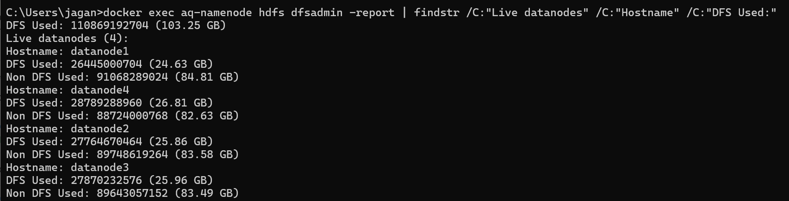
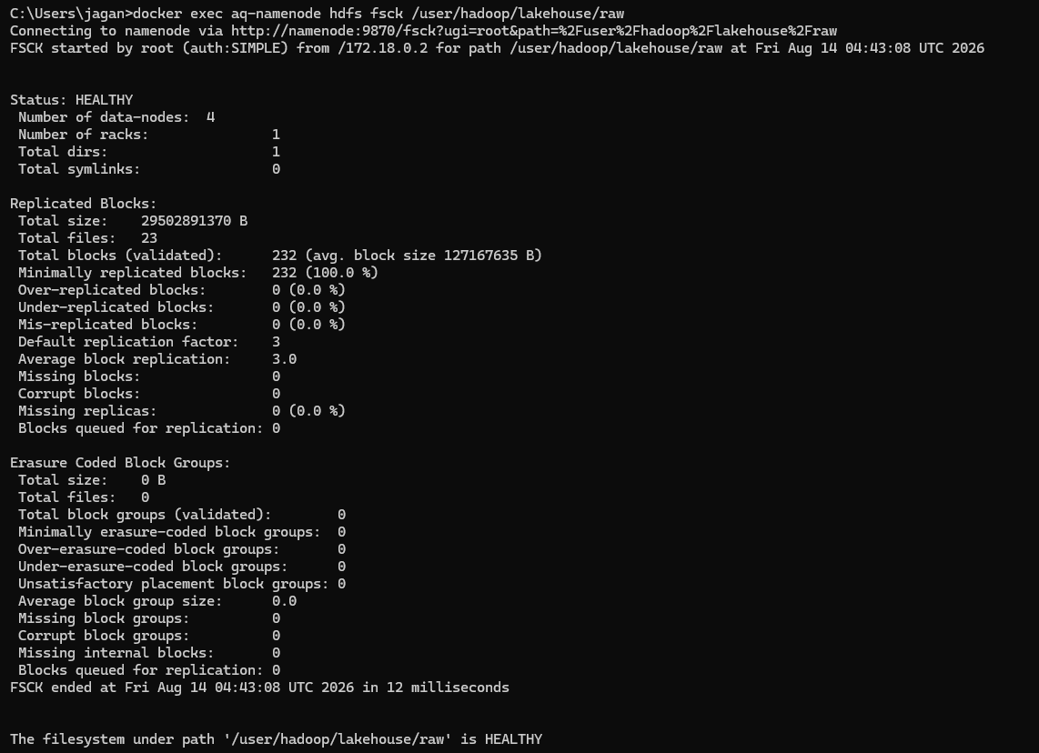
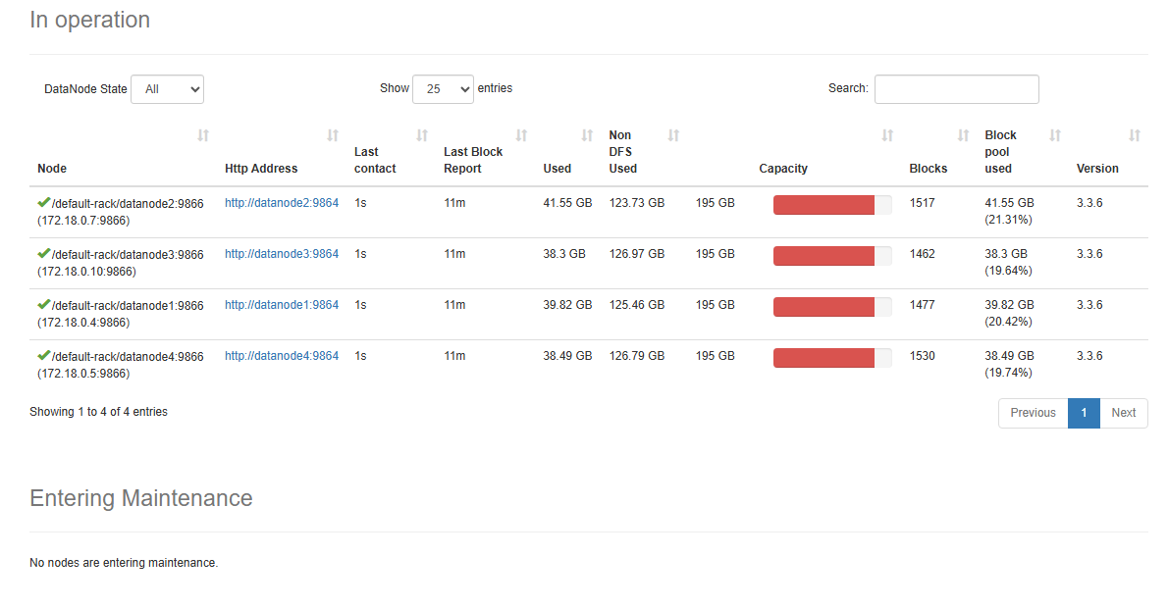
Appendix — Evidence: HDFS Cluster
dfsadmin -report: Live datanodes (4), 4 DataNodes each holding ≈ 24–28 GB
hdfs dfs -du -h: raw 27.5 GB → 82.4 GB on disk (3×); clean_scala 10.0 GB → 20.0 GB (2×)
NameNode UI — DataNodes in service
hdfs fsck /lakehouse/raw: HEALTHY — 232 blocks, replication 3.0, 0 missing / corrupt
Notes:
Screenshots from the running cluster. dfsadmin shows 4 live DataNodes; fsck reports HEALTHY with 232 blocks at replication 3.0 and no missing or corrupt blocks; the NameNode UI and du show the data layers.

Slide 12
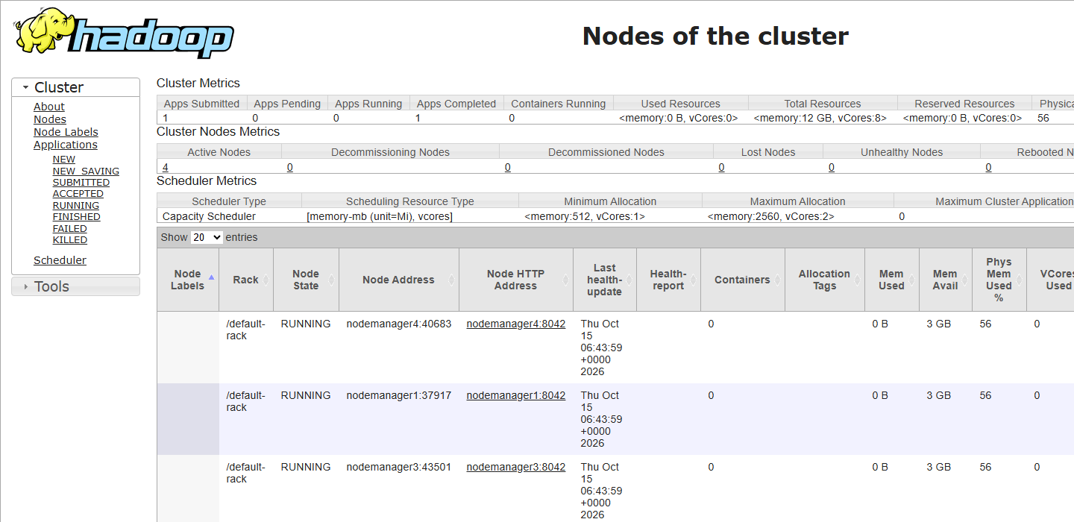
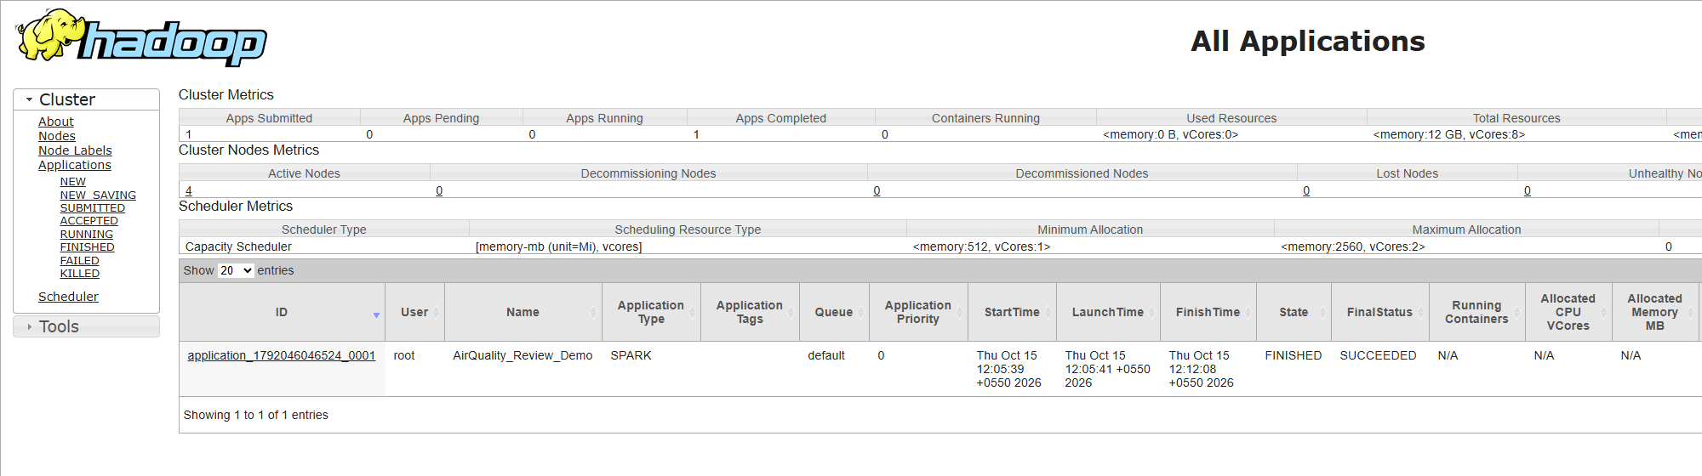
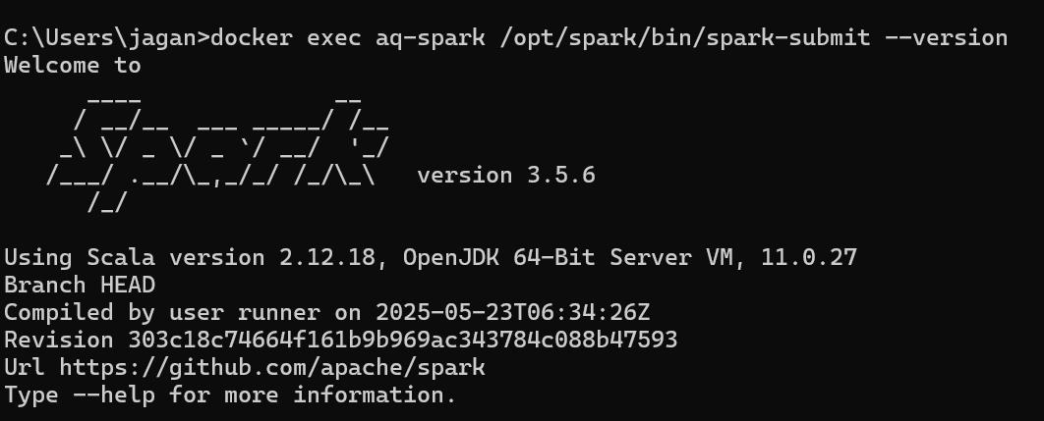
Appendix — Evidence: YARN and Spark on the Cluster
Applications: AirQuality_Review_Demo → FINISHED / SUCCEEDED
YARN ResourceManager — 4 NodeManagers, RUNNING
master : yarn
app id : application_1792046046524_0001
|semistructured_json|cams_history|8263440 |230
|semistructured_json|live_api |44160 |230
|structured_csv |real |16252931 |241
|structured_csv |synthetic |130023448|241
TOTAL rows: 154,583,979 (expected 154,583,979 -> True)
First Spark job on YARN: Spark 3.5.6 / Scala 2.12.18, state ACCEPTED → RUNNING → SUCCEEDED
spark_on_yarn_demo.log — distributed count over the unified table
Notes:
YARN lists four NodeManagers; the applications list shows the Spark job we submitted; the terminal shows master yarn and the reconciled total of 154,583,979 rows.

Slide 13
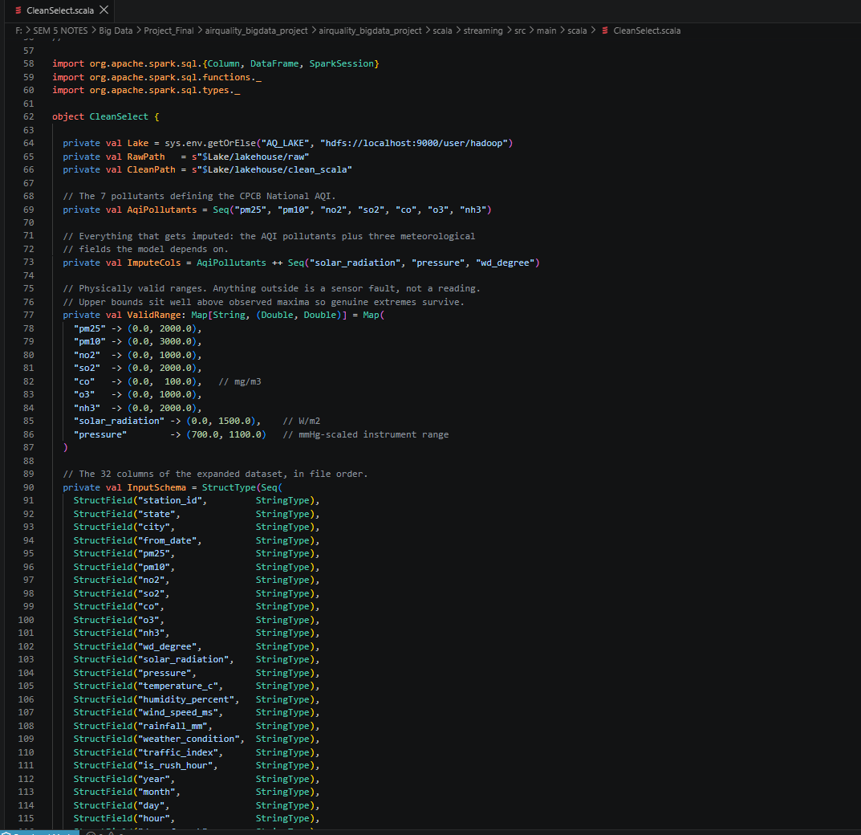
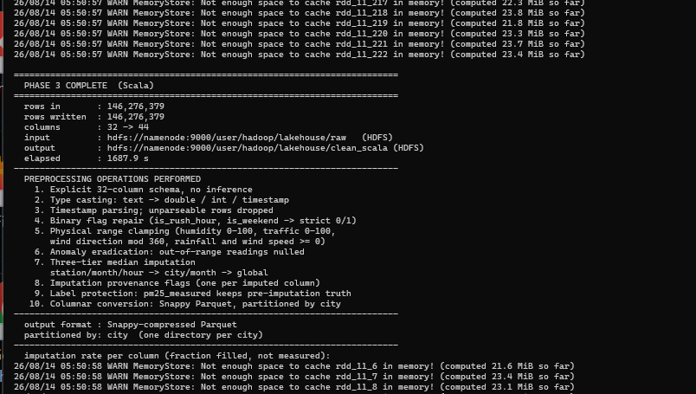
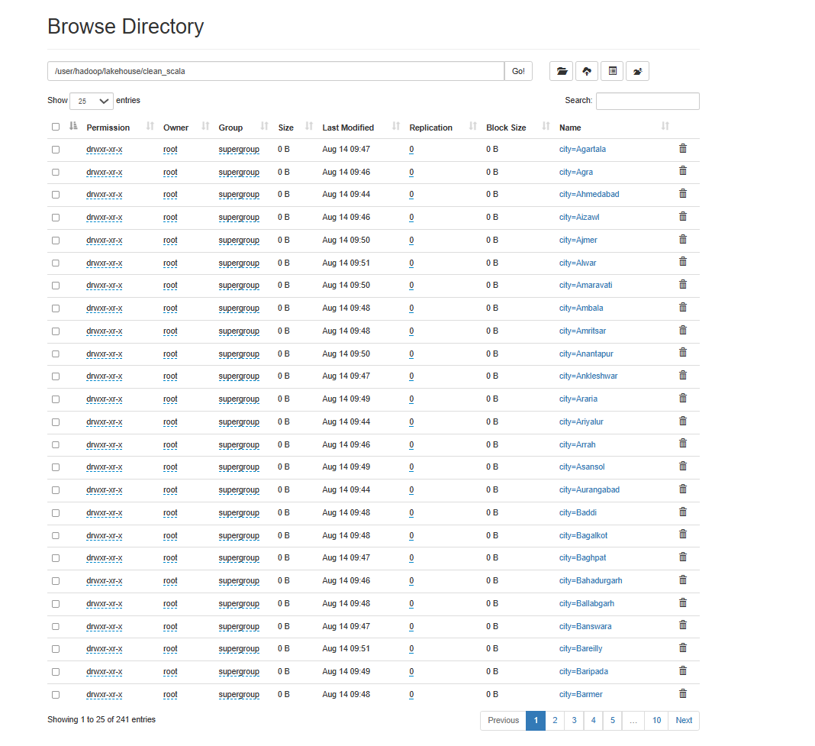
Appendix — Evidence: Scala Processing and Feature Engineering
CleanSelect at full scale: 146,276,379 rows in → out
rows in : 146,276,379
rows after dedupe : 128,660,967
rows with T+1 label: 93,216,105
rows assemblable : 93,216,105
numeric features : 54 one-hot width : 32
FEATURE VECTOR DIM : 86 partitioned by: city
elapsed : 4411.0 s (73.5 min)
HDFS clean_scala: city=… partitions (241)
Preprocessing: 32 → 44 columns, 10 steps, 3-tier imputation, every fill flagged; Phase 4 output 19.7 GB in 241 city partitions.
CleanSelect.scala (source)
phase4_fullscale.log
Notes:
Left: the Scala source in the editor. Middle: the CleanSelect run at full scale. Right: the processed layer in HDFS partitioned by city (241 directories). Bottom: the Phase 4 feature job summary.

Slide 14
Appendix — Evidence: Model Training and Data Validation
train 10,000,552 rows | test 18,671,121 rows
test window: 2022-07-01 -> 2023-03-31
PERSISTENCE BASELINE R2=0.8563 RMSE=25.443
trained on 10,000,552 rows, 300 trees
REAL ROWS ONLY (n=2,074,569)
persistence baseline 0.8587 24.831 9.937
GBT model 0.8910 21.806 8.926
RMSE reduction 12.18%
PASS (real rows): beats persistence by 0.0323 R2
Cross-validation: CPCB vs CAMS, 1,152,707 city-hours (Pearson r)
trackB_train_fullscale.summary.log — PHASE 6 evaluation (5 h 50 m on one host)
Persistence gate: the script prints *** FAIL *** if the model does not beat “next hour = this hour” on the same rows.
5 / 5
11
6th / 86
SO₂ agreement is essentially none (0.083) — published as a limitation, not hidden.
paired synthetic-vs-real tests pass (blocking)
defects found by running, all fixed
pm25_was_imputed importance
Notes:
Left: the verbatim evaluation block of the 300-tree training log; the script's own gate printed PASS. Right: the independent CPCB-versus-CAMS cross-validation on 1.15 M matched city-hours, reported as mixed.

Slide 15
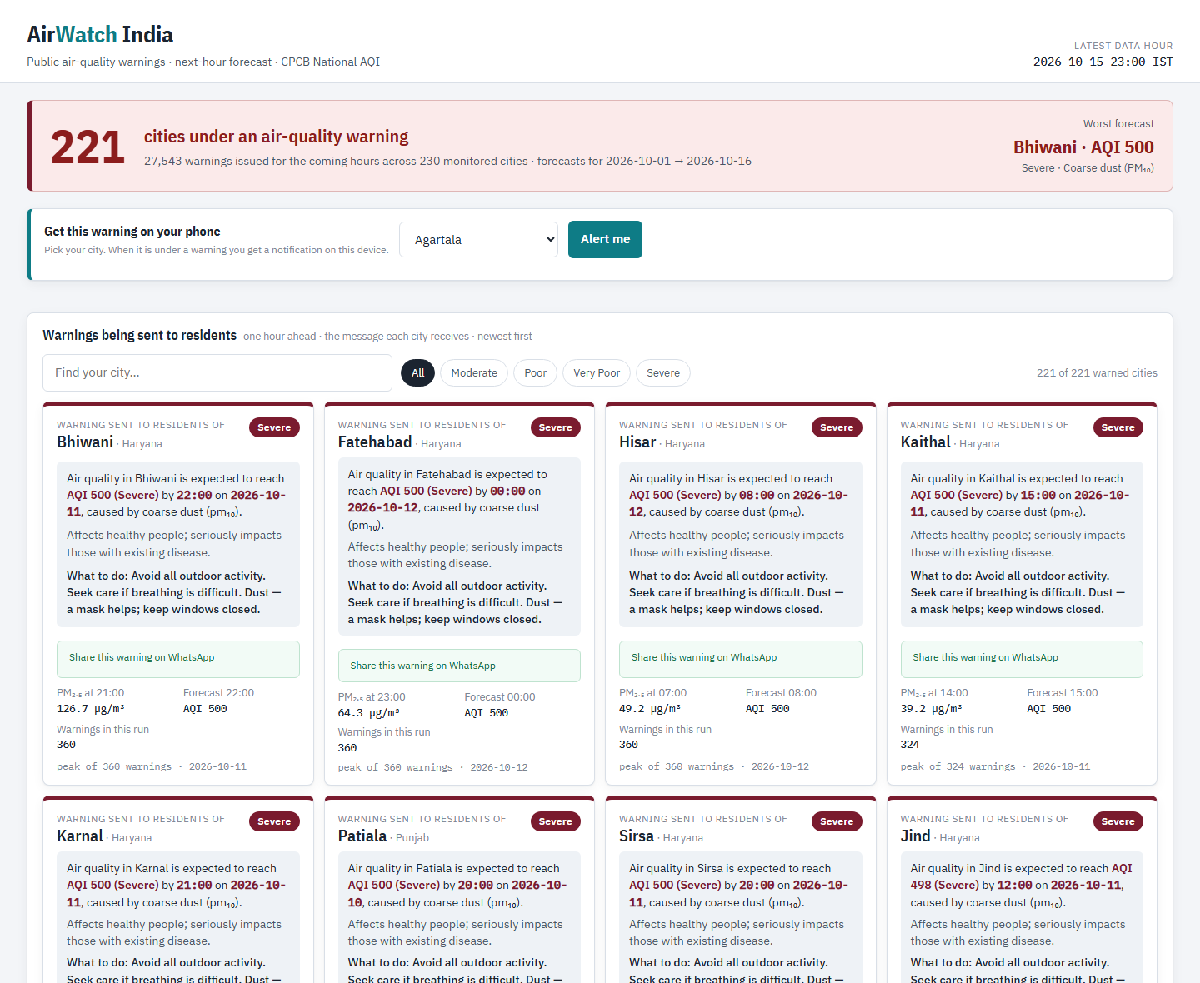
Appendix — Evidence: October Live Run, Alerts and Website
cams window : 2026-10-01 .. 2026-10-15 23:00
weather window : 2026-10-01 .. 2026-10-15 23:00
joined rows : 82,800
enriched rows : 82,800 across 230 cities
pm25 nulls=0 temperature_c nulls=0
pressure nulls=0 traffic_index nulls=0
Public warning board (AirWatch_India.html): 221 cities, worst forecast first; search, severity filter, WhatsApp share, “Alert me” notification.
october_live_cycle.log (LiveEnrichment on YARN)
[batch 0] no history yet - first run
[batch 0] *** 27543 ALERTS ***
[batch 0] rows in=82,800 predicted=82,800
alerts=27,543 latency=57,820 ms
Hive stream_alerts: 27543 rows, 221 cities,
2026-10-01 .. 2026-10-16 00:00
Telegram delivery is built and dry-run tested; a live message needs the bot token.
october_stream_scoring.log + Hive count
clock 20:00 108 cities warned -> 2 sent
Hisar new warning (AQI 463 Severe)
Fatehabad new warning (AQI 418)
clock 21:00 93 warned -> 2 sent, 2 suppressed
(already sent 1.0 h ago)
clock 02:00 0 under warning, 0 sent
hourly_dedupe_demo.log — dry-run replay
Notes:
October 1–15: 82,800 live rows enriched on YARN with no nulls on key columns, scored in the stream (27,543 alerts, 221 cities), served in Hive, shown on the board, and dispatched with de-duplication on a replay of the forecast.

Slide 16
Appendix — Claim to Evidence Index
Claim | Where the proof is
154,583,979 rows, one schema | spark_on_yarn_demo.log, merge_run.log (A2)
4 DataNodes, replication 3, HEALTHY | dfsadmin + fsck screenshots (A1)
Spark job ran on YARN, read HDFS | YARN UI screenshots + spark_on_yarn_demo.log (A2)
146,276,379 rows cleaned, 241 city partitions | CleanSelect run + HDFS browse (A3)
93,216,105 labelled rows, 86 features | phase4_fullscale.log (A3)
R² 0.8910 vs 0.8587, RMSE − 12.18 % | trackB_train_fullscale.summary.log (A4)
CPCB vs CAMS cross-validation | crossval.log, scripts/04_cross_validate_overlap.py (A4)
Oct 2026: 82,800 rows → 27,543 alerts | october_live_cycle.log, october_stream_scoring.log (A5)
De-duplicated alert dispatch | hourly_dedupe_demo.log, scripts/send_alerts.py (A5)
Hive tables and Delhi seasonality | hive_create.log, hive_queries.log
Every number reproducible | scripts/_audit/ (15 scripts), docs/WORK_LOG.md, PROJECT_REPORT.pdf
Notes:
If asked how we know a number, open the named file. All logs are preserved in docs/run_logs; screenshots are in this appendix.

