Slide 1
A Scalable Big Data Platform for Real-Time Urban Air Quality Tracking and Public Safety Alerting
Final Project Review | 23AID302 — Big Data Analytics | Group A14
Team member | Register number
Sangeeth S | CB.AI.U4AID24050
Jaganath R | CB.AI.U4AID24021
Niranjan S | CB.AI.U4AID24035
PL Kowshik | CB.AI.U4AID24036
Faculty:
[ enter faculty name ]
Stack: Hadoop HDFS · YARN · Spark 3.5 · Scala 2.12 · PySpark MLlib · Structured Streaming · Hive
Notes:
(1 min) Introduce the team and the one-line goal: forecast each city's PM2.5 one hour ahead on a distributed platform and warn people before it arrives. Fill in the faculty name on this slide before presenting.

Slide 2
Problem Statement, Objectives and Why Big Data
Problem
Objectives
Why big data is needed
• Air-quality models run on one machine — they cannot hold a city-wide, multi-year history in memory
• Batch reports arrive after the fact; a pollution spike is a health event happening now
• Published frameworks stop at prediction — none turn a forecast into a public warning
• Fault-tolerant HDFS lakehouse (4 DataNodes, 3× replication)
• Distributed cleaning and feature engineering in Scala on Spark/YARN
• Gradient-boosted forecaster that must beat the persistence baseline
• Structured Streaming speed layer, 10 s micro-batches
• Alert engine: warn when forecast AQI > 150, one hour ahead
• Serve results through Hive and a public warning board
154.6 M
33 GB
rows
on disk
• Volume: 33 GB vs 15.7 GB RAM on the host — only partitioned, distributed processing fits
• Velocity: live feed scored every 10 s
• Variety: flat CSV and nested JSON on one schema
• Veracity: 88.9 % synthetic rows must be validated, not trusted
Notes:
(1.5 min) Three gaps: scale, latency, automation. Then the objectives and the numbers that make this a big-data problem: 154.6 M rows and 33 GB on a host with 15.7 GB RAM; a 10-second streaming requirement; two data models.

Slide 3
Dataset — Source, Size, Volume / Variety / Velocity, Key Attributes
Layer | Source | Format | Rows | Size | Period
Structured | CPCB stations (+ validated synthetic expansion) | Flat CSV | 146,276,379 | 27.5 GB | 2010 – 2023
Semi-structured | CAMS reanalysis via Open-Meteo (history) | Nested JSON | 8,263,440 | 458 MB | 2022-08 → 2026-09
Semi-structured | CAMS + weather, live (keyless API, CC-BY 4.0) | Nested JSON | 82,800 / refresh | ≈ 20 MB | 1–15 Oct 2026
154,583,979
241 / 4,077
33 GB
88.9 %
rows in the unified table
cities / stations
Parquet + CSV in HDFS
of structured rows synthetic
Volume · Variety · Velocity
Key attributes
• Volume: 154.6 M rows, 232 HDFS blocks per raw copy
• Variety: CSV + nested JSON, one 17-column schema
• Velocity: 10 s micro-batches, 7 s latency
• Identity / time: station_id, city, state, timestamp (hourly)
• Pollutants: pm25, pm10, no2, so2, co, o3, nh3 → CPCB AQI and the T+1 label (next-hour PM₂.₅)
• Weather: temperature, humidity, wind speed / direction, pressure, rain, solar radiation
• Context: traffic_index, urbanization_index, climate_type, is_rush_hour; provenance: data_source, *_was_imputed
• Clean layer 32 columns → model input 54 numeric + 32 one-hot = 86 features
Notes:
(1.5 min) Three layers with three jobs: structured CPCB trains, semi-structured CAMS history validates, live data alerts. Be upfront that 88.9 percent of structured rows are synthetic and that every accuracy figure is quoted on real rows.

Slide 4
System Architecture
DATA SOURCES
STORAGE
SPARK CLUSTER (YARN: 1 RM + 4 NM)
OUTPUT
CPCB stations CSV
146.3 M rows
HDFS lakehouse
1 NameNode
4 DataNodes
128 MB blocks
3× replication
raw → clean → features
→ unified → stream
Scala 2.12 jobs (sbt jar)
Hive
external
tables
CleanSelect
clean + impute
FeatureExtraction
86 features
CAMS history JSON
8.3 M rows
LiveEnrichment
CAMS+weather
AirQualityStream
10 s micro-batch
Alert
engine
AQI > 150
CAMS + weather
live APIs (230 cities)
PySpark + MLlib
GBTRegressor — 300 trees, delta target
Warning
board +
Telegram
city_profiles.csv
traffic, urbanization
Validation + cross-check (5 paired tests)
Lambda-style: a batch layer trains on 13 years of history; a speed layer scores live data against the same model. The trained model is stored in HDFS and loaded by the streaming job.
Notes:
(1.5 min) Walk left to right: sources land in HDFS; the Spark-on-YARN cluster runs Scala jobs for cleaning, features, enrichment and streaming, and PySpark for ML; the model is written to HDFS and loaded by the stream; outputs are Hive, the website and alert messages.

Slide 5
Spark Workflow — DataFrame Operations, DAG, Partitioning, Caching
DAG of the feature-engineering job (Phase 4)
Scan Parquet
Dedupe
Rolling
features
T+1 label
Assemble
vector
Write
232 tasks
(1 per block)
window by
station, hour
window
rangeBetween
lead join,
ts + 3600 s
54 + 32
= 86 dims
repartition(city)
241 dirs
Amber stages = wide transformations (shuffle). Blue = narrow (pipelined within a stage). Measured: 146.3 M → 128.7 M → 93.2 M rows, 73.5 min.
DataFrame / RDD operations
Partitioning
Caching choices
• read.parquet / csv with explicit schema
• Window: row_number (dedupe), rangeBetween rolling means, lag
• groupBy + percentile_approx → median tables
• broadcast join of the small tables
• withColumn / when / coalesce feature logic
• RDD: none hand-written — MLlib GBT runs on RDDs internally (1,300+ jobs)
• HDFS: 128 MB blocks → 232 input splits for the 27.5 GB raw copy
• Disk: partitionBy(city) = 241 directories (by year/month made 5,237 tiny files — rejected)
• Unified table: partitionBy(source_format) = 2
• Shuffle partitions tuned per job: 400 / 200 / 120 / 64 / 16
• repartition(city) before write → a few large files per city
• Clean job: df.cache() — reused by median tables, the join and the write; unpersist at the end
• GBT: train.cache(), test.cache() — scanned every iteration
• Stream: predictions.cache() — used by count, write and alert filter
• Small median tables: broadcast, not cached
• GBT checkpoint dir: breaks long lineage (earlier StackOverflow)
Notes:
(1.5 min) We work at the DataFrame level; Catalyst compiles it to RDD stages. The DAG for the feature job has three shuffles. Partitioning: 128 MB HDFS blocks give 232 input tasks, disk partitioning by city gives 241 directories, and shuffle partitions are tuned per job. Caching is used only where a DataFrame is reused.

Slide 6
Scala Implementation — Project Structure and Key Code
Project structure
FeatureExtraction.scala — dedupe + gap-safe rolling window
val dedupW = Window.partitionBy("station_id","variation_bucket","ts_unix")
.orderBy(col("pm25").desc_nulls_last)
df = df.withColumn("_rn", row_number().over(dedupW)).filter(col("_rn")===1)
def hoursBack(n: Int) = Window.partitionBy("station_id","variation_bucket")
.orderBy("ts_unix").rangeBetween(-(n-1).toLong * Hour, 0L) // value-based:
df = df.withColumn(s"${p}_avg${h}h", avg(col(p)).over(hoursBack(h))) // gap-safe
scala/streaming/
build.sbt Scala 2.12.18
Spark 3.5.6 (provided)
src/main/scala/
CleanSelect.scala 344
10-step clean, 3-tier
impute, write by city
FeatureExtraction.scala 377
86 features, T+1 label
LiveEnrichment.scala 324
CAMS+weather+profiles
AirQualityStream.scala 491
streaming + alert engine
sbt package -> jar
spark-submit --class <Job>
--master yarn
scripts/03_train_gbt.py
PySpark MLlib GBT
CleanSelect.scala — broadcast joins for the 3-tier median imputation
val t1 = df.groupBy("station_id","month","hour").agg(med(c).as(s"${c}__t1"))
val t2 = df.groupBy("city","month").agg(med(c).as(s"${c}__t2"))
df = df.join(broadcast(t1), Seq("station_id","month","hour"), "left")
.join(broadcast(t2), Seq("city","month"), "left")
df = df.withColumn(c, coalesce(col(c), col(s"${c}__t1"), col(s"${c}__t2"), lit(t3(c))))
AirQualityStream.scala — Structured Streaming speed layer
val raw = spark.readStream.schema(InputSchema).option("header","true")
.option("maxFilesPerTrigger","1").csv(StreamInput) // HDFS file source
raw.writeStream.option("checkpointLocation", CheckpointDir)
.foreachBatch { (batch: DataFrame, id: Long) =>
// union with 30 h history -> features -> GBT -> AQI -> alerts.write.partitionBy("city")
}.trigger(Trigger.ProcessingTime("10 seconds")).start()
Notes:
(1.5 min) 1,536 lines of Scala across four jobs. Scala 2.12.18 is pinned because Spark 3.5.6 is built against it. Show the three snippets: the gap-safe rolling window, the broadcast imputation join, and the streaming skeleton with foreachBatch.

Slide 7
Spark ML Pipeline — Features, Algorithm, Tuning
Features
(Parquet)
→
StringIndexer
+ OneHot
→
VectorAssembler
54 + 32 = 86
→
Chronological
split (not random)
→
GBTRegressor
300 trees
→
Model on HDFS
→ stream
Features (86)
Algorithm — GBTRegressor
Tuning — controlled experiments
• Current: pm25, pm10, no2, so2, co, o3, nh3
• History: lag_1h, rolling 3/6/24 h means, std_6h, delta_1h, surge_ratio
• CPCB AQI sub-indices, AQI rolling
• Weather: temperature, humidity, wind, pressure, rain, solar
• Time: hour_sin / hour_cos, rush hour
• Context: traffic, urbanization, climate (one-hot)
• Provenance: *_was_imputed flags
Parameter | Value
maxIter | 300
maxDepth | 6
stepSize η | 0.08
subsamplingRate | 0.8
featureSubset | sqrt
maxBins | 64
Target | PM₂.₅(t+1) − PM₂.₅(t)
Experiment | RMSE gain vs persistence
20 trees (plan default) | too few
19 cities, 120 trees | 5.67 %
Level target (local repro) | 5.6 %
Delta target (local repro) | 11.3 %
241 cities, 300 trees | 12.18 %
Split by time, never at random: consecutive hours correlate ≈ 0.81 → a random split leaks the answer.
Trained on 10 M rows (seeded sample; RAM ceiling), tested on all 18.7 M hold-out rows.
Notes:
(1.5 min) Pipeline from indexers to the GBT. We tuned by controlled experiments: tree count 20 to 120 to 300, and level target versus delta target, plus a chronological split. Persistence is the baseline and a built-in gate fails the run if the model does not beat it.

Slide 8
Results — Metrics, Model Comparison, Business Insight
Metric table | Persistence | GBT | Gain
R² (real rows) | 0.8587 | 0.8910 | + 0.0323
RMSE (real) | 24.831 | 21.806 | − 12.18 %
MAE (real) | 9.937 | 8.926 | − 1.011
R² (all 18.7 M) | 0.8563 | 0.8884 | + 0.0321
RMSE (all) | 25.443 | 22.429 | − 11.85 %
Business insight — Oct 2026 live run
27,543
221/230
warnings
cities warned
• 32 cities forecast Severe (AQI > 400); worst: Hisar, Bhiwani, Fatehabad — the Haryana–Punjab dust belt
• Cause mix: ozone 44 %, coarse dust 36 % → different advice: avoid midday exertion vs wear a mask
• A warning reaches residents one hour ahead, with CPCB health advice
• Delhi PM₂.₅ swings 5.5× (Aug 38.8 → Nov 213.6) — why 13 years of history matters
Model comparison | RMSE gain
Persistence (next hr = this hr) | baseline
GBT pilot (19 cities, 120 trees) | 5.67 %
GBT, level target (local) | 5.6 %
GBT, delta target (local) | 11.3 %
GBT full (241 cities, 300 trees) | 12.18 %
RMSE µg/m³ (lower is better), real rows n = 2,074,569
Top features: pm25, pm25_delta_1h, pm25_surge_ratio — and pm25_was_imputed ranks 6th of 86: the model learned to distrust filled-in values.
Notes:
(2 min) Real-rows figure first: R-squared 0.8910 vs 0.8587, RMSE down 12.18 percent. Then the business result from the October live run: 27,543 warnings, 221 of 230 cities, a dust belt in Haryana and Punjab. Switch to the website demo here.

Slide 9
Challenges, Limitations, Conclusion and Future Work
Challenges (found by running, then fixed)
Limitations
• Spark could not write to HDFS from the host → run Spark inside the cluster network
• Full-scale write died: DataNodes starved → driver 7→5 GB, replication 2, timeouts
• YARN executors OOM-killed (exit 137) on a 15.7 GB host → Phase 4 local mode; YARN proven by enrichment job
• 11 defects found (2 silent wrong answers) → reconcile every count
• 88.9 % of structured rows synthetic — results quoted on real rows only
• Trained on a 10 M-row sample of 74.5 M (RAM); evaluation not sampled
• CAMS is a model product, not a sensor feed; SO₂ agreement with CAMS is poor (0.083)
• October page is a snapshot; SMS needs a paid gateway; 230 of 241 cities
Conclusion
Future work
• A fault-tolerant 4-node HDFS + YARN + Spark platform processing 154.6 M rows
• GBT forecaster 12.18 % better than the honest baseline on real rows
• Live data scored in the stream and turned into 27,543 warnings with health advice
• Hive serving, public warning board, de-duplicated Telegram alert loop
• Hourly scheduler + SMS gateway; push via Telegram bot at scale
• Random Forest / XGBoost comparison
• Neighbour-station features (GraphX station network)
• Multi-host cluster to train on all 74.5 M rows; real-time CPCB feed with an API key
Notes:
(1.5 min) Name two real challenges and how they were solved, state the limitations before being asked, then conclude and point to the next steps.

Slide 10
References and GitHub
[1] Air Quality Prediction using Multi-Source Remote Sensing Data Integration with Hybrid Deep Learning Framework (MAST-Net). Nature, Scientific Reports, Dec 2025.
[2] Apache Hadoop 3.3.6 Documentation. hadoop.apache.org/docs/r3.3.6/
[3] Apache Spark 3.5.6 Documentation (SQL, MLlib, Structured Streaming). spark.apache.org/docs/3.5.6/
[4] Central Pollution Control Board. National Air Quality Index — Report of the Expert Group, 2014.
[5] Zaharia, M. et al. Resilient Distributed Datasets. NSDI, 2012.
[6] Shvachko, K. et al. The Hadoop Distributed File System. IEEE MSST, 2010.
[7] Friedman, J. H. Greedy Function Approximation: A Gradient Boosting Machine. Annals of Statistics 29(5), 2001.
[8] Copernicus Atmosphere Monitoring Service (CAMS), via Open-Meteo Air Quality API (CC-BY 4.0). open-meteo.com
[9] Apache Hive and Apache Parquet Documentation. hive.apache.org, parquet.apache.org
GitHub repository
https://github.com/jaganath010/A-Scalable-Big-Data-Platform-for-Real-Time-Urban-Air-Quality-Tracking-and-Public-Safety-Alerting
Uploaded: this PPT (presentation/) + PROJECT_REPORT.pdf (docs/), code (scala/, scripts/, hive/, dashboard/), run logs (docs/run_logs/)
Notes:
(0.5 min) References, then the repository link. Upload the PPT and the report to the repository before submission.

Slide 11
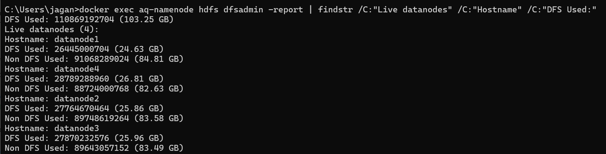
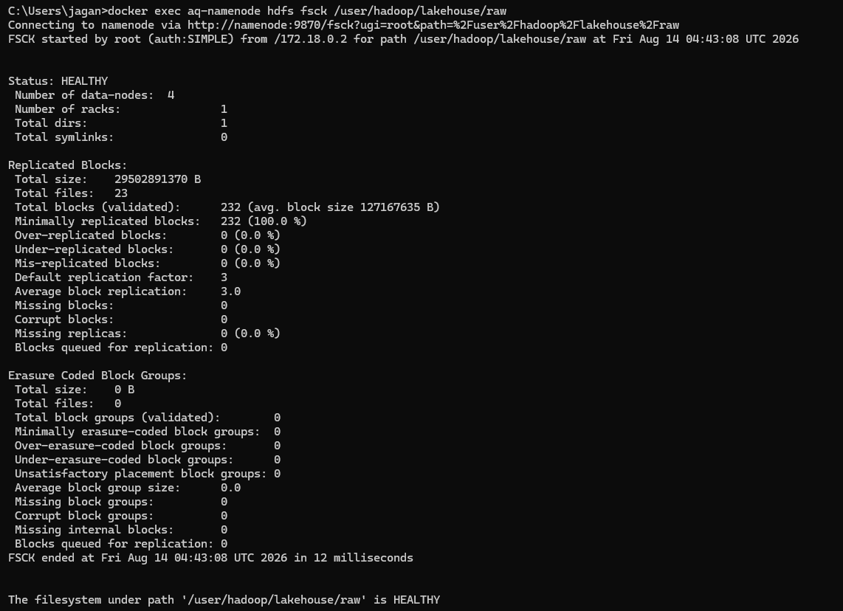
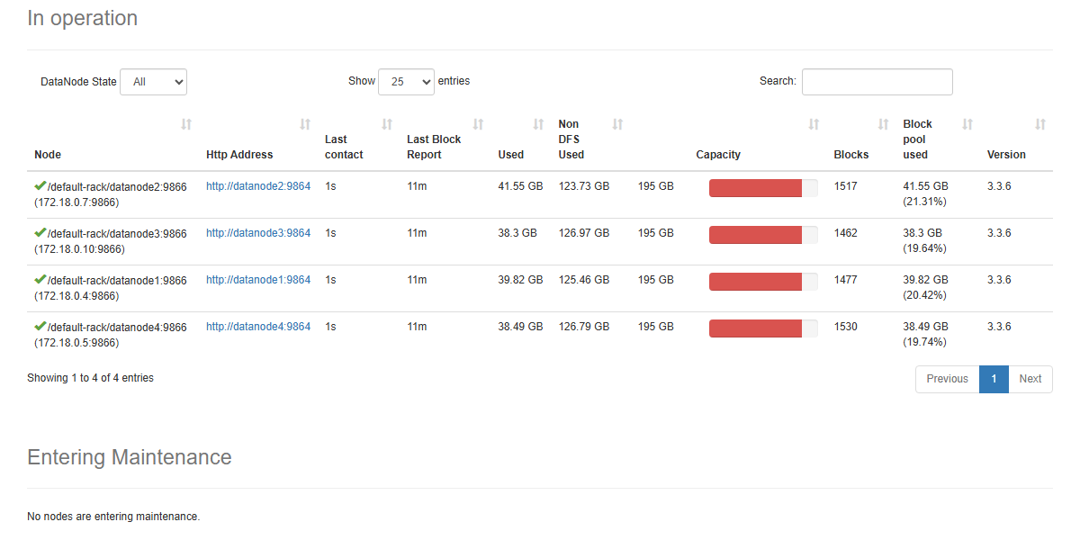
Appendix — Evidence: HDFS Cluster
dfsadmin -report: Live datanodes (4), 4 DataNodes each holding ≈ 24–28 GB
hdfs dfs -du -h: raw 27.5 GB → 82.4 GB on disk (3×); clean_scala 10.0 GB → 20.0 GB (2×)
NameNode UI — DataNodes in service
hdfs fsck /lakehouse/raw: HEALTHY — 232 blocks, replication 3.0, 0 missing / corrupt
Notes:
Screenshots from the running cluster. dfsadmin shows 4 live DataNodes; fsck reports HEALTHY with 232 blocks at replication 3.0 and no missing or corrupt blocks; the NameNode UI and du show the data layers.

Slide 12
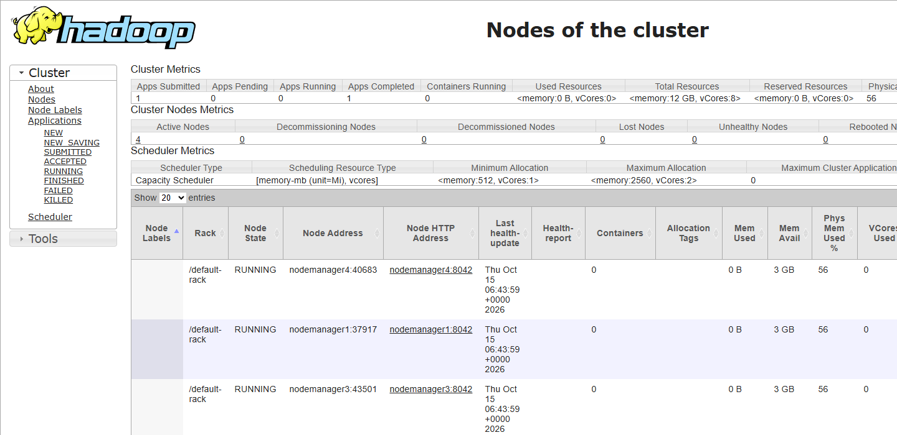
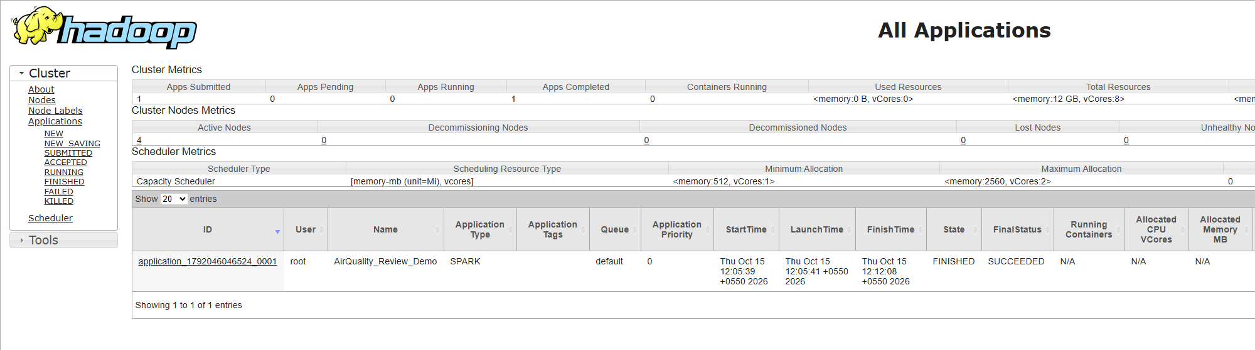
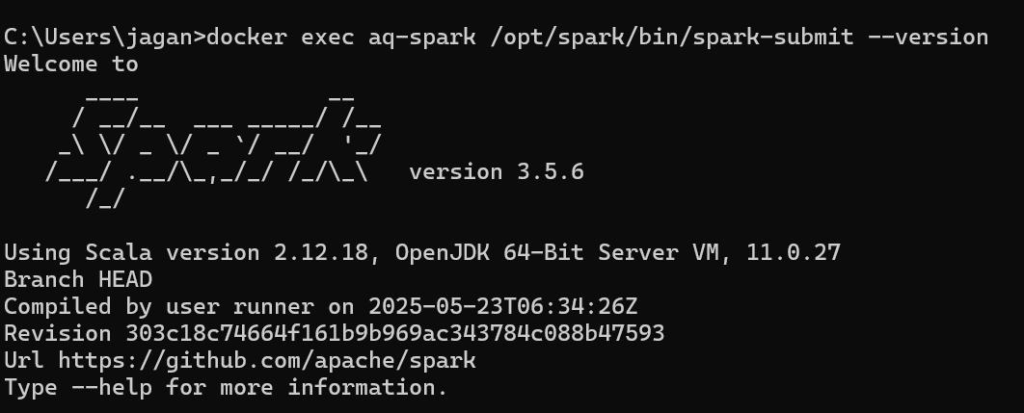
Appendix — Evidence: YARN and Spark on the Cluster
Applications: AirQuality_Review_Demo → FINISHED / SUCCEEDED
YARN ResourceManager — 4 NodeManagers, RUNNING
master : yarn
app id : application_1792046046524_0001
|semistructured_json|cams_history|8263440 |230
|semistructured_json|live_api |44160 |230
|structured_csv |real |16252931 |241
|structured_csv |synthetic |130023448|241
TOTAL rows: 154,583,979 (expected 154,583,979 -> True)
First Spark job on YARN: Spark 3.5.6 / Scala 2.12.18, state ACCEPTED → RUNNING → SUCCEEDED
spark_on_yarn_demo.log — distributed count over the unified table
Notes:
YARN lists four NodeManagers; the applications list shows the Spark job we submitted; the terminal shows master yarn and the reconciled total of 154,583,979 rows.

Slide 13
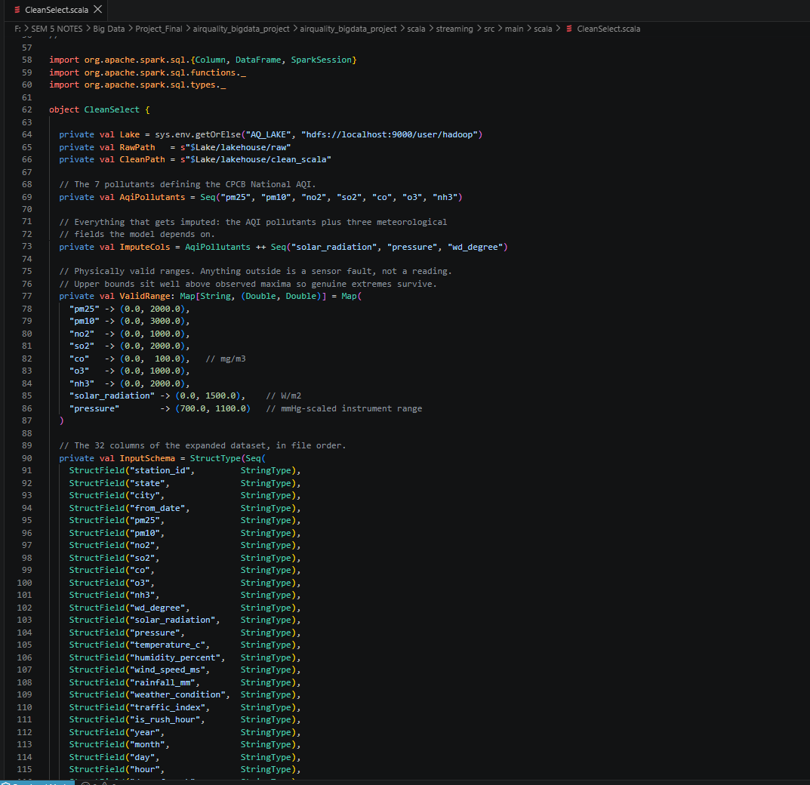
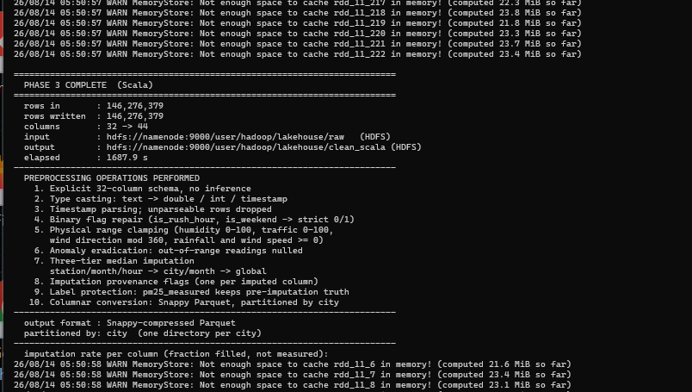
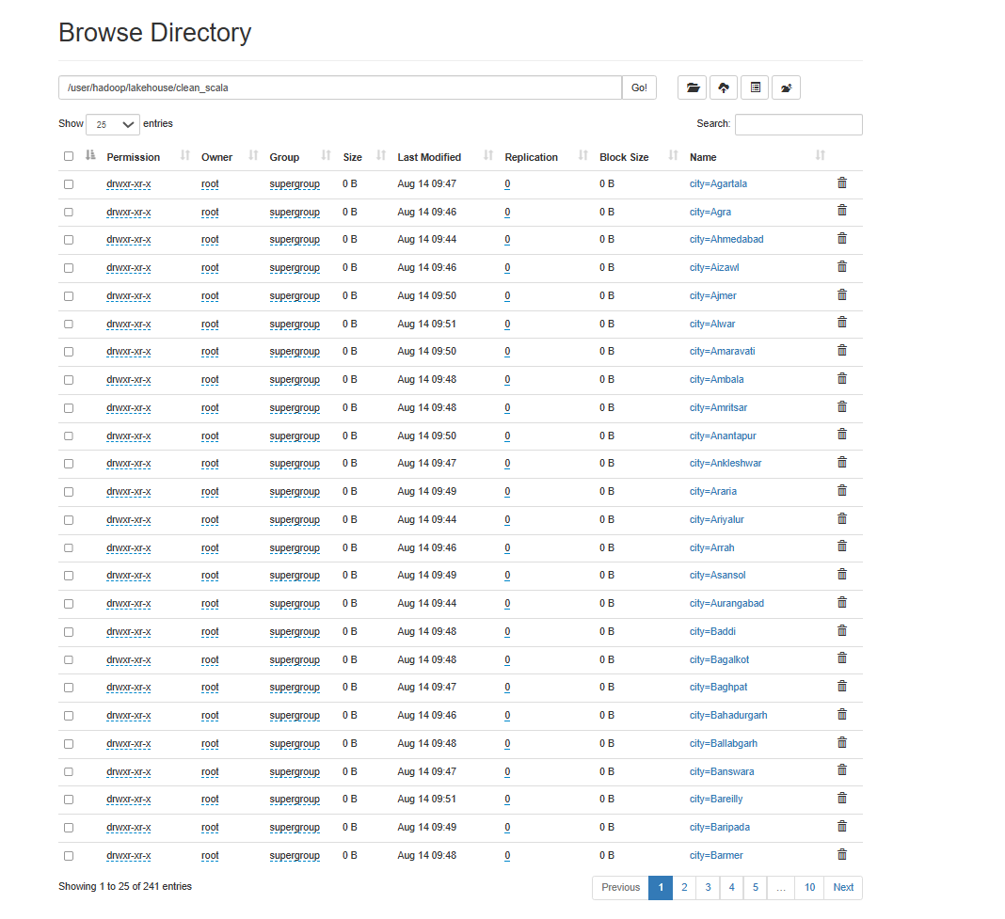
Appendix — Evidence: Scala Processing and Feature Engineering
CleanSelect at full scale: 146,276,379 rows in → out
rows in : 146,276,379
rows after dedupe : 128,660,967
rows with T+1 label: 93,216,105
rows assemblable : 93,216,105
numeric features : 54 one-hot width : 32
FEATURE VECTOR DIM : 86 partitioned by: city
elapsed : 4411.0 s (73.5 min)
HDFS clean_scala: city=… partitions (241)
Preprocessing: 32 → 44 columns, 10 steps, 3-tier imputation, every fill flagged; Phase 4 output 19.7 GB in 241 city partitions.
CleanSelect.scala (source)
phase4_fullscale.log
Notes:
Left: the Scala source in the editor. Middle: the CleanSelect run at full scale. Right: the processed layer in HDFS partitioned by city (241 directories). Bottom: the Phase 4 feature job summary.

Slide 14
Appendix — Evidence: Model Training and Data Validation
train 10,000,552 rows | test 18,671,121 rows
test window: 2022-07-01 -> 2023-03-31
PERSISTENCE BASELINE R2=0.8563 RMSE=25.443
trained on 10,000,552 rows, 300 trees
REAL ROWS ONLY (n=2,074,569)
persistence baseline 0.8587 24.831 9.937
GBT model 0.8910 21.806 8.926
RMSE reduction 12.18%
PASS (real rows): beats persistence by 0.0323 R2
Cross-validation: CPCB vs CAMS, 1,152,707 city-hours (Pearson r)
trackB_train_fullscale.summary.log — PHASE 6 evaluation (5 h 50 m on one host)
Persistence gate: the script prints *** FAIL *** if the model does not beat “next hour = this hour” on the same rows.
5 / 5
11
6th / 86
SO₂ agreement is essentially none (0.083) — published as a limitation, not hidden.
paired synthetic-vs-real tests pass (blocking)
defects found by running, all fixed
pm25_was_imputed importance
Notes:
Left: the verbatim evaluation block of the 300-tree training log; the script's own gate printed PASS. Right: the independent CPCB-versus-CAMS cross-validation on 1.15 M matched city-hours, reported as mixed.

Slide 15
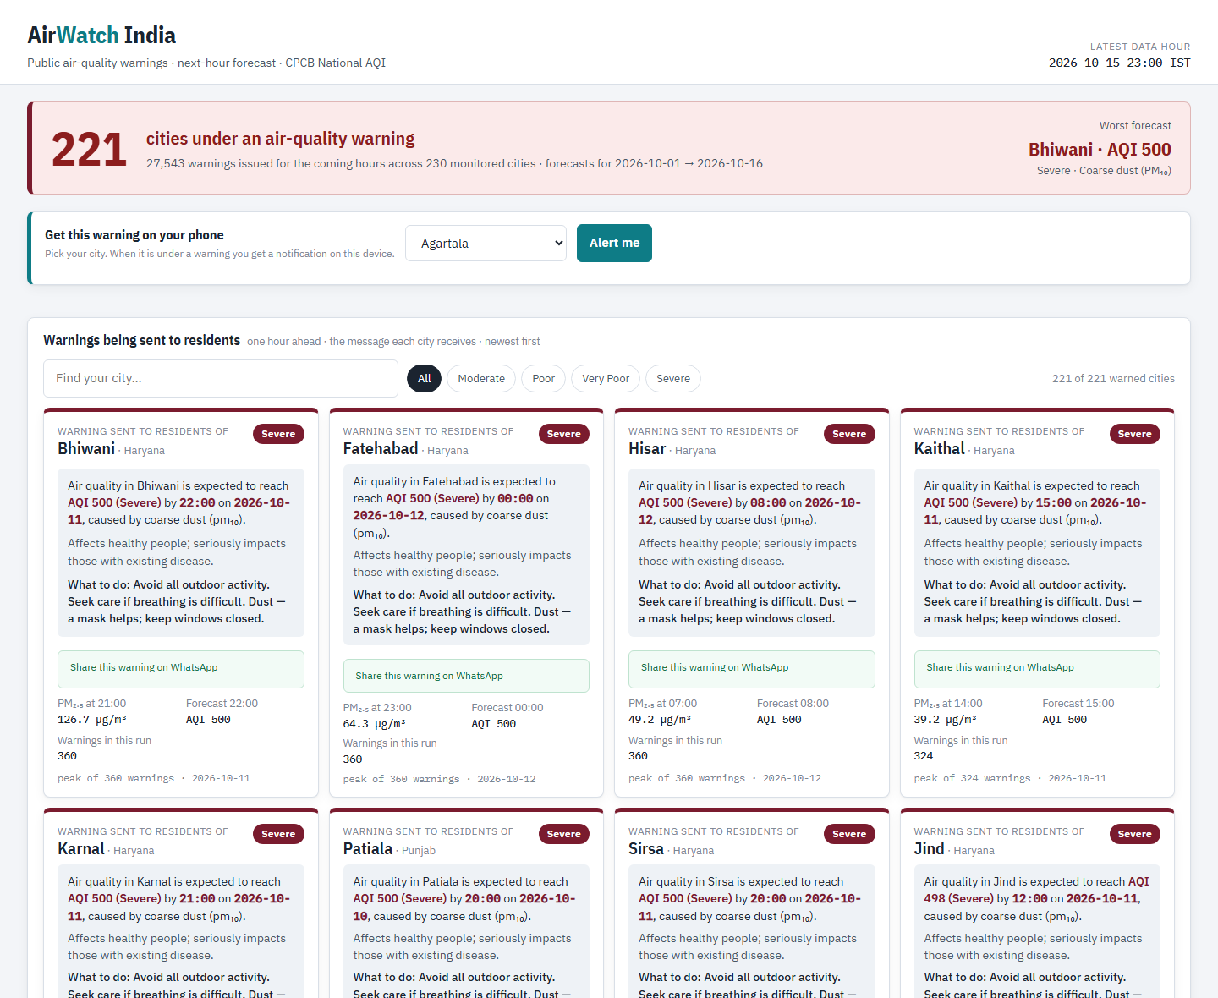
Appendix — Evidence: October Live Run, Alerts and Website
cams window : 2026-10-01 .. 2026-10-15 23:00
weather window : 2026-10-01 .. 2026-10-15 23:00
joined rows : 82,800
enriched rows : 82,800 across 230 cities
pm25 nulls=0 temperature_c nulls=0
pressure nulls=0 traffic_index nulls=0
Public warning board (AirWatch_India.html): 221 cities, worst forecast first; search, severity filter, WhatsApp share, “Alert me” notification.
october_live_cycle.log (LiveEnrichment on YARN)
[batch 0] no history yet - first run
[batch 0] *** 27543 ALERTS ***
[batch 0] rows in=82,800 predicted=82,800
alerts=27,543 latency=57,820 ms
Hive stream_alerts: 27543 rows, 221 cities,
2026-10-01 .. 2026-10-16 00:00
Telegram delivery is built and dry-run tested; a live message needs the bot token.
october_stream_scoring.log + Hive count
clock 20:00 108 cities warned -> 2 sent
Hisar new warning (AQI 463 Severe)
Fatehabad new warning (AQI 418)
clock 21:00 93 warned -> 2 sent, 2 suppressed
(already sent 1.0 h ago)
clock 02:00 0 under warning, 0 sent
hourly_dedupe_demo.log — dry-run replay
Notes:
October 1–15: 82,800 live rows enriched on YARN with no nulls on key columns, scored in the stream (27,543 alerts, 221 cities), served in Hive, shown on the board, and dispatched with de-duplication on a replay of the forecast.

Slide 16
Appendix — Claim to Evidence Index
Claim | Where the proof is
154,583,979 rows, one schema | spark_on_yarn_demo.log, merge_run.log (A2)
4 DataNodes, replication 3, HEALTHY | dfsadmin + fsck screenshots (A1)
Spark job ran on YARN, read HDFS | YARN UI screenshots + spark_on_yarn_demo.log (A2)
146,276,379 rows cleaned, 241 city partitions | CleanSelect run + HDFS browse (A3)
93,216,105 labelled rows, 86 features | phase4_fullscale.log (A3)
R² 0.8910 vs 0.8587, RMSE − 12.18 % | trackB_train_fullscale.summary.log (A4)
CPCB vs CAMS cross-validation | crossval.log, scripts/04_cross_validate_overlap.py (A4)
Oct 2026: 82,800 rows → 27,543 alerts | october_live_cycle.log, october_stream_scoring.log (A5)
De-duplicated alert dispatch | hourly_dedupe_demo.log, scripts/send_alerts.py (A5)
Hive tables and Delhi seasonality | hive_create.log, hive_queries.log
Every number reproducible | scripts/_audit/ (15 scripts), docs/WORK_LOG.md, PROJECT_REPORT.pdf
Notes:
If asked how we know a number, open the named file. All logs are preserved in docs/run_logs; screenshots are in this appendix.

