Slide 1
A Scalable Big Data Platform for Real-Time Urban Air Quality Tracking and Public Safety Alerting
First Review | 23AID302 — Big Data Analytics
Team Members: Sangeeth S (CB.AI.U4AID24050)
Jaganath R (CB.AI.U4AID24021)
Niranjan S (CB.AI.U4AID24035)
PL Kowshik (CB.AI.U4AID24036)
Group - A14

Slide 2
Abstract
Urban air pollution is a public-health problem that needs low-latency analytics, not overnight batch reports. Recent machine-learning frameworks predict air quality accurately but run on single machines: they cannot scale horizontally across a city, and they raise no automated warnings.
This project builds the distributed infrastructure those models lack.
• Hadoop HDFS stores a 27.5 GB air-quality lakehouse as 232 blocks, replicated three times across four DataNodes
• Apache Spark on YARN provides the distributed compute layer — one task per block
• Preprocessing is implemented in Scala for JVM-native execution; the analytics and ML layer is PySpark
• 146,276,379 hourly sensor readings across 4,077 monitoring stations and 241 cities
• A Gradient Boosted Tree regressor forecasts PM2.5 one hour ahead, feeding a closed-loop alert engine that fires when predicted AQI exceeds 150

Slide 3
Problem Statement
Three gaps between what exists and what a city actually needs
• Scale. Existing air-quality models run on a single machine. A city-wide deployment generates hundreds of millions of readings — more than one machine can hold in memory, let alone process repeatedly.
• Latency. Batch analytics produce reports after the fact. A pollution spike is a public-health event happening now; a warning delivered tomorrow has no value.
• Automation. Published frameworks stop at prediction. None close the loop by converting a forecast into an actionable public-safety alert.

Slide 4
Objectives
# | Objective | Success criterion
1 | Deploy a fault-tolerant HDFS cluster | ≥ 2 DataNodes, 3× replication, 0 corrupt blocks
2 | Activate distributed compute on the cluster | Spark running under YARN, not local mode
3 | Ingest the dataset into distributed storage | Full dataset split into 128 MB blocks
4 | Implement preprocessing in Scala | Reads HDFS, cleans, writes back to HDFS
5 | Engineer spatial-temporal features | T+1 target, rolling history, CPCB AQI
6 | Train a distributed GBT forecaster | Must beat the persistence baseline
7 | Build a streaming speed layer | Structured Streaming micro-batches
8 | Close the loop with an alert engine | Warning written when predicted AQI > 150

Slide 5
Literature Survey
Primary base paper
“Air Quality Prediction using Multi-Source Remote Sensing Data Integration with Hybrid Deep Learning Framework (MAST-Net)” — Nature, Scientific Reports, December 2025
Contribution
Demonstrates that fusing multiple environmental data streams — remote sensing, meteorology, ground sensors — improves predictive accuracy over single-source models.
The architectural gap this project addresses
• MAST-Net is built entirely on a localised, single-machine framework
• It has no distributed infrastructure for high-volume, multi-city scaling
• It provides no streaming mechanism for immediate real-time warnings
This project ports the data-fusion concept into a Hadoop + Spark cluster, adding the distributed storage, parallel compute, streaming and alerting layers the original work explicitly lacks.

Slide 6
Proposed System / Methodology
Lambda-style architecture: batch layer + speed layer over a shared HDFS lakehouse
Layer | Technology | Function
Storage | Hadoop HDFS 3.3.6 | 128 MB blocks, 3× replication across 4 DataNodes
Resource mgmt | Hadoop YARN | 1 ResourceManager + 4 NodeManagers allocate containers
Preprocessing | Apache Spark + Scala 2.12 | Cleaning, imputation, Parquet conversion
Feature engineering | Spark SQL (PySpark) | T+1 target, rolling windows, CPCB AQI
Batch ML | Spark MLlib (PySpark) | Gradient Boosted Tree regressor
Speed layer | Structured Streaming (Scala) | Micro-batch ingestion, sub-second latency
Alerting | Scala | Closed loop: predicted AQI > 150 → warning
Serving | Apache Hive | External tables over Parquet for ad-hoc SQL
Language split follows the project specification: PySpark for batch analytics and ML, Scala for the latency-critical speed layer.

Slide 7
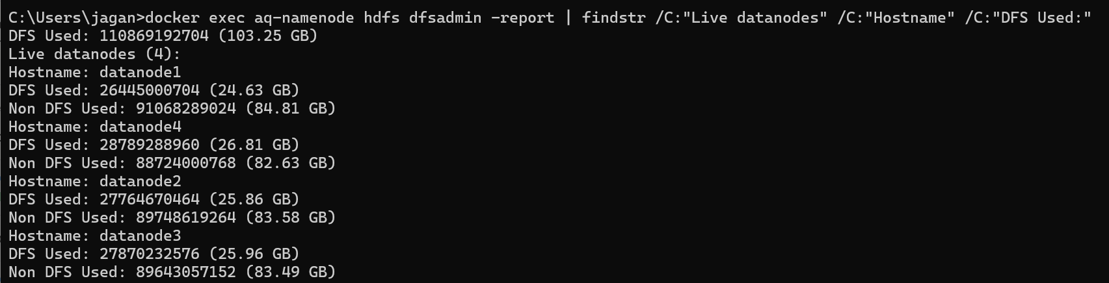
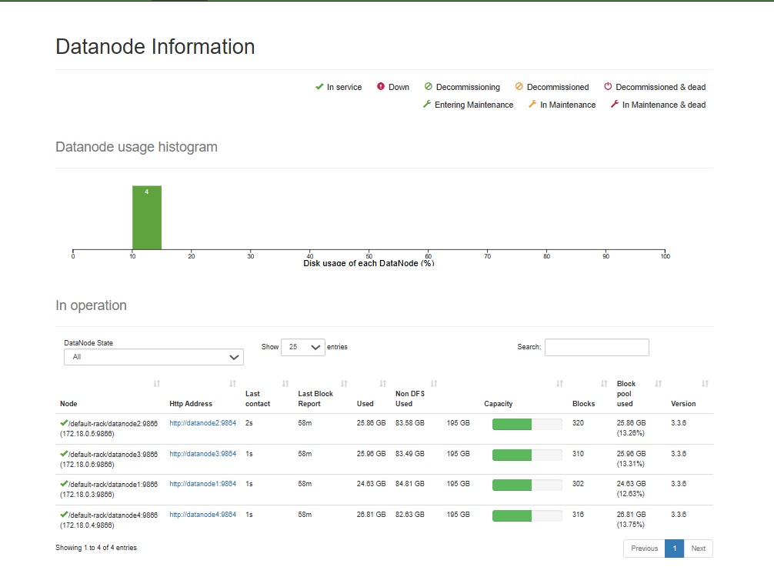
Implementation — Hadoop Cluster
1 NameNode + 4 DataNodes, containerised, with YARN resource management
Four DataNodes, not the minimum two: with three nodes at replication 3 every node must hold every block, so nothing distributes and a failed node has nowhere to re-replicate.

Slide 8
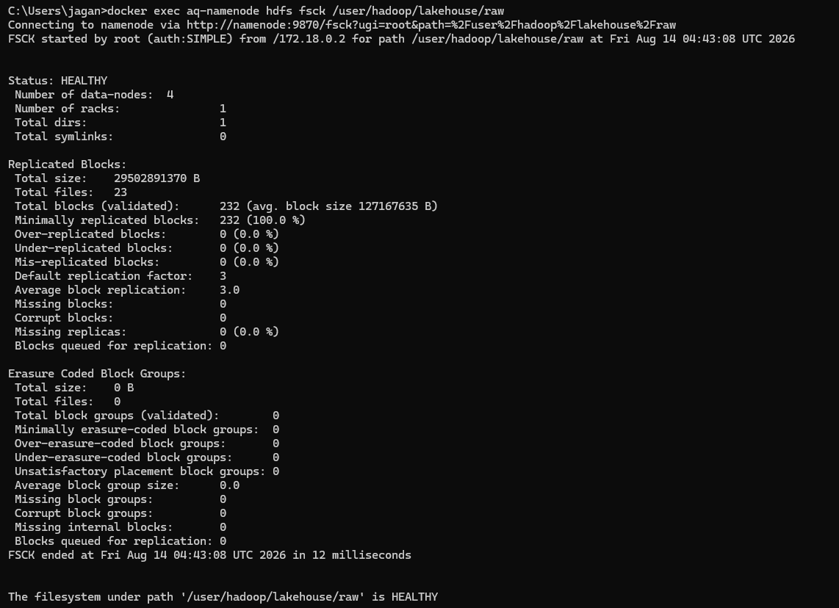
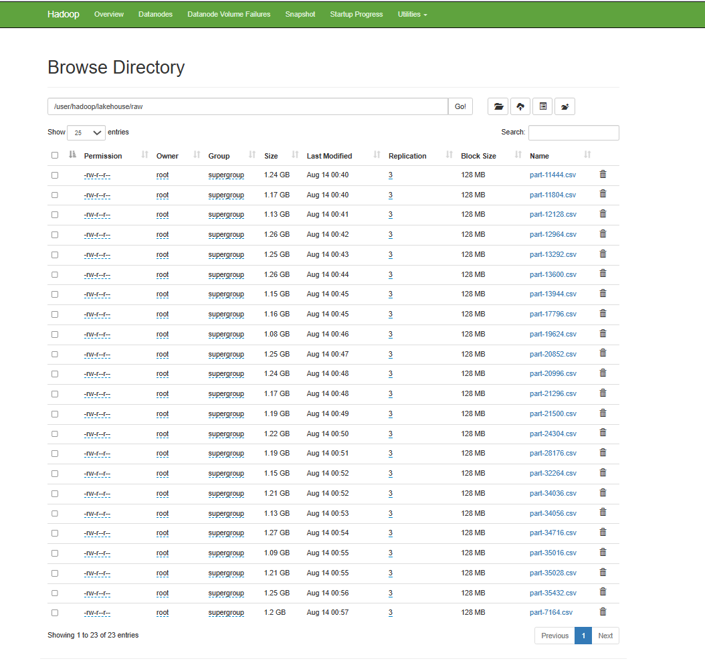
Implementation — Raw Dataset in HDFS
27.5 GB split into 232 blocks, replicated 3× to 82.4 GB
Block arithmetic
HDFS allocates blocks per FILE, not across the dataset as a whole. Each of the 23 files ends in a partial block.
Σ ceil(filesize ÷ 128 MB) = 232
232 blocks × 3 replicas = 696
≈ 174 replicas ≈ 20.6 GB per DataNode
232 blocks means 232 parallel input splits for Spark — one task per block.

Slide 9
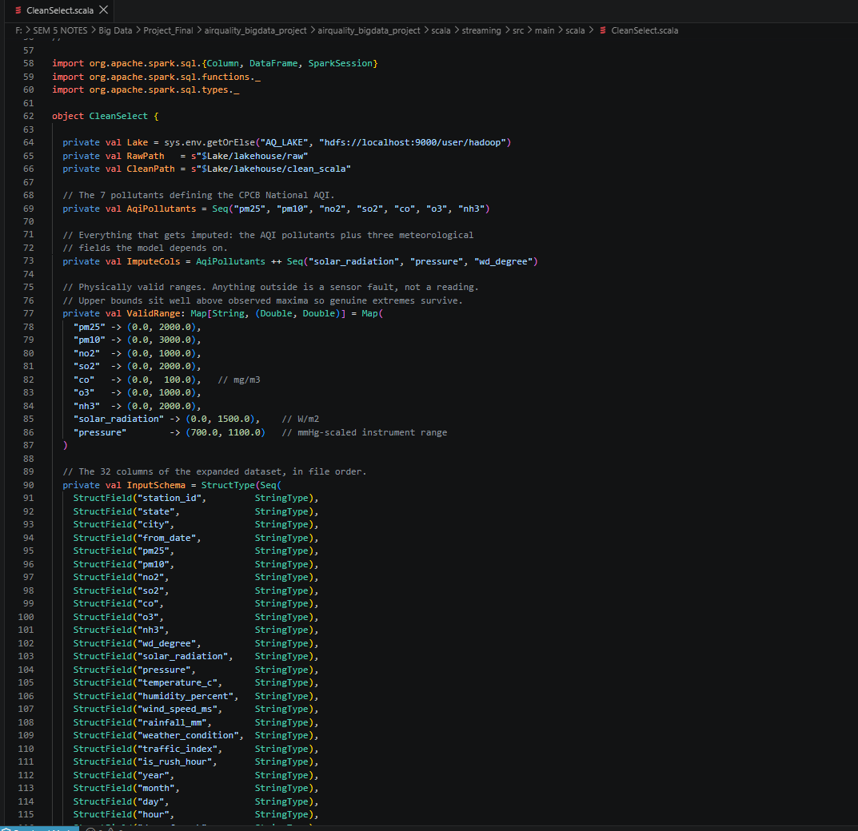
Implementation — Scala Preprocessing
CleanSelect.scala — reads HDFS, cleans, writes back to HDFS
Ten preprocessing operations
1. Explicit 32-column schema, no inference
2. Type casting to double / int / timestamp
3. Timestamp parsing; unusable rows dropped
4. Binary flag repair to strict 0/1
5. Physical range clamping
6. Anomaly eradication (out-of-range → null)
7. Three-tier median imputation
8. Imputation provenance flags
9. Label protection (pm25_measured)
10. Snappy Parquet, partitioned by city

Slide 10
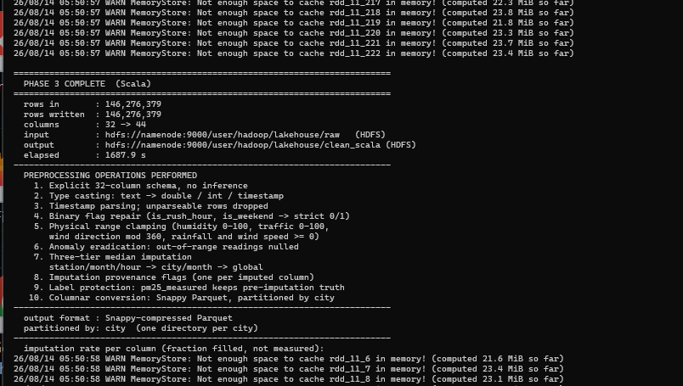
Results — Preprocessing Executed at Full Scale
Measured
Rows in: 146,276,379
Rows written: 146,276,379
Columns: 32 → 44
Input: HDFS
Output: HDFS

Slide 11
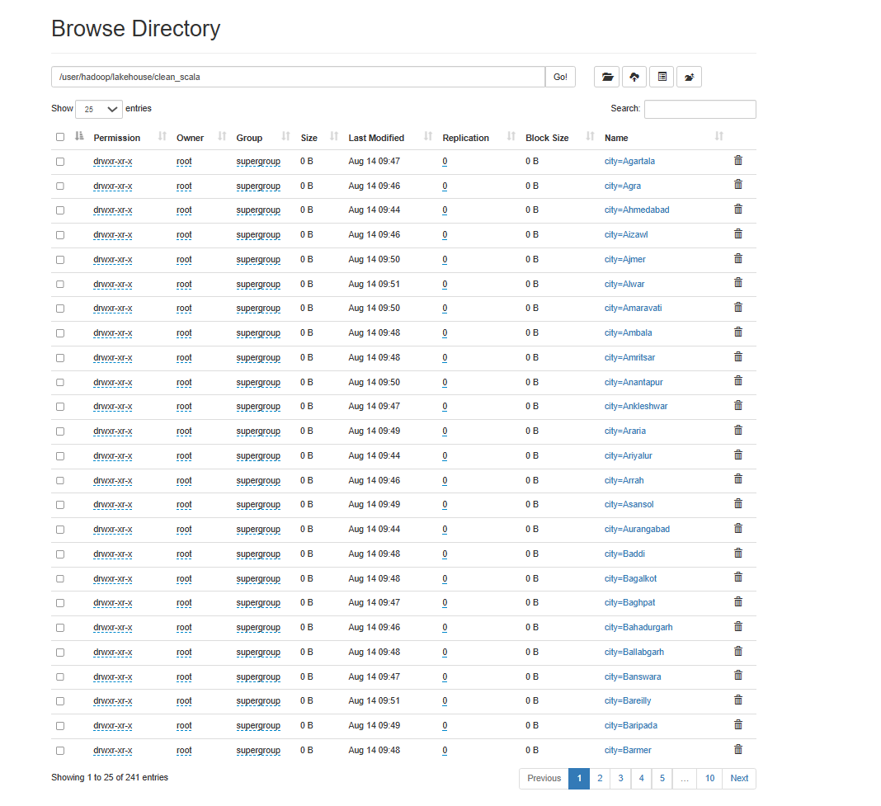
Results — Processed Dataset Back in HDFS
Both datasets in HDFS: raw input and processed output
Metric | Value
Logical size | 10.0 GB
Replicated size | 20.0 GB (×2)
Partitions | 241 — one per city
Format | Snappy Parquet
CSV → Parquet | 27.5 GB → 10.0 GB (2.75×)

Slide 12
Results — Data Quality and Imputation
Only ~46% of rows carry all seven CPCB pollutants; imputation is necessary and is fully flagged
Column | Imputed | Measured | Column | Imputed | Measured
pm25 | 27.17% | 72.83% | nh3 | 41.72% | 58.28%
pm10 | 34.20% | 65.80% | solar_radiation | 40.76% | 59.24%
no2 | 21.58% | 78.42% | pressure | 55.28% | 44.72%
so2 | 25.50% | 74.50% | wd_degree | 28.77% | 71.23%
co | 25.28% | 74.72% | o3 | 26.89% | 73.11%
Three-tier median imputation
station / month / hour → city / month → global
• Every filled value carries a *_was_imputed flag, so measured and estimated data never become indistinguishable
• The forecasting target is built only from pm25_measured — a model is never trained to predict an imputed median

Slide 13
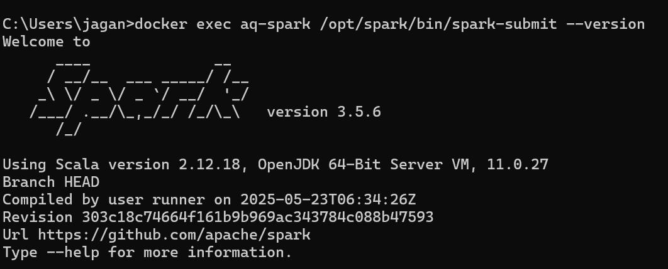
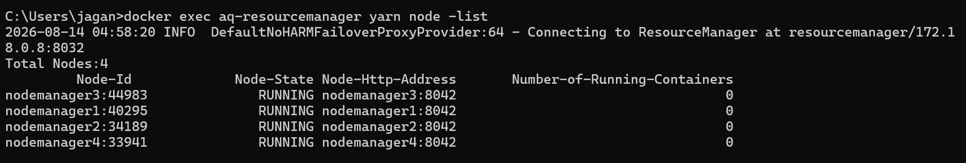
Results — Spark Engine Activation on YARN
Spark job executed on YARN
Uploading __spark_libs__.zip → HDFS
Submitted application_…_0002
state: ACCEPTED
ApplicationMaster registered
state: RUNNING
Pi is roughly 3.1416875708437852
FINISHED / SUCCEEDED / 100%
Genuine distributed compute — not single-machine local mode.
Spark 3.5.6 on Scala 2.12.18
yarn node -list — Total Nodes: 4, all RUNNING

Slide 14
Challenges and Limitations
Every item below was encountered, diagnosed and resolved during implementation
Challenge | Root cause | Resolution
Spark could not write to HDFS from the host | NameNode returns container-internal DataNode addresses the host cannot route to | Run Spark inside the cluster network, as real deployments do
Spark 3.5 refused to start | Java 23 removed the security-manager API Hadoop depends on | Pin JRE 8 per shell; system JDK untouched
Every Parquet write failed on Windows | winutils.exe / hadoop.dll absent — reads work, so it surfaces only at write time | Install Hadoop 3.3.x Windows binaries
Output fragmented into ~40,000 tiny files | Partitioning by (city, year, month); each file occupies ≥ 1 HDFS block | Partition by city alone → 241 well-sized files
Shuffle spill exhausted the system drive | Spark scratch defaulted inside the container image | Move scratch to a managed volume, monitor free space
Current limitation: the cluster runs on a single physical host with 15.7 GB RAM, of which the container VM receives 7.6 GB. This bounds executor memory and makes model training the slowest stage; it is a hardware constraint, not an architectural one.

Slide 15
Big Data Tools Used
Tool | Version | Role in this project
Hadoop HDFS | 3.3.6 | Distributed storage — 232 blocks, 3× replication, 4 DataNodes
Hadoop YARN | 3.3.6 | Resource management — 4 NodeManagers allocate containers
Apache Spark Core | 3.5.6 | Distributed execution engine, one task per block
Spark SQL | 3.5.6 | DataFrame API, Catalyst optimiser, window functions
Spark MLlib | 3.5.6 | Gradient Boosted Tree regressor
Structured Streaming | 3.5.6 | Speed layer — micro-batch ingestion
Scala | 2.12.18 | Preprocessing and streaming — JVM-native execution
PySpark / Python | 3.5.6 / 3.12 | Batch analytics, feature engineering, ML
Apache Parquet | Snappy | Columnar storage — 2.75× compression vs CSV
Docker | 29.7.2 | Container orchestration for the cluster

Slide 16
Big Data Tools vs Conventional Processing
The same 146,276,379-row workload, measured
Dimension | Conventional (single machine, pandas/CSV) | This platform (Hadoop + Spark)
Storage volume | 27.5 GB CSV on one disk | 10.0 GB Parquet, 2.75× compression
Memory requirement | Dataset must fit in RAM — 15.7 GB available, insufficient | Streams from disk; 128 MB blocks processed independently
Fault tolerance | One disk failure loses everything | 3× replication survives two simultaneous node failures
Parallelism | Single process, one core at a time | 232 blocks → 232 parallel input splits across 4 nodes
Scaling model | Vertical — buy a bigger machine | Horizontal — add DataNodes, capacity and throughput grow
Data locality | All data moves to the process | Computation is scheduled where the blocks already are
Recovery | A crash restarts the whole job | YARN reschedules only the failed containers
Real-time capability | Batch only, after the fact | Structured Streaming micro-batches for live alerting

Slide 17
Conclusion and Future Work
What has been demonstrated
• A fault-tolerant HDFS cluster storing 146,276,379 readings as 232 blocks, replicated three times across four DataNodes, verified HEALTHY with zero corrupt blocks
• Spark executing under YARN across four NodeManagers — distributed compute, not local mode
• Scala preprocessing performing ten cleaning operations over the complete dataset, reading from HDFS and writing back to HDFS in 28 minutes
• Columnar conversion achieving 2.75× compression with no data loss
Future work
• Complete distributed GBT training and export the model to HDFS
• Activate the Structured Streaming speed layer and the closed-loop alert engine
• Add the Hive serving layer for ad-hoc analytical SQL
• Build the operations dashboard — throughput, model comparison, live alert feed
• Extend to spatial neighbour features, enabling a GraphX station-network model

Slide 19
References
[1] Air Quality Prediction using Multi-Source Remote Sensing Data Integration with Hybrid Deep Learning Framework (MAST-Net). Nature, Scientific Reports, December 2025. [base paper]
[2] Apache Hadoop Documentation, version 3.3.6. The Apache Software Foundation. https://hadoop.apache.org/docs/r3.3.6/
[3] Apache Spark Documentation, version 3.5.6. The Apache Software Foundation. https://spark.apache.org/docs/3.5.6/
[4] Central Pollution Control Board (CPCB). National Air Quality Index — Report of the Expert Group, 2014. Government of India.
[5] Zaharia, M. et al. Resilient Distributed Datasets: A Fault-Tolerant Abstraction for In-Memory Cluster Computing. NSDI, 2012.
[6] Shvachko, K., Kuang, H., Radia, S., Chansler, R. The Hadoop Distributed File System. IEEE MSST, 2010.
[7] Friedman, J. H. Greedy Function Approximation: A Gradient Boosting Machine. Annals of Statistics, 29(5), 2001.
[8] Apache Parquet Documentation. The Apache Software Foundation. https://parquet.apache.org/

