Slide 1
REST API INTRODUCTION

Slide 2
Django REST Framework
Most of the people do not know this
It is mandatory technology
Django application with out retapi not that much powerful
3. It is easy technologies
4.It is very small technology

Slide 3
Most used words
API
Web API /Web Service
REST
REST API
Django REST Framework

Slide 4
API: Application program interface
What is API:
by using ATM GUI screen end user access ATM functionality
by using Key Pad of mobile we can access Mobile phone functionality
I have one software application to access my software application functionality API requried

Slide 5
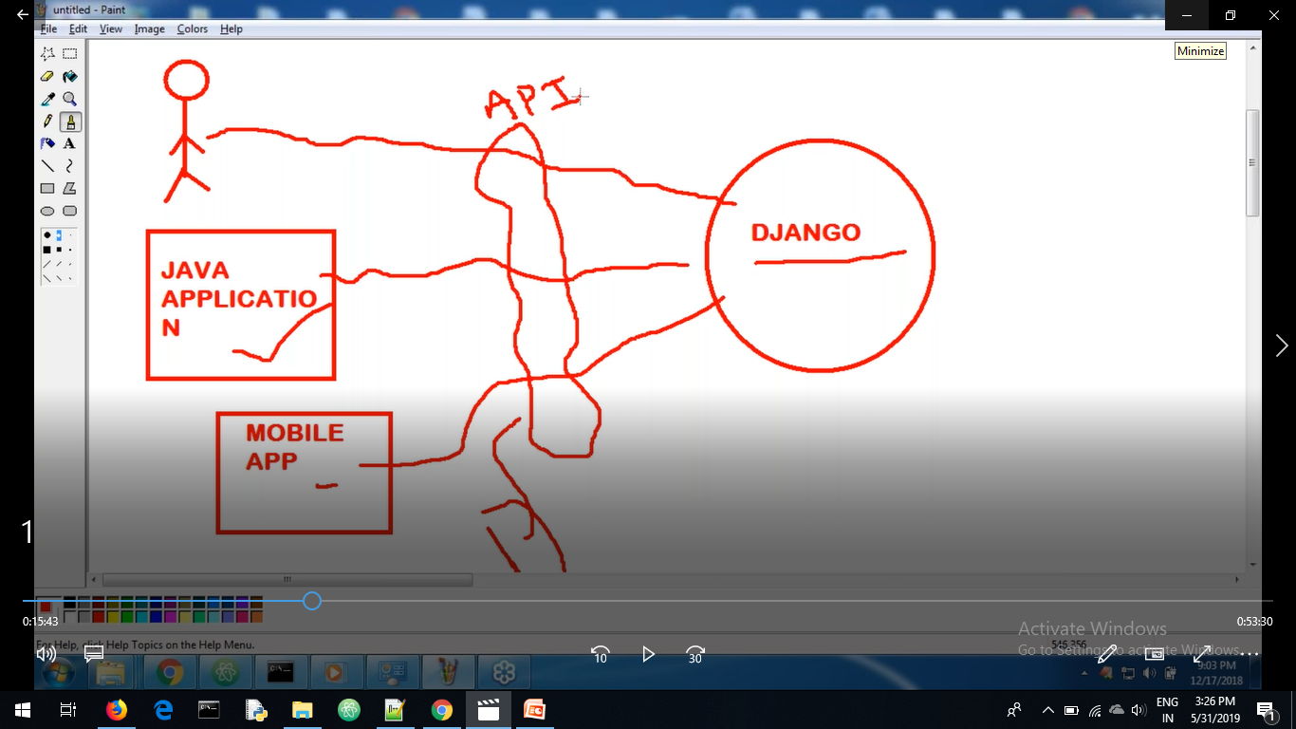
To access Django application from JAVA APPLICATION or from MOBILE APPLICATION we can provide some interface between it. So that JAVA APPLICATION or MOBILE APPLICATION is easily communicate with my Django application this interface is nothing but API

Slide 6
API Defination
To access functionality of one software application from another software application some interface is required that interface nothing but API
Or
Two applications wants to communicate compulsory mediator is required that mediator nothing but a API

Slide 7
Up to now we developed django applications that time our role is Django APP Developers.
Now I want developed API for communication between the applications. Now our role is API DEVELOPER
The main purpose of API is INTEROPERABILITY

Slide 8
Web API / Web Service
Web API same as API
I have one web application I developed one API for my web application now any person access my application through http protocol
API developed to access web application is known as Web API or Web service

Slide 9
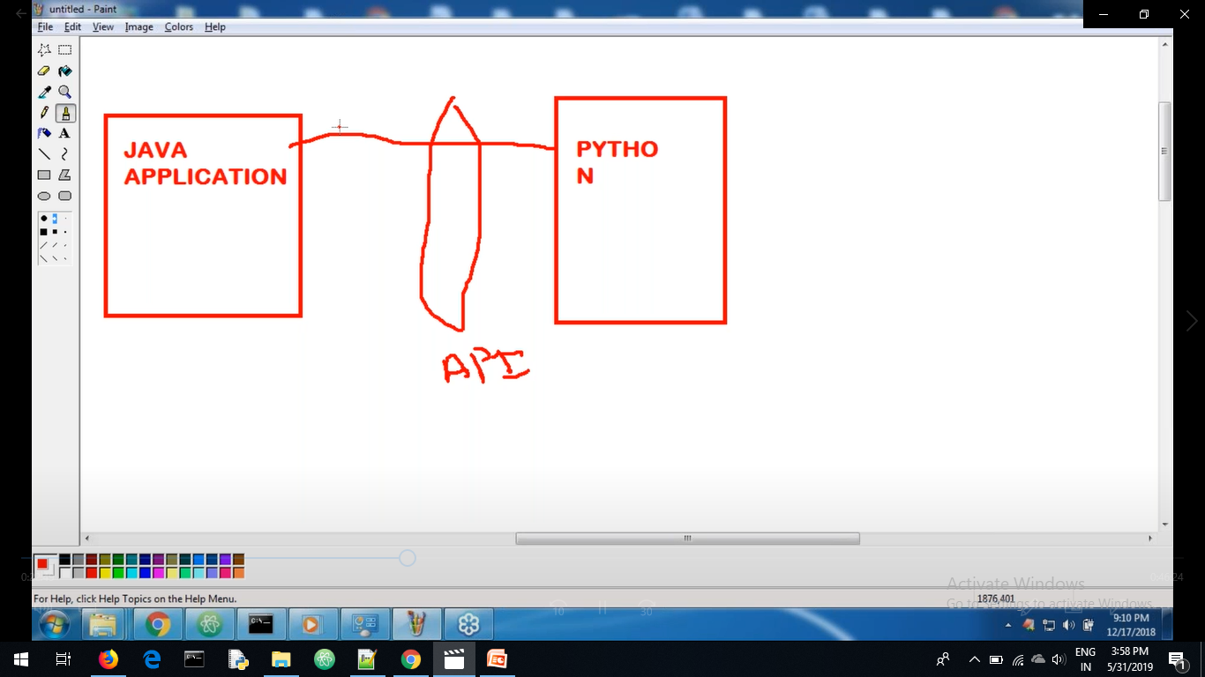
Normal API

Slide 10
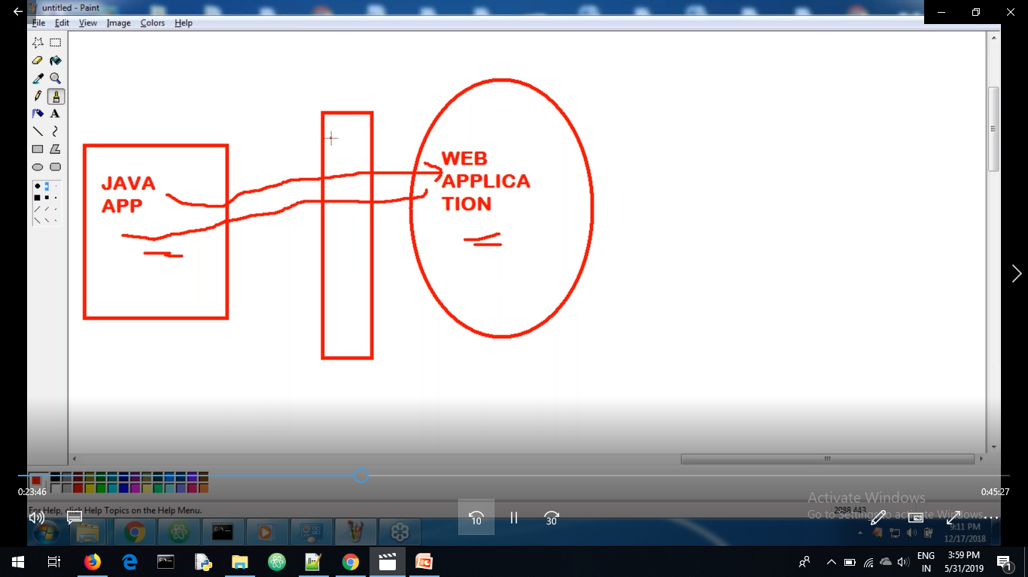
Web API

Slide 11
When ever booking ticket in red bus sometime please do not close browser application communicating to the bank application. Here red bus application and bank application communicate through API

Slide 12
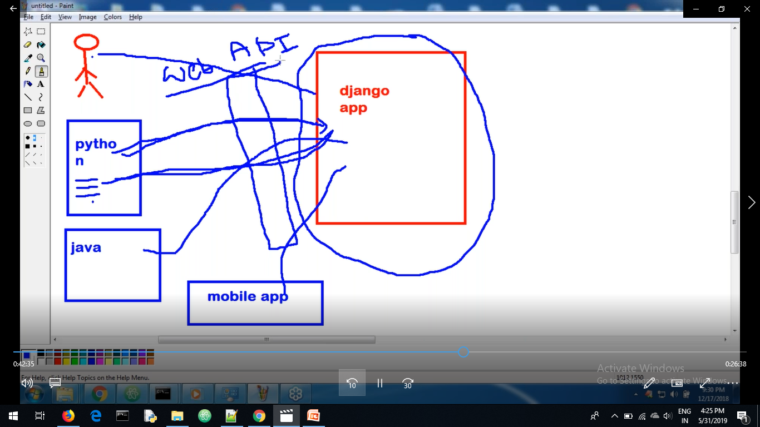

Slide 13
REST: REST is Architecture
REST defines several guidelines to develop web apis very easily.
The APIs which are developed by REST are known as REST APIs or RESTFUL APIs.
Django REST Framework provides several tools to develop RESTful APIs very easily .

Slide 14
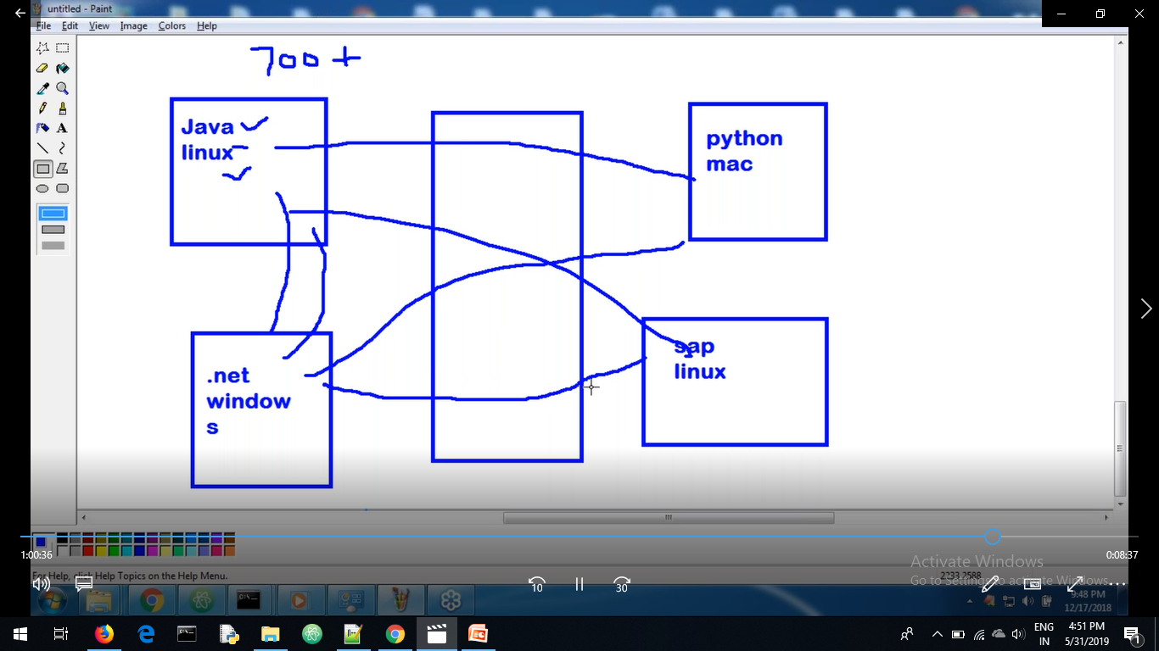

Slide 15
We know any type of application understand http language
Common message format every application understand are xml and json
json=--------→ java script object notations
Now days json more common message format used

