Slide 1
Restproject1
Html response
Json response
API to access the server and get data

Slide 2
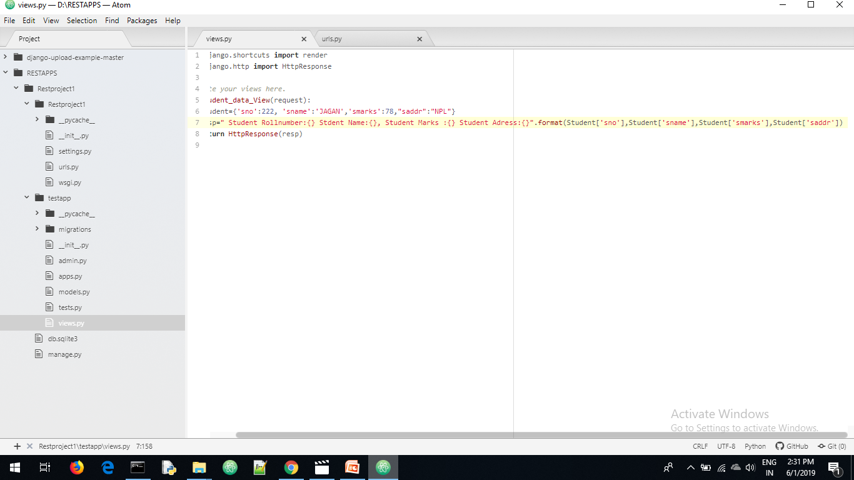
Views.py

Slide 3
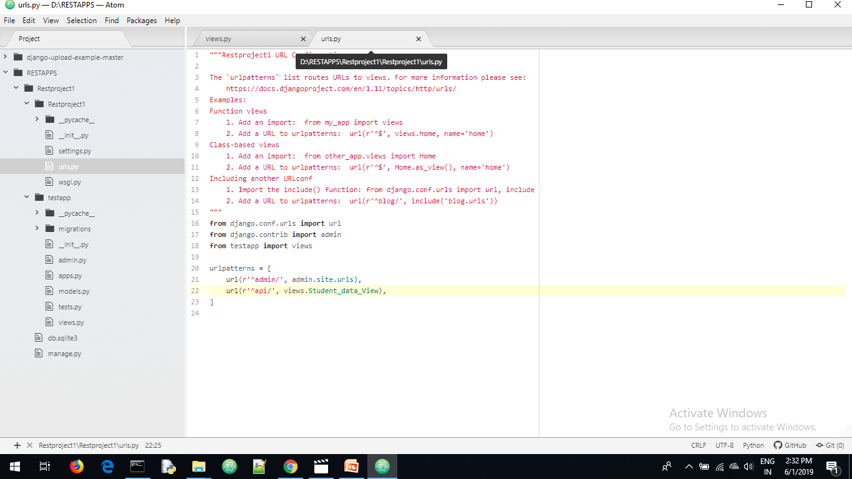
Urls.py

Slide 4
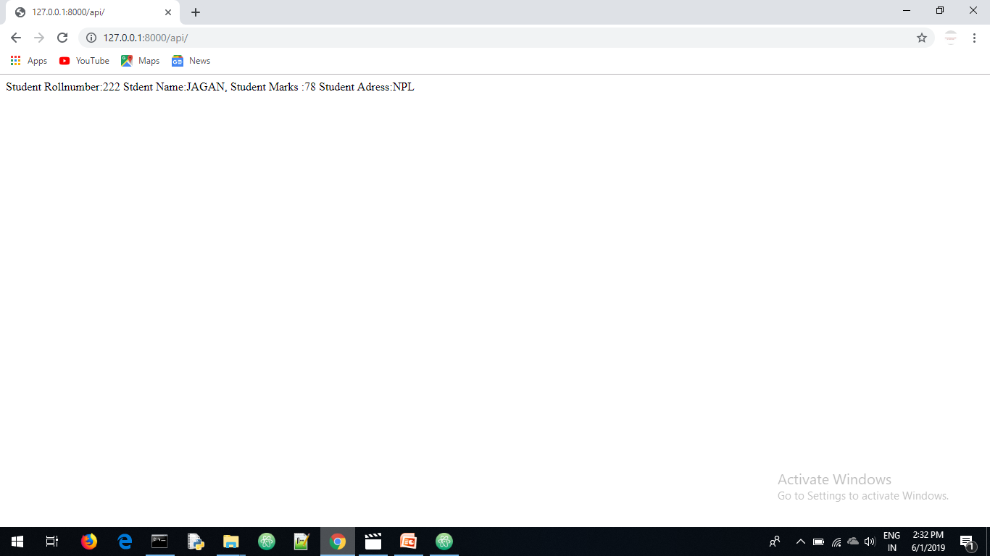

Slide 5
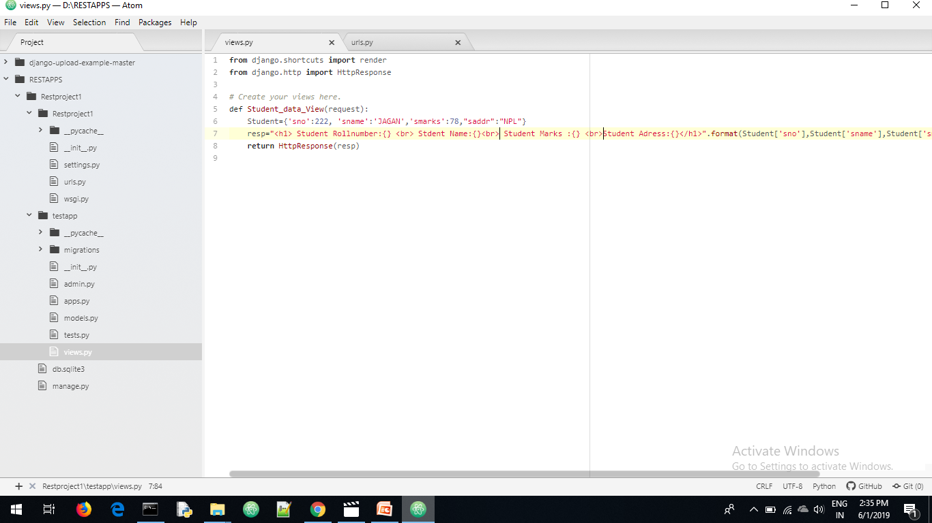
Views.py

Slide 6
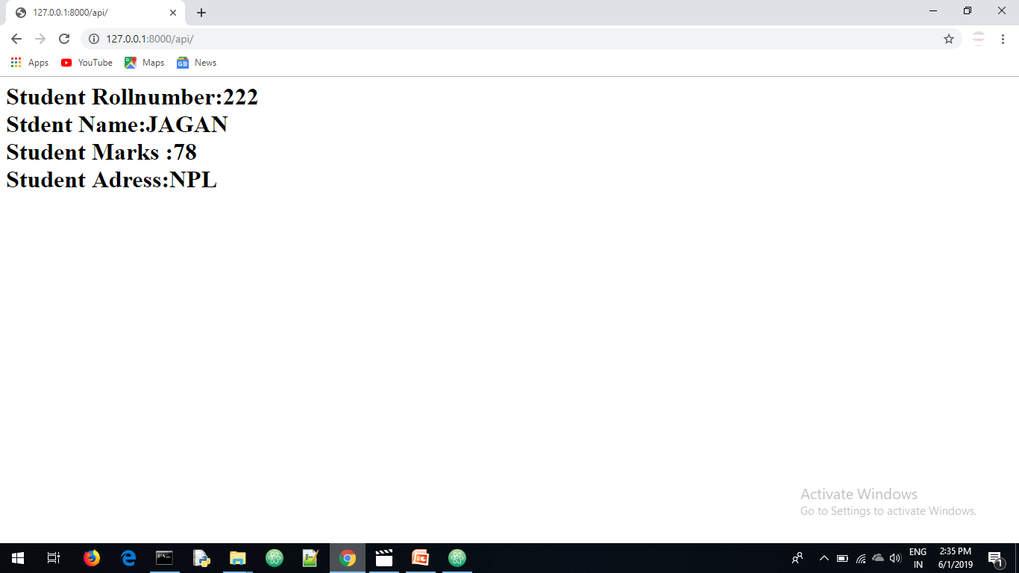
Html responce

Slide 7
Any request Our application return response is html response always
Suppose java application send a request to our application . Our application returns html response the java application not under stand the html response
Our job is all applications who send request to our Django application the applications understand the our djangoapplication response.
For that json is required

Slide 8
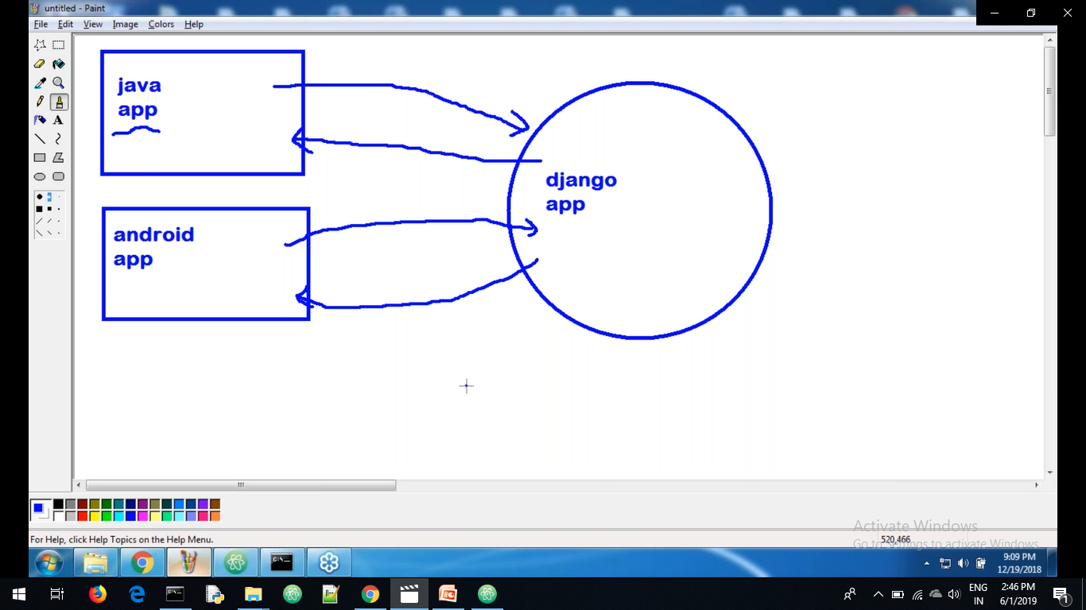

Slide 9
Json advantages is in world every application understand the json response
Json is light weigh application

Slide 10
dumps() and loads() are the functions
dumps() and loads() are inside python inbuilt module json module

Slide 11
Purpose of dumps() and loads()
I want convert python dict to json object we required use dumps() function
I want convert json data to python dict we required use loads()

Slide 12
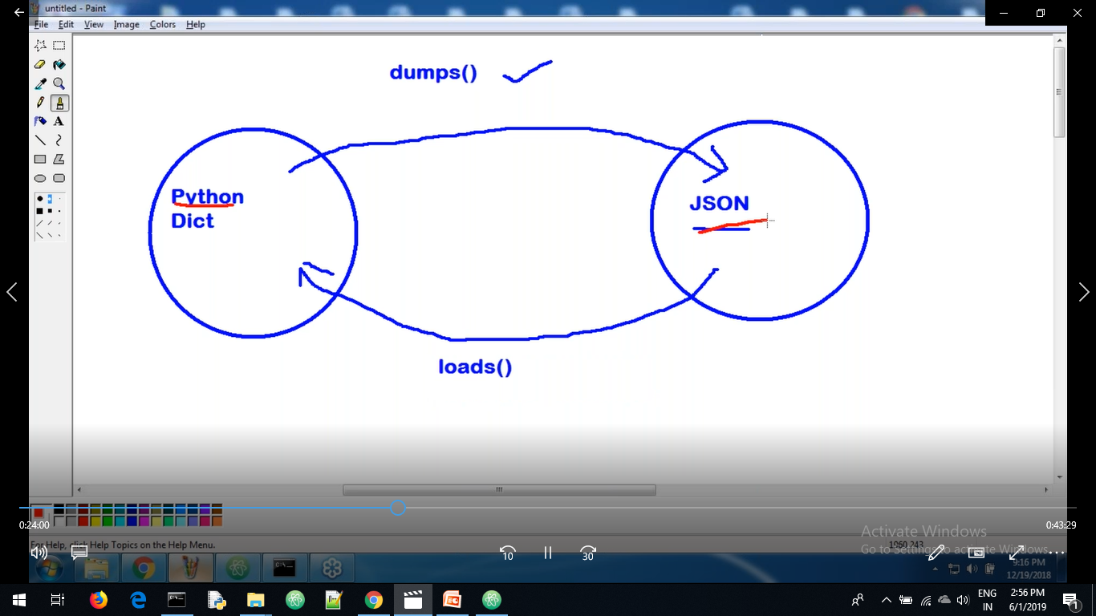

Slide 13
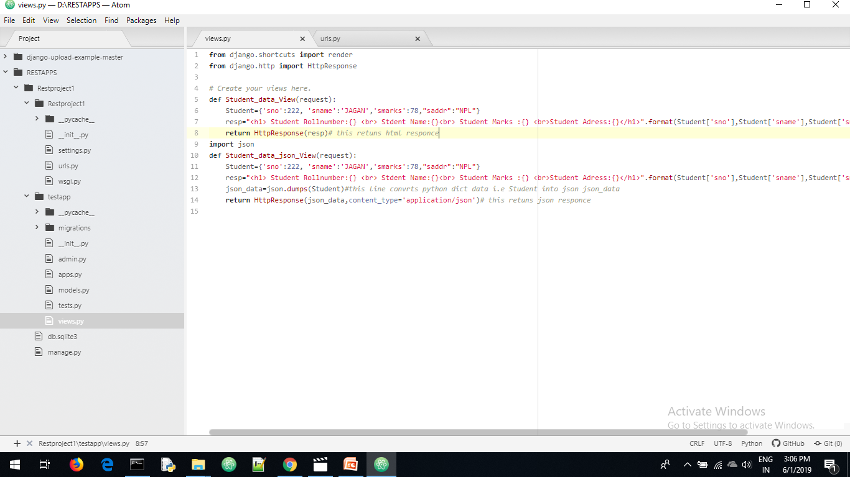
Views.py

Slide 14
Response to other software applications compulsory our application response is json only
content_type='application/json-→this response is known as MIME (multi purpose internet mail extinction) type
Html response understand human (human readable form)
Json response understand the other soft ware applications

Slide 15
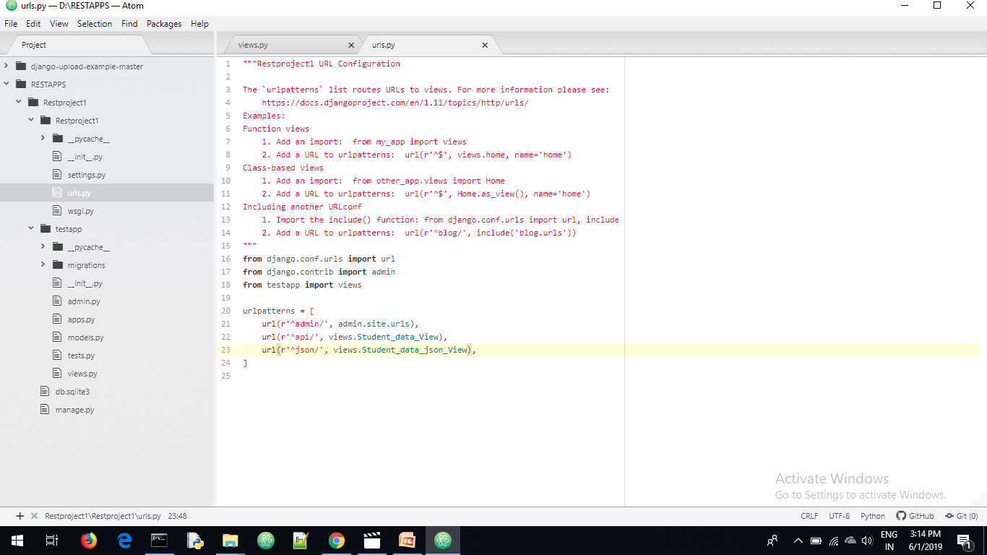
Urls.py

Slide 16
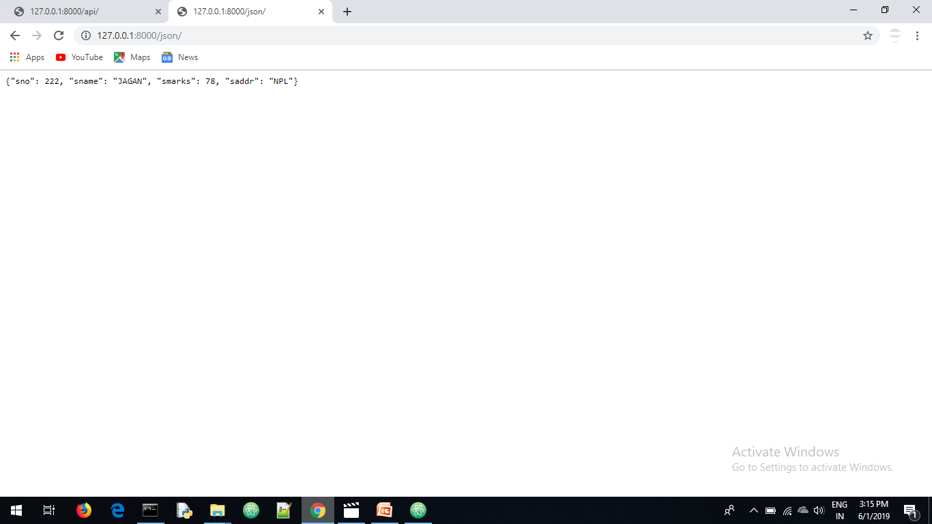
Json response

Slide 17
We send the http request from browser
Is it possible to send http request from cmd promt?
command line http clients are there using these clients we send http request from cmd
Curl, httpie …..are cmd line clients
To install httpie pip→pip install httpie

Slide 18
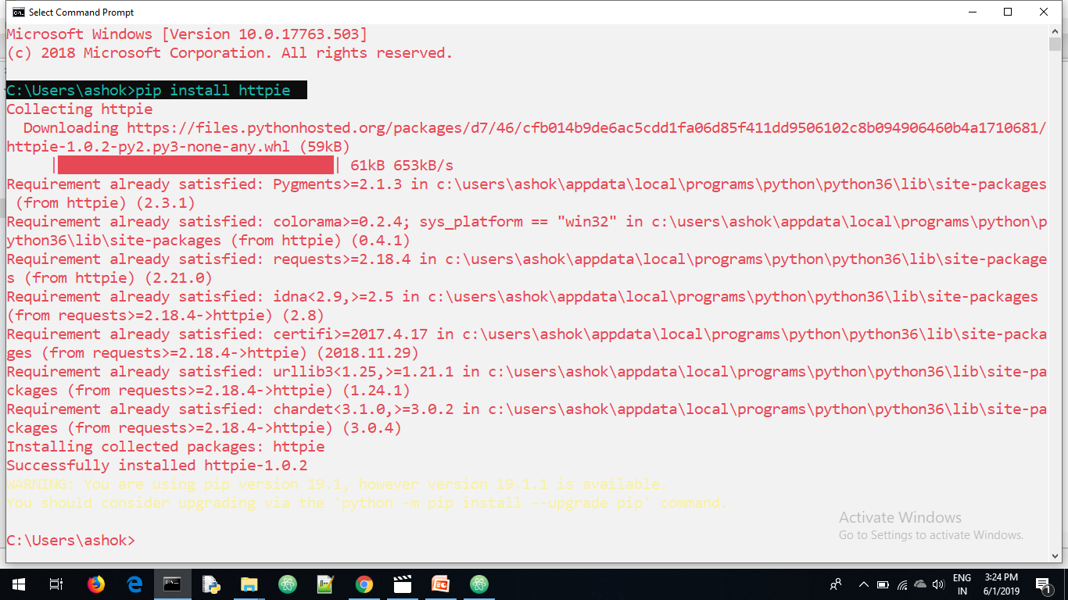
pip install httpie

Slide 19
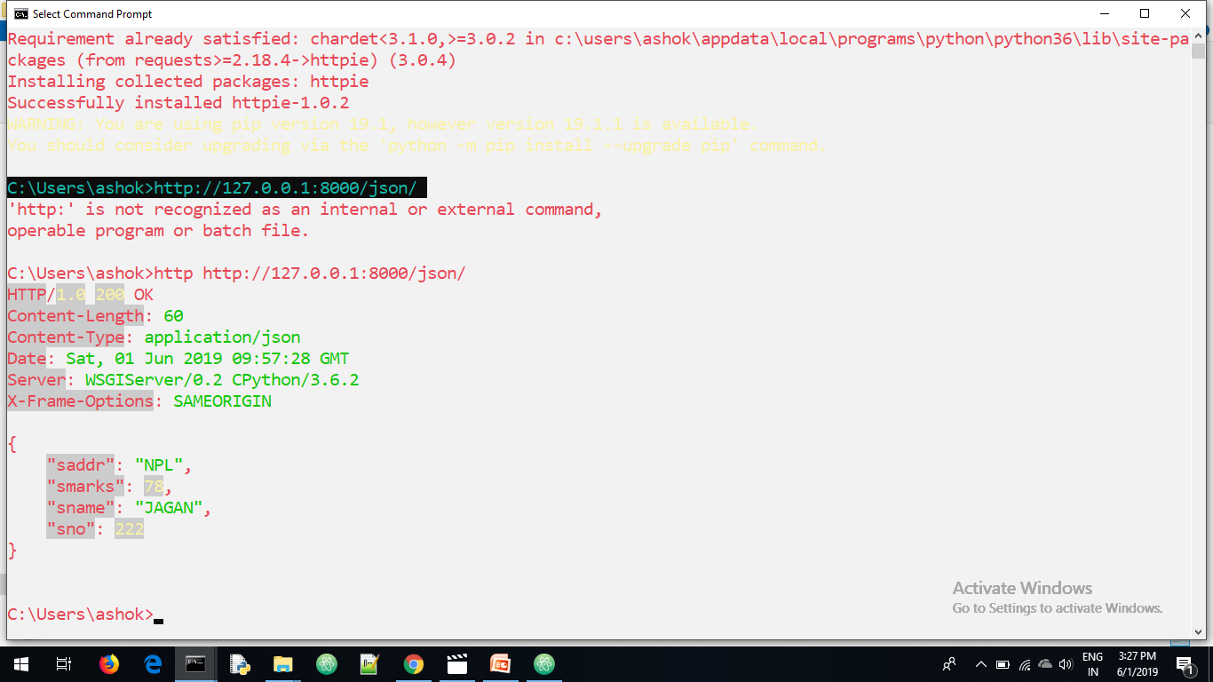
http://127.0.0.1:8000/json/ sending request from cmd

Slide 20
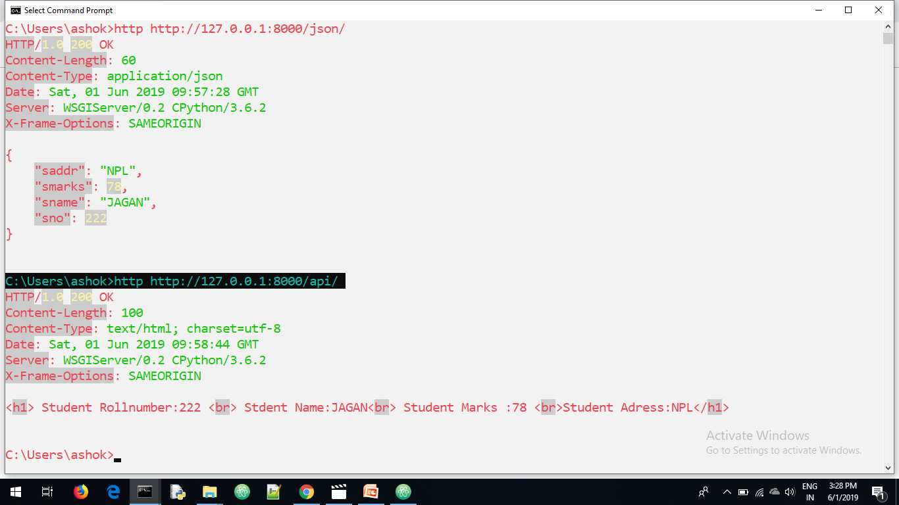
http://127.0.0.1:8000/api/ sending request from cmd

Slide 21
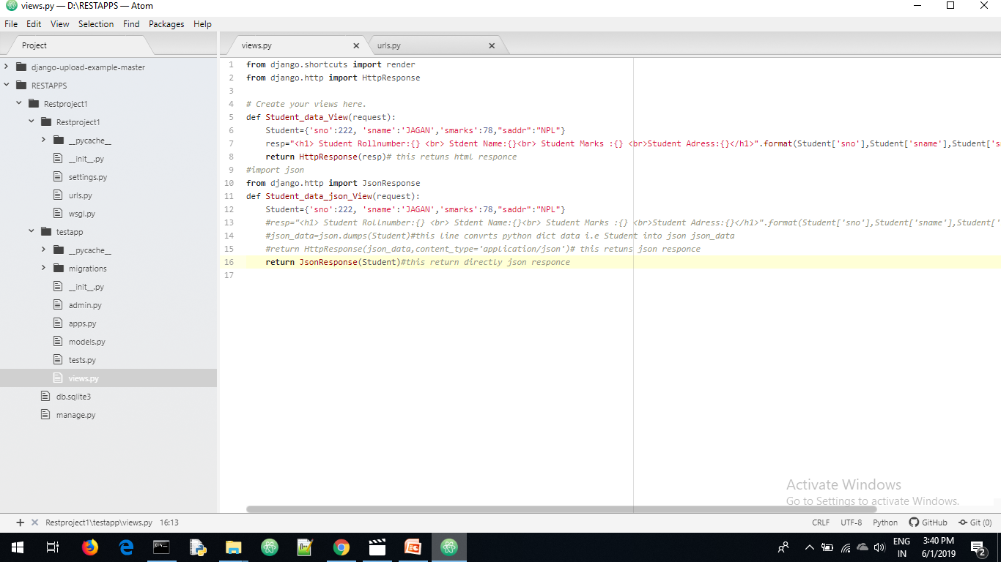
Views.py

Slide 22
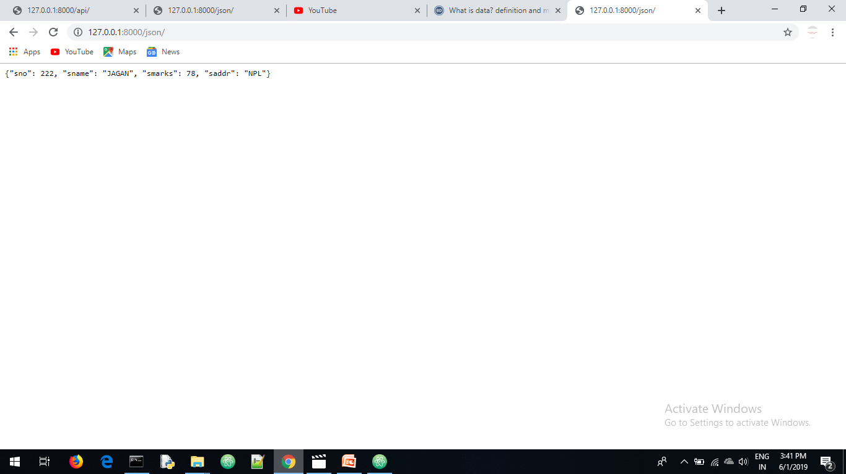

Slide 23
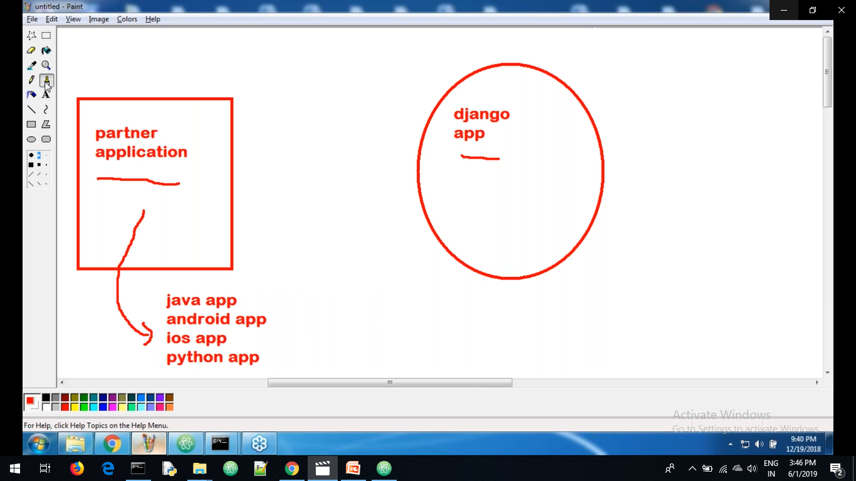

Slide 24
pip install requests
I want send http request through python application
We create the one python file any where in the project
we send request from python file we install requests modules
pip install requests

Slide 25
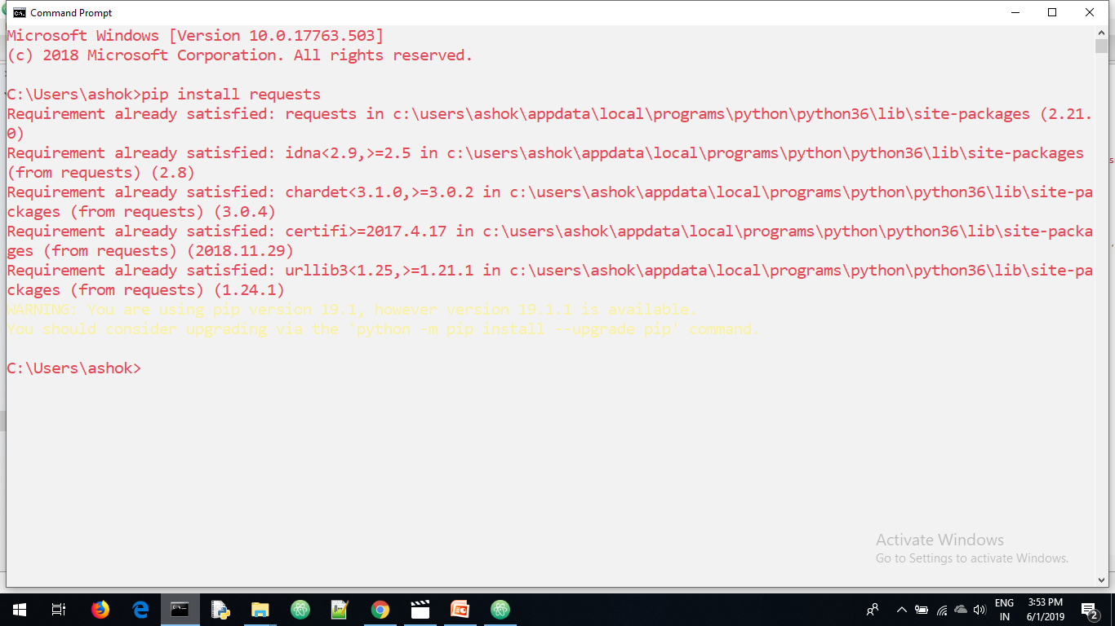
pip install requests

Slide 26
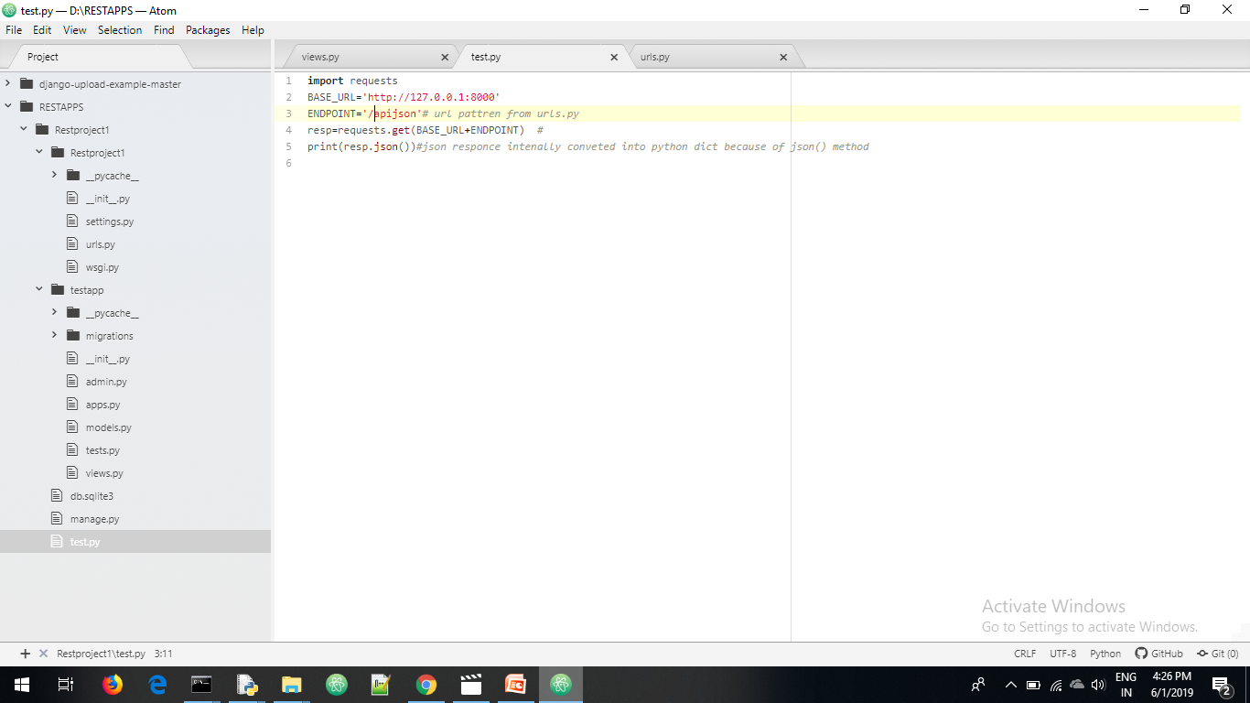

Slide 27
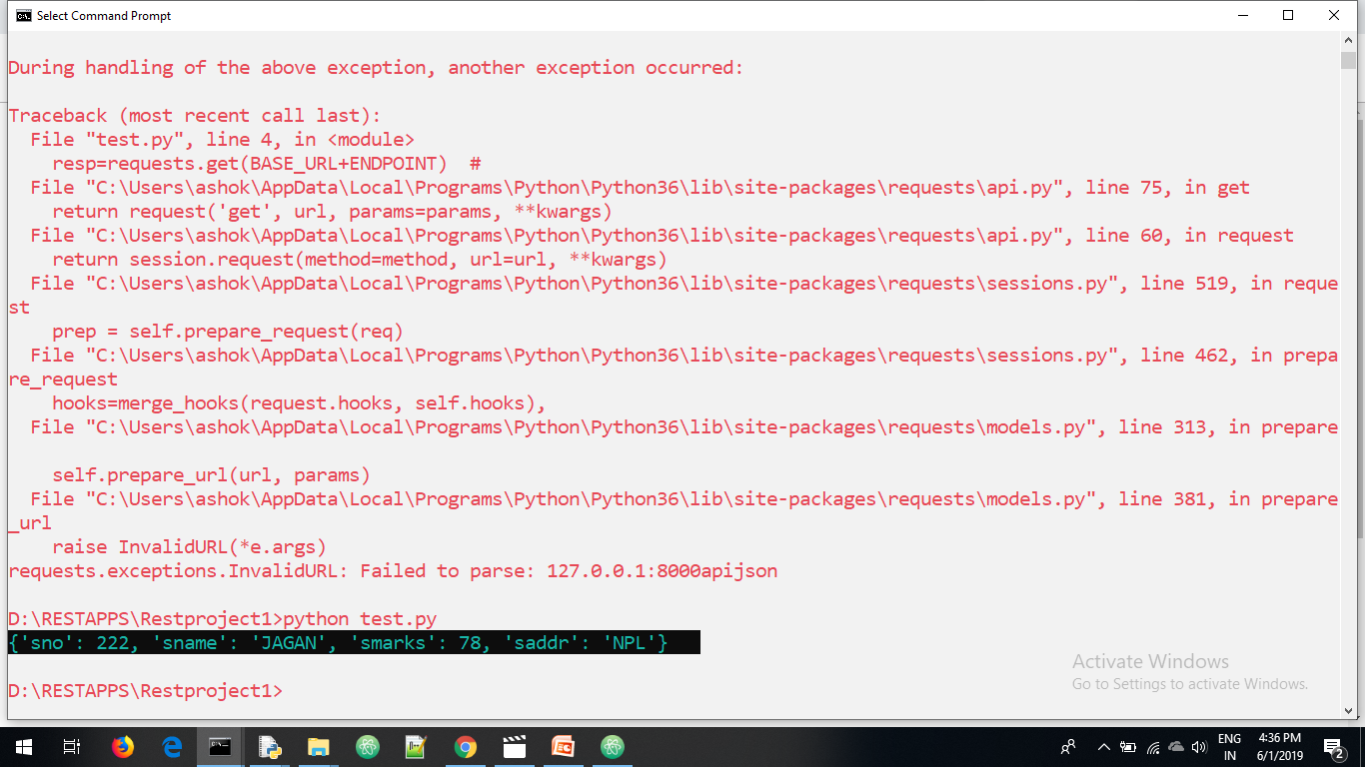
Sending request from python i.e test.py

Slide 28
Drive link
https://drive.google.com/open?id=1KhiYeUXohTTcqFXVlDBflgnPGKNpxsWR

