Slide 1
Angular Change Detection
By
Jagan Kumar

Slide 2
Topics
Why & When ?
Dynamic HTML
Life Cycle hooks
What is Zone.js ?
Zone.js Architecture
How Angular detect the changes ?.
Demo
Change Detection Execution
OnPush VS Default Demo

Slide 3
Why?
To build optimized angular component.
To reduce the CD cycles by targeting the actual component and its ancestor components.
When?
Frequent UI updates like real time displaying

Slide 4
Dynamic HTML
Demo Application Link
https://jsfiddle.net/jagan_fiddle/Lrfpc7ke/32/

Slide 5
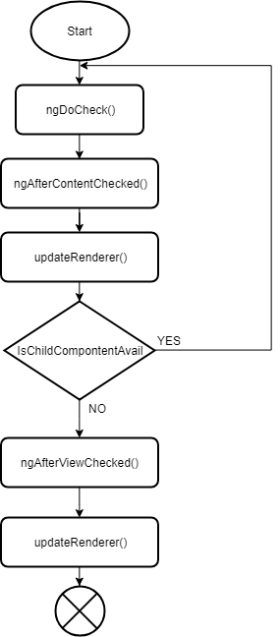
Life Cycle Hooks
ngOnInit()
ngDocheck()
ngAfterContentInit()
ngAfterContentChecked()
ngAfterViewInit()
ngAfterViewChecked()
ngOnDestroy()

Slide 6
What is Zone.js ?
Zones are useful for frameworks to know when to render.
A Zone is an execution context that persists across async tasks ( like thread-local storage ).
Zones are useful for debugging, testing, profiling.
There are three kinds of tasks of interest:
MicroTask
MacroTask
EventTask
Source link: (https://github.com/angular/angular/tree/master/packages/zone.js)
https://github.com/angular/angular/blob/master/packages/zone.js/STANDARD-APIS.md

Slide 7
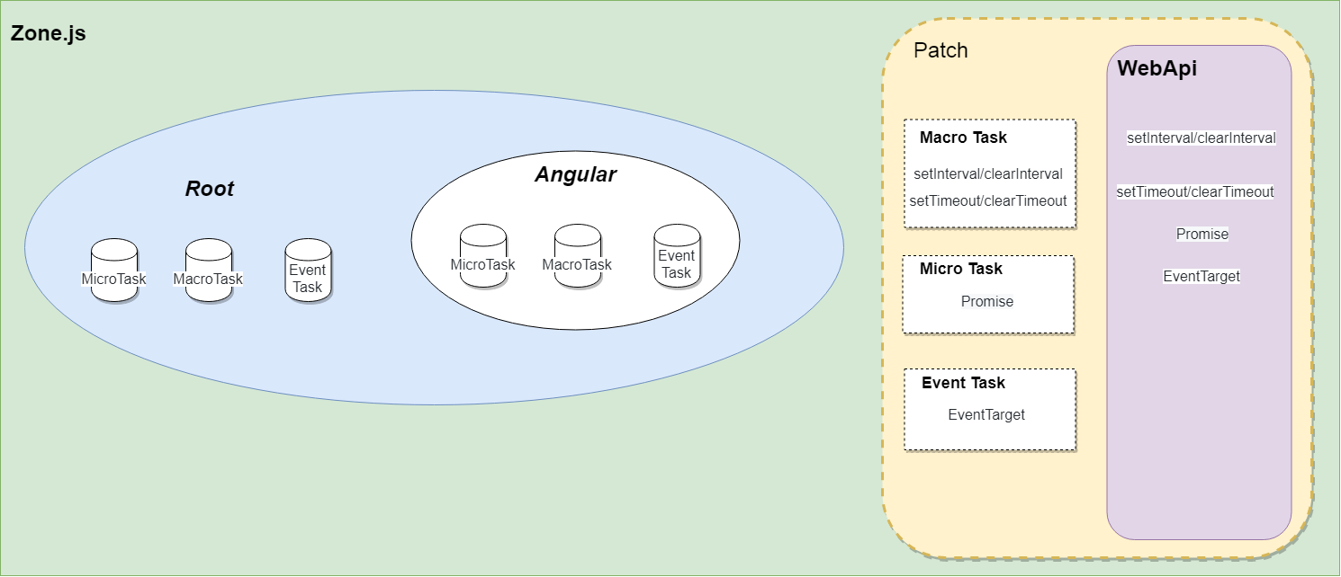
Zone.js Architecture

Slide 8
How Angular detect the changes ?.
Zone Js only leverages the execution context to detect changes and async events so it could trigger UI update.
Zone.js
Angular Application
Zone Schedule Loop {
Drainallmicrotask();
Eventtask();
MacroTask();
}
Class ApplicationRef
{
Constructor(){
this._zone.onMicrotaskEmpty.subscribe(
{next: () => { this._zone.run(() => { this.tick(); }); }});
}
}

Slide 9
Demo
Zone.js Demo Application link.
https://stackblitz.com/edit/angular-yrh2pm

Slide 10
Change Detection Execution
OnPush
Default

Slide 11
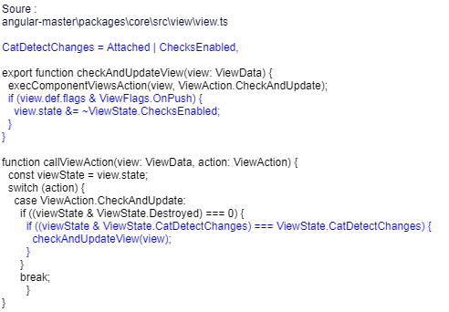
OnPush (checkOnce)
Code
Ways to Update
The Input reference changes.
Eg,. @Input() inputattribute
DOM events.
By explicitly call detectChanges() & markForCheck()

Slide 12
OnPush VS Default Demo
OnPush vs Default sample App link.
https://stackblitz.com/edit/angular-x3m2e6 ( View Rendering )
https://stackblitz.com/edit/angular-asbkkv ( Update data by diff types )

Slide 13
Thank you

