Slide 1
NET TOOLS
GOOLE TOOLS

Slide 2

CHATGPT

Slide 3
CHAT GPT
ChatGPT is an AI chatbot developed by OpenAI that generates human-like text, audio, and images in response to user prompts. It functions as a large language model, or generative pre-trained transformer, trained on massive datasets of information to recognize patterns and predict the most likely next word in a sequence, making it conversational and capable of summarizing, translating, and creating content. Users can interact with ChatGPT through its website or mobile app for various tasks, from answering questions to assisting with creative projects.

Slide 4
HOW IT WORK
Training:
The underlying models are "trained" by analyzing enormous amounts of text and other data from the internet to understand patterns, context, and relationships between words and concepts.
Generative Pre-trained Transformer (GPT):
This refers to the specific architecture and training methodology of the model, which allows it to "generate" responses and is "pre-trained" on a vast amount of data.
Predictive Word Generation:
When a user provides a prompt, the model processes it and predicts the next most likely word in the sequence, one word at a time , to built a coherent response

Slide 5
GEMINIS
Gemini is a family of multimodal AI models and a generative developed by Google AI. It was designed to process and understand multiple types of data, including text, images, audio, video, and code.
The Gemini chatbot; is the user-facing application that utilizes the underlying Gemini models. It was formerly known as Bard.

Slide 6
GEMINI

Slide 7
Writing and Drafting: Gemini can help you write emails, blog posts, reports, creative stories, poems, and scripts. You can give it a simple prompt and it will generate a draft for you to refine.
Summarization: It excels at condensing large documents, PDFs, web pages, and even long email threads into concise summaries. This is particularly useful for quickly getting the gist of a long piece of text or a complex topic.
Brainstorming: It can act as a thought partner to help you brainstorm ideas, organize a project, or outline a presentation or marketing campaign.
Image Generation: Gemini's built-in image generation capabilities, often referred to by the internal project name "Nano Banana," allow you to create custom visuals from text prompts for presentations, social media, or creative projects.
Notes:
code works, and help with debugging.3. Personal Assistant and Mobile

Slide 8
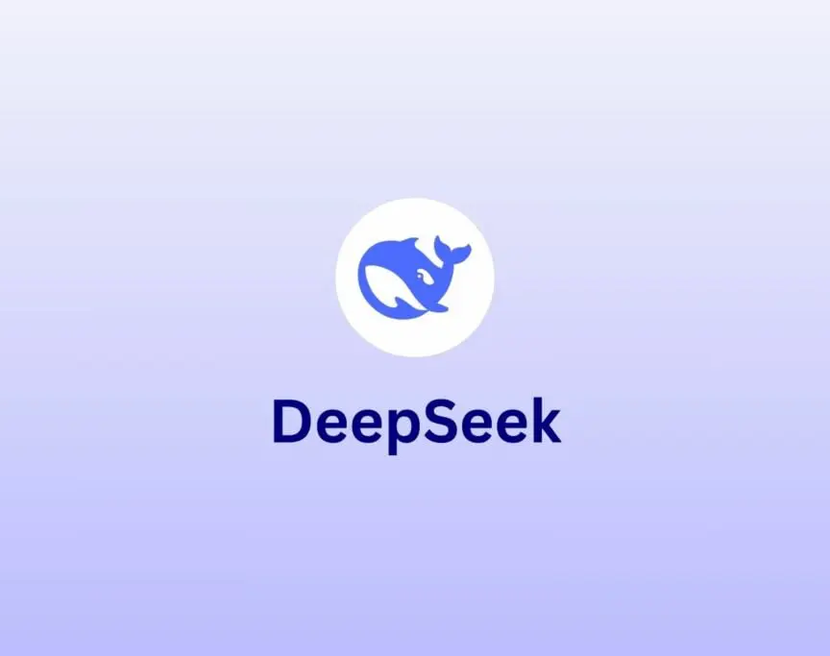
DEEPSEEK

Slide 9
deepseek
DeepSeek is a Chinese AI startup known for developing advanced, open-source large language models (LLMs) that are competitive with top global AI mod
Founded by High-Flyer hedge fund, DeepSeek's notable open-source models like DeepSeek-R1 use innovative "chain-of-thought" reasoning and reinforcement learning to achieve high performance on tasks like math and codingels at a lower cost, challenging American AI dominance.

Slide 10
DEEPSEEK
pen-Source Approach:
Unlike many commercial AI labs, DeepSeek offers its models for free and in an open-source format, allowing developers worldwide to inspect and improve the software.
High Performance at Low Cost:
DeepSeek's models, such as the DeepSeek-R1, demonstrate comparable or superior performance to leading American models on benchmarks for math, reasoning, and coding, but are trained and run at significantly lower costs.
Innovations

