Slide 1

Community Project
Branch: CSE-Artificial Intelligence & Machine Learning
Department: Data Engineering
Semester: V Section: A Regulation: R24 Course Code: R24MSCSP001
Project Title: Smartgarbage Management System
Batch Number: 2
SS. No | Register Number | Student Name
1. | 24331A4441 | M.Jaganmohan
2. | 24331A4434 | L.Reshma
3. | 24331A4446 | P.Narashimha Murthy
4. | 24331A4426 | K.Augustin Paul Kumar
Guide Name: Mrs.S.Nikhila
Designation: Assistant Professor
Project Coordinator:
Designation:
Head of the Department: Dr. V. Jyothi
Designation: Associate Professor

Slide 2
Abstract
SmartGarbage is a web portal engineered using Python(Flask),HTML, and SQLite to fix solid waste collection bottlenecks in Chintalavalasa Village. It provides citizens with instant street schedule searches and a simple form to report missed pickups with live phone photo proof. This data populates a secure Gram Panchayat dashboard, allowing government officials to verify issues visually and deploy collection tractors efficiently. The system also integrates a Random Forest machine learning model that tracks live weather data and report volumes to forecast route delays in advance, turning a daily civic challenge into a simple, trackable, and accountable digital workflow.

Slide 3
Introduction
🏛️ Local Context & Demographics
Target Study Area: Chintalavalasa Gram Panchayat layout (Vizianagaram).
Population Surge: Rapid residential expansion driven by the adjacent MVGR campus.
Infrastructure Strain: Massive increase in daily household solid waste volume.
⚠️ The Communication Bottleneck
Manual Workflows: Reliance on traditional, un-tracked tractor collection loops.
Information Vacuum: Zero public notice boards, SMS alerts, or scheduling lookups.
Project Objective: Introduce a low-cost, smartphone-compatible web utility to digitize village sanitation.

Slide 4
Problem Statement
🚫 Infrastructure & Communication Gaps
Information Blackout: Total lack of notice boards, SMS alerts, or digital tracking channels for arrival times.
Unpredictable Routines: Garbage trucks follow inconsistent schedules, causing trash to sit on streets for days.
Zero Accountability: Citizens have no administrative link to report skipped street lines to local authorities.
⚠️ Public Health & Environmental Hazards
Vector Breeding: Piled, rotting waste creates active breeding grounds for mosquitoes during monsoon cycles.
Epidemiological Risk: Heightened community exposure to waterborne diseases like dengue, cholera, and typhoid.
Stray Animal Hazards: Open street-level dumping allows stray dogs to tear trash bags, scattering litter across lanes.

Slide 5
Project Objectives
📱 Resident Empowerment & Transparency
Eradicate Unpredictability: Deliver an immediate, street-level collection schedule lookup portal.
Paperless Grievance Flow: Create a digital form allowing citizens to file reports with live camera photo proof.
Proactive Public Warning: Use machine learning to display advanced route delay alerts to villagers.
🏛️ Government Automation & Engineering
Centralized Command: Provide a secure administrative dashboard for Gram Panchayat sanitation desks.
Visual Audit Control: Enable supervisors to instantly verify reported waste piles via uploaded images.
Coursework Integration: Apply Python, Flask, and Random Forest subjects to solve a real-world civic issue.

Slide 6
Project Scope
📍 Boundary & Administrative Limits
Geographic Target: Restricted to the structural boundaries of Chintalavalasa Gram Panchayat.
Sector Mappings: Focused on the five major village residential wards and the college campus road layout.
User Personas: Handles data interaction loops exclusively for local residents and panchayat sanitation staff.
🛠️ Functional & Technical Limits
Web Architecture: Implements a lightweight, responsive three-tier portal built via Flask, SQLite, and Bootstrap.
AI Modeling Scope: Uses a Random Forest Classifier trained on local parameters for weather-based delay checks.
Hardware Exclusion: Relies entirely on cloud software databases to avoid high hardware sensor installation costs.

Slide 7
Literature Review/ Background Study
📉 Traditional & Existing Systems
Static Routing Inefficiency: Fixed route models operate blindly regardless of actual dump accumulation levels, wasting fuel.
Tracking Blind Spots: Lack of public communication grids isolates citizens and hides operational delay records.
High Infrastructure Costs: Previous smart designs rely on expensive IoT physical bin sensors, making rural deployment impractical.
📈 Modern Technical Baseline
Data-Driven Transparency: Literature confirms that relational web apps successfully close public service accountability gaps.
Ensemble Model Stability: Research proves Random Forest Classifiers excel at route prediction by mapping erratic local patterns.
Dynamic Grounding: Integrating open climate datasets with local report density yields highly accurate public delay alerts.

Slide 8
Data Gathered/ Data Used
📊 Google Forms Field Survey Layer
Digital Data Ingestion: Deployed a targeted Google Form to gather empirical feedback from Chintalavalasa residents.
Grievance Baseline: Captured real-world data points on garbage accumulation cycles and schedule awareness gaps.
Database Grounding: Processed the Google Form responses to structure our SQLite relational tables and define true village sector parameters.
🤖 Technical Machine Learning Inputs
Temporal Factor: Calendar day of the week mapped as an integer to trace historical routing patterns.
Live Climate Telemetry: Real-time data streams pulled from the Open-Meteo API to track monsoon rain indices.
Complaint Velocity: Rolling count of active, unresolved citizen reports in that specific ward over the past 7 days.
Spatial Feature Mappings: Distinct numeric integer identifiers corresponding to the 5 major residential village wards.

Slide 9
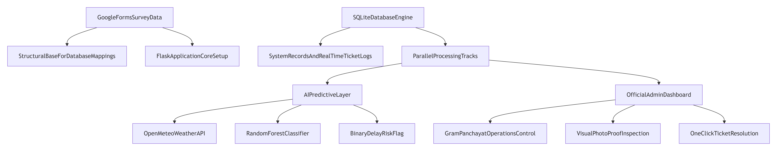
Methodology / System Design
Flow Chart

Slide 10
Methodology/ System Design(cont.)
Block Diagram
📱 Block 1: Citizen Mobile UI ──► Captures street location data and streams live phone photo proof.
⚙️ Block 2: Flask Web Core ──► Handles central server routing, image file streams, and API links.
🤖 Block 3A: Random Forest AI ──► Reads live Open-Meteo weather codes to predict vehicle route delays.
🏛️ Block 3B: Panchayat Admin ──► Live official dashboard to verify community photo proof and track fleets.
🗄️ Block 4: SQLite Database ──► Secure relational file system storing village schedules and ticket logs.

Slide 11
Implementation / Modules
Link to code:
📂 Core System Modules
Scheduling Module (schedule.html): Allows citizens to filter the SQLite database rows by village ward to fetch morning pickup details.
Grievance Module (report.html): Captures multi-part form payloads, filters input data, and streams phone photo uploads to the cloud server disk.
Panchayat Panel (admin.html): Restricts access to a secure administrative workflow workspace for tracking and updating complaint states.
🌐 Project Deployment Parameters
Hugging Face Cloud Repository Link: https://hugging face.co/spaces/Jaganmohansmile/Smartgarbage
Production Runtime Target Engine: Gunicorn WSGI HTTP server containerized over Python 3.12 stack environments.
⚙️ Key Backend Routing Snippet (routes.py)
# Fetches data from SQLite and runs the Random Forest AI model
@main.route('/schedule', methods=['GET', 'POST’])
def schedule():
all_schedules = Schedule.query.order_by(Schedule.ward).all()
filtered_schedules = []
ai_prediction = None
if request.method == 'POST':
ward = request.form.get('ward')
filtered_schedules = Schedule.query.filter_by(ward=ward).all()
ai_prediction = predict_miss(ward) # AI Model Trigger
return render_template('schedule.html', schedules=filtered_schedules, all_schedules=all_schedules, prediction=ai_prediction)

Slide 12
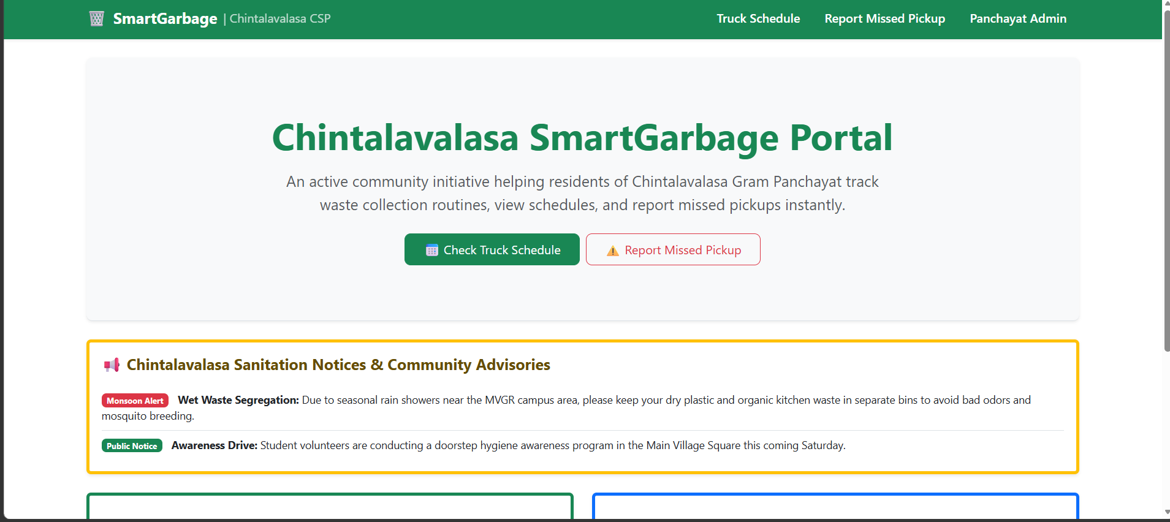
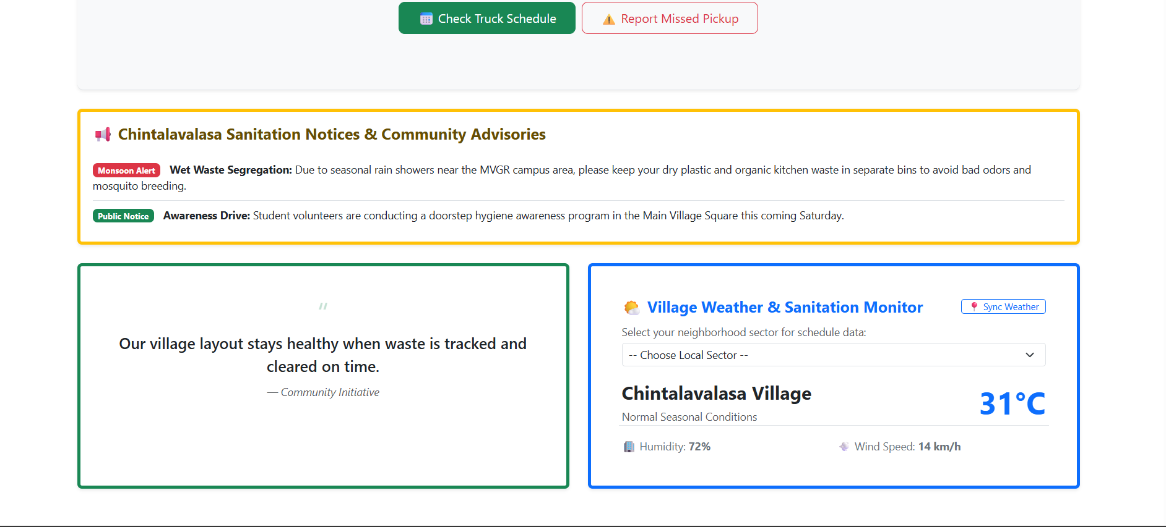
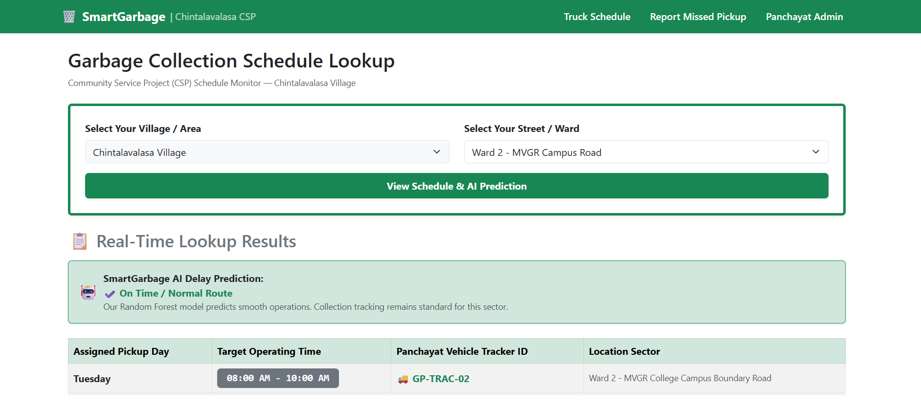
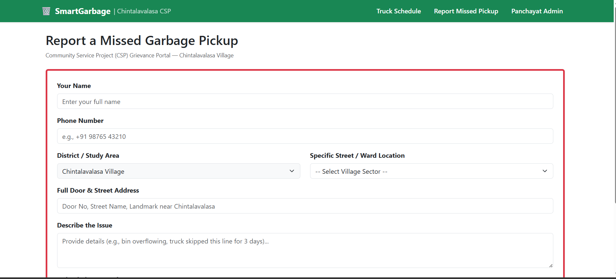
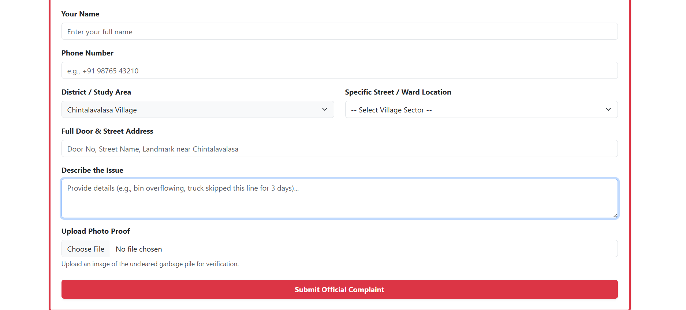
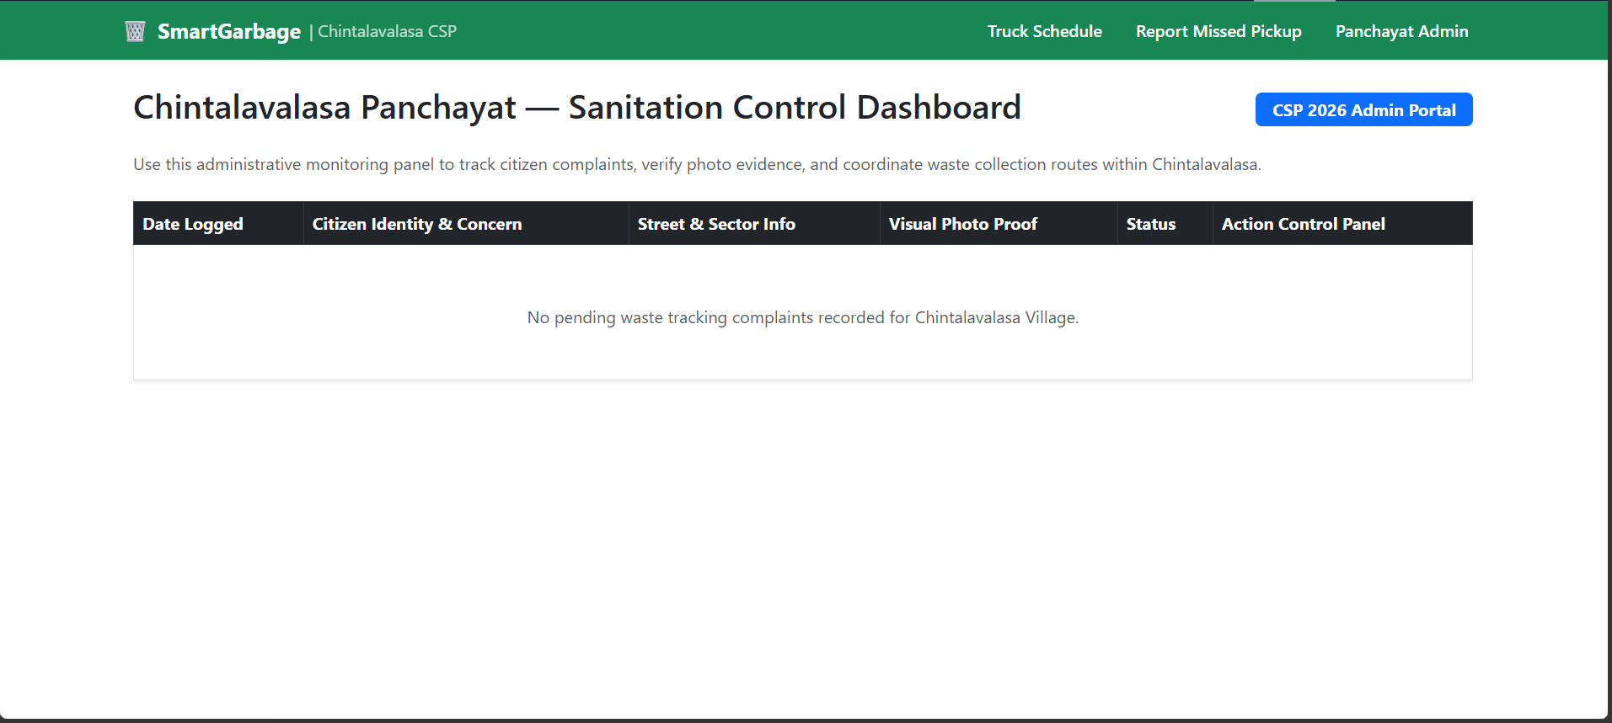
Results (Full) / Screenshots

Slide 13
Impact Assessment
⚙️ Technical Impact (Software & Data Engineering)
High Efficiency Stack: Replaces heavy smart-city hardware infrastructure with a lightweight, low-cost Python/Flask web utility.
Predictive Capability: Proves that ensemble models like Random Forest can compute accurate route delay warnings using live API telemetry.
Centralized Data Hub: Migrates manual village paper logs into a secure, searchable SQLite relational data model.
👥 Social & Economic Impact (Chintalavalasa Layout)
Empowered Community: Converts passive village residents into active participants in keeping their streets clean.
Administrative Bridge: Connects citizens directly to the Gram Panchayat Desk, eliminating traditional communication delays.
Public Health Shield: Timely waste removal reduces vector breeding grounds, protecting citizens from dengue and typhoid.
Resource Optimization: Helps officials deploy tractors only to high-complaint areas, saving vehicle fuel and public money.

Slide 14
Challenges Faced
⚙️ Data Engineering & Model Constraints
Imbalanced Training Inputs: Google Forms field datasets initially lacked historical route delay rows, requiring synthesized feature balancing.
API Ingestion Mismatches: Resolved data stream syntax conflicts when parsing external live JSON fields from the weather API.
Non-Stable Hashing Bugs: Replaced Python's native string hashing function with a secure, stable MD5 digest algorithm to maintain unique ward row indexes.
🌐 Cloud Storage & Deployment Blockages
Volatile File Disks: Overcame Hugging Face container file resets by routing SQLite files and photo uploads to secure volume directories.
Folder Hierarchy Errors: Cleaned up relative import scripts to stop backend route crashes during production build phases.
Directory Path Normalization: Adjusted Flask static configurations dynamically to support asset loading across local and cloud environments.

Slide 15
Conclusion
SmartGarbage bridges the communication gap between citizens and municipal authorities in Hyderabad. By replacing unpredictable routines with a reliable web platform, the system accomplishes three vital goals:
Empowers Communities: Residents gain total transparency over schedules, eliminating skipped collection guessing games.
Ensures Accountability: The direct dashboard closes the loop on issues, turning citizen complaints into trackable, actionable tasks for municipal teams.
Drives Proactive Management: By integrating a Random Forest Machine Learning model, the system evolves from basic tracking into a smart tool that anticipates delays before they lead to public health hazards.
Ultimately, this project transforms waste management from a daily neighborhood frustration into an organized, data-driven service—ensuring a cleaner, healthier, and smarter urban environment.

Slide 16
Future Work
To scale SmartGarbage from a local prototype into a robust, city-wide platform, the following advancements are planned:
IoT & Live GPS Tracking
  Install GPS hardware on municipal vehicles.
  Provide residents with real-time truck tracking on a live map interface.
Automated Citizen Alerts
  Integrate WhatsApp and SMS notification systems.
  Send instant pings when a vehicle enters a lane or a delay is predicted.
Scalable Cloud Infrastructure
  Migrate the local SQLite database to a cloud system like PostgreSQL.
  Ensure permanent data storage and smooth performance as user numbers grow.
Advanced AI Routing
  Train the Random Forest model on historical traffic and fuel data.
  Optimize vehicle routes dynamically to save municipal time and costs.

Slide 17
References
Municipal Frameworks & Guidelines
  Greater Hyderabad Municipal Corporation (GHMC) Solid Waste Management Bylaws.
  Swachh Bharat Mission (Urban) Guidelines, Ministry of Housing and Urban Affairs, Government of India.
Web Development & Backend Architecture
  Flask Documentation: Development and Routing with Python-based Web Frameworks.
  SQLite Documentation: Lightweight Relational Database Design for Local Storage.
Machine Learning & Predictive Modeling
  Scikit-Learn Documentation: Ensemble Methods — Training and Tuning Random Forest Classifiers.
  Leo Breiman (2001): Random Forests, Machine Learning Journal.
Public Health & Environmental Studies
  World Health Organization (WHO) Reports on Vector-Borne Diseases: The Link Between Unmanaged Urban Waste and Dengue/Cholera Outbreaks.

Slide 18
Any Queries/ Questions?
Open Floor for Discussion
Thank you for your time and feedback.
Welcoming all queries, suggestions, and technical questions from the panel.

