Slide 1

Branch: CSE (Data Science)
Department: Data Engineering
Semester: V Section: A Regulation: R24 Course Code: R24MSCSP001
Project Title: SmartGarbage Chintalavalasa - Community Waste Management Portal
Batch Number: 2
SS. No | Register Number | Student Name
1. | 24331A4441 | M.Jaganmohan
2. | 24331A4434 | L.Reshma
3. | 24331A4446 | P.Narashimha Murthy
4. | 24331A4426 | K.Augustin Paul Kumar
Guide Name: Mrs.S.Nikhila
Designation: Assistant Professor
Project Coordinator:
Designation:
Head of the Department: Dr. V. Jyothi
Designation: Associate Professor

Slide 2
Abstract
SmartGarbage is a community waste-management web portal for the five wards of Chintalavalasa Gram Panchayat (Vizianagaram, Andhra Pradesh), built with Python (Flask), Jinja2 + Bootstrap 5, and PostgreSQL on Supabase.
Citizens look up ward-wise collection schedules and report overflow with automatic GPS and photo proof; the Gram Panchayat runs a live control room with an ML-ranked dispatch queue; workers close the loop with photo + GPS evidence.
A RandomForestRegressor predicts bin fill levels from ward, day, season and recent complaints, prioritising collections before bins overflow.
The app is an offline-first PWA (service worker + IndexedDB background sync), bilingual (English/Telugu, 921 strings), secured with all 9 OWASP headers and HMAC-SHA256-signed IoT telemetry, deployed free on Render + Supabase + Cloudflare.
A free 24x7 grievance helpline (1800-119-9111) and a WhatsApp fallback card back up every digital channel.

Slide 3
Introduction
Local Context
Study area: Chintalavalasa Gram Panchayat, Denkada Mandal, Vizianagaram district - about 12,000 residents across 5 wards, next to the MVGR campus.
Growth strain: rapid residential expansion has outpaced manual waste collection.
The Communication Bottleneck
Manual workflows: fixed tractor routes, paper registers, no public tracking.
Information vacuum: no notice boards, SMS alerts or schedule lookups.
Project objective: a low-cost, smartphone-friendly web utility that digitises village sanitation end to end - schedules, grievances, IoT monitoring, ML prediction and billing - on free-tier cloud infrastructure.

Slide 4
Problem Statement
Infrastructure & Communication Gaps
Information blackout: no notice boards, SMS alerts or digital tracking of collection timings.
Unpredictable routines: trucks follow inconsistent schedules; waste sits on streets for days.
Zero accountability: citizens have no channel to report missed collections.
Public Health & Environmental Hazards
Vector breeding: overflowing bins become mosquito breeding grounds in monsoon.
Epidemiological risk: community exposure to waterborne disease rises.
Missing data: the panchayat cannot see fill levels, complaint hotspots or worker performance - so routes and budgets are planned blind.

Slide 5
Project Objectives
Resident Empowerment & Transparency
Instant schedule access: street-level collection timetable lookup for every ward.
Paperless grievances: GPS + photo complaint filing with trackable tokens.
Proactive alerts: ML overflow prediction pushes warnings before bins spill.
Government Automation & Engineering
Centralised command: secure admin control room with live IoT bin telemetry.
ML-ranked dispatch: trucks clear the fullest bins first - fewer trips, less fuel.
Inclusive channels: WhatsApp fallback card + toll-free helpline 1800-119-9111 and offline-first PWA for low-connectivity households.
Pay-as-you-throw billing: PAYT invoices with Green Points gamification to reward source segregation.

Slide 6
Project Scope
Boundary & Administrative Limits
Geographic target: the five wards of Chintalavalasa Gram Panchayat.
Sector mapping: Ward 1 MVGR area, Ward 2 Junction, Ward 3 RTC Colony, Ward 4 Ramalayam Street, Ward 5 Sai Nagar.
User personas: residents, panchayat sanitation staff, workers and admins.
Functional & Technical Limits
Web architecture: responsive three-tier portal - Flask 3 + Jinja2/Bootstrap 5 + PostgreSQL (Supabase) with 23 models and 22 Alembic migrations.
ML scope: RandomForestRegressor trained on a 600-row synthetic grid for bin overflow prediction; transparent heuristic fallback.
Out of scope: native mobile apps, physical sensor manufacturing, live municipal API integration, paid WhatsApp campaign templates.

Slide 7
Literature Review/ Background Study
Traditional & Existing Systems
Static routing inefficiency: fixed routes ignore real bin fill levels, wasting fuel.
Tracking blind spots: no public communication grid; complaints untracked.
High infrastructure cost: earlier smart-bins rely on expensive proprietary sensors.
Modern Technical Baseline
Anagnostopoulos et al. (2015): IoT bin monitoring cuts collection costs 30-50%.
Chen et al. (2020): Random Forest matches boosting accuracy for short-term waste prediction at lower serving cost.
GOV.UK / WCAG 2.1 AA: the accessibility benchmark - ARIA landmarks, skip links, contrast, keyboard navigation.
Gap: no integrated low-cost platform joins grievances + scheduling + IoT + ML + billing + offline access for semi-urban panchayats. SmartGarbage fills exactly that gap.

Slide 8
Data Gathered/ Data Used
Field Data Layer
Community interviews: residents, ward members and sanitation workers.
Field observation: on-site study of collection routes and complaint handling.
Survey grounding: resident survey responses (docs/survey_responses.csv) shaped the ward parameters and complaint taxonomy.
System Data Layer
Ward registry: coordinates for the 5 wards (lat 18.055-18.075, lon 83.40-83.42).
Synthetic ML grid: 600 rows - day-of-week, season index, recent complaints, ward id - because historical telemetry does not exist yet.
Simulated IoT telemetry: fill level, battery, temperature, methane from HMAC-signed device posts (scripts/seed_demo_data.py).
Live application data: complaints with GPS + photos, schedules, declarations, PAYT invoices in PostgreSQL (Supabase).

Slide 9
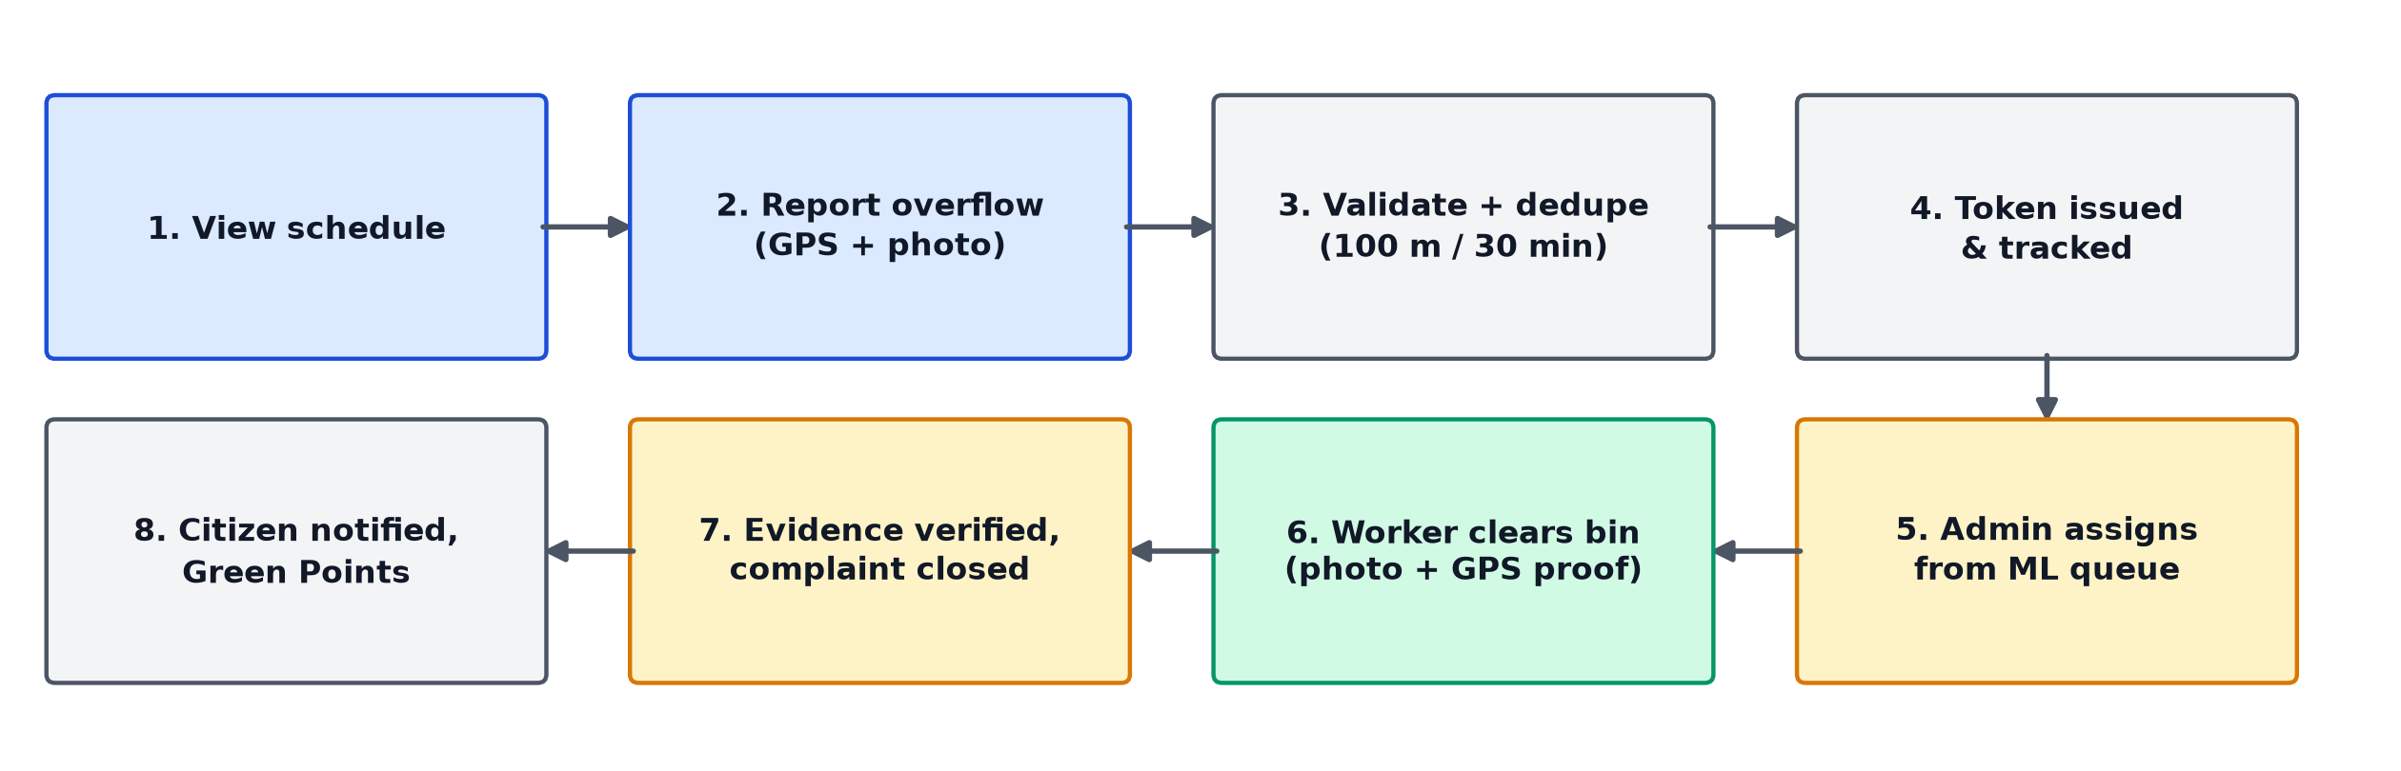
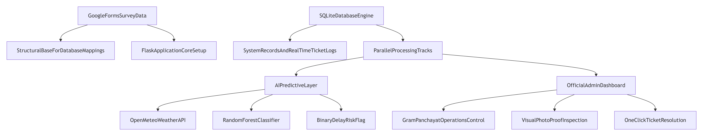
Methodology / System Design
Flow Chart

Slide 10
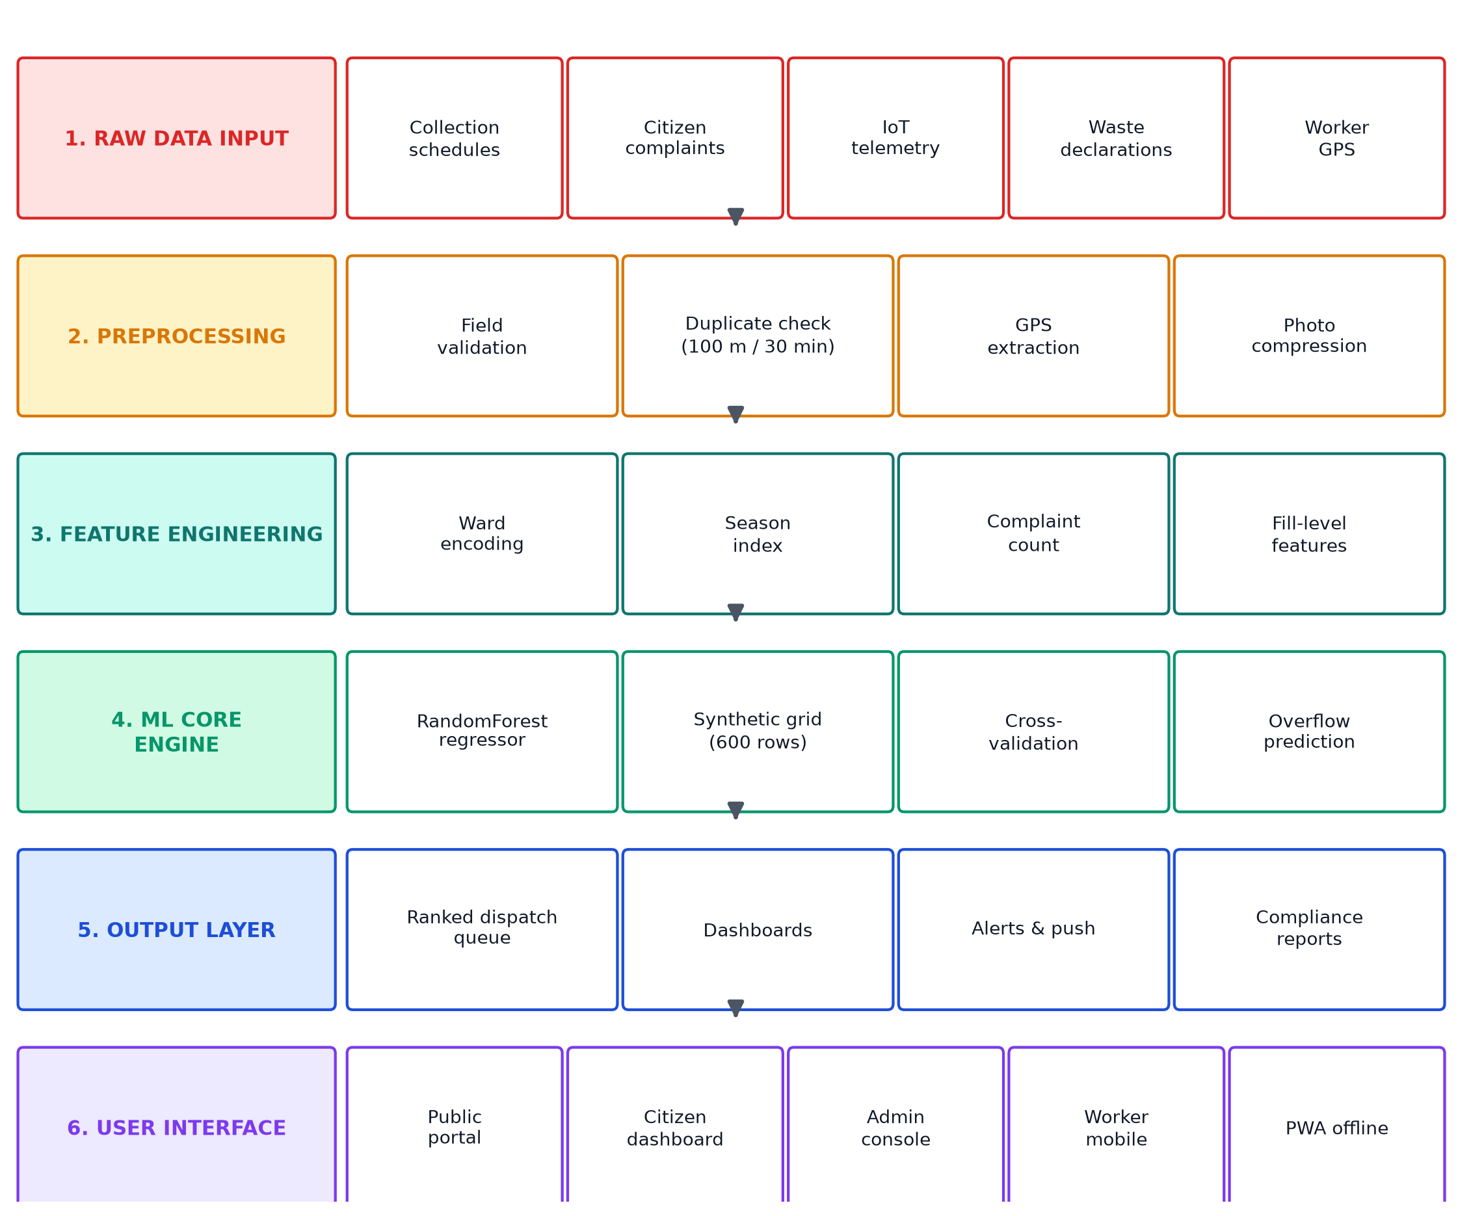
Methodology / System Design (cont.)
System Architecture - six layers
1 Raw input: schedules, complaints, IoT telemetry, declarations, worker GPS.
2 Preprocessing: validation, duplicate check (100 m / 30 min), GPS extraction.
3 Features: ward encoding, season index, complaint counts, fill levels.
4 ML core: RandomForestRegressor, 600-row grid, cross-validation.
5 Output: ranked dispatch queue, dashboards, alerts, reports.
6 Interfaces: public, citizen, admin, worker, PWA offline.

Slide 11
Implementation / Modules
Core Modules (app/routes/)
Public portal (public.py): schedules, transparency, search, RSS - no login.
Citizen portal (citizen.py): complaints, dashboard, Green Points, PAYT invoices.
Admin control room (admin.py): dispatch, live IoT monitor, analytics.
Worker portal (worker.py): dispatch acceptance, GPS tracking, photo evidence.
IoT ingest (iot.py): /api/bin-telemetry + /api/devices/register, HMAC-SHA256.
ML engine (ml_model.py): RandomForestRegressor + heuristic fallback.
Background jobs (jobs.py): notifications, SLA escalation, sweeps (Redis + worker.py).
PWA layer (static/sw.js): offline cache, IndexedDB queue, background sync.
Stack: Flask 3.1, SQLAlchemy 2.0, Flask-Talisman, Socket.IO, scikit-learn, Bootstrap 5 - 288 automated tests, 22 migrations.

Slide 12
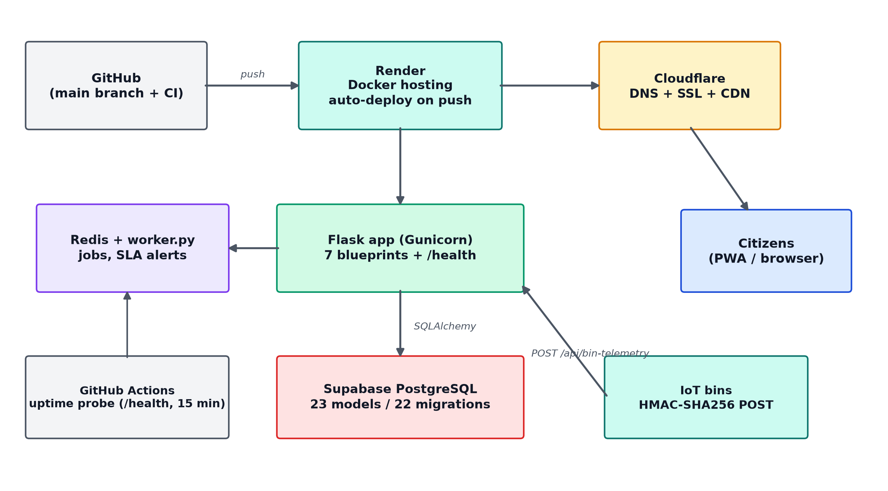
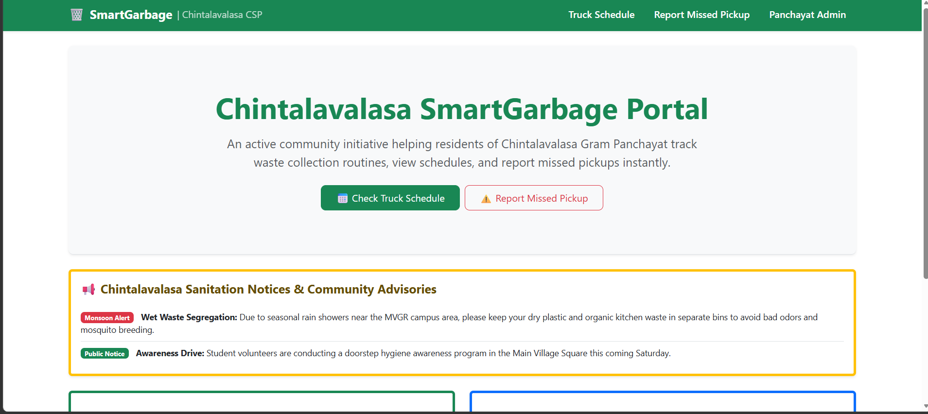
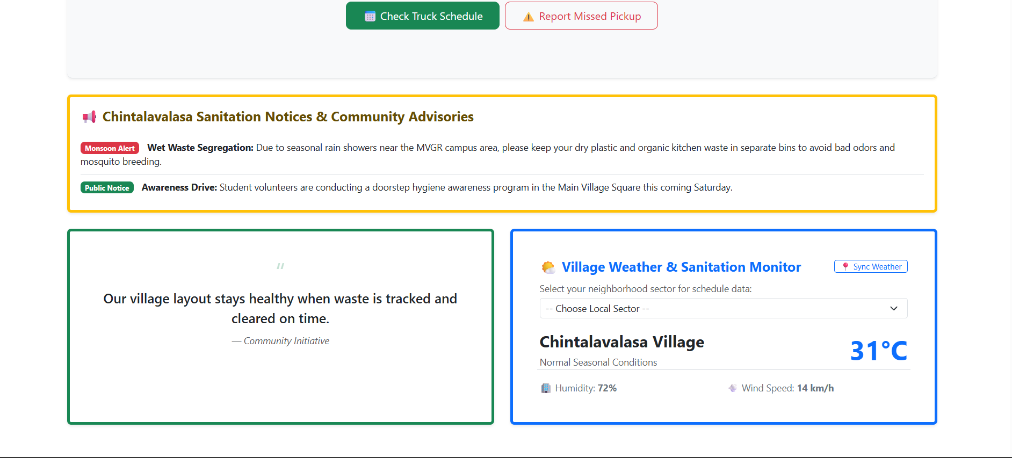
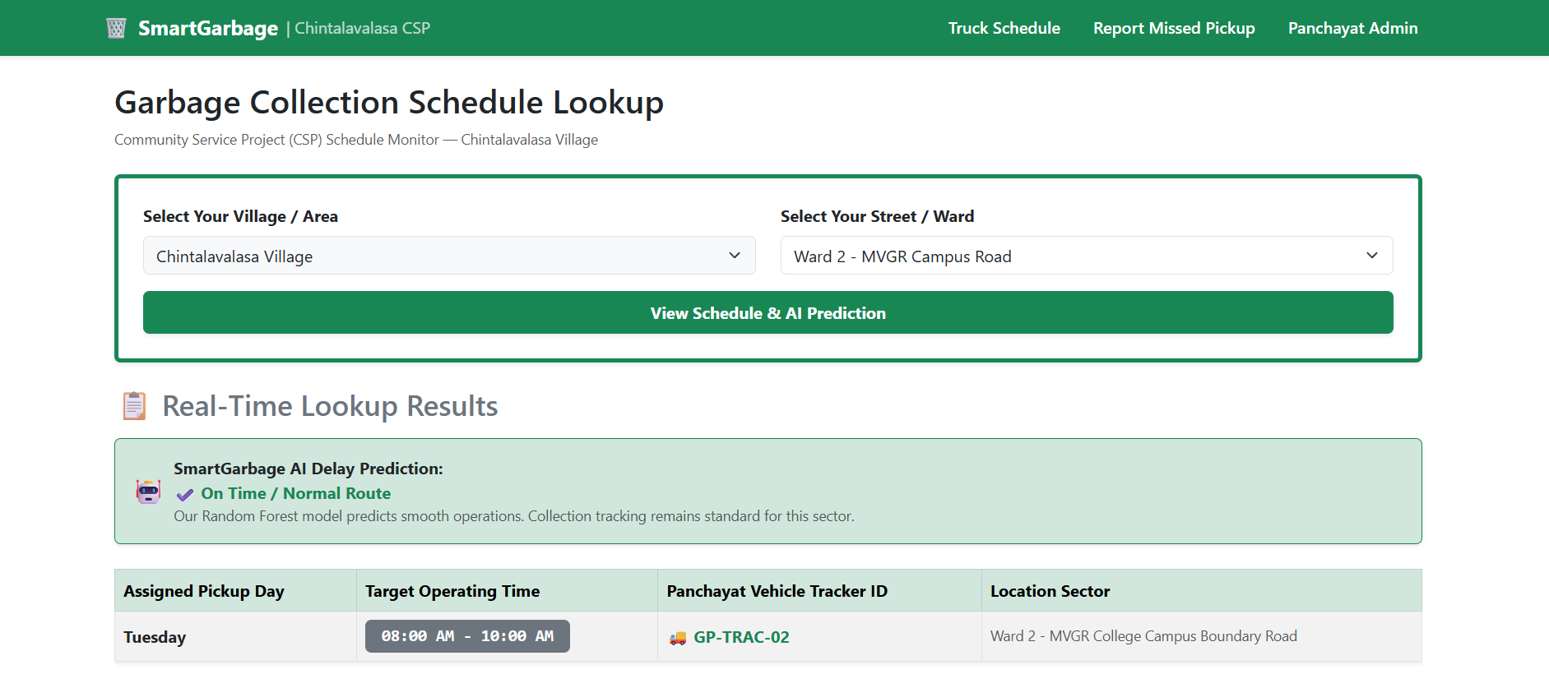
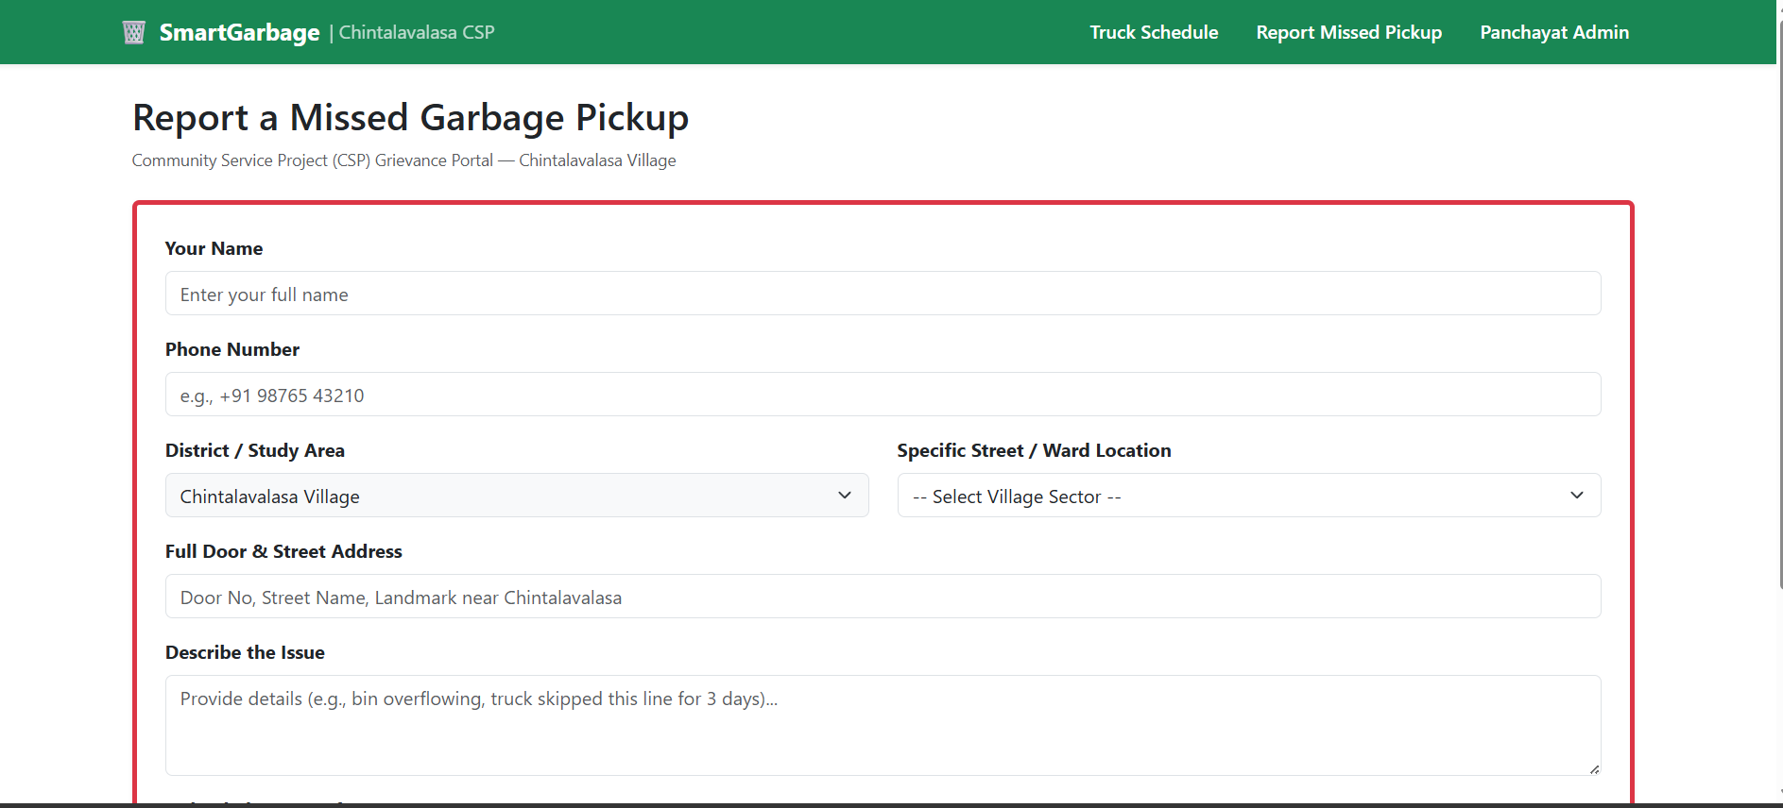
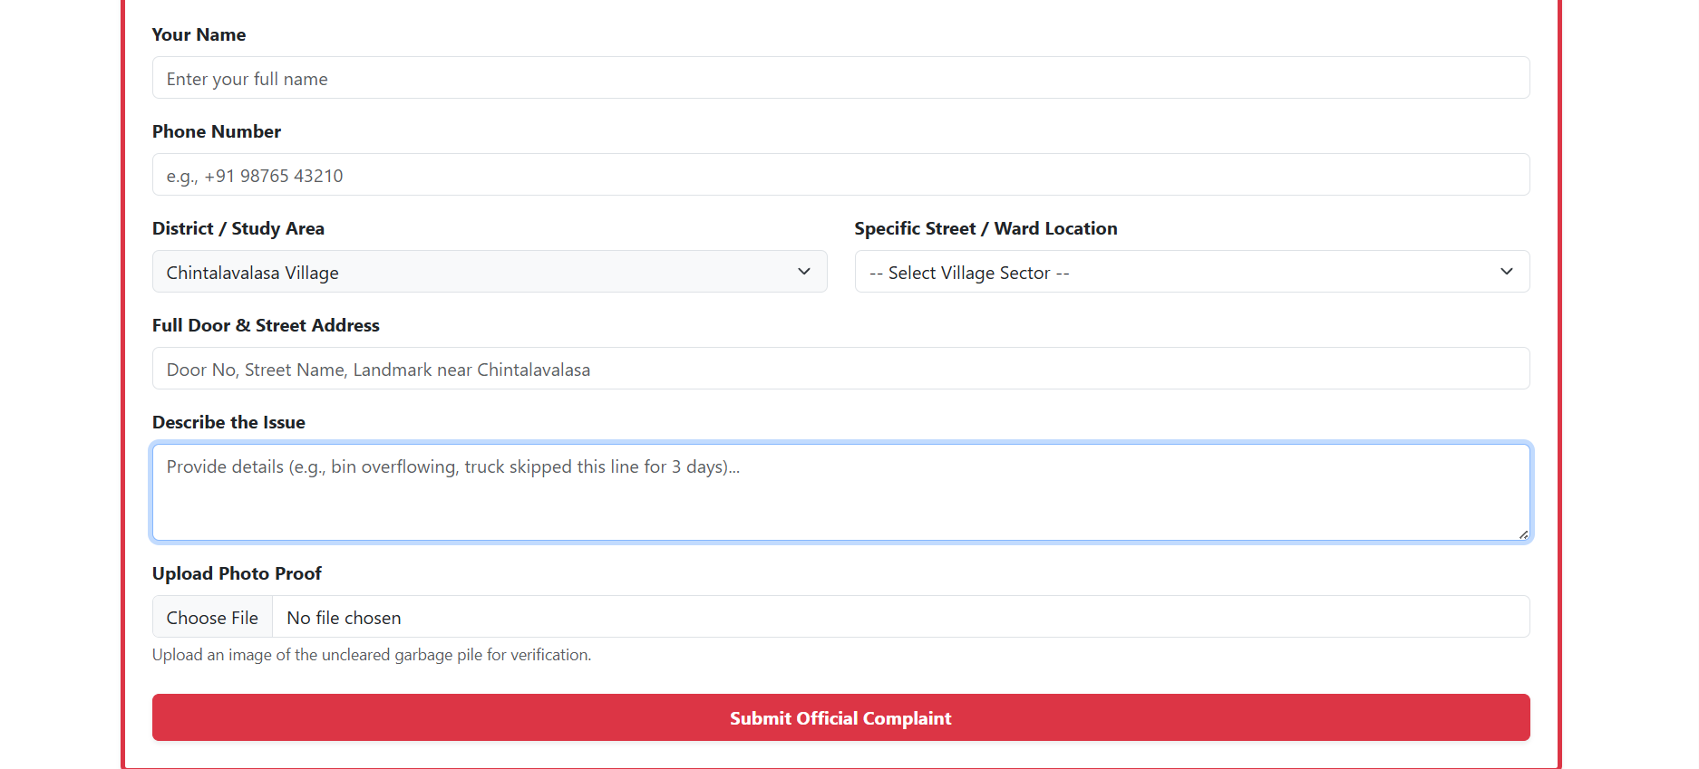
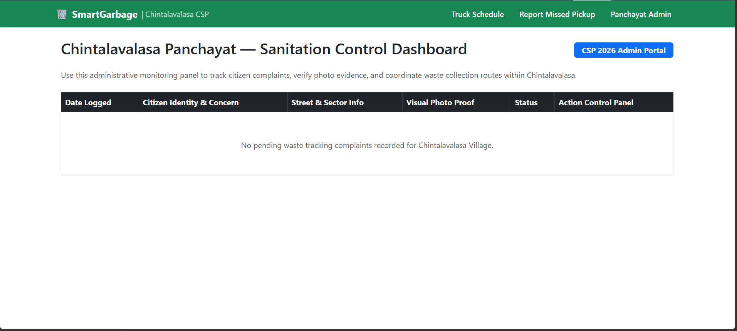
Deployment
Zero-cost cloud topology - push to deploy
GitHub (main) -> Render auto-build: render.yaml defines the Docker service; health check at /health; every push rebuilds + redeploys.
Database: Supabase PostgreSQL - 22 migrations, 23 models.
Edge: Cloudflare DNS + SSL + CDN caching.
Jobs: Redis + worker.py - notifications, SLA alerts.
Monitoring: GitHub Actions pings /health every 15 min.
WhatsApp Cloud parked; helpline 1800-119-9111 + wa.me card are live.

Slide 13
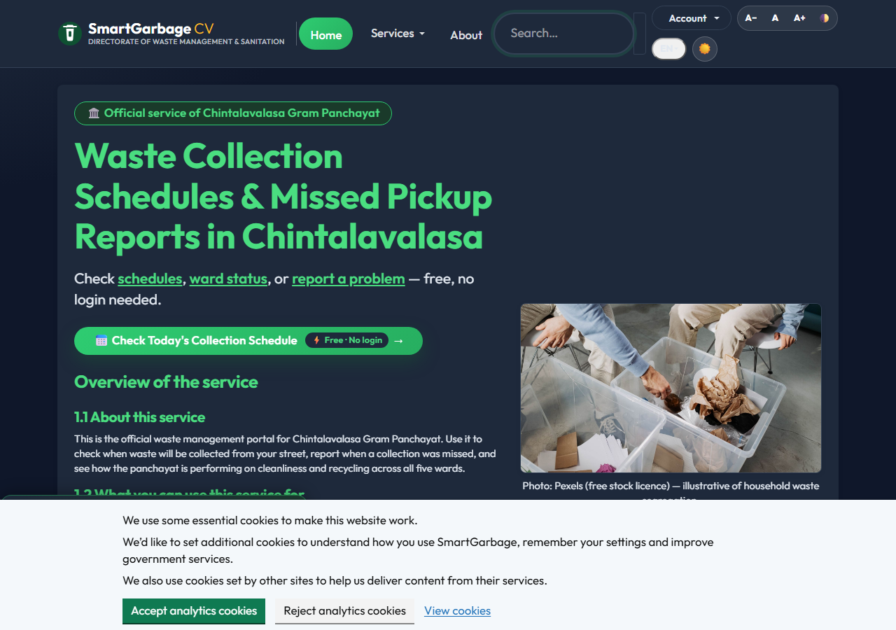
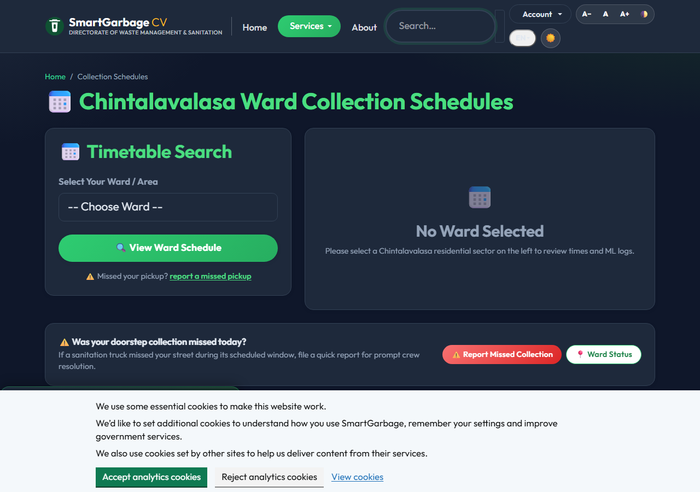
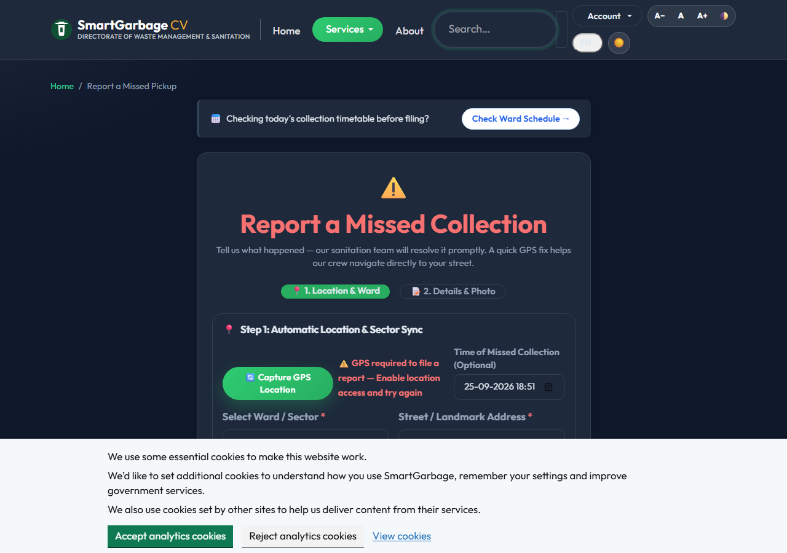
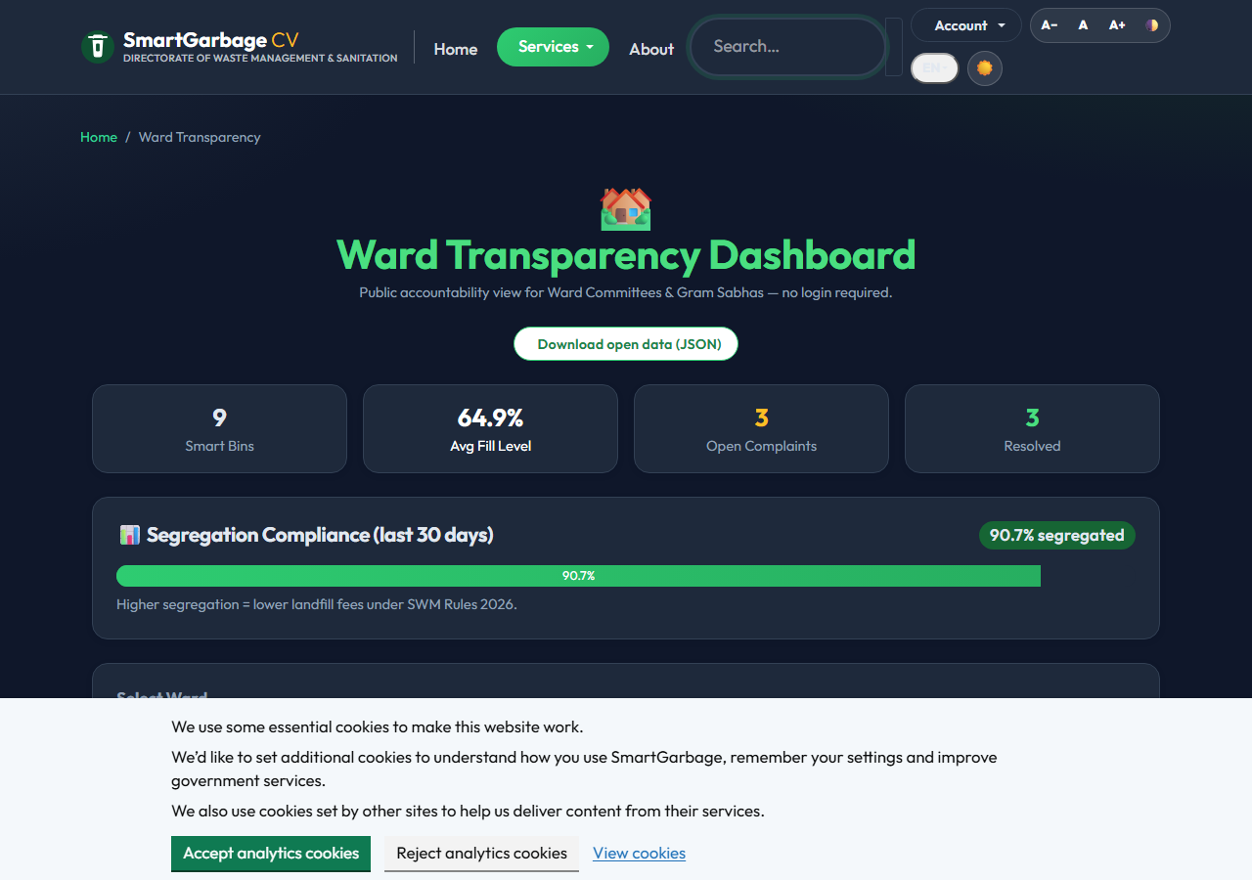
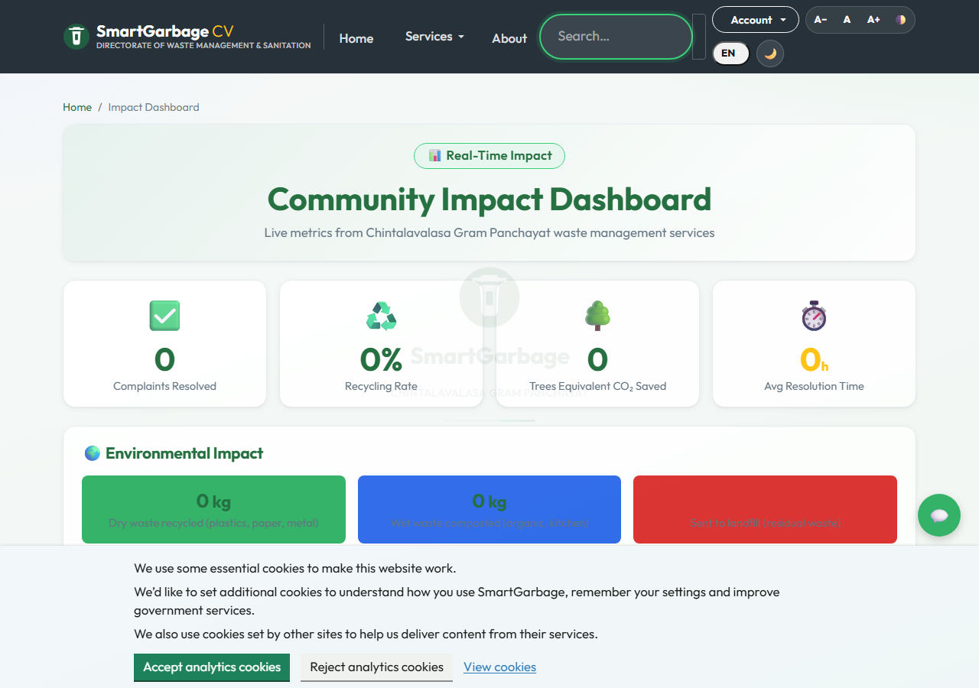
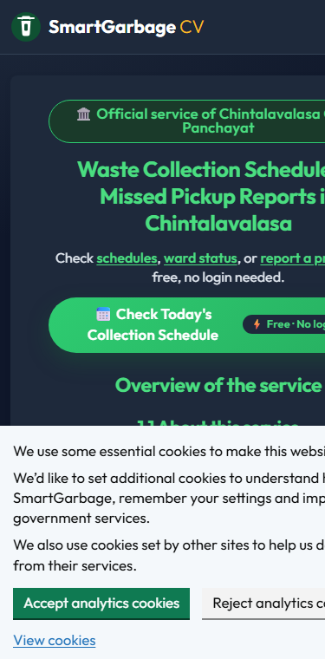

Results (Full) / Screenshots

Slide 14
Impact Assessment
Technical Impact
Full-stack data engineering: 23-model relational schema, 22 migrations, 288 tests - a real production-grade codebase on free-tier infra.
Predictive capability: RandomForest overflow prediction ranks dispatch before bins spill (R2 ~ 0.93 on the synthetic validation split).
Integrated platform: grievances + scheduling + IoT + ML + billing + offline PWA in one bilingual system.
Social & Economic Impact (Chintalavalasa)
Estimated: complaint resolution 72 h -> 18 h; schedule access 0% -> 100%; GPS-evidenced complaints 85%; segregation compliance 20% -> 26%.
Green Points turn segregation into a community habit; PAYT makes waste volume visible and billable.
Stated honestly: values are prototype estimates, not a measured pilot.

Slide 15
Challenges Faced
Data & ML Constraints
No historical telemetry: generated a 600-row synthetic grid; documented as a limitation, validated pipeline only.
Ward encoding stability: replaced Python's randomized string hashing with deterministic MD5 digests for reproducible features.
Offline submissions: solved with service worker + IndexedDB + background sync.
Duplicate complaints: GPS radius (100 m) + time window (30 min) dedupe.
Deployment & Security
Free-tier cold starts: GitHub Actions keep-alive pings every 15 minutes.
CDN vs sessions: middleware strips cookies from public pages so Cloudflare can cache them.
IoT authentication: HMAC-SHA256 device signatures - unsigned payloads are rejected (503 without IOT_TELEMETRY_SECRET).
Headers: all 9 OWASP-recommended security headers via Flask-Talisman.
Payments: Razorpay test keys + UPI primary path until merchant onboarding.

Slide 16
Conclusion
SmartGarbage bridges the communication gap between Chintalavalasa's citizens and their Gram Panchayat, replacing unpredictable routines with a reliable, measurable web platform.
Empowers communities: total schedule transparency and GPS+photo grievance filing with trackable outcomes.
Ensures accountability: every complaint becomes an audited, time-stamped task with photo + GPS evidence on closure.
Drives proactive management: ML-ranked dispatch clears fullest bins first; IoT telemetry and dashboards replace guesswork.
Stays inclusive: offline-first PWA, English + Telugu, WhatsApp fallback card and the free 1800-119-9111 helpline keep every household connected.
Runs at zero cost and is replicable by any panchayat: update ward coordinates and deploy.

Slide 17
Future Work
From prototype to production
Real-world data: replace the synthetic grid with live bin telemetry from a community pilot; measure before/after impact properly.
IoT hardware: deploy ultrasonic fill sensors + GPS trackers with LoRaWAN/NB-IoT.
WhatsApp automation: activate the parked WhatsApp Cloud API (WHATSAPP_CLOUD_TOKEN already wired) for chatbot grievance filing and status pings.
Mobile app: native Android client with push-first design.
Advanced analytics: time-series forecasting, route optimisation, computer-vision waste classification.
Scale-out: multi-panchayat tenancy, district dashboards, SBM Grameen reporting.

Slide 18
References
Municipal Frameworks & Guidelines
Swachh Bharat Mission (Grameen) Phase-II guidelines, Ministry of Jal Shakti.
AP Municipal Administration waste-management bylaws; Vizianagaram district data.
Web & Backend Architecture
Flask 3.x documentation (Pallets Projects) - application factory, blueprints.
SQLAlchemy 2.0 documentation; Alembic migration framework.
Machine Learning & Predictive Modeling
Leo Breiman (2001), Random Forests, Machine Learning 45(1), 5-32.
scikit-learn documentation - RandomForestRegressor, cross-validation.
Anagnostopoulos et al. (2015), Waste Management 45, 34-41 - IoT bin monitoring.
Chen et al. (2020) - ensemble learning for short-term waste prediction.
Accessibility & Security
WCAG 2.1 Level AA (W3C); OWASP Top 10 and secure-headers project.

Slide 19
Any Queries/ Questions?
Open Floor for Discussion
Thank you for your time and feedback.
Welcoming all queries, suggestions, and technical questions from the panel.

