Slide 1

Branch: CSE (Data Science)
Department: Data Engineering
Semester: V Section: A Regulation: R24 Course Code: R24MSCSP001
Project Title: SmartGarbage Chintalavalasa - Community Waste Management Portal
Batch Number: 2
SS. No | Register Number | Student Name
1. | 24331A4441 | M.Jaganmohan
2. | 24331A4434 | L.Reshma
3. | 24331A4446 | P.Narashimha Murthy
4. | 24331A4426 | K.Augustin Paul Kumar
Guide Name: Mrs.S.Nikhila
Designation: Assistant Professor
Project Coordinator:
Designation:
Head of the Department: Dr. V. Jyothi
Designation: Associate Professor

Slide 2
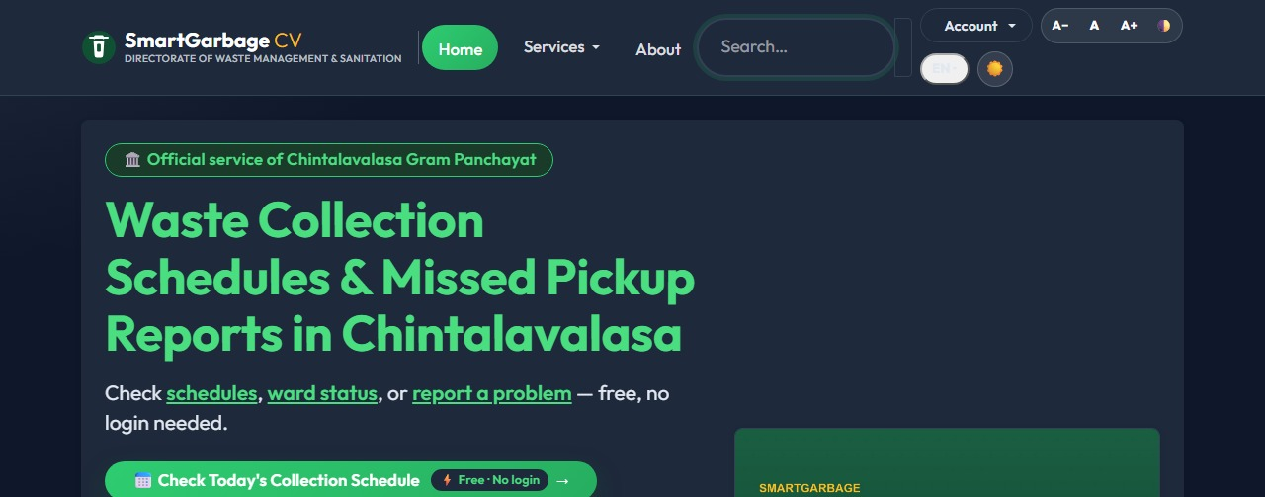
Abstract
5
wards live
3
user roles
SmartGarbage connects ~12,000 residents of Chintalavalasa Gram Panchayat (5 wards) with their Panchayat through one accountable digital channel.
Residents get street-level schedules, complaint tracking with signed links, WhatsApp reporting, PAYT billing and Green Points rewards.
An HMAC-secured IoT telemetry pipeline feeds scikit-learn models for bin overflow ETA, anomaly alerts and route priority - with every action audit-logged.
406
tests green
Rs 0
running cost
Flask 3 | PWA
PostgreSQL | 29 tables
scikit-learn ML
Docker
Live portal - smartgarbage.onrender.com

Slide 3
Introduction
Study area
Chintalavalasa Gram Panchayat, Denkada Mandal, Vizianagaram district, AP - 5 wards, ~12,000 residents.
The five wards
01
- Ward 1 - MVGR College Area
- Ward 2 - Chintalavalasa Junction
- Ward 3 - RTC Colony
- Ward 4 - Ramalayam Street
- Ward 5 - Sai Nagar
02
Stakeholders
Residents | sanitation workers (CV-01...05) | Panchayat admins | state reviewers.
!
The gap
No digital channel: paper notices, word-of-mouth complaints, zero data for planning.
~12,000 residents | 2 pickups per ward per week
Field-surveyed boundaries & schedules (seed data)

Slide 4
Problem Statement
Info blackout
Complaints vanish
1
2
No digital schedule - residents miss pickups or wait by the road.
Word-of-mouth reporting; nothing is tracked, nothing is proved.
Segregation unproven
Reactive operations
3
4
Voluntary 4-stream sorting with no incentive and no record.
Fixed routes ignore real bin fill; overflows discovered late.
Paper notices
Missed pickups
Street overflow
Health & odour risk
Citizen distrust

Slide 5
Project Objectives
1
Publish street-level collection schedules for every ward
100%
schedule visibility
2
Report & track complaints via signed 90-day tracking links
<48h
complaint SLA
3
Reward verified segregation - Green Points + 4-stream declarations
4
Digitise PAYT billing with UPI payments and receipts
Rs 0
messaging via WhatsApp
5
Give admins live telemetry, SLA escalation and audit-grade exports

Slide 6
Project Scope
IN SCOPE
OUT OF SCOPE (honest boundary)
- All 5 wards: schedules, reporting, transparency
- 3 roles - citizen, worker, admin (+ public, no login)
- IoT ingestion: HMAC-signed telemetry (ESP32-ready)
- WhatsApp reporting bot + status alerts
- PAYT invoicing, UPI payment, receipts
- PWA offline shell + installable app
- Native iOS/Android apps (PWA covers installability)
- Bin hardware manufacturing (ESP32 firmware is future work)
- Wards beyond Chintalavalasa (schema is multi-ward ready)
- Property-tax or other Panchayat services
- Card-on-file payments (UPI/PAYT only)
Everything demonstrated in this deck runs on the live deployment - smartgarbage.onrender.com

Slide 7
Literature Review/ Background Study
Dimension | Notice boards / word-of-mouth | Generic municipal apps | SmartGarbage
Schedule visibility | Paper only, no updates | City-level, no wards | Street-level, per ward, live
Complaint tracking | None | Email, no SLA | Signed link + 48h SLA + auto-escalation
Incentives | None | None | Green Points + PAYT pricing
Data for planning | None | Siloed dashboards | Live telemetry + ML ETA + state exports
Positioning: ward-level accountability + incentives + live data - the three gaps in existing systems

Slide 8
Data Gathered/ Data Used
A
B
C
Field survey (primary)
IoT telemetry (live path)
Synthetic history (disclosed)
Ward boundaries, street-level schedules (10 rows), stakeholder interviews, helpline & contacts - from direct field observation.
Fill %, temperature, methane ppm, battery, tilt from 10 bins - HMAC-signed pings into PostgreSQL via the production ingestion API.
600-row, 48-hour ramping grid per bin gives the fill-rate model velocity on a fresh install - documented as a limitation; retrains on live pings.
No Panchayat stores last year's per-bin history - we say so, size models to the data, and retrain automatically as real pings accumulate.

Slide 9
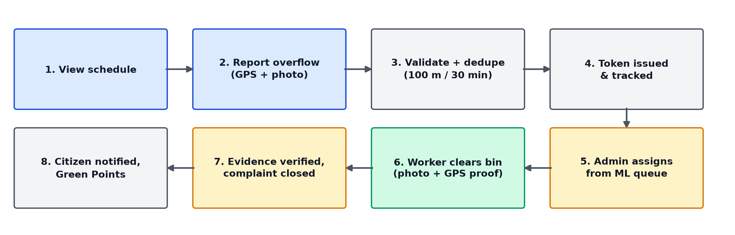
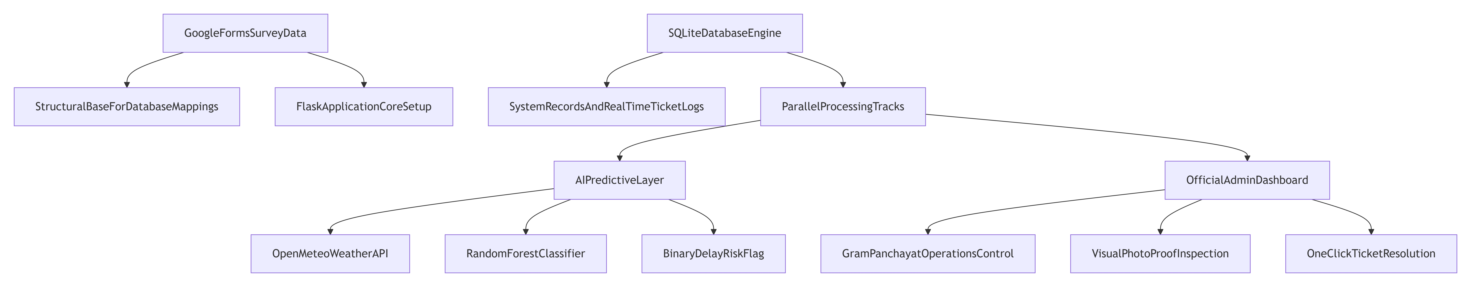
Methodology / System Design
End-to-end workflow: every arrow is an implemented endpoint, queue job or DB write
Intake (web | WhatsApp | IoT)
Validate & sign
Store (PostgreSQL)
Learn (ML)
Act (routes | alerts | SLA)

Slide 10
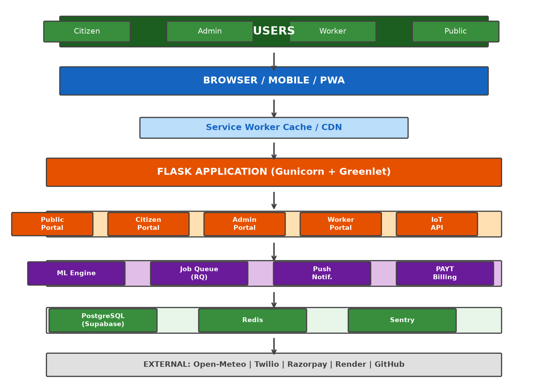
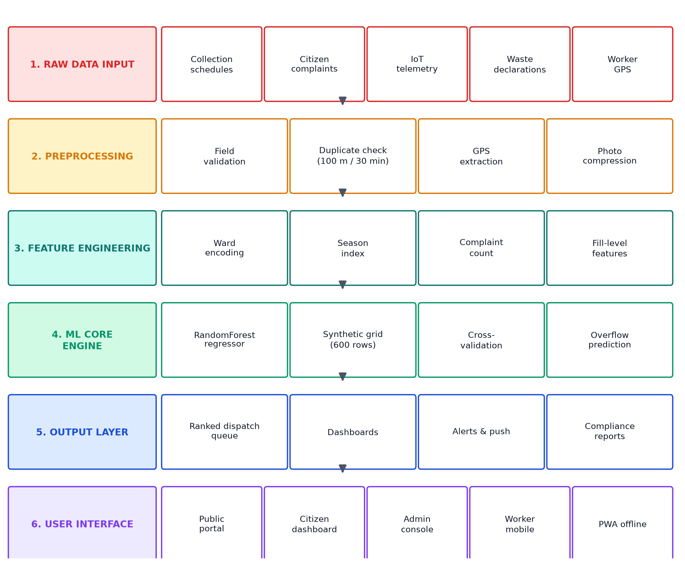
Methodology / System Design (cont.)
1 | Ingest
Forms, WhatsApp bot, HMAC IoT pings
2 | API
8 Flask route modules, CSRF + rate limits
3 | Data
PostgreSQL | 29 tables | Alembic x30
4 | ML
ETA | anomaly | miss prediction
5 | Real-time
Socket.IO dashboards | SSE alerts
6 | Deliver
Docker on Render | /health | PWA

Slide 11
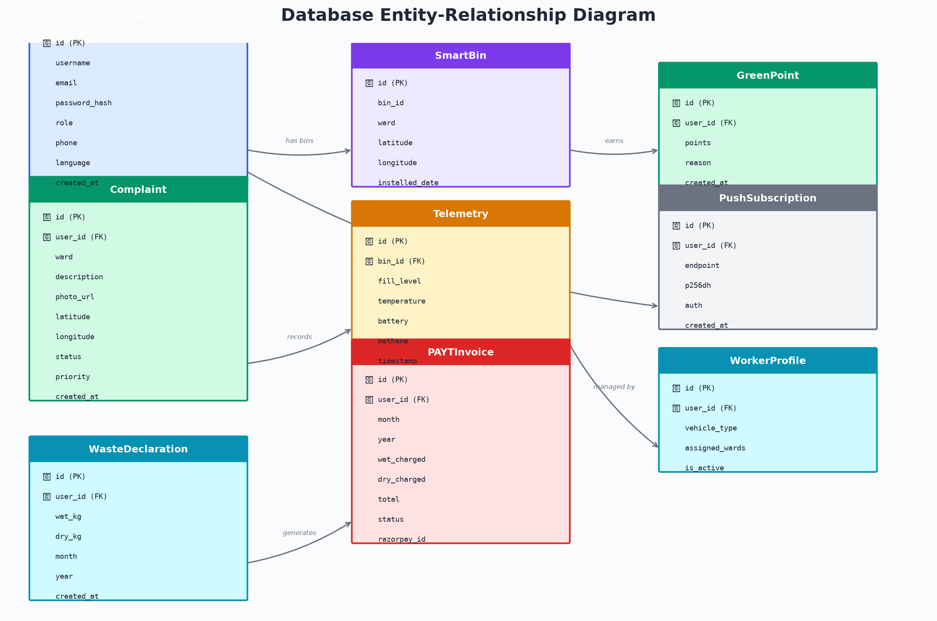
Implementation / Modules
P
Public portal
Schedules, transparency, FAQ, search - no login
C
Citizen
Complaints + tracking, declarations, PAYT, Green Points
W
Worker
Route, geofence enforcement, offload proof
A
Admin
Control room: incidents, SLA, OTA firmware, exports
29-table relational schema (Alembic-managed, 30 migrations)

Slide 12
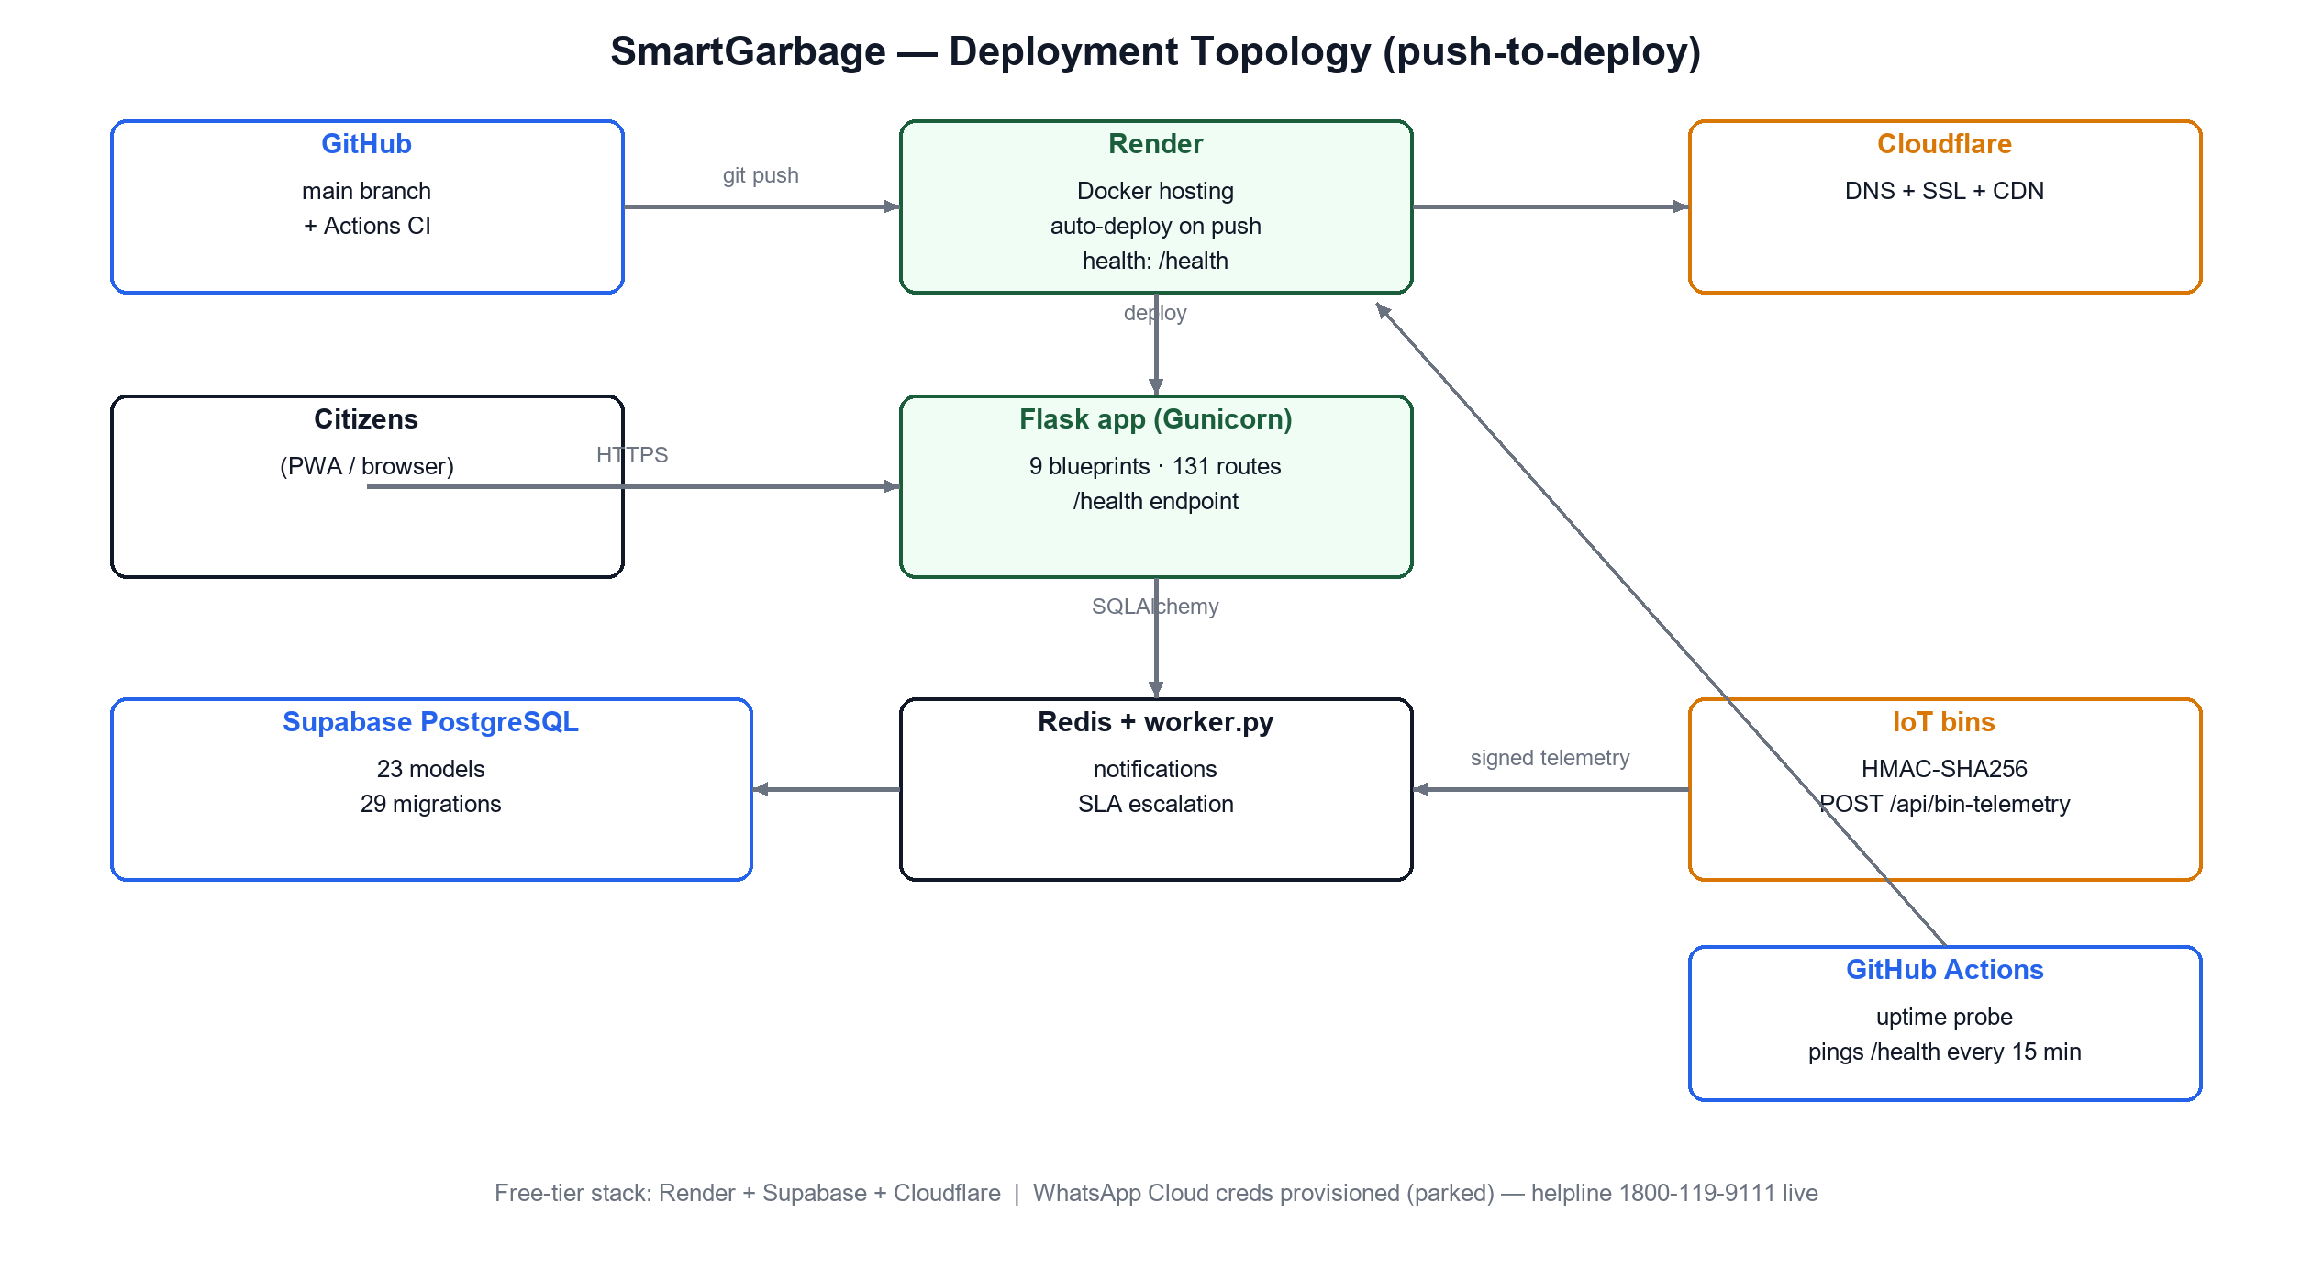
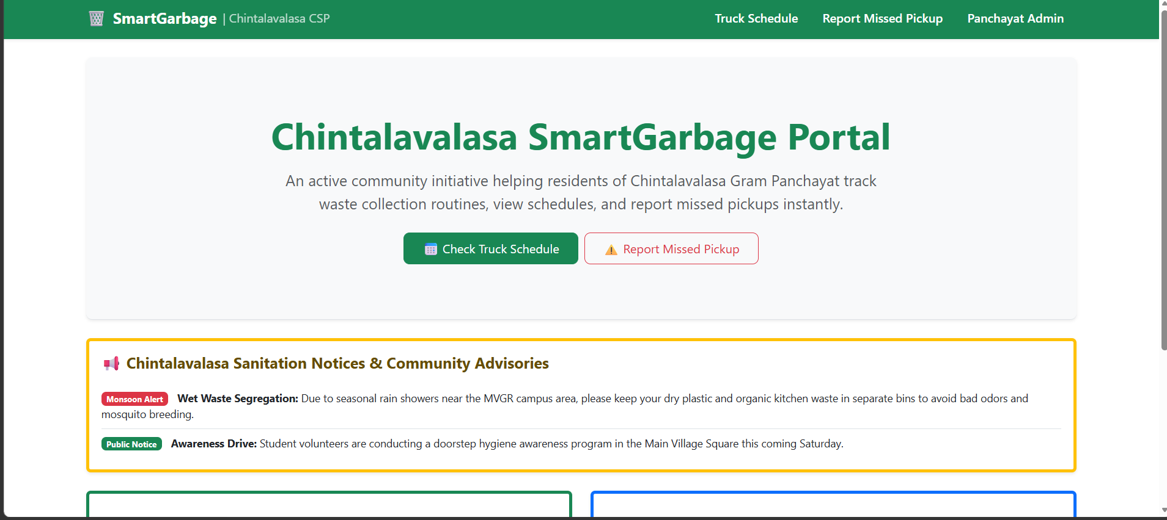
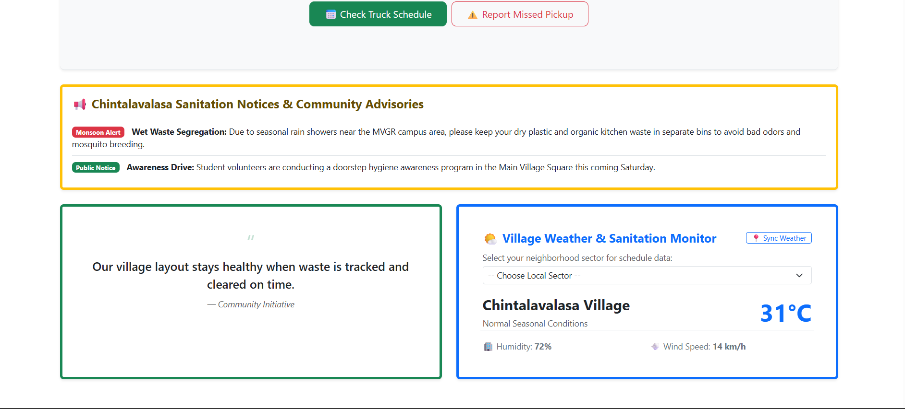
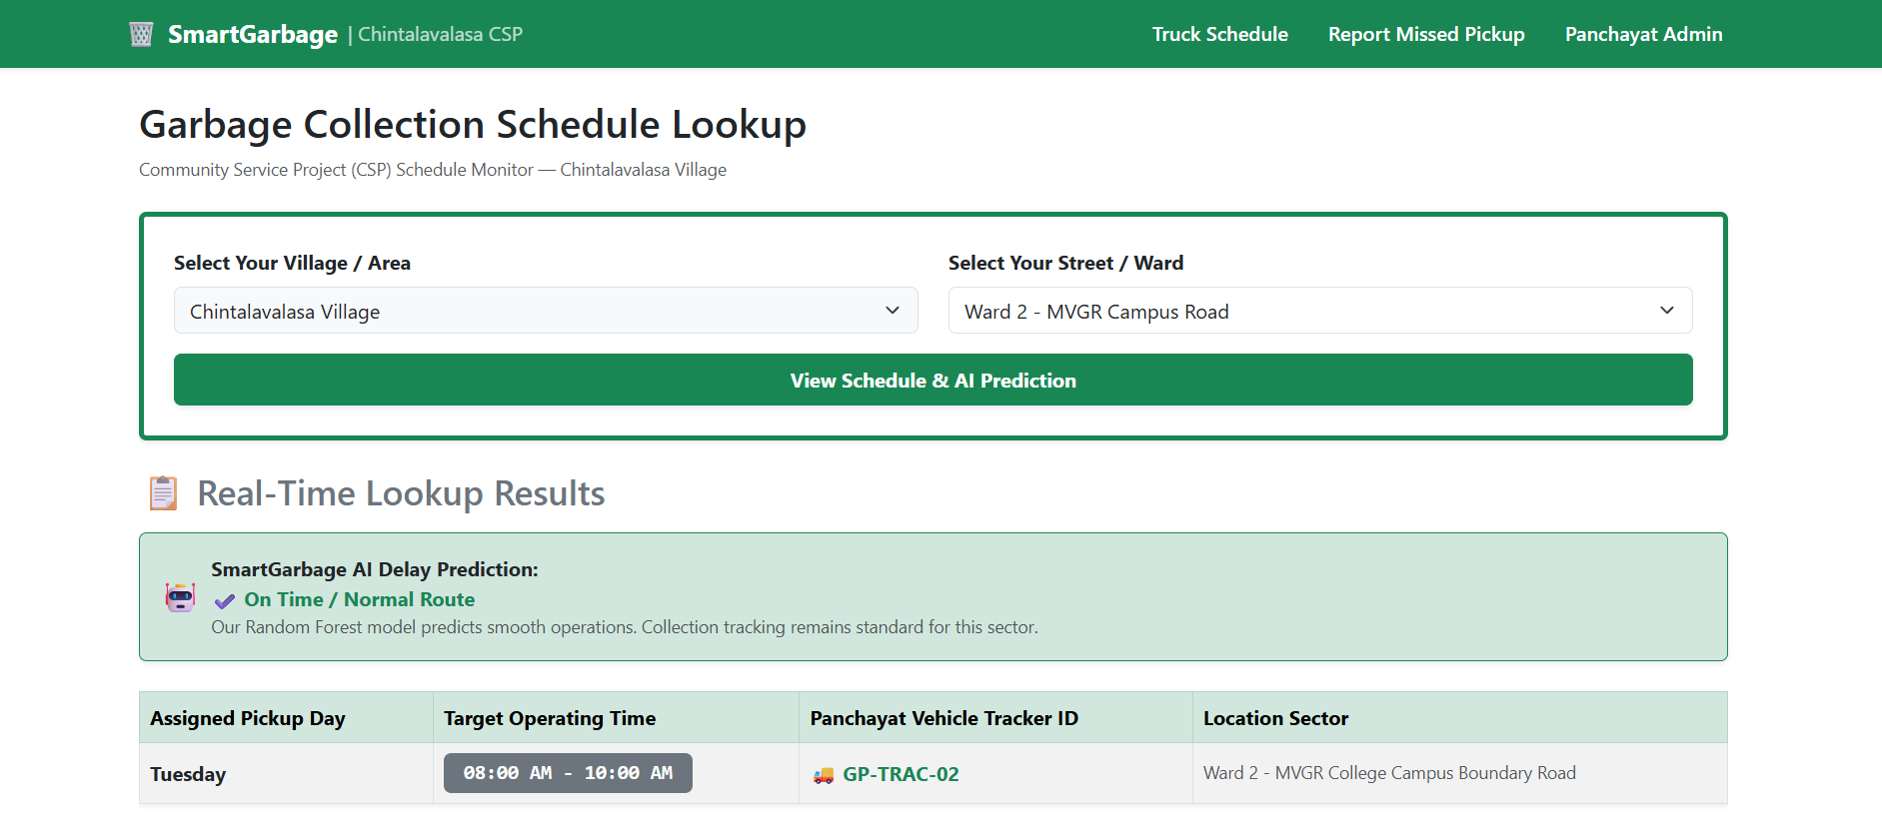
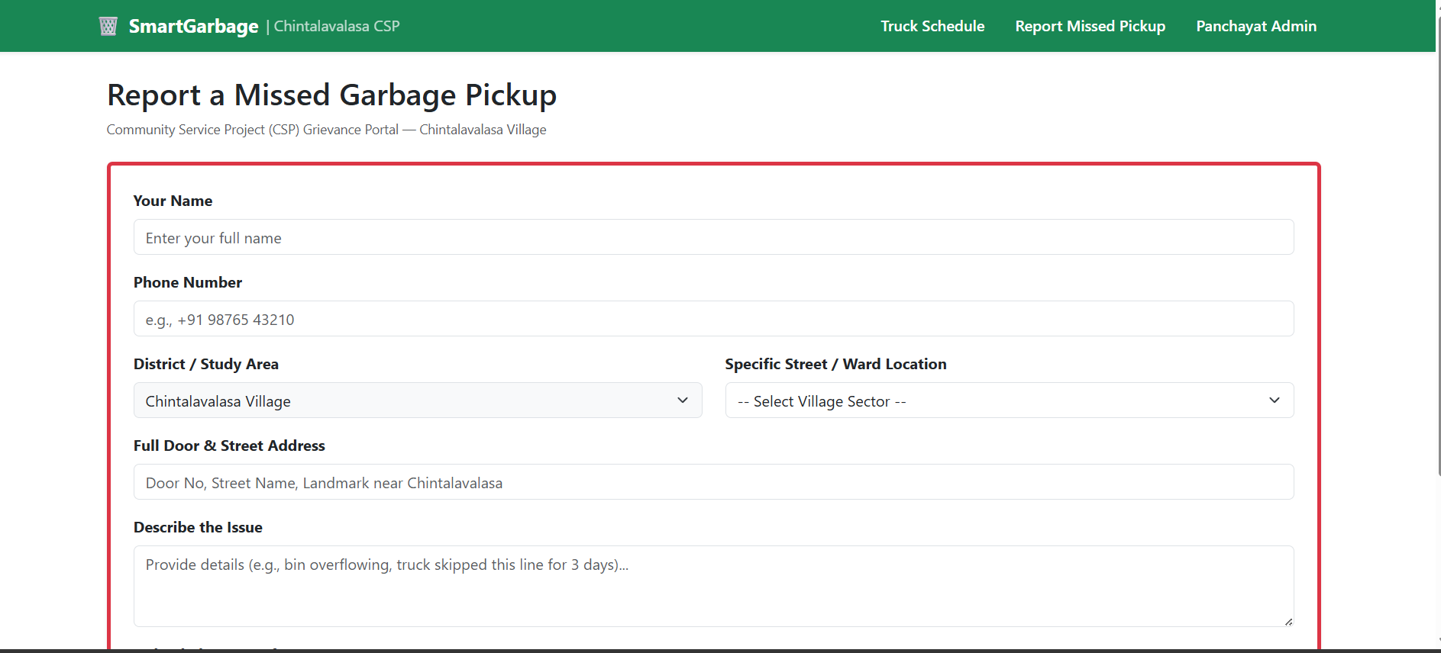
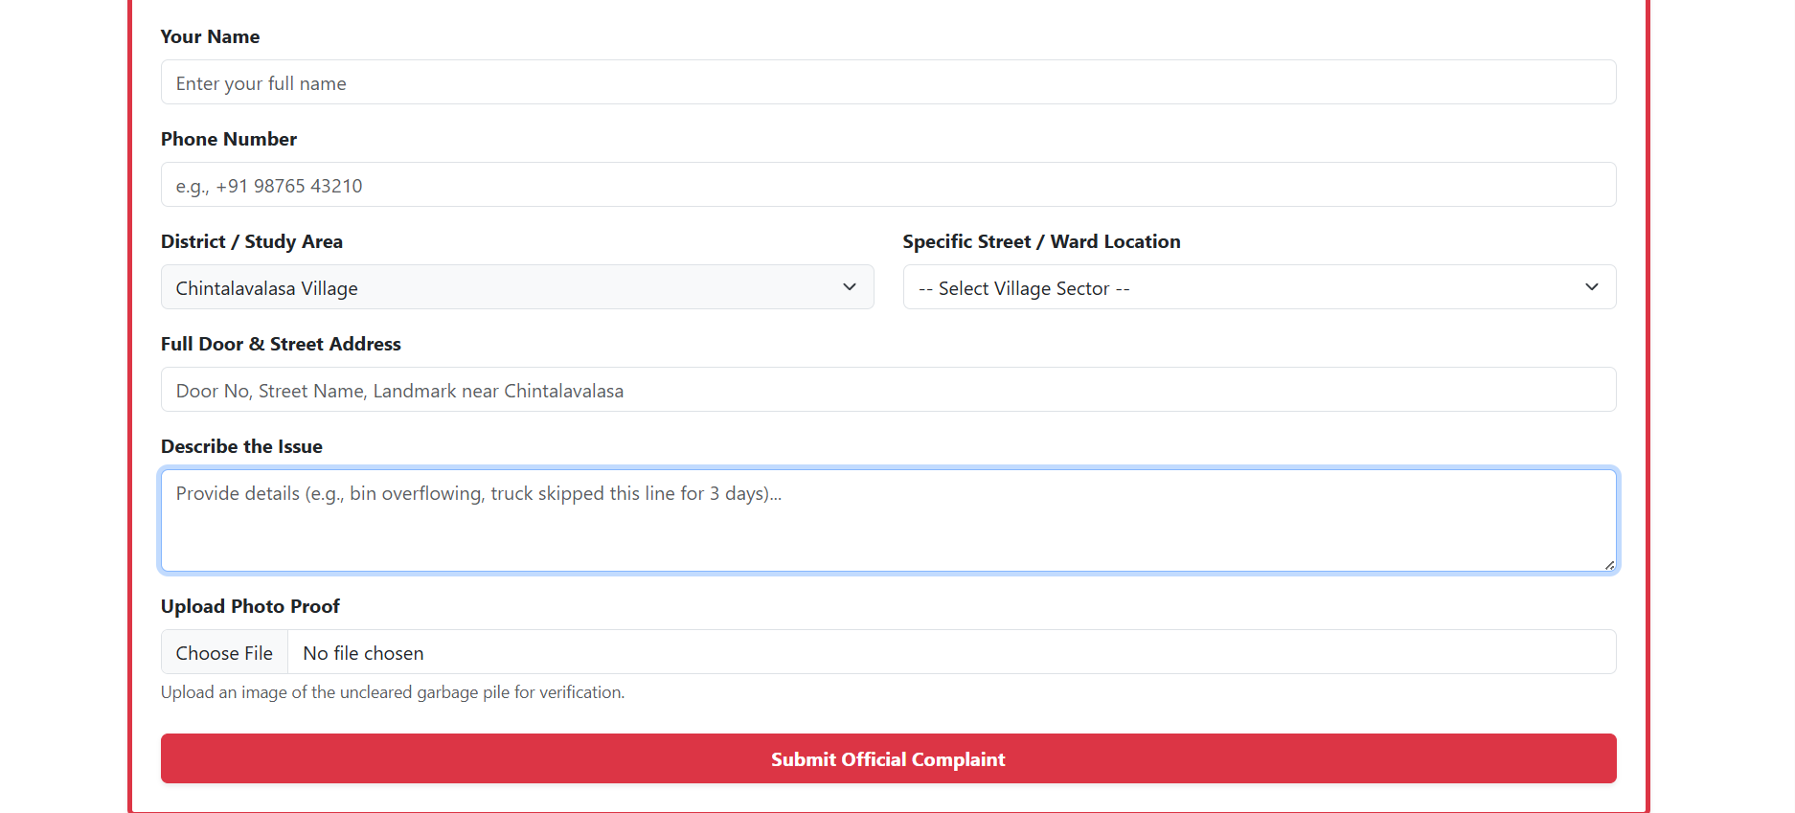
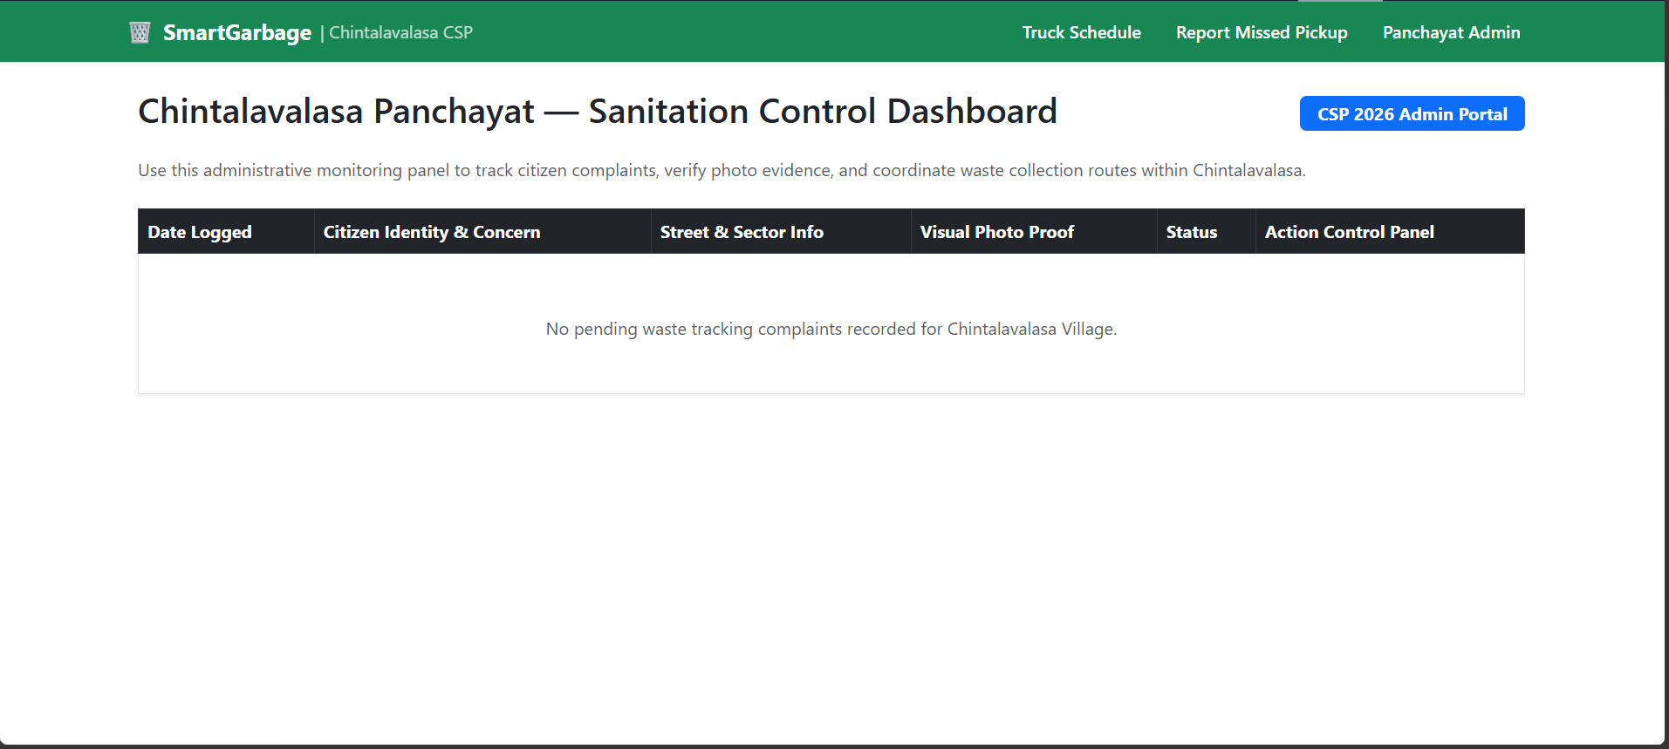
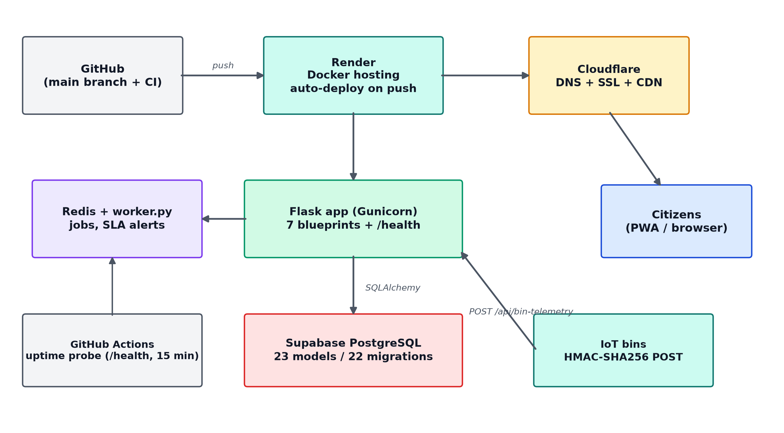
Deployment
8 route modules | 138 routes | 29 tables | 30 Alembic migrations | gunicorn + gevent x2
git push
Docker build
flask db upgrade
gunicorn + gevent x2
/health OK

Slide 13
ML Quality Assurance - The Photo Gate
Classify
96.6%
validation top-1 accuracy
1
ONNX photo gate: 224px ImageNet-normalised input; a photo ships only when p_reject < 0.70.
Verify
2
0.9998
canary p_reject (live)
Dual canary probes (reject + accept) score the deployed model on schedule; breaches raise day-deduplicated alerts.
Watch
3
Weekly p_reject drift vs a signed baseline; mean shift > 0.01, floor drop > 0.005 or any score < 0.90 files an issue.
406
automated tests green
Improve
4
Relabelled false positives ingested exactly once, gated at >= 0.90 validation accuracy, baseline auto-refreshed.
A second ML model keeps non-garbage photos out of the worker queue - and monitors its own health.

Slide 14
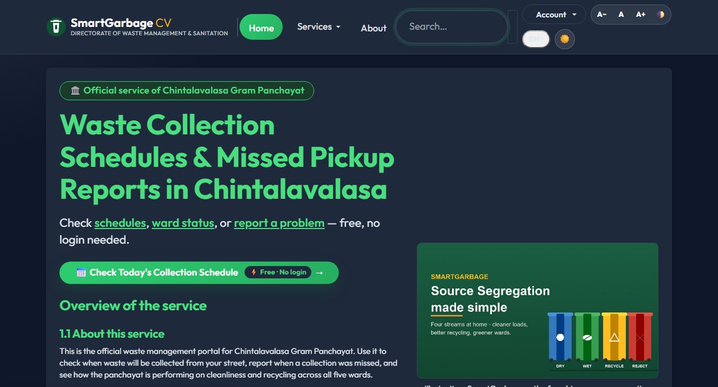
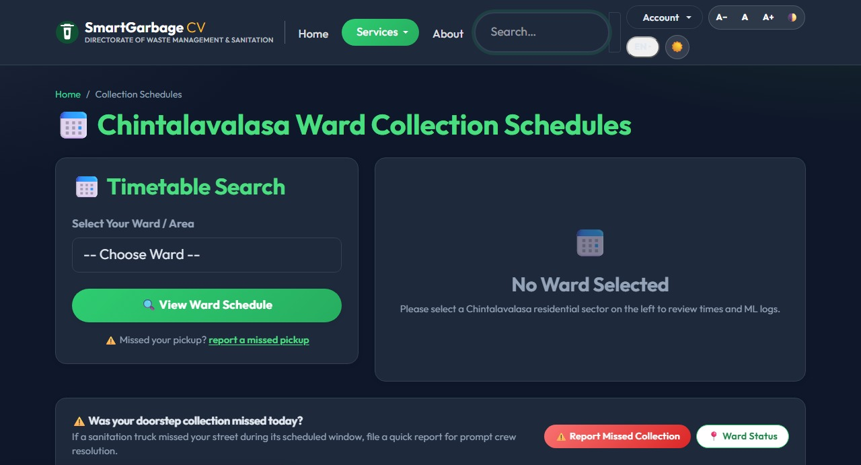
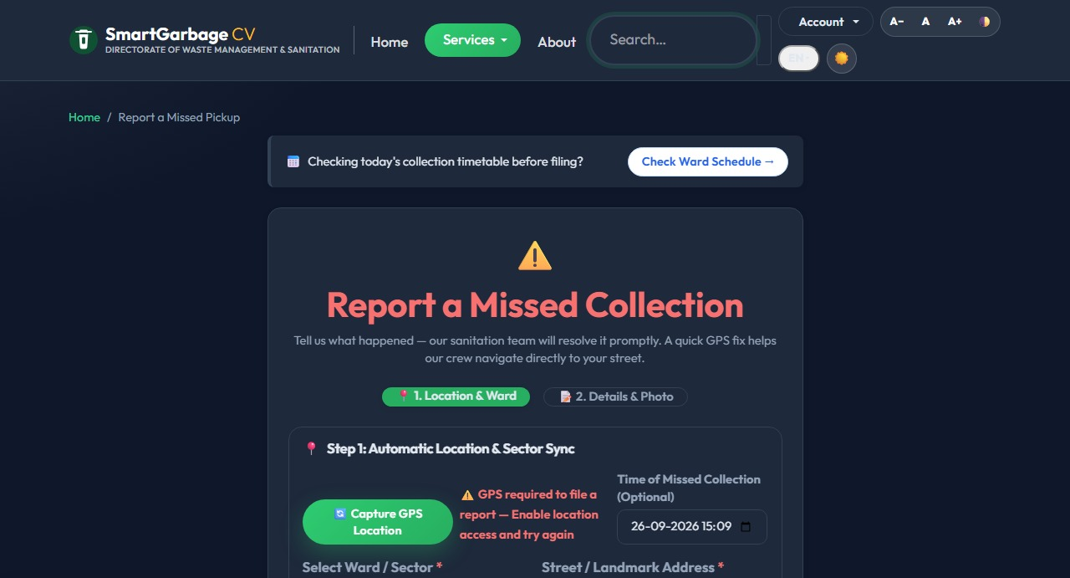
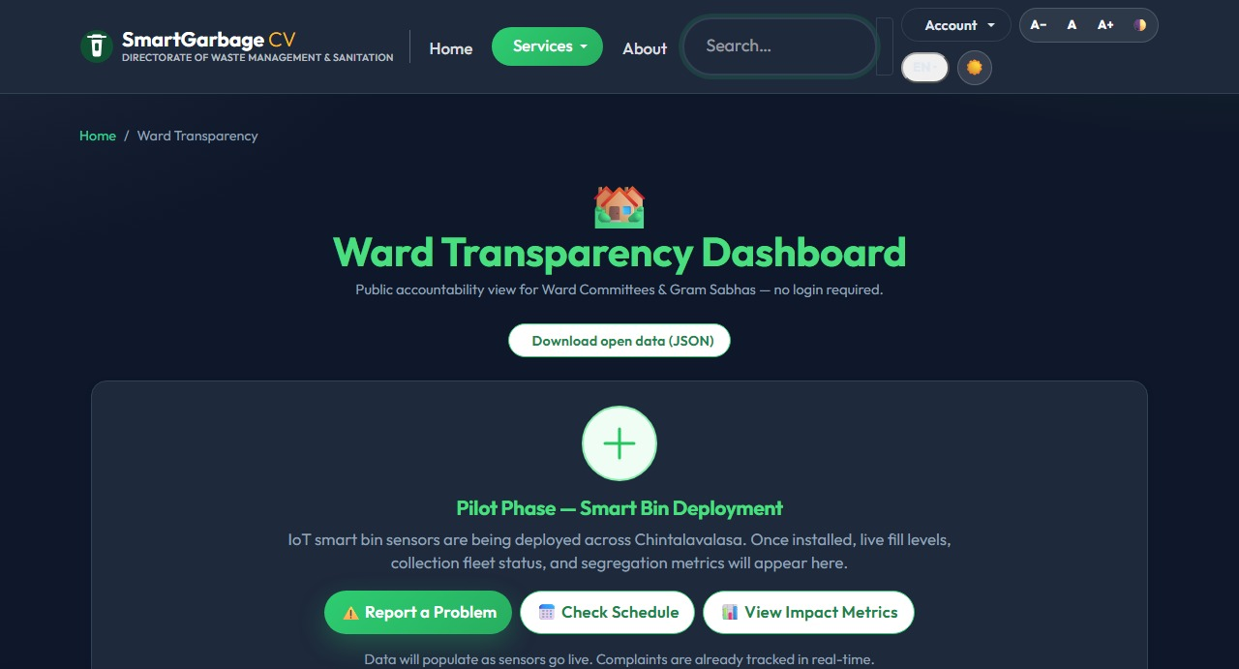
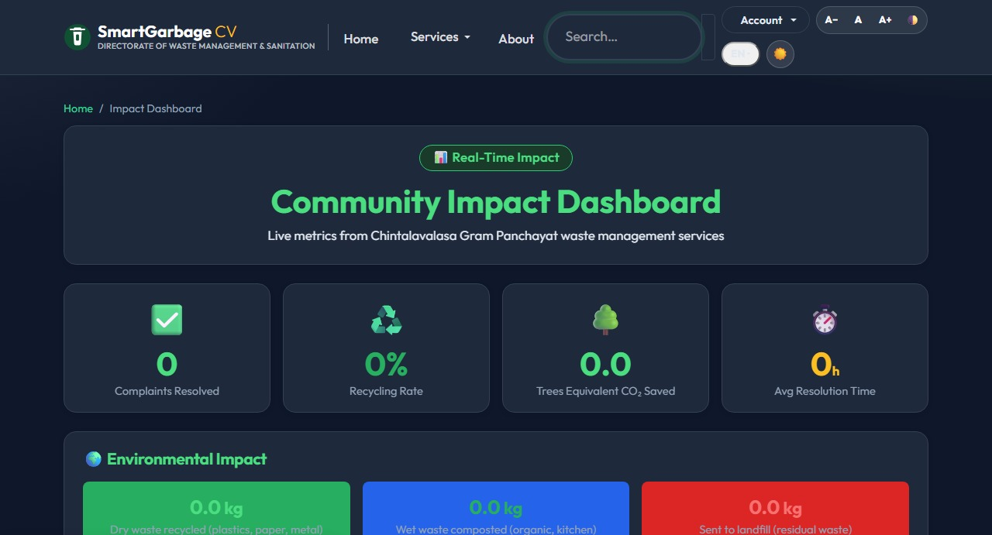
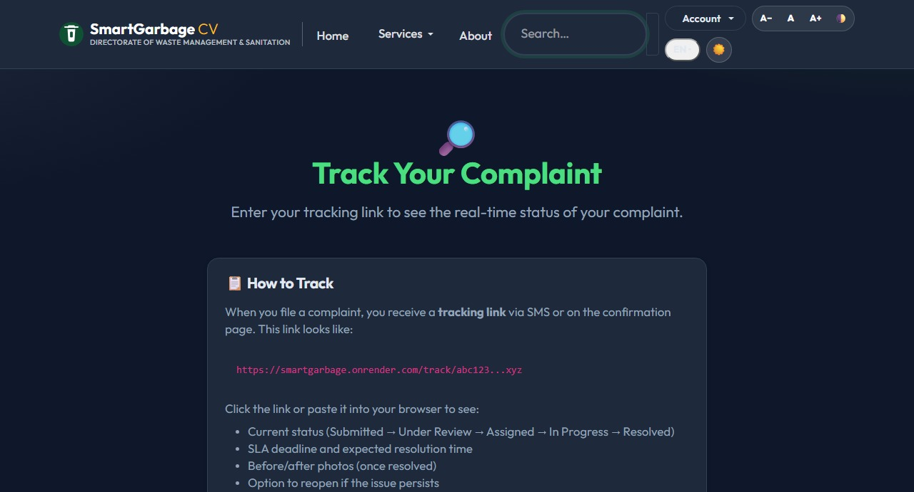
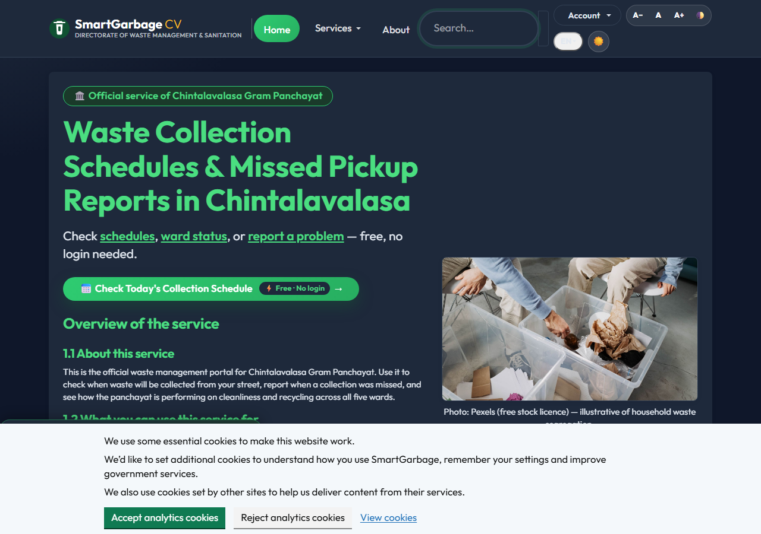
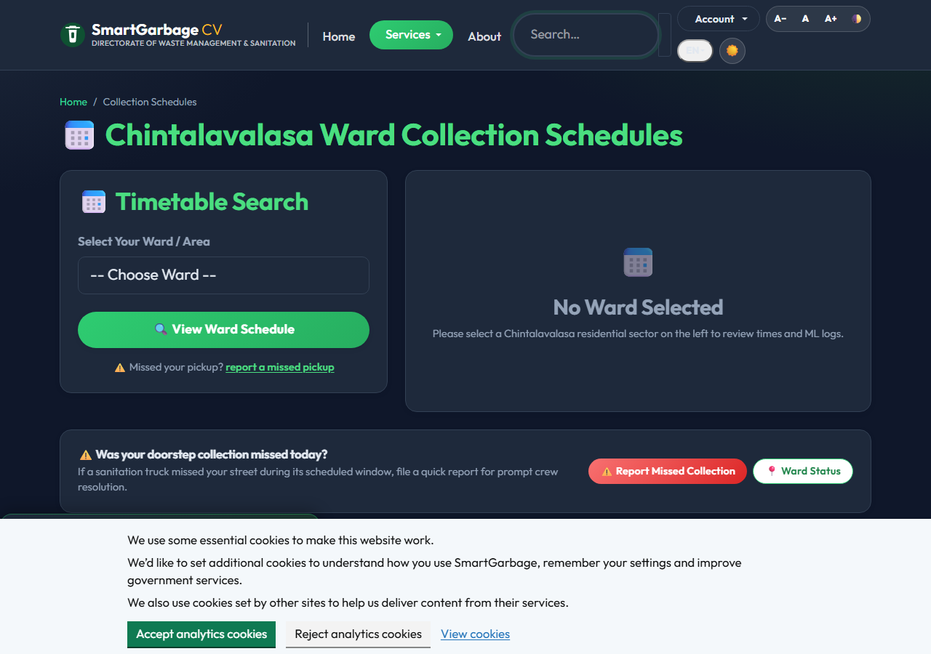
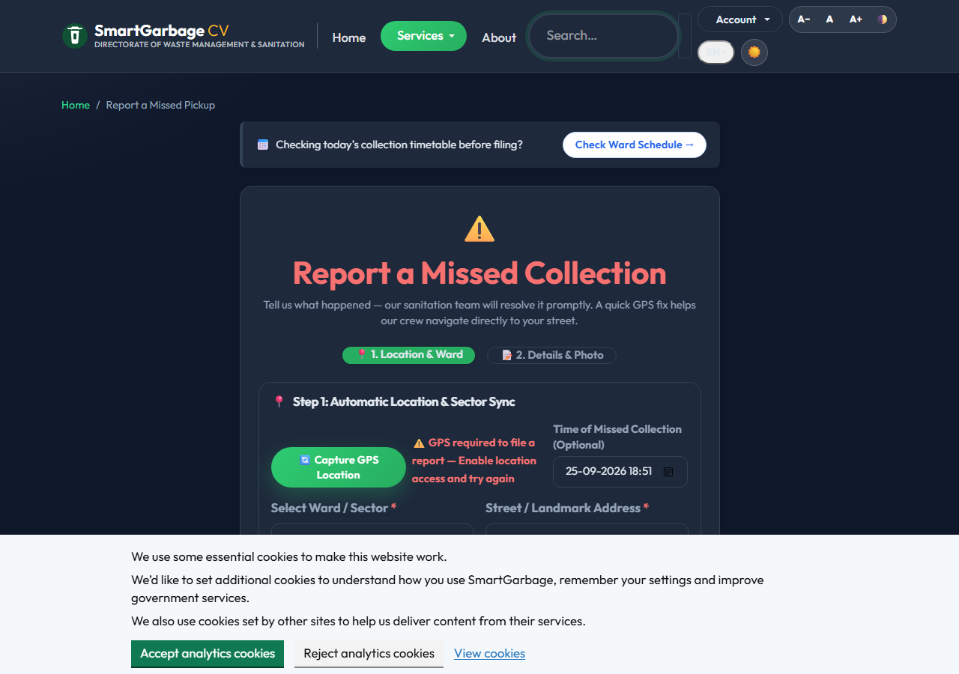
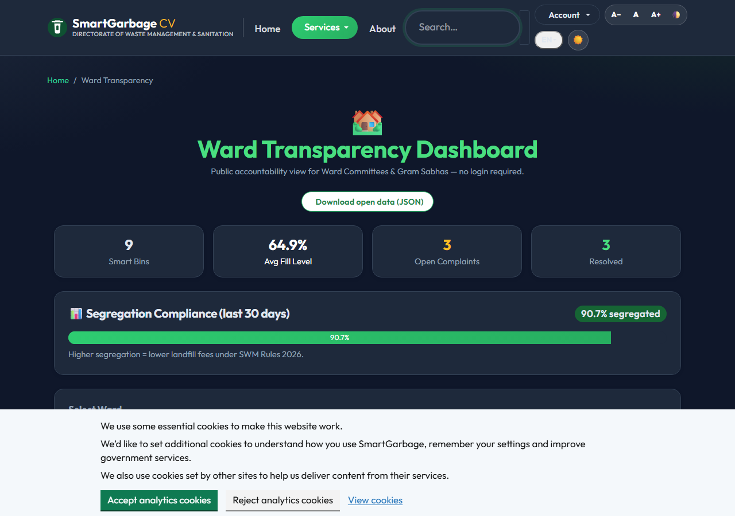

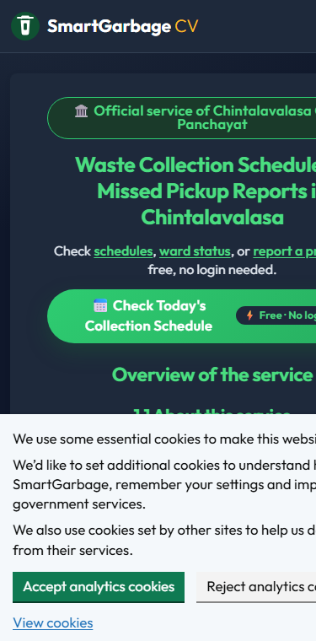
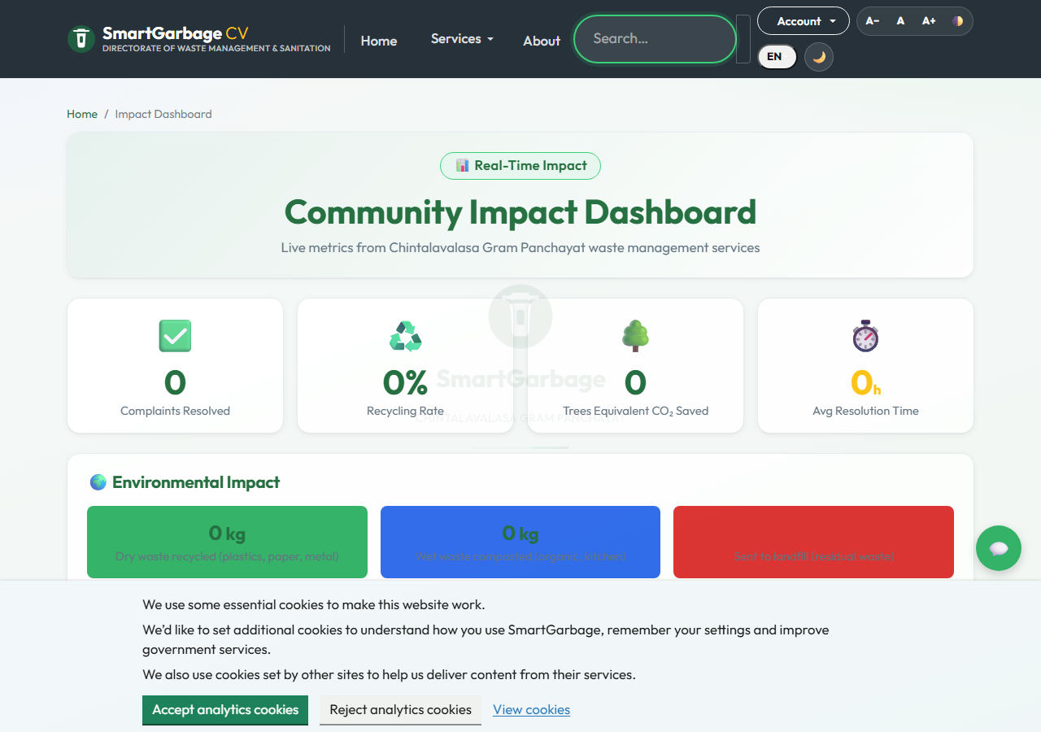
Results - Live Portal (Every Feature)
Home
Schedule lookup
Report & WhatsApp
Transparency
Impact
Complaint tracking
Captured from the live deployment - desktop PWA (1280px)

Slide 15
Impact Assessment
~12k
residents served
5
wards live
29 / 30
tables / migrations
406
tests green
Governance
Environment
G
Audit trail on every privileged action; CSV/JSON state-compliance exports.
E
PAYT + 4-stream declarations steer waste to compost/recycle, not landfill.
Social
Engineering
S
WhatsApp-first access - no app store, works on basic Android; offline PWA shell.
T
Queue with retries + dead-letter alerts; /health; Prometheus-style metrics.

Slide 16
Challenges Faced
CHALLENGE
OUR SOLUTION
No historical bin telemetry
600-row synthetic grid + auto-retrain on live pings - limitation disclosed
CHALLENGE
OUR SOLUTION
Free tier: no worker service
In-process RQ worker, retry policies, dead-letter alerts, /health probes
CHALLENGE
OUR SOLUTION
1 vCPU page-load stalls
gevent x2 workers, compression, Redis cache, offline PWA shell

Slide 17
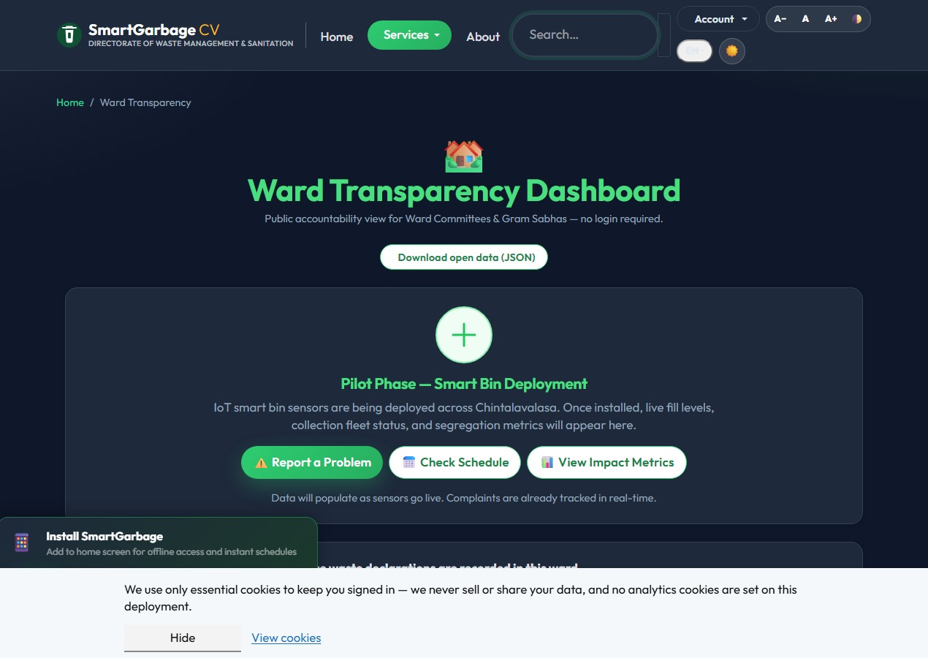
Conclusion
SmartGarbage replaces a notice board and a phone tree with one
accountable, data-producing channel - schedules people can trust,
complaints that cannot vanish, and operations data the Panchayat
can finally act on.
One accountable channel
Data-driven operations
Ready for the next ward
Transparency dashboard - the Panchayat's public ledger
Live: smartgarbage.onrender.com | fully open to inspection today

Slide 18
Future Work
ESP32 on real bins
Retrain on live pings
Nightly route optimisation
District rollout
Step 1
Step 2
Step 3
Step 4
OTA firmware channel already ships in the admin console
model_retraining_job swaps the synthetic grid out
ETA + miss predictions blended into worker routes
Multi-panchayat schema is already ward-scoped
Each step reuses what already ships - no rewrite, only new data and configuration.

Slide 19
References
[1] Swachh Bharat Mission (Grameen) Phase-II guidelines, Ministry of Jal Shakti.
[7] scikit-learn - HistGradientBoostingRegressor (overflow ETA) & IsolationForest (anomaly detection), as used in app/ml_model.py.
[2] Web & Backend Architecture
[8] Anagnostopoulos et al. (2015), Waste Management 45, 34-41 - IoT bin monitoring.
[3] Flask 3.x documentation (Pallets Projects) - application factory, blueprints.
[9] Chen et al. (2020) - ensemble learning for short-term waste prediction.
[4] SQLAlchemy 2.0 documentation; Alembic migration framework.
[10] Accessibility & Security
[5] Machine Learning & Predictive Modeling
[11] WCAG 2.1 Level AA (W3C); OWASP Top 10 and secure-headers project.
[6] Liu, Ting & Zhou (2008), Isolation Forest, AAAI - the anomaly model actually deployed.

Slide 20
Thank You
Open Floor for Discussion
Live demo: smartgarbage.onrender.com

