Slide 1



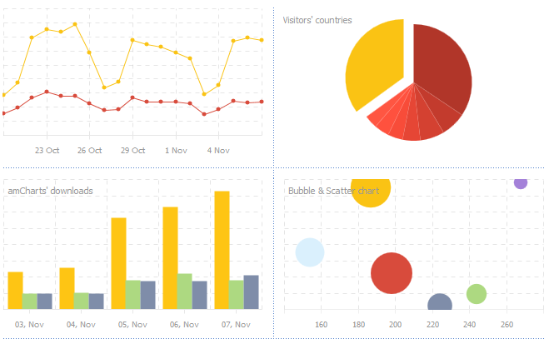

Management information assistant
MIA
July 07, 2017
Achin Jain, Bijjam Reddy, Hardik Verma and Mehul Soni
Mr. Siddharth Raghuvanshi

Slide 2
Content
Introduction
Challenges Faced
Widgets: Functions
Search Engine
Future Scope

Slide 3



The entire process uses a lot of time and is very sensitive to updation in data
Even a minor change requires a lot of time and incorporating the changes decreases efficiency.
Eliminating and optimizing the task of data consolidation.
Automation of report making and simplistic method for analyzing and visualizing the data.
Bringing the whole team on a single dais to work together and increasing accessibility through a dynamic sharing platform.
PRESENT SCENARIO
PROBLEM STATEMENT
MIA
Robust search
Messaging and Commenting
Customizable Templates
No Codes!
Friendly UI
Easy sharing and accessibility
Multiple Chart Options
Xampp
Nginx
Less
Sublime
AngularJs
HTML
Bower
Python
Tools and Tech
TM
TM
TM

Slide 4
The features of an ideal reporting tool
The present market: Competition and Contrast
The Scope: New areas to be explored
Applicable to varied domains
Basic functional unit of the dashboard
Variety of widgets e.g. graphs, maps, etc.
Helps in making the data user friendly
BUSINESS
INTELLIGENCE
WIDGETS
What are widgets ?
More flexibility in terms of new charts and graphs
Dynamic data flow
User controlled data flow
Input
Process
Output
Uses
How they help?

Slide 5
Content
Introduction
Challenges Faced
Widgets: Functions
Search Engine
Future Scope

Slide 6
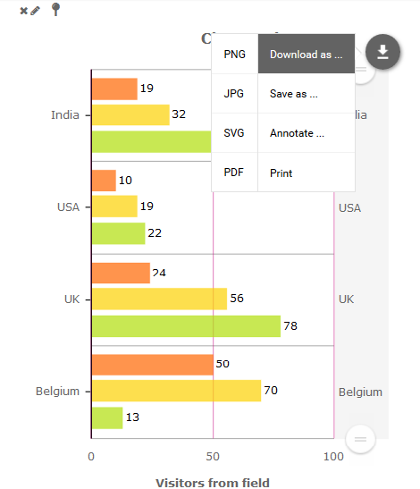

A Simple Chart and its features
Automatic Comments/ insights.
Download data and Save the charts
Pin your chart to Dashboard.
Filter data for a specific part.
Shrink/Expand data to get only the required chart.

Slide 7
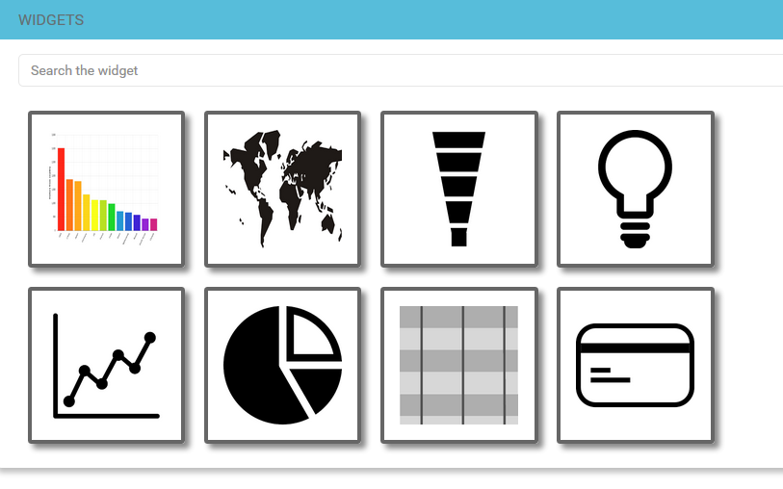
Thumbnail access buttons.
Change on hover.
Search charts with specific attributes.
Each chart has associated tags, which helps to filter the search results.
Thumbnail Palette for easy access
Thumbnail Palette for easy access

Slide 8
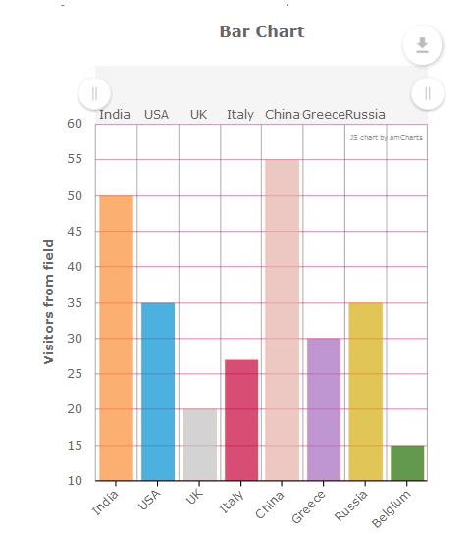
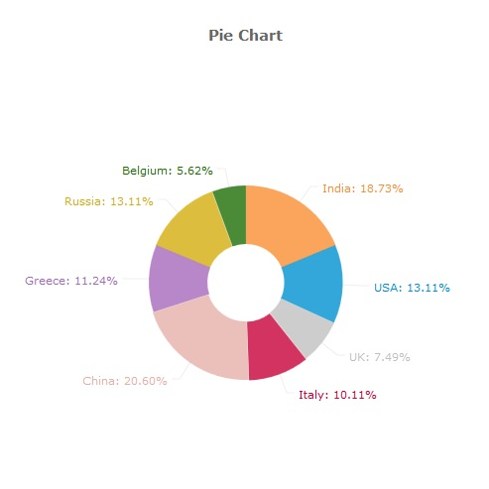
Data from charts with similar data-types can be exchanged.
Allows multiple visualizations of the same data.
Functionalities of one may act as a feature of other.
Inter Convertible Charts

Slide 9
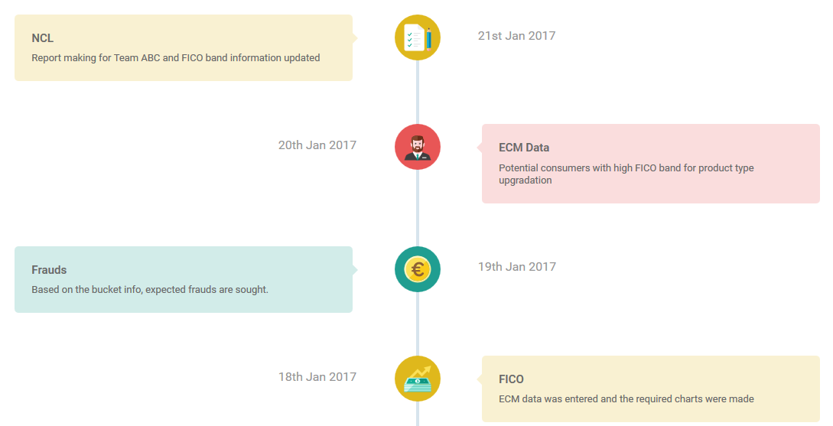
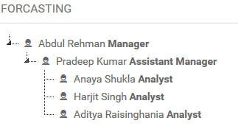
Auto Updating timeline for users.
Daily activities executed are recorded.
Higher authorities can view the timeline of subordinates.
Activity Timeline

Slide 10
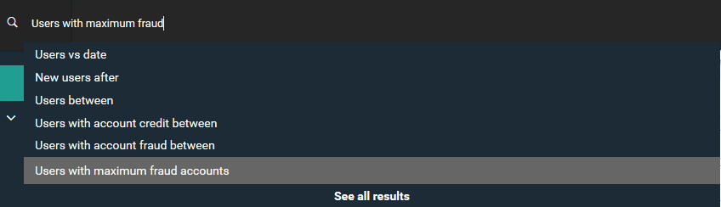
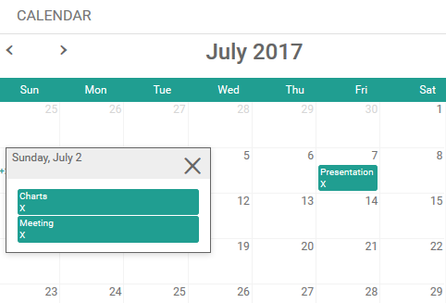
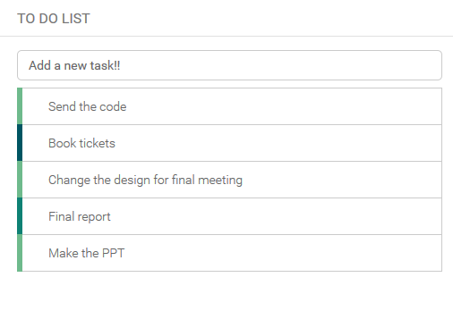
Predictive search: With the look and feel of any popular search engine.
Event scheduler. Add and delete events.
We didn’t want to miss anything, so used this and added it!!

Slide 11
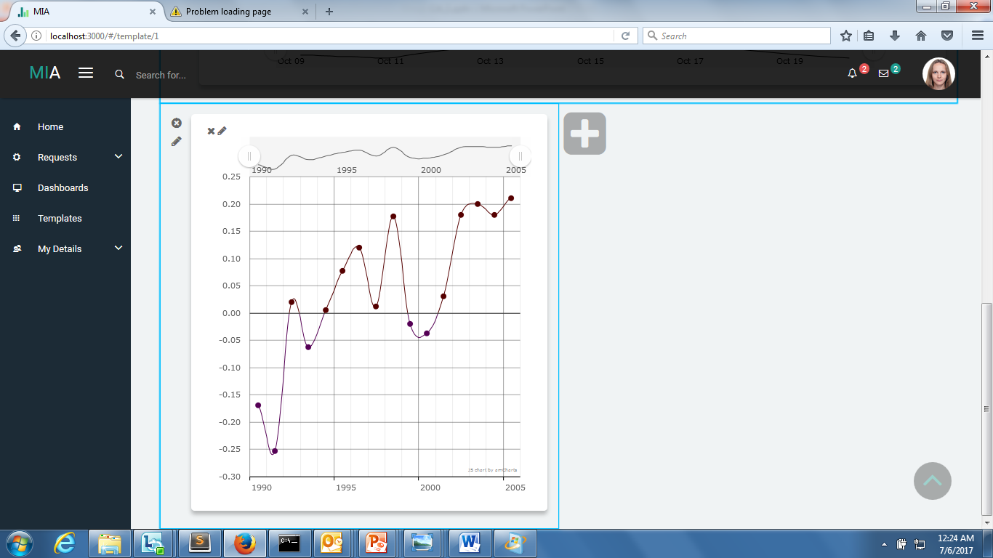
Zooming
Zoom- in
Adjustment of range in the chart
Enables clear understanding in case of large data
Dynamic data extraction
Zooming

Slide 12
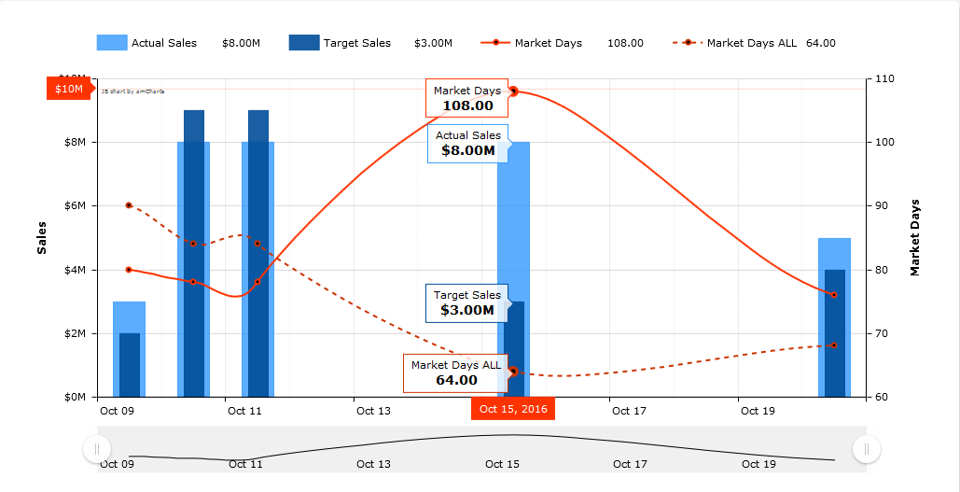
Hovering
In case of multiple variables in one chart, this feature provides a deeper look into the data
HOVERING

Slide 13
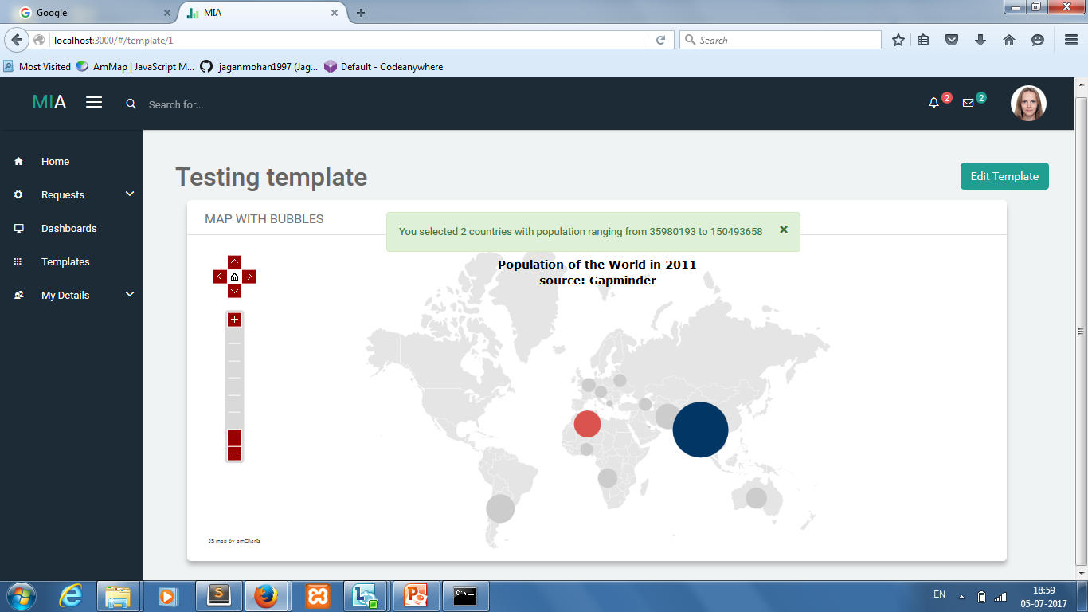
Auto Comments
Automated Insights of the data

Slide 14
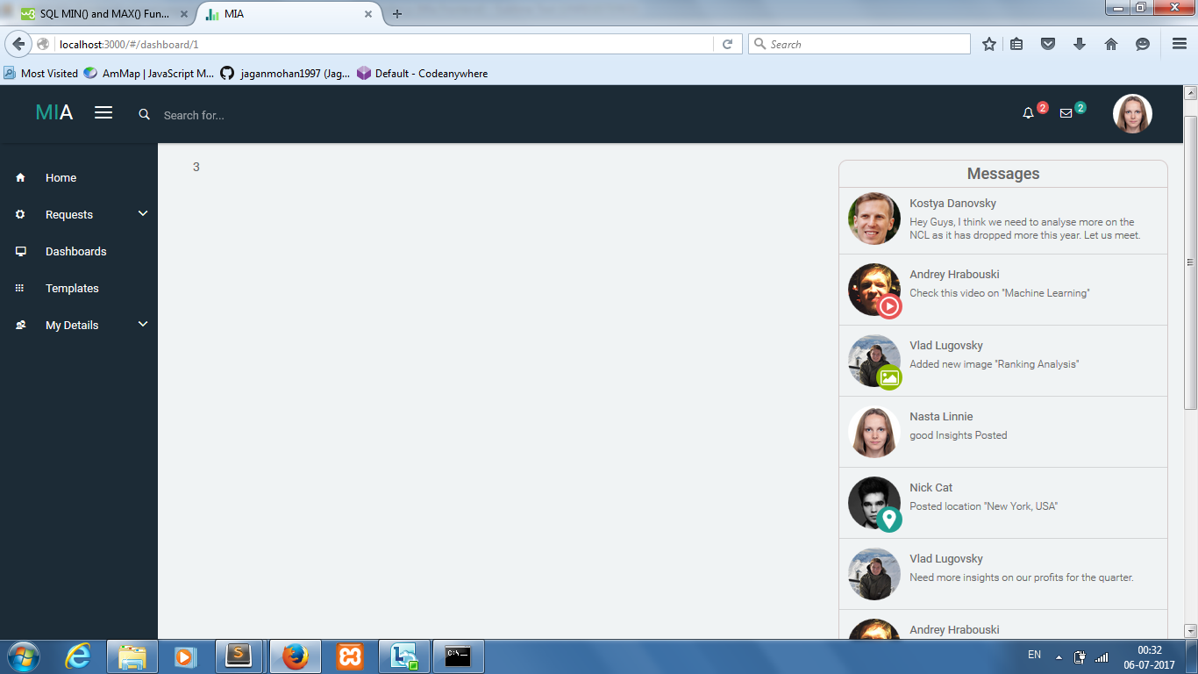
Message Section
Along with Auto Comments users can also provide their personal insights
Helps increase project management.

Slide 15
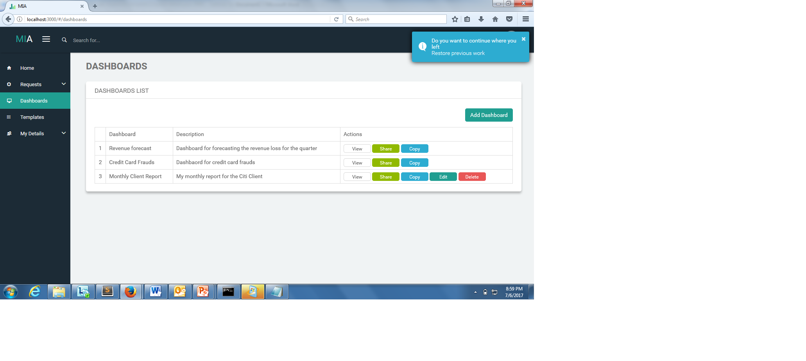
Restore Work
Provide the user an option to go back to his/her last work
Curbs the problem of losing of data. Making MIA fault tolerant

Slide 16
Content
Introduction
Challenges Faced
Widgets: Functions
Search Engine
Future Scope

Slide 17
We have to search the widgets we need and then input the data to the widget
MIA Search Engine
To extract data based on user’s search string so that suitable charts/graphs with required data are dynamically shown to the user
To prevent the need for writing SQL queries.
PRESENT SCENARIO
An algorithm that converts the simple english queries fed by the user into SQL queries which are then used to fetch the data to be given as input for any widget
PROBLEM STATEMENT
SOLUTION

Slide 18
The Algorithm
Input
Output
USER’S STRING
SQL QUERY
USER INPUT | SQL QUERY
Users | SELECT `user` FROM `userdata`
User with credit between $200 and $300 | SELECT `user`, `credit` FROM `userdata` WHERE `credit` BETWEEN $200 AND $300
Maximum credit of user with account id=12345 | SELECT `user`, MAX (`credit `) WHERE `account id` = 12345

Slide 19
How can this be achieved?
LANGUAGE
We have documented the whole set of string types a user can give.
We analyzed these types to obtain a common parameter
SCHEMA
A common point between the language and the queries we have generated is that they can classified as General Schema and Filtering Schema

Slide 20
Schema
Mathematical Functions
Field / Table Column
Per,
Vs,
with
Field / Table Column
Between Top, Order By, Where
Condition
X == ‘a’
AND /OR
Y==‘b’
Functions
Main Column
Conjunction
Sub Column
Conditions
Max
Users
by
After 2016
Credit
User

Slide 21
Content
Introduction
Challenges Faced
Widgets: Functions
Search Engine
Future Scope

Slide 22
Challenges Faced
Understanding the already done work since we joined the team in the mid-project
Coming up with a standardized method of data extraction to ensure communication between charts
The complexity of the code posed a problem at every step
Making the Search Engine algorithm dynamic to incorporate new schemas
Future Scope
Making a search engine which understands even the Natural Language Query
Incorporating Forecasting, Modeling and other complex mathematical features
Reporting with pagination
Learning user’s choices to give him/her better results and experience

Slide 23
Content
Introduction
Challenges Faced
Widgets: Functions
Search Engine
Future Scope

Slide 24
THANK YOU

