Slide 1
CRYPTO VOLATILITY & risk Analyzer
Mentor Name: Ms. S. Sophiya
By:
Atturu Jagan Mohan Reddy

Slide 2
CONTENTS
Project Statement
Introduction
Work Flow
Structure Of Architecture
Flow Of Modules
Summary

Slide 3
PROJECT STATEMENT
Crypto Volatility and Risk Analyzer delivers real‑time dashboards that reveal cryptocurrency risk through volatility and performance metrics.

Slide 4
introduction
Market Dynamics: Cryptocurrencies are highly volatile assets, with prices influenced by global demand, trading volume, and market sentiment.
Need for Risk Analysis: Investors face uncertainty due to rapid fluctuations. Measuring volatility and risk metrics helps in making informed decisions.
Project Objective: To design a Crypto Volatility & Risk Analyzer that integrates live data, applies statistical measures, and visualizes risk levels.
Key Features:
Real-time data acquisition from APIs (Binance, CoinGecko)
Statistical calculations (Volatility, Sharpe Ratio, Beta)
Interactive dashboards for visualization
Risk classification into Low, Medium, High categories
Outcome: A user-friendly system that empowers traders and analysts with actionable insights for safer crypto investing.

Slide 5
WORK FLOW
Data
Acquisition
Data Processing
Risk Calculation
Visualization
Risk Classification
Reporting

Slide 6
Architecture Diagram:
Binance API
CoinGecko API
Data Sources
Python Backend
Database
Backend
Processing
Data Processing
Risk Calculation
Frontend
Dashboard
Report Generator

Slide 7
MODULEs TO BE IMPLEMENTED
Categorized based on the Milestone Levels:-
Data Acquisition Module
Data Preprocessing & Calculation Module
Data Visualization Module
Risk Classification & Reporting Module

Slide 8
Tools used!!!
Python : A core programming language for the entire project.
HTML/CSS : Used for custom UI Components.
Streamlit : Used to develop interactive web dashboards.
Numpy : Used for Numerical Calculations.
Pandas : Used for manipulating the data.
Matplotlib : Used for Data Visualization.
SQL : Used for authentication and connection with server.
API : Used to fetch real-time data.
Google Colab : For Primary development environment.

Slide 9
MILESTONE-1
Data Acquisition & Setup:
Fetching the live crypto price data from various web page sources.
Integrating API’s to fetch those data.
Storing the fetched data in the CSV format.
Preparing the environment to develop further process by providing required libraries.

Slide 10
WORKFLOW
Sources:
Finding best datasets from APIs
Those APIs are Kaggle, Coin gecko etc.,
CRYPTOCURRENCIES:
List of various currencies like Bitcoin, Ethereum, etc..,
FACTORS:
It involves in extracting based on Volume, Price, Market details
TYPE OF FILE:
Extracted and the whole data in the form of CSV file.

Slide 11
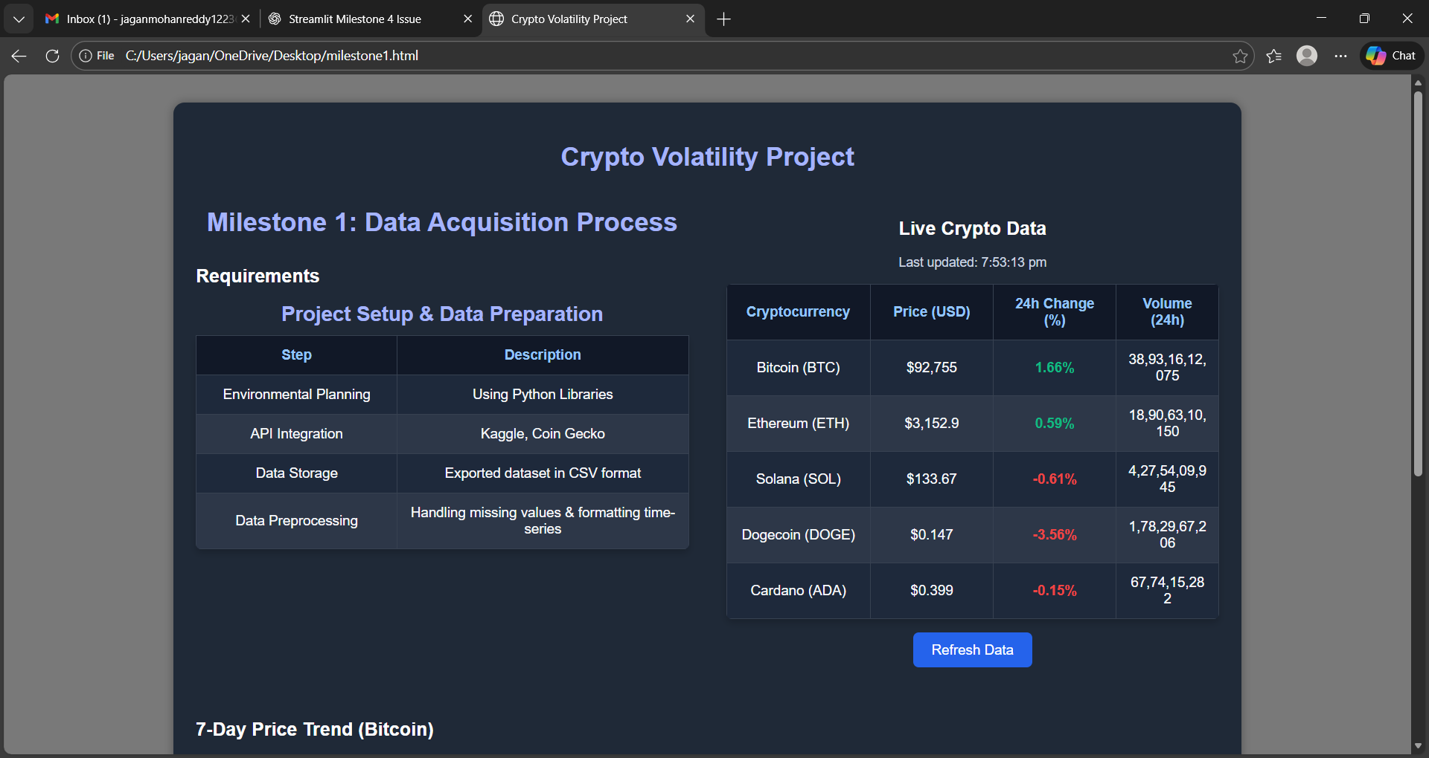
Output:

Slide 12
MILESTONE-2
Data Processing & Calculation:
Calculating daily returns
Using statistical measures to derive:
Daily & Annualized volatility
Sharpe Ratio
Beta coefficient

Slide 13
DATA CLEANING & PROCESSING:
Missing values must be identified and handled appropriately by using the functions like fillna( ), dropna( ) with the help of aggregate functions.
It will be very helpful to provide best analysis.
DAILY RETURNS CALCULATION:
The percentage of change of price from one day to the next day is known as the daily returns.
It is very helpful to assess the daily returns of the assets.

Slide 14
Statistical measures
Volatility:
Volatility measures how much an asset’s price fluctuates over time.
We can calculate volatility using standard deviation of daily returns of the assets.
Sharpe Ratio:
Used to measure the returns earned per unit of risk.
It helps evaluate investment performance.

Slide 15
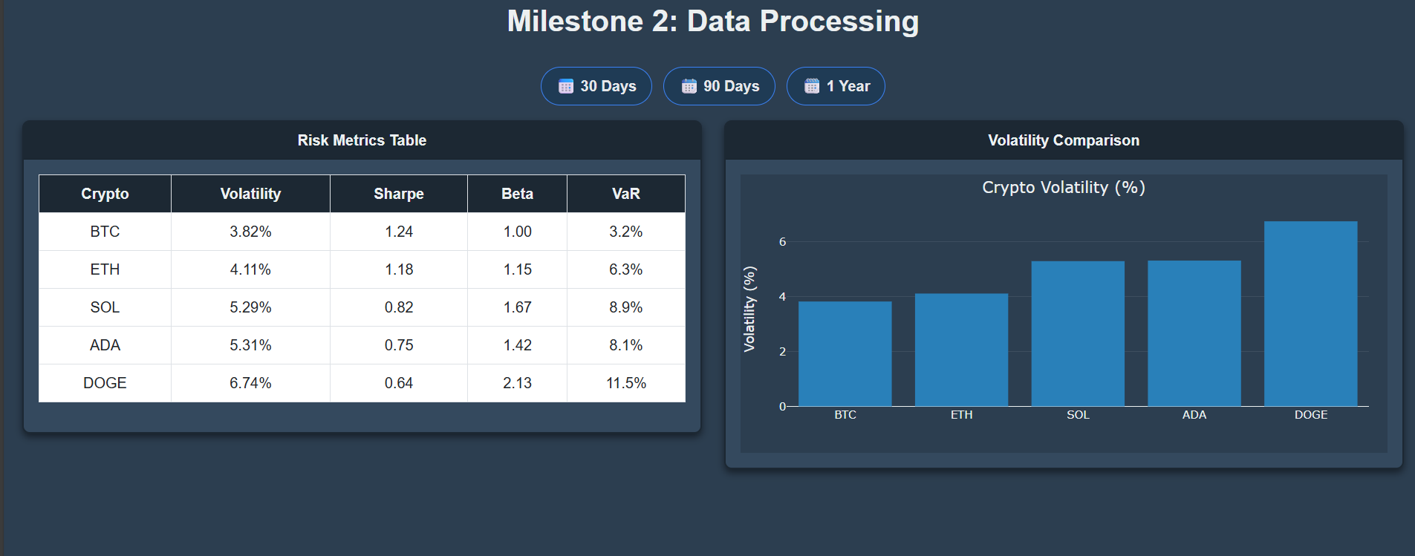
Output:

Slide 16
MILESTONE-3
Data Visualization:
Building interactive dashboards using streamlit & matplot library.
Displaying various time-series graphs for better analysis.
Developing the interactive and responsive dashboard helps to enable date range selection & asset comparison.

Slide 17
Visuals we used!!
Line Chart:
These are most widely used visual in data visualization because they clearly show trends, patterns, and changes over time.
Here, in our project we used to compare volatility and trend of the market over time.
Scatter Plot Chart:
These are mainly used to plot the differences between two different numerical values.
These are ideal for spotting trends, clusters, and outliers.

Slide 18
Dashboard development
STREAMLIT:
Streamlit is an open source python framework used to build more interactive dashboards.
By using this framework there is no need to learn about the front-end technologies like HTML, CSS, JS.

Slide 19
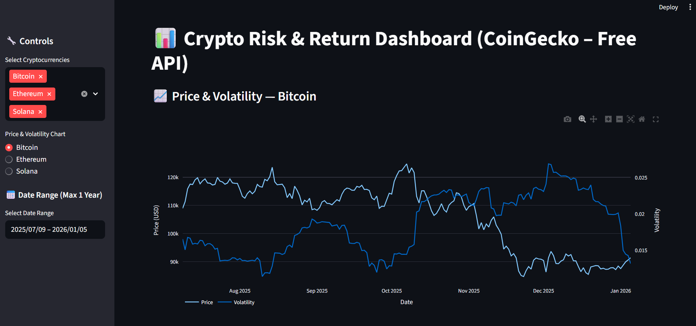
Output:

Slide 20
MILESTONE-4
Risk Classification & Reporting:
Focuses on classifying risk levels for crypto currency(Low, Medium, High).
Generating the final summarised reports in the form of PDF formats.
Helps to analyse and to let the users know the accurate levels of the risks.

Slide 21
Report Generation
Generating summary reports:
Creating final summarized report about the crypto market in the form of CSV, PNG or PDF formats.
Here, we used CSV format which helps for better understanding.

Slide 22
Workflow
Classifying the risks:
Classification of the risk levels based on their volatility range values over time (Low, Medium, High).
Highlighting those high-risk assets in the dashboard.
Using Quantiles thresholds:
Less Risk (TOP 33% Volatility)
Medium Risk (In B/w Values of Top & Less Values)
High Risk (Least 33% Volatility)

Slide 23
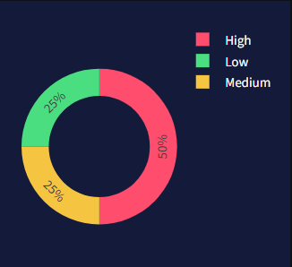
Visual used
Donut Chart:-
Here, in our project we used it to represent the classification of the risks of the crypto coins.
It helps to classify the portion levels of the data contribution.

Slide 24
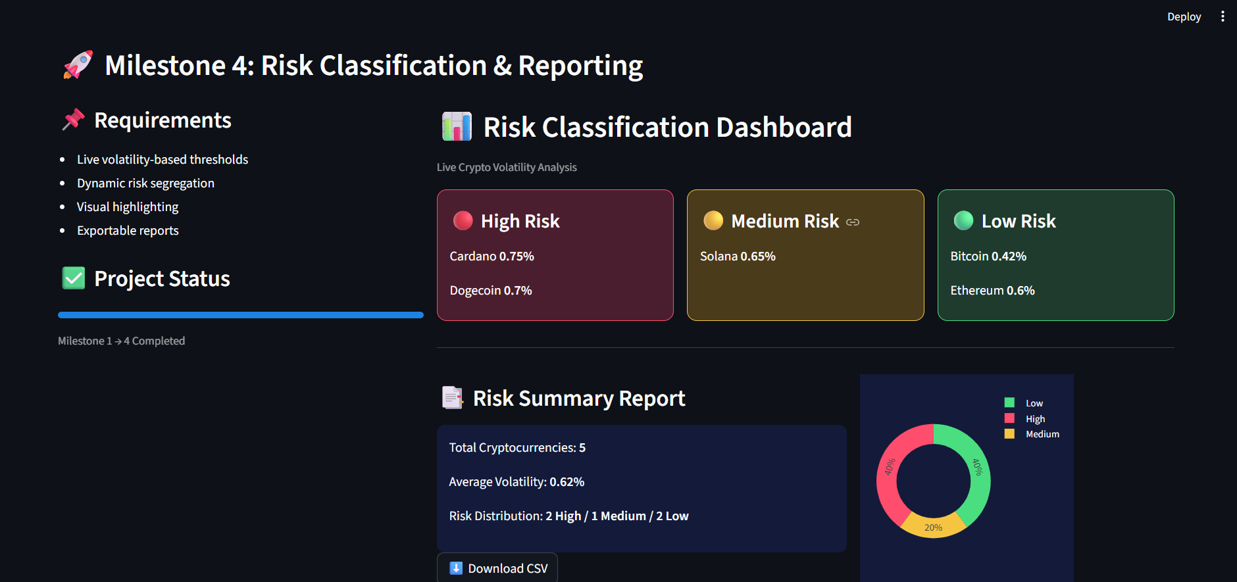
Output:

Slide 25
SUMMARY
This project analyzes cryptocurrency risk by combining historical data from Kaggle and live market data from CoinGecko. After preprocessing and cleaning the data, key risk metrics such as volatility, Sharpe ratio, beta coefficient, and IQR were calculated to evaluate market behavior.
The results were visualized using interactive charts, and cryptocurrencies were classified into high, medium, and low risk categories. A user-friendly interface was developed that allows users to download the risk metrics in CSV format, making the system practical and accessible for further analysis and informed decision-making.

Slide 26
THANK YOU
Atturu Jaganmohanreddy​
jaganmohanreddy1223@gmail.com

