Slide 1

LIFE INSURANCE PREDICTION
DEPARTMENT OF COMPUTER SCIENCE WITH ARTIFICIAL INTELLIGENCE
PRESENTED BY
PEDDADA SRINIVAS – 226Q5A4301
VENNAPU AJAY – 226Q5A4305
NAKKA VINAY – 226Q5A4303
SIRIKI JAGAN – 216Q1A4364
ADDURI LOKESH KUMAR – 216Q1A4329

Slide 2
AIM
The main aim of our project is to build a machine learning model which predicts whether the person is eligible for the life insurance or not . And it also predicts the type of insurance policy. The model predicts based on the factors. These factors are responsible for giving the better accuracy and the output for the user. Our project aims to simplify this process by predicting insurance needs based on individual characteristics and lifestyle factors.

Slide 3
ABSTRACT
Our project focuses on the development of a machine learning model tailored to predict life insurance eligibility and policy type. By analyzing various individual characteristics and lifestyle factors, the model aims to offer accurate and personalized insights into insurance needs. Our goal is to streamline the insurance application process by providing a predictive tool that enhances decision-making for both insurance providers and customers.

Slide 4
INTRODUCTION
In this project, we're creating a smart tool using computer technology to help people figure out if they can get life insurance and what type of policy might suit them best. We're looking at things like age, health, habits, and other factors to make predictions. The goal is to make the insurance process easier and more accurate for everyone involved, from customers to insurance companies.

Slide 5
TECHNOLOGIES USED
HTML , CSS , Flask
Python
Machine Learning

Slide 6
TOOLS USED
TOOL USED:
Pandas
Scikit-Learn
Random Forest Classifier

Slide 7
METHODS USED
Data Preprocessing
Model Training
Web Application Development
Form Submission and Prediction
Displaying Results

Slide 8
EXISTED SYSTEM
The existing online insurance application platforms offer basic eligibility checks and limited policy recommendations based on predefined rules. Conversely, our project employs advanced machine learning models to provide more accurate eligibility predictions and personalized policy suggestions tailored to individual users' profiles.
While existing platforms may require users to manually input extensive information, our system streamlines the process by leveraging predictive analytics to dynamically adjust the application interface based on user input, enhancing user experience and reducing application time

Slide 9
PROPOSED SYSTEM
The proposed system utilizes machine learning algorithms to predict life insurance eligibility and recommend suitable policy types based on individual user data. Through an intuitive online interface, users can conveniently input their information and receive instant, accurate predictions. Additionally, it enables real-time updates and dynamic adjustments to ensure ongoing relevance and effectiveness. Ultimately, the system aims to enhance accessibility, efficiency, and accuracy in the insurance sector while providing a seamless user experience.

Slide 10
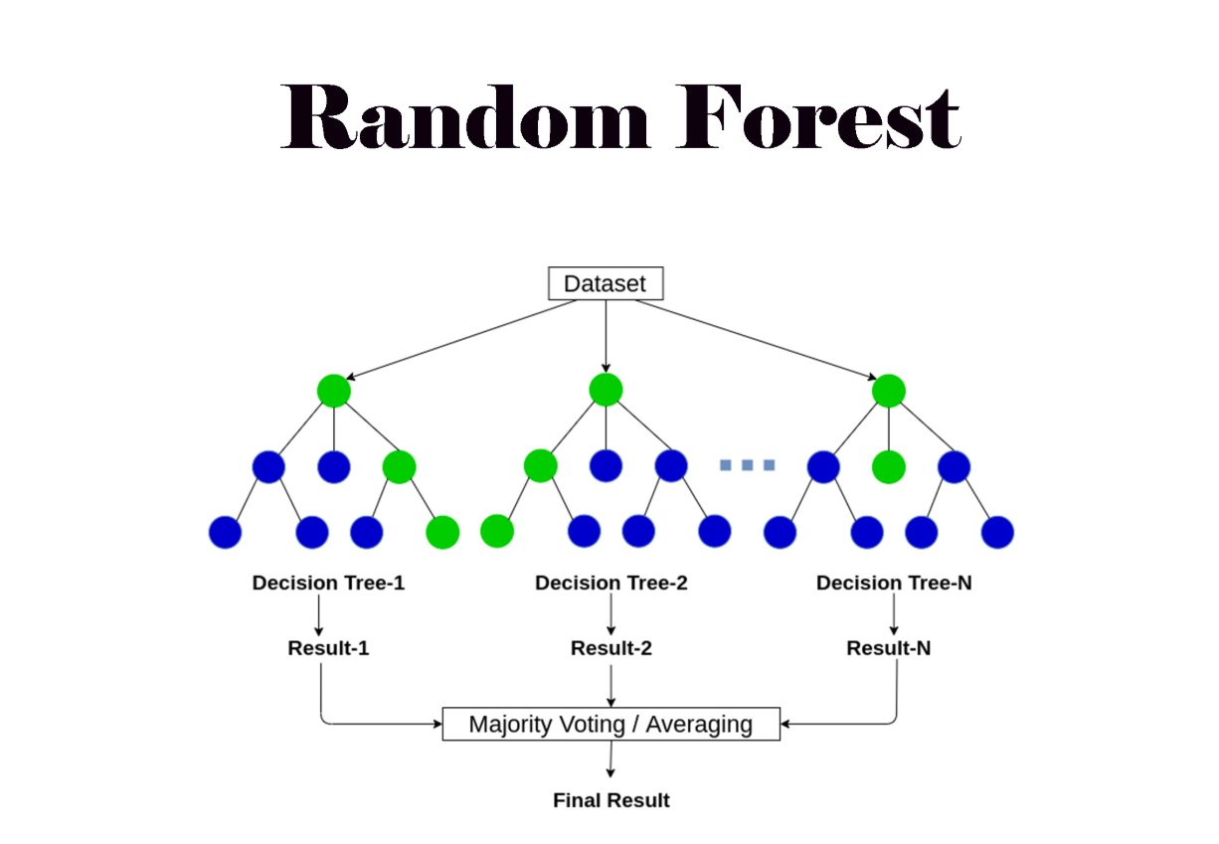
ALGORITHM
The algorithm we have used for developing the model is Random Forest classifier.

Slide 11
Random Forest Classifier:
1. Ensemble of Decision Trees: Random Forest builds multiple decision trees, each trained on a different random subset of the data and considering only a random subset of features. This creates diverse trees.
2. Random Data and Feature Selection: The randomness in data and feature selection during tree construction is key. It reduces overfitting and makes the model more robust by ensuring each tree learns different aspects of the data.
3. Majority Voting for Prediction: For classification, the Random Forest combines the predictions of all individual trees through majority voting. The class that receives the most votes becomes the final prediction. This aggregation often leads to higher accuracy and better generalization compared to a single decision tree.

Slide 12
Main Outcomes:
In this project, the Random Forest Classifier is employed to predict two main outcomes:
Eligibility for Life Insurance: The model predicts whether an individual is eligible or not based on various factors such as age, health status, income, expenses, financial goals, marital status, number of dependents, debts, liabilities, risk tolerance, and future financial needs.
Type of Insurance Policy: Additionally, the model predicts the type of insurance policy that is most suitable for the individual based on the same set of factors.
The predicted outcomes are then returned to the user interface for display, providing insights into the individual's eligibility status and recommended insurance type.

Slide 13
TECHNIQUES
The techniques used in this project include:
Supervised Learning: The project uses supervised learning techniques to train machine learning models. Specifically, it utilizes a decision tree classifier for predicting life insurance eligibility and type based on input features.
Feature Encoding: Categorical features in the dataset are encoded using Label Encoding technique, which assigns unique numerical labels to different categories. This ensures that categorical data can be used as input for machine learning algorithms.

Slide 14
Random Forest Classifier: Random Forest builds multiple decision trees on random subsets of data and features, then aggregates their predictions through voting for improved accuracy and robustness.
Web Development with Flask: Flask, a micro web framework for Python, is used to develop the web application. It handles HTTP requests from the frontend, processes them using the trained machine learning models, and returns predictions to the user.
Frontend Development with HTML and JavaScript: The frontend of the web application is developed using HTML for structuring the layout and JavaScript for handling form submission and displaying prediction results dynamically.

Slide 15
METHODS
There are several methods you can use for life insurance prediction using the logistic regression algorithm.
Data Preprocessing: Clean and preprocess your data, handling missing values, encoding categorical variables, and scaling numerical features if necessary.
Model Training: This method involves training machine learning models using the preprocessed data. In this project, decision tree classifiers are trained for predicting eligibility for life insurance and determining the type of insurance policy based on input features such as age, health status, income, and financial goals.

Slide 16
Web Application Development: This method involves creating a web-based interface for users to interact with the machine learning model.
Form Submission and Prediction: This method handles the submission of user input from the web form to the backend server for prediction.
Displaying Results: This method involves displaying the prediction results back to the user in a clear and understandable format.

Slide 17
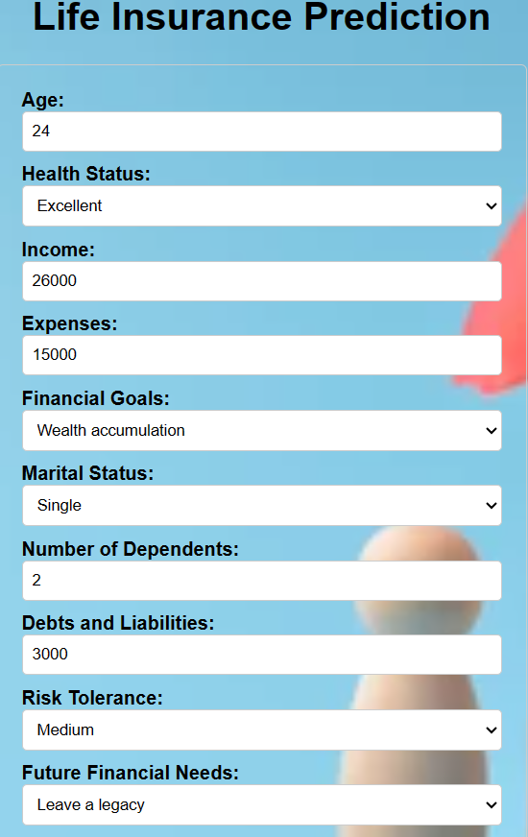
RESULT(A)

Slide 18

OUTPUT(A)
This is the user interface that the user can interact through this and by giving all the personal information the model predicts the outcome. So the predicted outcome is eligible and type is term.

Slide 19
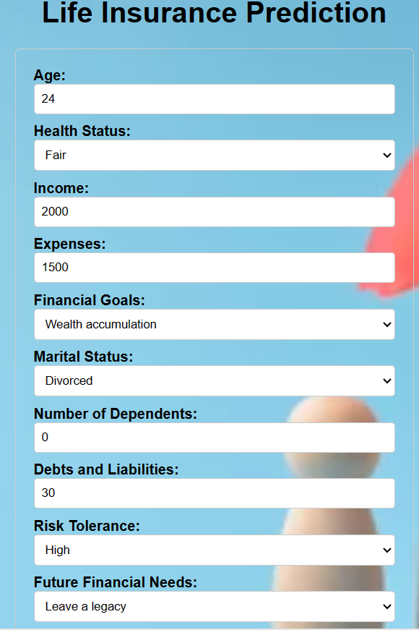
RESULT(B)

Slide 20

OUTPUT(B)
This is the user interface that the user can interact through this and by giving all the personal information the model predicts the outcome.So the predicted outcome is not eligible and type is term.

Slide 21
APPLICATIONS
Insurance Companies
Financial Advisory Platforms
Banking Sector

Slide 22
ADVANTAGES
It saves time.
Cost Effectiveness.
Fraud Detection.
Gives Transparent Information.

Slide 23
CONCLUSION
In conclusion, our project leverages machine learning techniques to predict life insurance eligibility and recommend suitable insurance policies based on user input. By employing decision tree classifiers and a user-friendly web interface, we aim to simplify the insurance decision-making process for individuals. Through extensive data preprocessing and model training, we ensure accurate predictions tailored to individual needs. This project underscores the potential of machine learning in the insurance industry, offering personalized recommendations and enhancing accessibility to financial services.

Slide 24
FUTURE SCOPE
Our project can expand to predict insurance charges, aiding users in estimating policy costs. Additionally, we could develop a feature to identify banks offering life insurance, simplifying the selection process for users. These enhancements would provide valuable insights and streamline decision-making in insurance and financial services.

Slide 25


