Slide 1
StoxChai
Advanced Stock Analysis with AI
Jagadish Thoutam

Slide 2
Comprehensive Stock Analysis Platform
StoxChai is an all-in-one analysis platform make data-driven decisions by providing:
Real-time and historical stock data with interactive, filterable price and volume charts
Technical analysis using dynamic moving averages, trend detection, and automatic pattern recognition
Automated news sentiment analysis leveraging NLP to assess market perception from latest headlines
Volume analysis to highlight unusual activity, spot anomalies, and detect liquidity shifts
AI-powered insights and trade ideas delivered through a natural language chat interface
Retrieval Augmented Generation (RAG) for context-aware responses, combining semantic search with local LLMs for precise and relevant answers
Data automatically preprocessed and cached for speed and reliability
System activity and user interactions are logged for easy monitoring and troubleshooting

Slide 3
StoxChai Architecture
Client Layer
Dashboard
RAG Query
AI Analysis
AI Assistant Chat
Application Layer
Stock Price Analysis
Volume Analysis
News Sentiment
Company Information
RAG-based AI Analysis
AI Chat Interface
Plotly: Charts
Pandas: Data analysis
Data Preprocessing
Async Task Manager
AI Services
Databases
Other Services
Ollama
Vector DB
Google Search
Yahoo Finance API
Local LLMs
LangChain Embeddings
Private Deploy
Custom Models
No API Costs
Document Embeddings Similarity Search
Semantic Retrieval
High Performance
Bing Search
Bing Search

Slide 4
Technology Stack
Frontend
Backend & AI
Streamlit - Python-based UI framework
Plotly - Interactive data visualization
Custom CSS - Responsive design
Interactive components - Filters, charts, inputs
Python - Core application logic
yfinance - Real-time market data
Pandas/NumPy - Data processing
Ollama - Local LLM integration
Custom RAG system - Context-aware AI
NLTK - Sentiment analysis

Slide 5
Key Functionalities
📰
News Sentiment
NLP-driven analysis of news articles with NLTK sentiment scoring.
🤖
AI Assistant
RAG-powered insights with vector similarity search using context retrieval.
📈
Price Analysis
Interactive candlestick charts with moving averages and technical indicators.
📊
Volume Analysis
Track trading volume patterns and identify significant spikes.

Slide 6
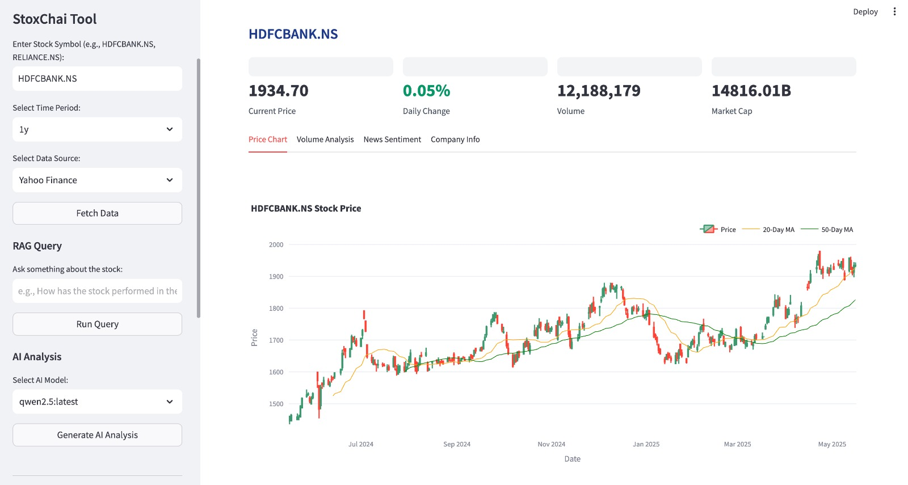
Interactive Price Charts
Analyze stock price movements with candlestick charts, multiple timeframes, and technical indicators.

Slide 7
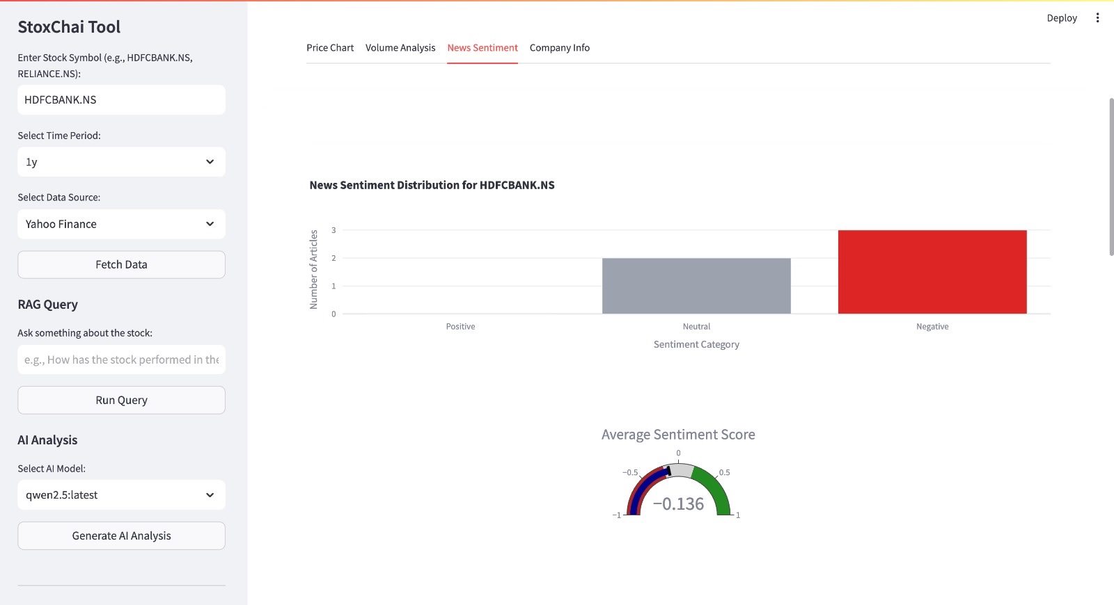
News Sentiment Analysis
Track market perception through automated analysis of news articles with sentiment scoring visualization.

Slide 8
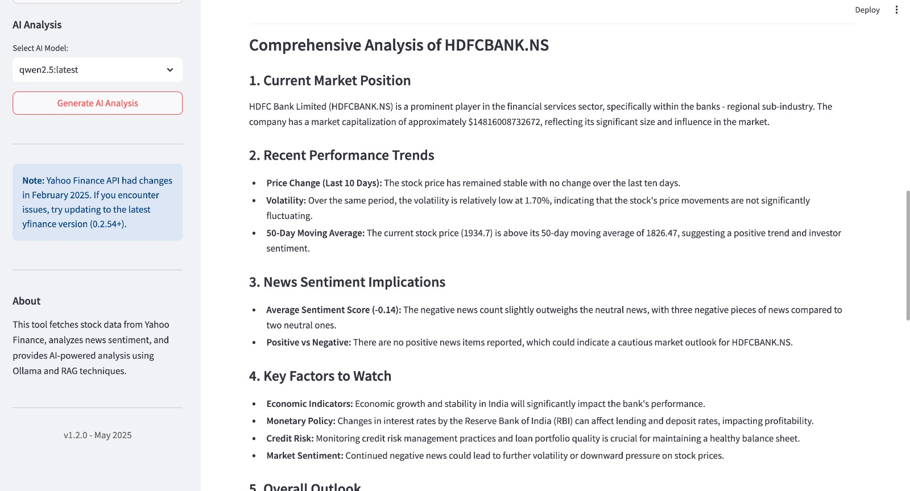
AI Analysis
Generate comprehensive stock analyses with key metrics, performance trends, and sector comparisons.

Slide 9
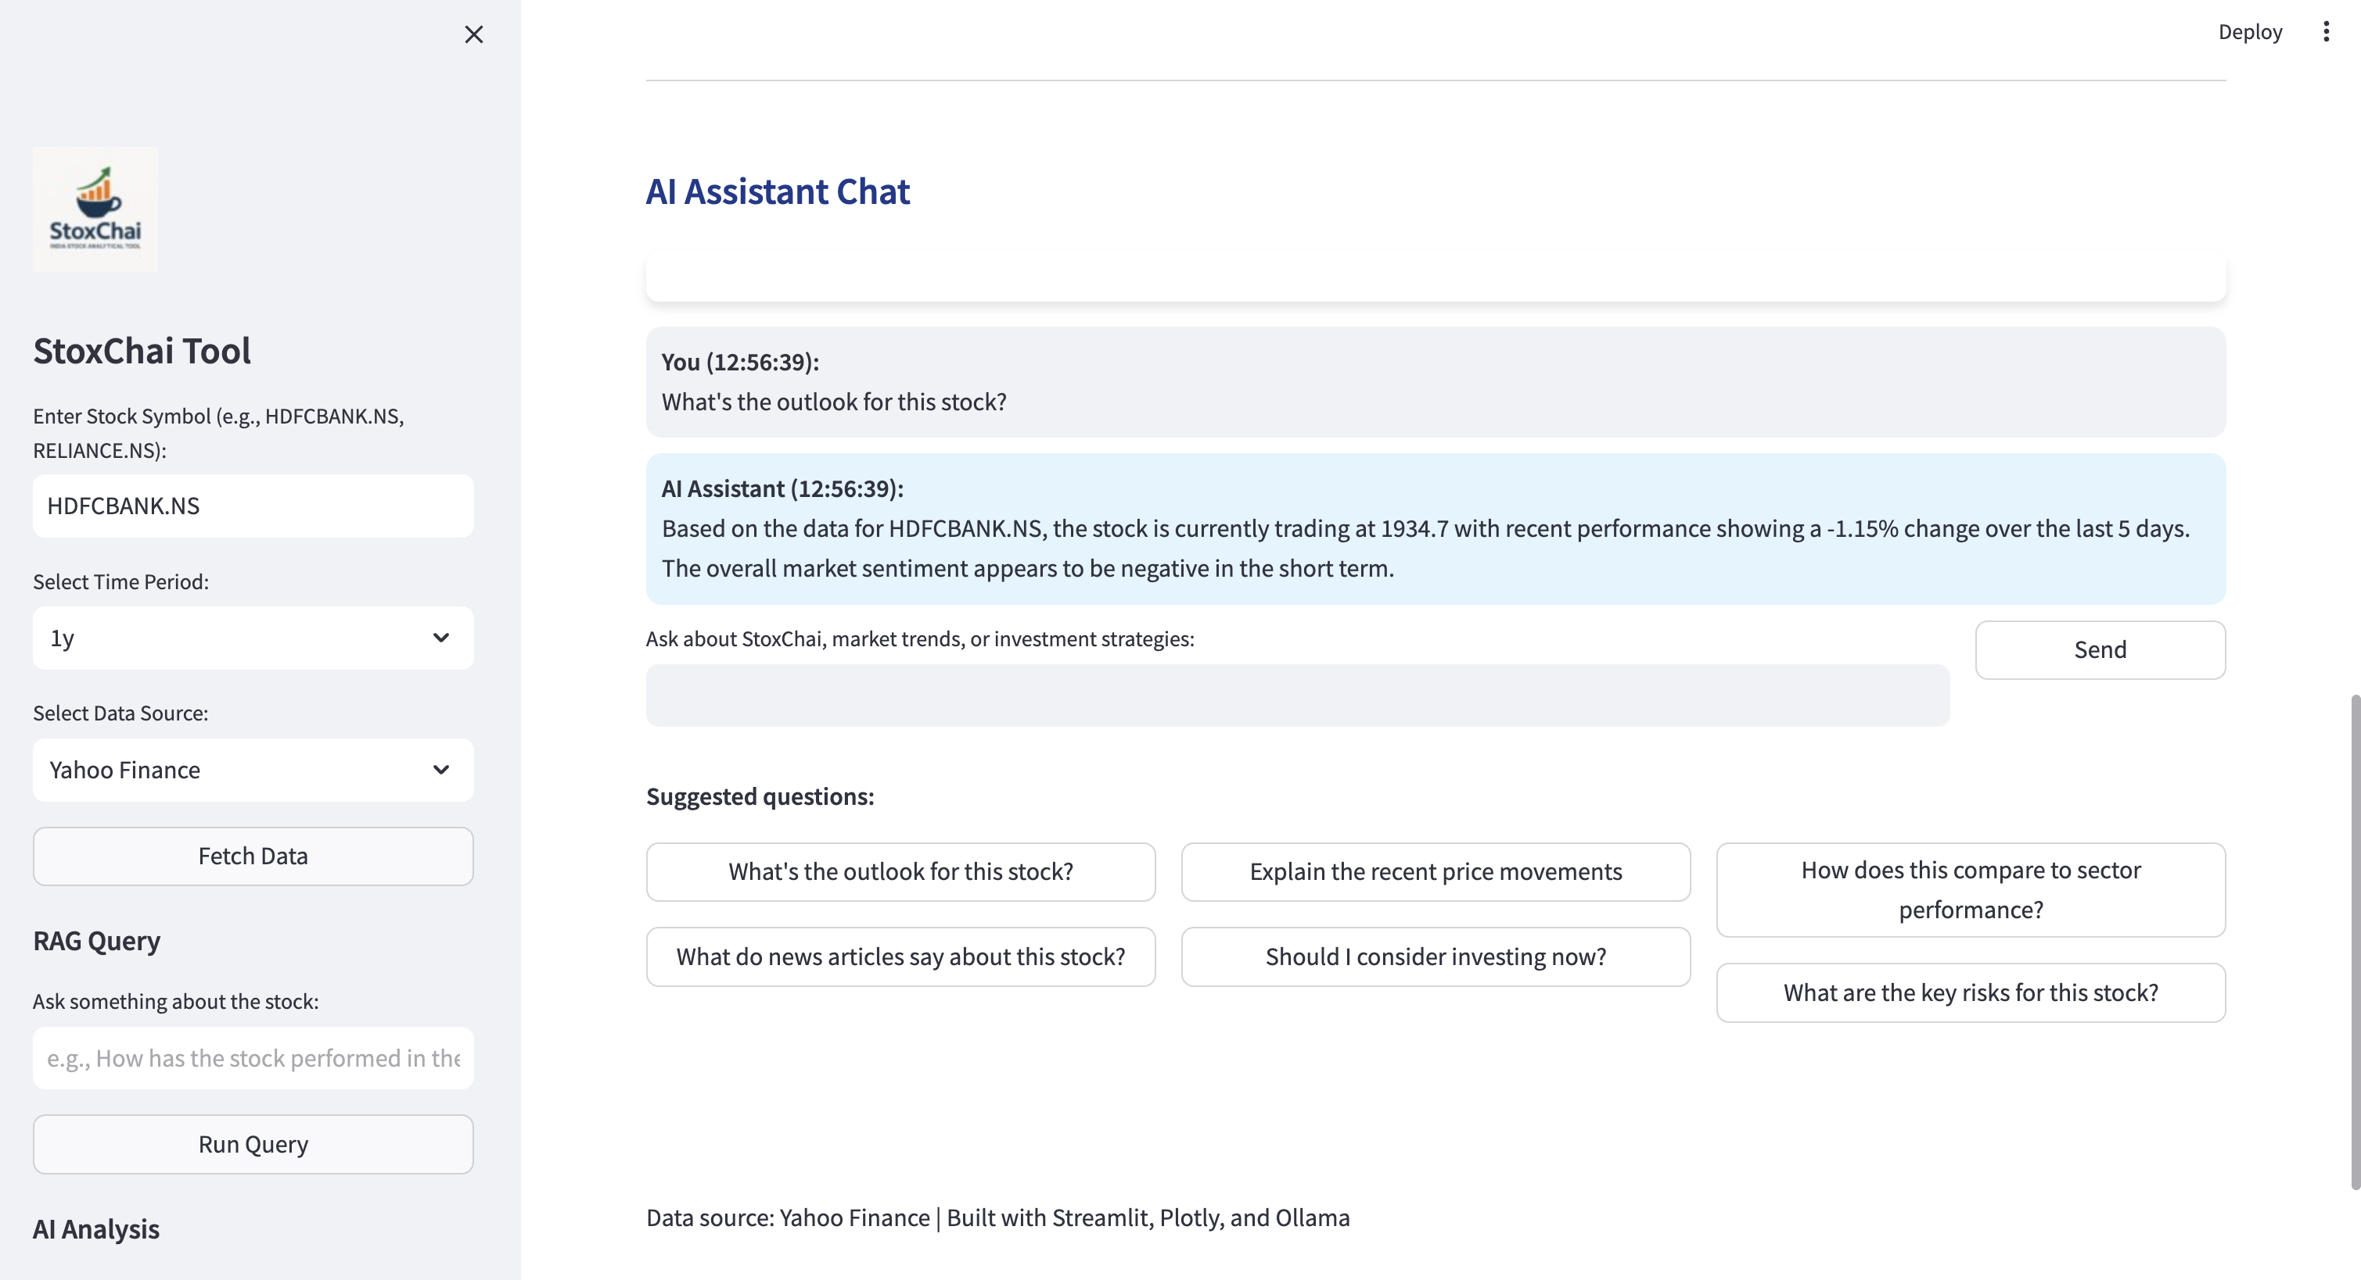
AI Assistant Chat
Interact with an AI assistant that provides context-aware responses about stocks using RAG technology.

Slide 10
Who Benefits From StoxChai?
⚡
Day Traders
Real-time technical indicators for quick decision making
📝
Long-Term Investors
Fundamental data and trend analysis for portfolio decisions
👔
Financial Advisors
Client-ready visualizations and summaries
🎓
Finance Students
Learning platform for market analysis techniques

Slide 11
Thank You!
https://github.com/jaganthoutam/stoxchai

