Slide 1
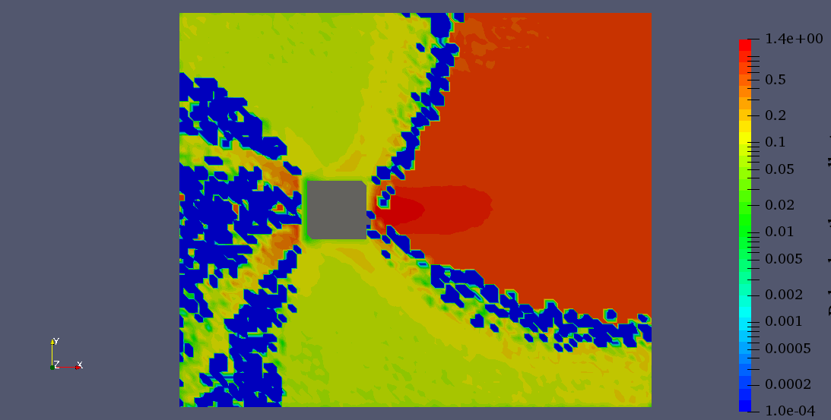
y = 24.0
y = 4.0
y = 2.0
y = 0.6
x = 10.2
x = 13.2
x = 5.0
x = 9.0
x = 24.0
x = 42.0
dx = 0.02
x = 7.0
dx = 0.04
dx = 0.2
dx = 0.6

Slide 2
dx = 0.02
dx = 0.04
dx = 0.2
dx = 0.6

