Slide 1
System
1...n
PIC
Field
Motion_Solver
PIC_2D_rm1o
Electric_Field
Magnetic_Field
Leap_Frog
Boris_Push
Electrostatic_2D_rm
Constant_Magnetic_Field
Mesh
1...n
Particles_In_Mesh
Electrostatic_2D_rm_sat
Species
Particle
Mesh_2D_rm_sat
Electrostatic_2D_rm_sat_cond
1...n
Electron
Proton
solver.py
Boundary
Electron_SW
Proton_SW
Output.py
Outer_2D_Rectangular
Inner_2D_Rectangular
Photoelectron
execution_times.py
Outer_1D_Rectangular
Secondary_Emission_Electron
particle_tracker.py

Slide 2
System
1...n
PIC
Field
Motion_Solver
Electric_Field
Magnetic_Field
1...n
PIC_2D_rm1o
Particles_In_Mesh
Species
Particle
Electrostatic_2D_rm_sat_cond
Constant_Magnetic_Field
Mesh
1...n
Electron
Proton
Boundary
Mesh_2D_rm_sat
Electron_SW
Proton_SW
Outer_2D_Rectangular
Inner_2D_Rectangular
Photoelectron
Outer_1D_Rectangular
Secondary_Emission_Electron

Slide 3
System
1...n
PIC
Field
Motion_Solver
PIC_2D_rm1o
Electric_Field
Magnetic_Field
Leap_Frog
Boris_Push
Electrostatic_2D_rm
Constant_Magnetic_Field
Mesh
1...n
Particles_In_Mesh
Electrostatic_2D_rm_sat
Species
Particle
Mesh_2D_rm_sat
Electrostatic_2D_rm_sat_cond
1...n
Electron
Proton
solver.py
Boundary
Electron_SW
Proton_SW
Output.py
Outer_2D_Rectangular
Inner_2D_Rectangular
Photoelectron
execution_times.py
Outer_1D_Rectangular
Secondary_Emission_Electron
particle_tracker.py

Slide 4
Mesh_recursive
Mesh_2D_rm_sat
Mesh_2D_rm_sat_recursive
PIC_recursive
PIC_2D_rm1o
PIC_2D_rm1o_recursive

Slide 5
Parent
Child
Mesh 1
Mesh 2
Electrostatic_2D_rm_sat_cond_recursive
Electrostatic_2D_rm_sat_cond_recursive
Electrostatic_2D_rm_sat_cond_recursive
Constant_Magnetic_Field_recursive
Constant_Magnetic_Field_recursive
PIC_2D_rm1o_recursive
PIC_2D_rm1o_recursive
Mesh 1
Mesh 2
Mesh_2D_rm_sat_recursive
Mesh_2D_rm_sat_recursive
Electrostatic_2D_rm_sat_cond
Electrostatic_2D_rm_sat_cond
Constant_Magnetic_Field
Constant_Magnetic_Field
PIC_2D_rm1o
PIC_2D_rm1o
Mesh_2D_rm_sat
Mesh_2D_rm_sat

Slide 6
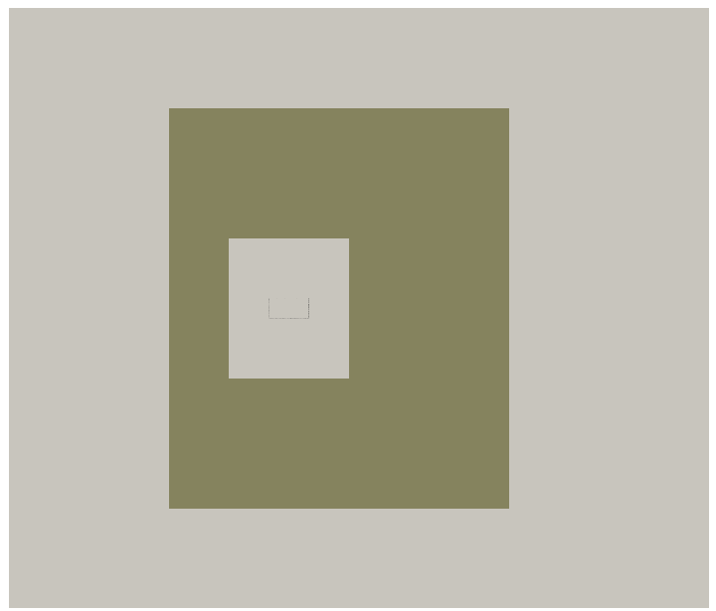
dx = 2cm
dx = 0.1m
dx = 0.5m

