Slide 1
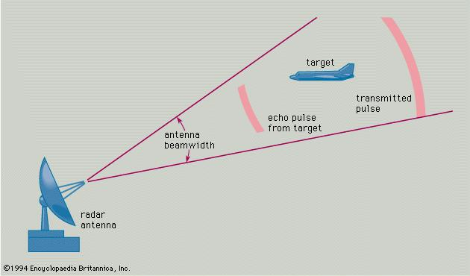
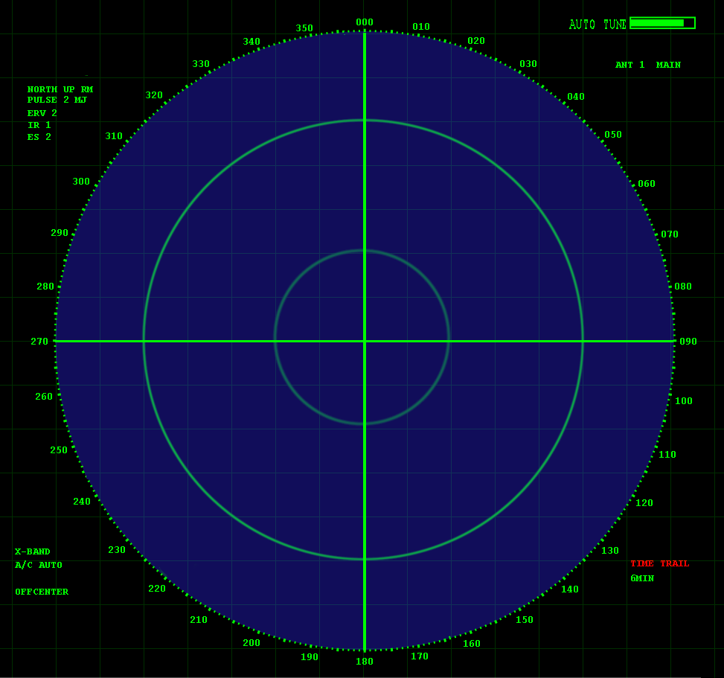
Understanding the ML classification performance metrics,
a RADAR (RAdio Detection And Ranging) application example.
Machine learning notes
Msc. John Alexander Garzón Vásquez
Suppose that our base control should detect any enemy airplane approximation based on RADAR detection
Based on: https://es.wikipedia.org/wiki/Radar#/media/File:Radar_screen.svg

Slide 2
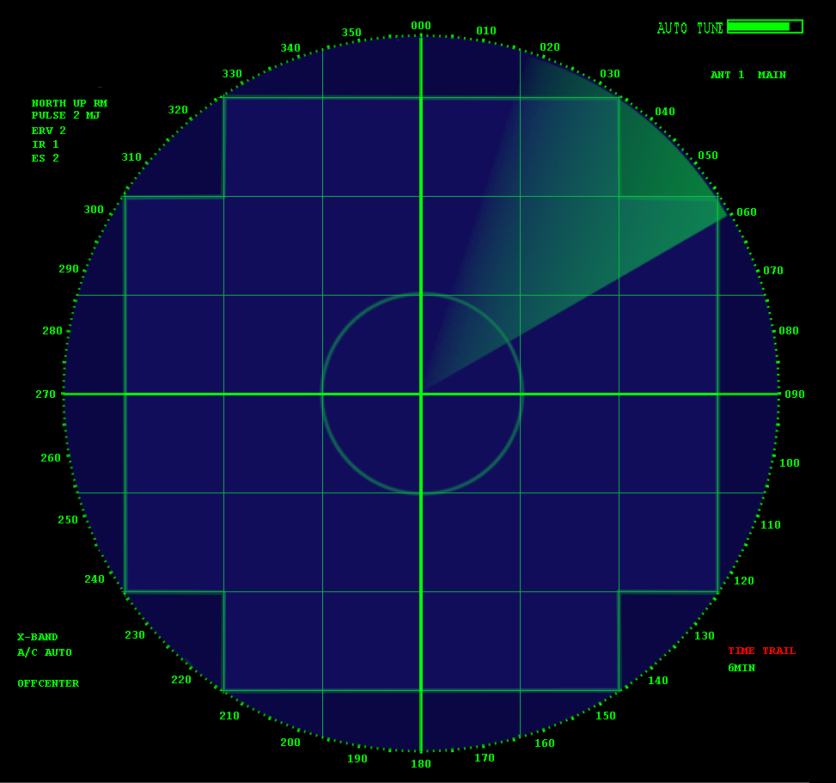


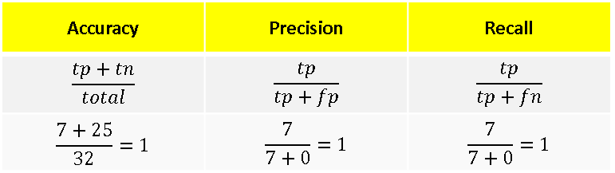
The perfect RADAR detection and ranging performance
IDEAL RADAR
OUR RADAR
Accuracy | Precision | Recall
$$\frac{tp+tn}{total}$$ | $$\frac{tp}{tp+fp}$$ | $$\frac{tp}{tp+fn}$$
$$\frac{7+25}{32}=1$$ | $$\frac{7}{7+0}=1$$ | $$\frac{7}{7+0}=1$$

Slide 3

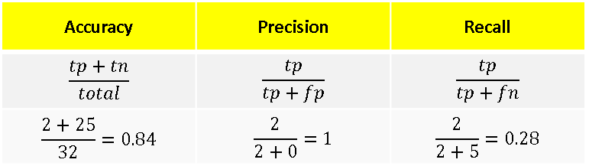
RADAR detection case I: Recall problems , ¡we are blind!
IDEAL RADAR
OUR RADAR
Accuracy | Precision | Recall
$$\frac{tp+tn}{total}$$ | $$\frac{tp}{tp+fp}$$ | $$\frac{tp}{tp+fn}$$
$$\frac{2+25}{32}=0.84$$ | $$\frac{2}{2+0}=1$$ | $$\frac{2}{2+5}=0.28$$

Slide 4

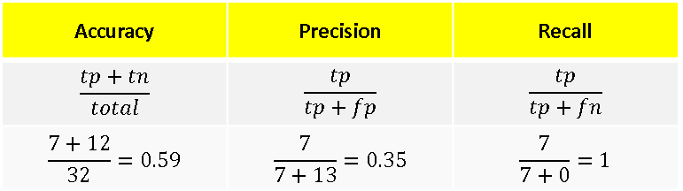
RADAR detection case II: Precision problems , ¡we are confused!
IDEAL RADAR
OUR RADAR
Accuracy | Precision | Recall
$$\frac{tp+tn}{total}$$ | $$\frac{tp}{tp+fp}$$ | $$\frac{tp}{tp+fn}$$
$$\frac{7+12}{32}=0.59$$ | $$\frac{7}{7+13}=0.35$$ | $$\frac{7}{7+0}=1$$

