Slide 1
Problem Statement
To understand & predict the growth rate of the COVID-19 Virus

Slide 2




Prediction of COVID-19 Disease Spread
Data
Data Preprocessing
Clean-up “NA”
Rename Countries/ Continents
Data Exploration
Calculate Mortality Rate
Show last_updated case details
Death
Recovered
Confirmed
Compare the Trend with other countries Overall trend of confirmed cases
Use time-series data of Confirmed cases for all countries
Prediction Models –
Exponential Growth
Sigmoid Function
Power Law
Logistic Growth
Output – Predicted Values of Confirmed cases
https://github.com/CSSEGISandData/COVID-19
2019 Novel Coronavirus COVID-19 (2019-nCoV) Data Repository by Johns Hopkins CSSE – from Kaggle

Slide 3
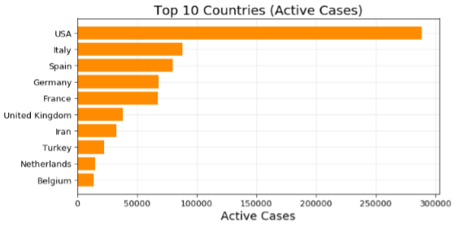
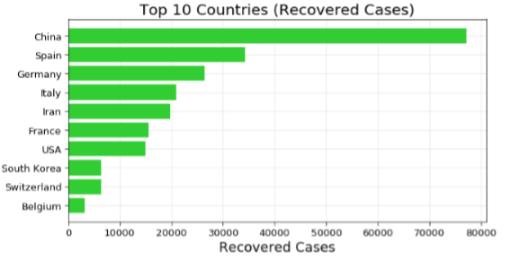
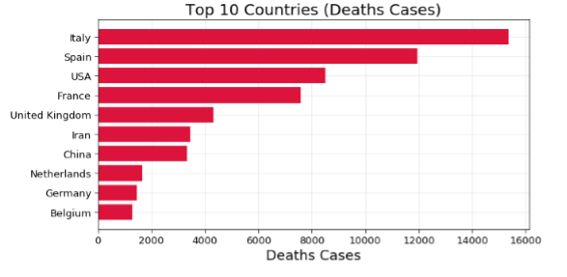
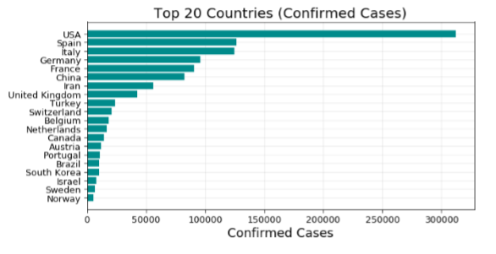
Data Exploration

Slide 4
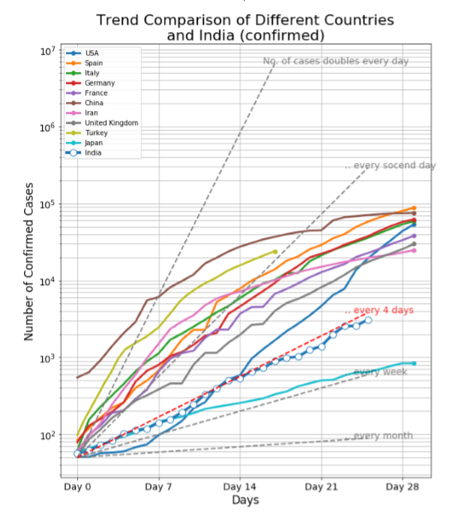
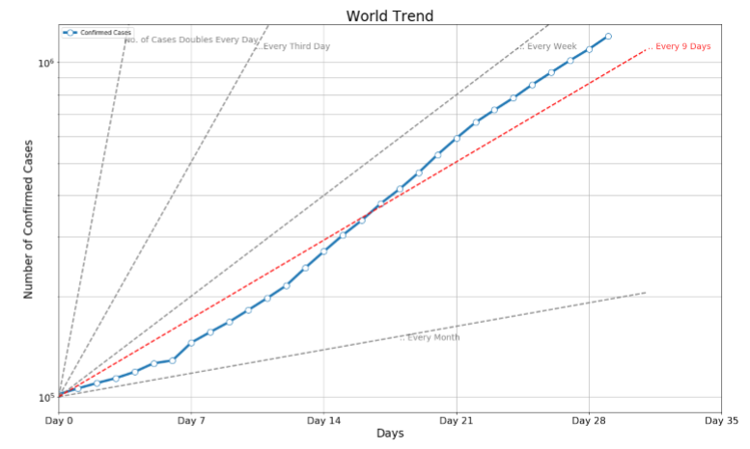
Data Exploration

Slide 5
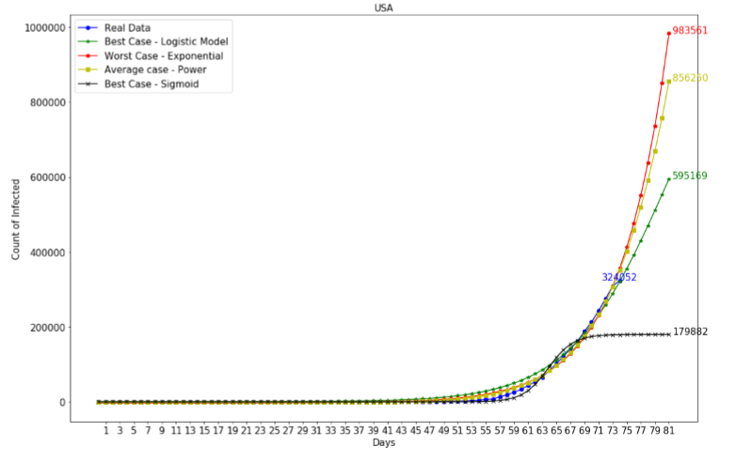
Prediction of COVID-19 Disease Spread

Slide 6
Next Steps
We can still consider working on fine-tuning the prediction model or identifying an equation for the curve.
However, on the comparison of COVID Confirmed cases from different countries, the growth rate differs between countries that could be based on population or other factors like medical treatments, precautionary measures taken. And we can include more metrics that can bring more accuracy to the prediction by adding more datasets

Slide 7




About Us
Jayshree Jagathi AP
Hemakiruthika M
Assistant Professor
Business Data Analyst
Education:
B.E in Computer Science (2013-17)
MBA in Marketing & Analytics (2017-19)
Education:
B.E in Computer Science (2013-17)
M.E in Computer Science (2017-19)
Country: India - State: Tamil Nadu - City: Chennai

