Slide 1
EDA Project
By – Jagat Ram Semwal

Slide 2

Dream Cars
Take Home Your Dream Car

Slide 3
Introduction
Economist see car sales as an indicator to GDP. They believe “If People Feel Rich, They Will Buy Cars“
With increasing GDP, people's living standard has also elevated globally
People are buying cars like never before, but these all are not only the brand new cars
So what makes someone buy a used car?
A used car will be priced much lesser than the new car
It'll also fulfil the same purpose - status, comfort, convenience etc
Used car is sometimes the best choice for people who recently got their license
What you expect the most from a used car?
You want it to be as reliable as a new car

Slide 4
Problem Statement
'Dream Cars' is a company that buys & sells used cars
The company promise to provide three things
Best Price
Best Car Condition & Performance
Best After Sales Service
The company is looking to improve their business strategy & sales

Slide 5
Problem Statement
|01| car | Car brand name|
|02| model | Available car different Variants|
|03| year | purchasing Year|
|04| body | Body type-Hatchback, Sedan, Crossover etc|
|05| mileage | car Mileage|
|06| engV | Engine version|
|07| engType | Car Fuel type - Petrol, Diesel, gas etc|
|08| drive | Wheel Drive Front, back|
|09| registration | Check if the vehicle is registered|
|10| price | Price of Car in $|
|11| Car Category | Executive, Premium & Luxury|

Slide 6
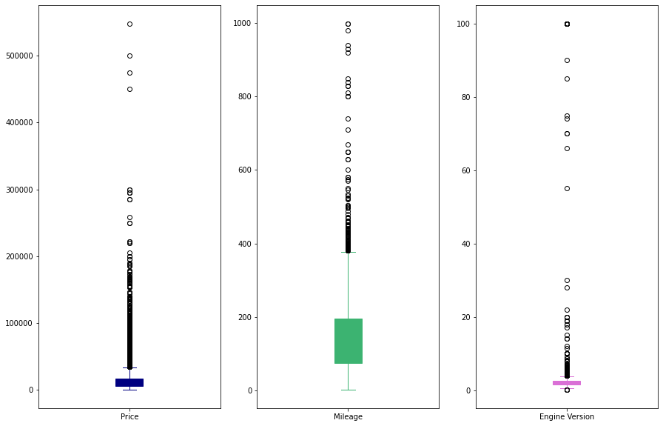
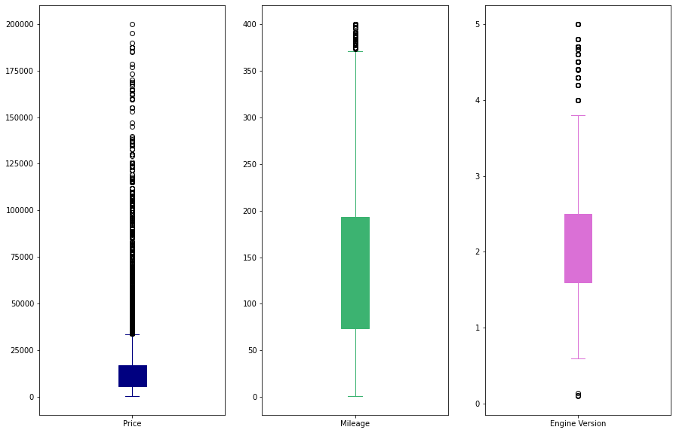
Cleaning Data
Before
After

Slide 7
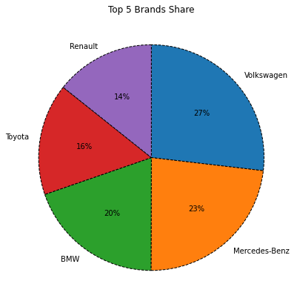
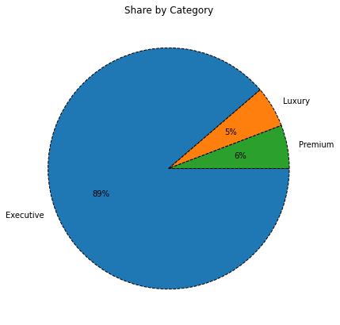
Brand & Category Share
Brand
Category

Slide 8
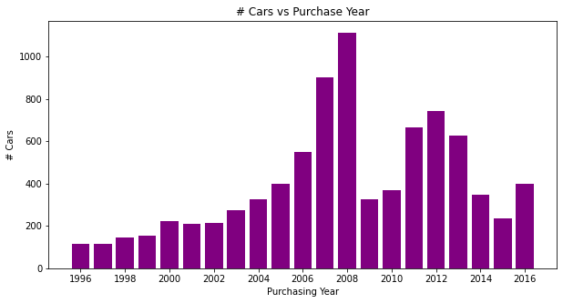
Car Count
We have highest 1000+ cars from year 2008 and 800+ cars from 2007

Slide 9
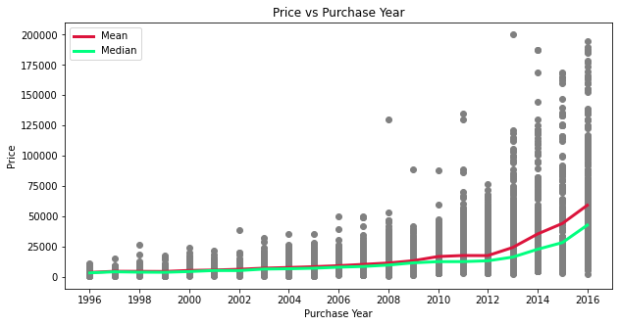
Price
Car Depreciation – is not a new term
We’re all aware that the car prices decreases over time.

Slide 10
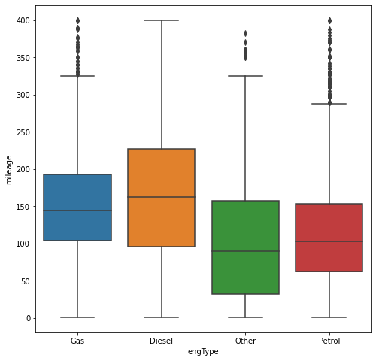
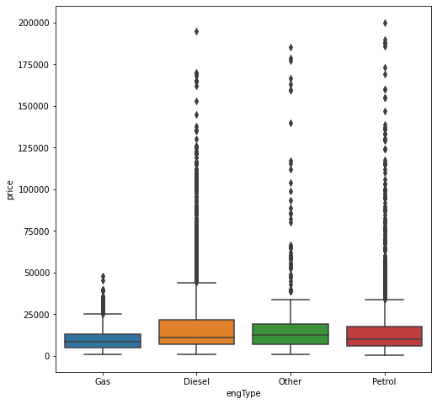
Engine Type
Gas & Diesel engines provides high mileage
Gas cars are the most affordable

Slide 11
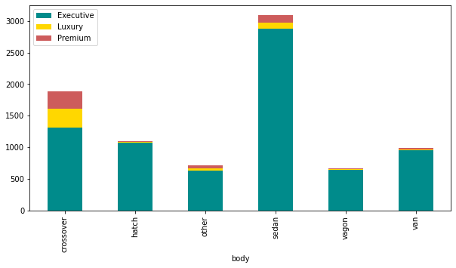
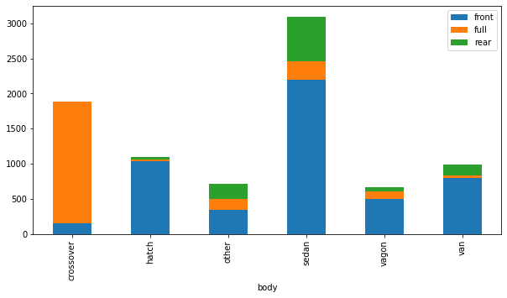
Body
Sedan is preferred in Executive class followed by crossover in Premium & Luxury class
Crossover is preferred with Full drive
All other body types with Front drive

Slide 12
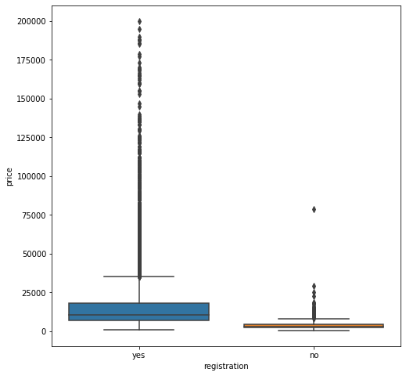
Registration
Cars without registration are priced way lower than cars with registration

Slide 13
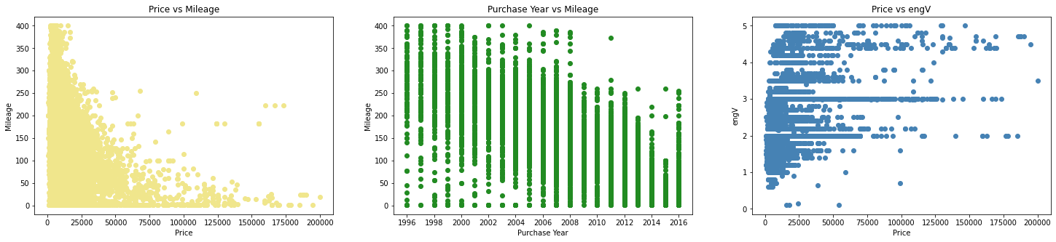
Correlation
Negative (-0.4)
Negative (-0.7)
Positive (0.5)

Slide 14
Conclusion
Car prices decreases over time (Car Depreciation)
2007 & 2008 car volume is higher than usual
Volkswagen followed by Mercedes-Benz are the top two brands available for sale
Sedan cars are preferred in Executive class while Crossover cars in Premium & Luxury class
The most preferred cars are Petrol followed by Diesel
Gas cars are the most economic in terms of price as well as fuel efficiency
Sedan is all time favorite car followed by crossover
Crossover cars are mostly full drive

Slide 15
Actionable Insights
Car prices being the most critical parameter needs an effective pricing system that can consider all factors that decides a car price.
Crossover Petrol variant can be recommended to high profile customers
Gas variant being the cheapest & fuel efficient can be recommended for customers looking for an economic car
Old cars specially year 2007 & 2008 cars should be sold at special discount or attractive deals to clear the stock
Highly recommend ‘Year End Sale’ with heavy discounts to increase sale and will be a win win deal for the customer and the company

