Slide 1
Events in Parklea Gurughar
Name | Time | Venue
Gatka training | Sunday 5-7 PM | Langar Hall
Turban / Dumalla training | Sunday | Gallery Hall
Punjabi School | Saturday , Sunday | Punjabi School
Tabla training |  | Gallery Hall
Stringed Musical instruments training |  | Gallery Hall

Slide 2
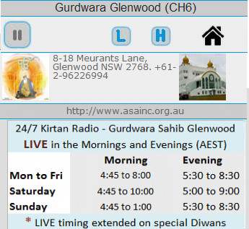
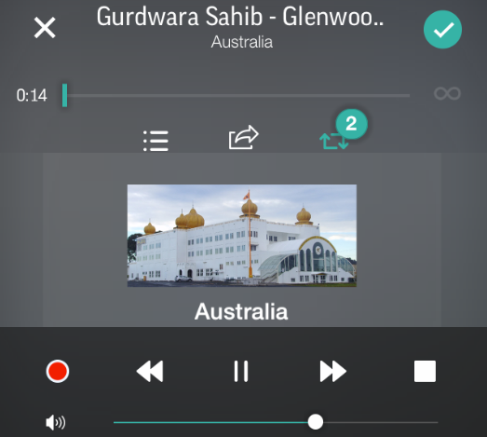

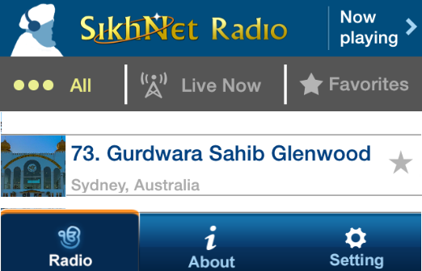

3 ways to listen 24/7 Kirtan Radio from Gurdwara Sahib Glenwood LIVE in the Mornings and Evenings
Gurdwara Sahib official website asainc.org.au
Download TuneIn radio app on your smart phone and search for Glenwood
Download SikhNet radio app on your smart phone and search for Channel 73 OR go to SikhNet.com

