Slide 1
Hukamnama in progress.
Kindly sit and listen
Please don’t speak
Translation to follow .

Slide 2
Please spare 15-30 min. to do sewa (volunteer) for
Serving Langar
Cleaning
Kitchen
Utensils
Mats
Floor

Slide 3
Library volunteers needed for
Book issuing
Registering new members
Opening hours
Saturday , 6 PM – 8 PM
Sunday , 10 AM – 1 PM
Weekdays , Evening 6 – 7 PM

Slide 4
Ardaas in progress.
Kindly stand and listen
Please don’t speak
Ardaas means Prayer

Slide 5
Headlights of Car number
are ON
Please turn them OFF

Slide 6
Child named
has separated from Parents. Please come near stage

Slide 7
Mobile <>
has been found/lost
Please come near stage

Slide 8
Keys<>
has been found/lost
Please come near stage

Slide 9
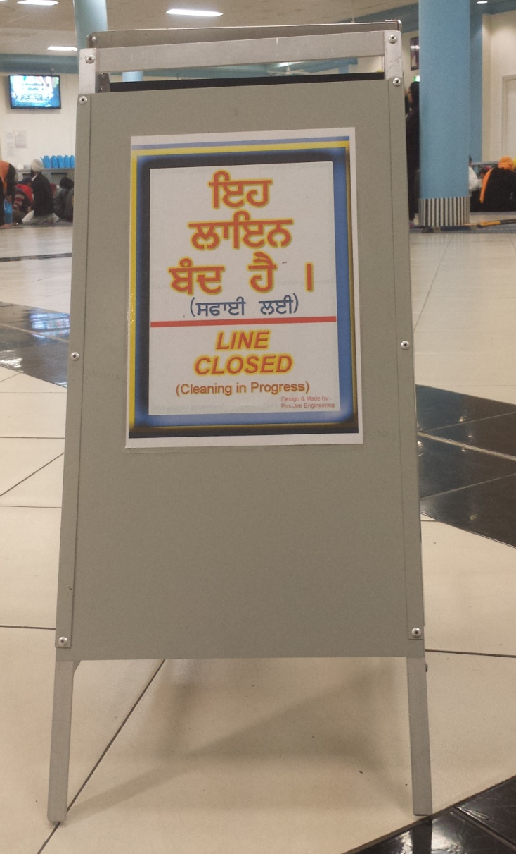
In Langar Hall
Please do not sit
in lines with
cleaning in progress
boards

