Slide 1
Optimization technique

Slide 2
Case -2 : Modern Portfolio Theory
How is risk aversion measured in modern portfolio theory (MPT)?
Introduction
One of the major goals of the modern enterprise of data science and analytics is to solve complex optimization problems for business and technology companies to maximize their profit.
In my article “Linear Programming and Discrete Optimization with Python,” we touched on basic discrete optimization concepts and introduced a Python library PuLP for solving such problems.
Although a linear programming (LP) problem is defined only by linear objective function and constraints, it can be applied to a surprisingly wide variety of problems in diverse domains ranging from healthcare to economics, business to military.
In this article, we show one such amazing application of LP using Python programming in the area of economic planning — maximizing the expected profit from a stock market investment portfolio while minimizing the risk associated with it.
How to maximize profit and minimize risk in the stock market?
The 1990 Nobel prize in Economics went to Harry Markowitz, acknowledged for his famous Modern Portfolio Theory (MPT), as it is known in the parlance of financial markets. The original paper was published long back in 1952.
A good, balanced portfolio must offer both protections (minimizing the risk) and opportunities (maximizing profit).
And, when concepts such as minimization and maximization are involved, it is natural to cast the problem in terms of mathematical optimization theory.
The fundamental idea is rather simple and is rooted in the innate human nature of risk aversion.
In general, stock market statistics show that higher risk is associated with a greater probability of higher return and lower risk with a greater probability of smaller return.
MPT assumes that investors are risk-averse, meaning that given two portfolios that offer the same expected return, investors will prefer the less risky one. Think about it. You will collect high-risk stocks only if they carry a high probability of large return percentage.
But how to quantify the risk? It is a murky concept for sure and can mean different things to different people. However, in the generally accepted economic theory, the variability (volatility) of a stock price (defined over a fixed time horizon) is equated with risk.
Therefore, the central optimization problem is to minimize the risk while ensuring a certain amount of return in profits. Or, maximizing the profit while keeping the risk below a certain threshold.
According to modern portfolio theory (MPT), degrees of risk aversion are defined by the additional marginal return an investor needs to accept more risk. The required additional marginal return is calculated as the standard deviation of the return on investment (ROI), otherwise known as the square root of the variance.
The general level of risk aversion in the markets can be seen in two ways: by the risk premium assessed on assets above the risk-free level and by the actual pricing of risk-free assets
Modern Portfolio Theory and Risk
When MPT was introduced, its definition of risk, or the standard deviation from the mean, seemed unorthodox. Over time, standard deviation probably became the most-used gauge for investment risk.
Standard deviation shows how dramatically an asset's returns oscillate over a period of time. A trading range around the mean price can be created using the upswings and downswings as measured by standard deviation. Investors use this information to estimate possible returns for future portfolios.
Those who are more risk averse tend to want assets with lower standard deviations. A lower deviation from the mean suggests the asset's price experiences less volatility and there is a lower probability for major loss. Aggressive investors are comfortable with a higher standard deviation because it suggests higher returns are also possible.
Is variance good or bad for stock investors?
Variance is neither good nor bad for investors in and of itself. However, high variance in a stock is associated with higher risk, along with a higher return. Low variance is associated with lower risk and a lower return. High variance stocks tend to be good for aggressive investors who are less risk-averse, while low variance stocks tend to be good for conservative investors who have less risk tolerance.
Variance is a measurement of the degree of risk in an investment. Risk reflects the chance that an investment's actual return, or its gain or loss over a specific period, is higher or lower than expected. There is a possibility some, or all, of the investment will be lost.
What Is Modern Portfolio Theory (MPT)?
Modern portfolio theory (MPT) is a theory on how risk-averse investors can construct portfolios to optimize or maximize expected return based on a given level of market risk, emphasizing that risk is an inherent part of higher reward. According to the theory, it's possible to construct an "efficient frontier" of optimal portfolios offering the maximum possible expected return for a given level of risk. This theory was pioneered by Harry Markowitz in his paper "Portfolio Selection,"
https://www.kdnuggets.com/2019/06/optimization-python-money-risk.html
https://www.investopedia.com/ask/answers/041615/how-risk-aversion-measured-modern-portfolio-theory-mpt.asp
https://www.investopedia.com/ask/answers/041415/variance-good-or-bad-stock-investors.asp

Slide 3
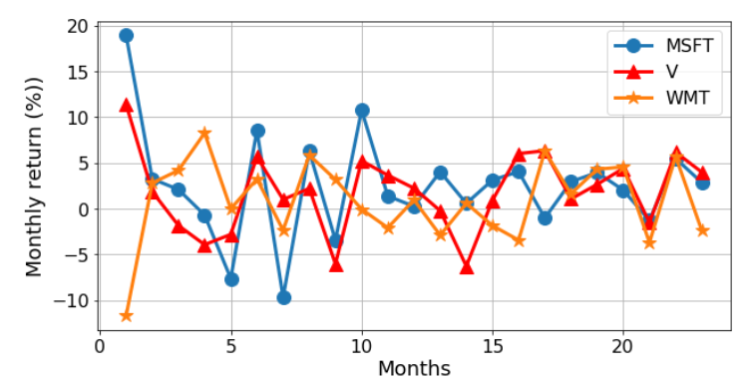
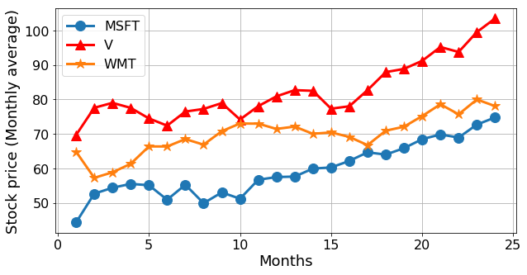
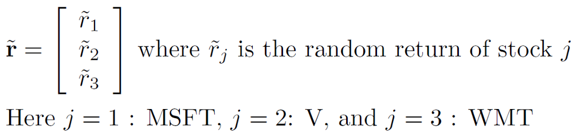
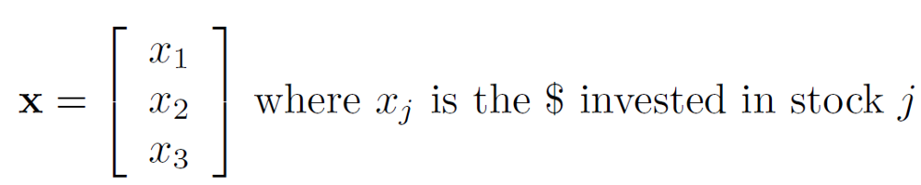
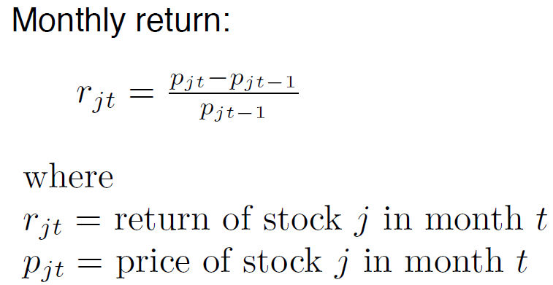
An example problem
In this article, we will show a very simplified version of the portfolio optimization problem, which can be cast into an LP framework and solved efficiently using simple Python scripting.
The goal is to illustrate the power and possibility of such optimization solvers for tackling complex real-life problems.
We work with 24 months stock price (monthly average) for three stocks — Microsoft, Visa, Walmart. These are older data, but they demonstrate the process flawlessly.
The optimization model
The return on a stock is an uncertain quantity. We can model it as a random vector.
The portfolio can also be modeled as a vector.
How to define the return? We can simply compute a rolling monthly return by subtracting the previous month’s average stock price from the current month and dividing by the previous month’s price.
Therefore, the return on a certain portfolio is given by an inner product of these vectors, and it is a random variable. The million-dollar question is:
How can we compare random variables (corresponding to different portfolios) to select a “best” portfolio?
Following the Markowitz model, we can formulate our problem as,
Given a fixed quantity of money (say $1000), how much should we invest in each of the three stocks so as to (a) have a one month expected return of at least a given threshold, and (b) minimize the risk (variance) of the portfolio return
We cannot invest a negative quantity. This is the non-negativity constraint,
https://www.kdnuggets.com/2019/06/optimization-python-money-risk.html

Slide 4

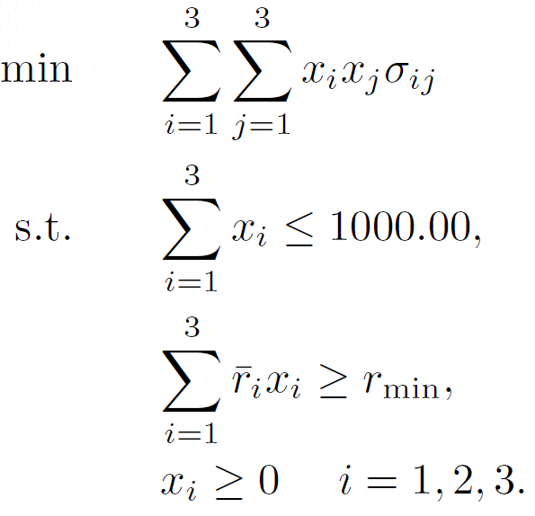
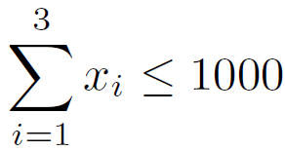
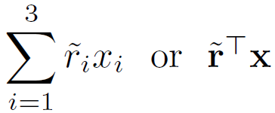
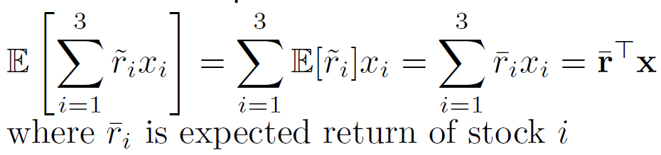
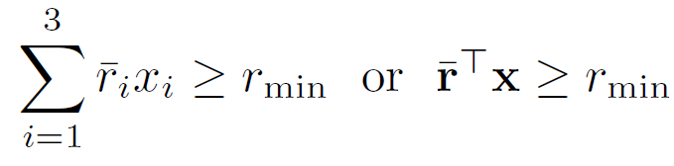
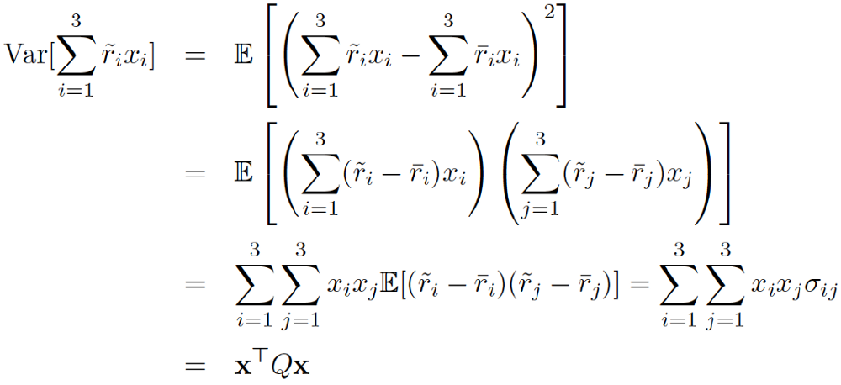
Putting together, the final optimization model is,
Assuming no transaction cost, the total investment is restricted by the fund at hand,
Return on the investment
But this is a random variable. So, we have to work with the expected quantities,
Supposed we want a minimum expected return. Therefore,
Now, to model the risk, we have to compute the variance,
https://www.kdnuggets.com/2019/06/optimization-python-money-risk.html

Slide 5
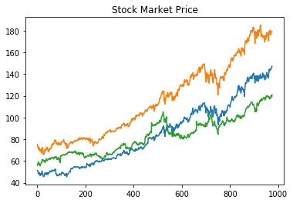
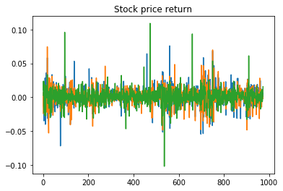
Using Python to solve the optimization: CVXPY
CVXPY is a Python-embedded modeling language for convex optimization problems. It allows you to express your problem in a natural way that follows the math, rather than in the restrictive standard form required by solvers.
import pandas as pd
import numpy as np
import matplotlib.pyplot as plt
from cvxpy import *
##mp = ffn.get('msft,v,wmt', start = '2016-01-01')
mp = pd.read_csv("C:\\Users\\yh10\\Desktop\\Jagdish\\optimizationtechniq\\mp.csv“,index_col =0)
mp = mp.set('Date')
# get columns to plot
import matplotlib.pyplot as plt
columns = mp.columns.drop
# create x data
x_data = range(0, mp.shape[0])
# create figure and axis
fig, ax = plt.subplots()
# plot each column
for column in columns:
ax.plot(x_data, mp[column], label=column)
# set title and legend
ax.set_title('Stock Market Price')
ax.xlabel('Date')
ax.ylabel('Stock Price')
ax.legend()
##Compute monthly returns
mr = pd.DataFrame()
for s in mp.columns:
date = mp.index[0]
pr0 = mp[s][date]
for t in range(1,len(mp.index)):
date = mp.index[t]
pr1 = mp[s][date]
ret = (pr1-pr0)/pr0
mr.set_value(date,s,ret)
pr0=pr1
mr.head()
#Plot of returns
columns = mr.columns
x_data = range(0,mr.shape[0])
fig,ax = plt.subplots()
for column in columns:
ax.plot(x_data,mr[column],label = column)
ax.set_title("Stock price return")
ax.xlabel('Date')
ax.ylabel('Returns')
ax.legend()
https://www.kdnuggets.com/2019/06/optimization-python-money-risk.html
https://github.com/tirthajyoti/Optimization-Python/blob/master/Portfolio_optimization.ipynb

Slide 6
#Get symbol names
symbols = mr.columns
return_data = mr.as_matrix().T
#Mean Return
r = np.asarray(np.mean(return_data,axis=1))
#array([0.00118054, 0.00097116, 0.0008688 ])
#Covariance Matrix
C = np.asmatrix(np.cov(return_data))
[[1.95759379e-04, 1.29904478e-04, 4.32631258e-05],
[1.29904478e-04, 1.61822825e-04, 4.13455766e-05],
[4.32631258e-05, 4.13455766e-05, 1.50832804e-04]])
#Number of variables
n = len(symbols)
#The variables vector
x = Variable(n)
#The minimum return
req_return = 0.02
#The Return
ret = r.T*x
#The risk in xT.Q.x format
risk = quad_form(x,C)
#The core problem definition with the problem class from CVXPY
prob = Problem(Minimize(risk), [sum(x)==1, ret >= req_return, x >=0])
##Try solving the problem within a try/except loop
try:
prob.solve()
print("Optimal portfolio")
print("----------------------")
for s in range(len(symbols)):
print("Investment in {} : {}% of the portfolio".format(symbols[s],round(100*x.value[s],2)))
print("-------------------")
print("Exp ret = {}%".format(round(100*ret.value,2)))
print("Expected Risk = {}%".format(round(100*risk.value**0.5,2)))
except:
print("Error")
prob.status
x.value
##Print expected Returns and risk
for j in range(len(symbols)):
print('%s: Exp ret = %f,Risk = %f' %(symbols[j], r[j],C[j,j]**0.5))
msft: Exp ret = 0.001181,Risk = 0.013991
v: Exp ret = 0.000971,Risk = 0.012721
wmt: Exp ret = 0.000869,Risk = 0.012281
https://www.kdnuggets.com/2019/06/optimization-python-money-risk.html
https://github.com/tirthajyoti/Optimization-Python/blob/master/Portfolio_optimization.ipynb

Slide 7
Introduction to Optimization
Unconstrained Optimization versus Constrained Optimization
Another important distinction is between problems in which there are no constraints on the variables and problems in which there are constraints on the variables. Unconstrained optimization problems arise directly in many practical applications; they also arise in the reformulation of constrained optimization problems in which the constraints are replaced by a penalty term in the objective function. Constrained optimization problems arise from applications in which there are explicit constraints on the variables. The constraints on the variables can vary widely from simple bounds to systems of equalities and inequalities that model complex relationships among the variables. Constrained optimization problems can be furthered classified according to the nature of the constraints (e.g., linear, nonlinear, convex) and the smoothness of the functions (e.g., differentiable or nondifferentiable).
None, One or Many Objectives
Most optimization problems have a single objective function, however, there are interesting cases when optimization problems have no objective function or multiple objective functions. Feasibility problems are problems in which the goal is to find values for the variables that satisfy the constraints of a model with no particular objective to optimize. Complementarity problems are pervasive in engineering and economics. The goal is to find a solution that satisfies the complementarity conditions. Multi-objective optimization problems arise in many fields, such as engineering, economics, and logistics, when optimal decisions need to be taken in the presence of trade-offs between two or more conflicting objectives. For example, developing a new component might involve minimizing weight while maximizing strength or choosing a portfolio might involve maximizing the expected return while minimizing the risk. In practice, problems with multiple objectives often are reformulated as single objective problems by either forming a weighted combination of the different objectives or by replacing some of the objectives by constraints.
Deterministic Optimization versus Stochastic Optimization
In deterministic optimization, it is assumed that the data for the given problem are known accurately. However, for many actual problems, the data cannot be known accurately for a variety of reasons. The first reason is due to simple measurement error. The second and more fundamental reason is that some data represent information about the future (e. g., product demand or price for a future time period) and simply cannot be known with certainty. In optimization under uncertainty, or stochastic optimization, the uncertainty is incorporated into the model. Robust optimization techniques can be used when the parameters are known only within certain bounds; the goal is to find a solution that is feasible for all data and optimal in some sense. Stochastic programming models take advantage of the fact that probability distributions governing the data are known or can be estimated; the goal is to find some policy that is feasible for all (or almost all) the possible data instances and optimizes the expected performance of the model.
Optimization is an important tool in making decisions and in analyzing physical systems. In mathematical terms, an optimization problem is the problem of finding the best solution from among the set of all feasible solutions.
Constructing a Model
The first step in the optimization process is constructing an appropriate model; modeling is the process of identifying and expressing in mathematical terms the objective, the variables, and the constraints of the problem.
An objective is a quantitative measure of the performance of the system that we want to minimize or maximize. In manufacturing, we may want to maximize the profits or minimize the cost of production, whereas in fitting experimental data to a model, we may want to minimize the total deviation of the observed data from the predicted data.
The variables or the unknowns are the components of the system for which we want to find values. In manufacturing, the variables may be the amount of each resource consumed or the time spent on each activity, whereas in data fitting, the variables would be the parameters of the model.
The constraints are the functions that describe the relationships among the variables and that define the allowable values for the variables. In manufacturing, the amount of a resource consumed cannot exceed the available amount.
Types of Optimization Problems
Continuous Optimization versus Discrete Optimization
Some models only make sense if the variables take on values from a discrete set, often a subset of integers, whereas other models contain variables that can take on any real value. Models with discrete variables are discrete optimization problems; models with continuous variables are continuous optimization problems. Continuous optimization problems tend to be easier to solve than discrete optimization problems; the smoothness of the functions means that the objective function and constraint function values at a point x can be used to deduce information about points in a neighborhood of x. However, improvements in algorithms coupled with advancements in computing technology have dramatically increased the size and complexity of discrete optimization problems that can be solved efficiently. Continuous optimization algorithms are important in discrete optimization because many discrete optimization algorithms generate a sequence of continuous subproblems.
https://neos-guide.org/optimization-tree

Slide 8
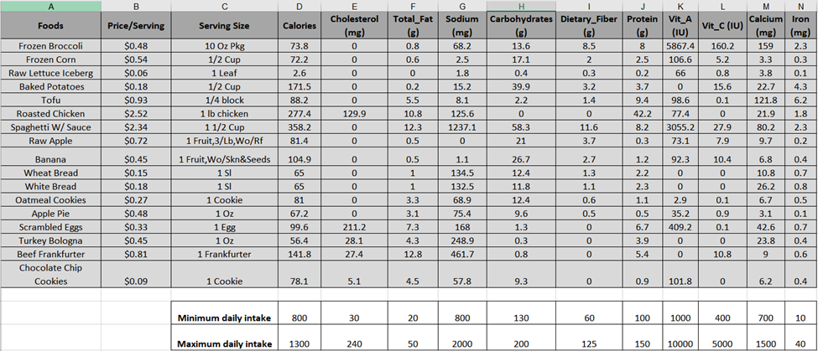

Linear programming and discrete optimization with Python using PuLP
Linear and integer programming are key techniques for discrete optimization problems and they pop up pretty much everywhere in modern business and technology sectors. We will discuss how to tackle such problems using Python library PuLP and get a fast and robust solution.
Introduction
Discrete optimization is a branch of optimization methodology which deals with discrete quantities i.e. non-continuous functions. It is quite ubiquitous in as diverse applications such as financial investment, diet planning, manufacturing processes, and player or schedule selection for professional sports.
Linear and (mixed) integer programming are techniques to solve problems which can be formulated within the framework of discrete optimization.
Knowledge of such optimization techniques is extremely useful for data scientists and machine learning (ML) practitioners as discrete and continuous optimization lie at the heart of modern ML and AI systems as well as data-driven business analytics processes.
There are many commercial optimizer tools, but having hands-on experience with a programmatic way of doing optimization is invaluable.
There is a long and rich history of the theoretical development of robust and efficient solvers for optimization problems. However, focusing on practical applications, we will skip that history and move straight to the part of learning how to use programmatic tools to formulate and solve such optimization problems.
An example problem (or two)
Suppose you are in charge of the diet plan for high school lunch. Your job is to make sure that the students get the right balance of nutrition from the chosen food.
However, there are some restrictions in terms of budget and the variety of food that needs to be in the diet to make it interesting. The following table shows, in detail, the complete nutritional value for each food item, and their maximum/minimum daily intake.
The discrete optimization problem is simple: Minimize the cost of the lunch given these constraints (on total calories but also on each of the nutritional component e.g. cholesterol, vitamin A, calcium, etc.
Essentially, in a casual mathematical language, the problem is,
Notice that the inequality relations are all linear in nature i.e. the variables f are multiplied by constant coefficients and the resulting terms are bounded by constant limits and that’s what makes this problem solvable by an LP technique.
You can imagine that this kind of problem may pop up in business strategy extremely frequently. Instead of nutritional values, you will have profits and other types of business yields, and in place of price/serving, you may have project costs in thousands of dollars. As a manager, your job will be to choose the projects, that give maximum return on investment without exceeding a total budget of funding the project.
Similar optimization problem may crop up in a factory production plan too, where maximum production capacity will be functions of the machines used and individual products will have various profit characteristics. As a production engineer, your job could be to assign machine and labor resources carefully to maximize the profit while satisfying all the capacity constraints.
Fundamentally, the commonality between these problems from disparate domains is that they involve maximizing or minimizing a linear objective function, subject to a set of linear inequality or equality constraints.
For the diet problem, the objective function is the total cost which we are trying to minimize. The inequality constraints are given by the minimum and maximum bounds on each of the nutritional components.
https://towardsdatascience.com/linear-programming-and-discrete-optimization-with-python-using-pulp-449f3c5f6e99

Slide 9
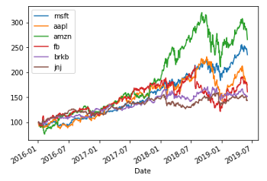
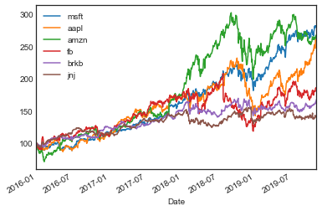
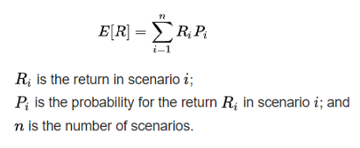
Case 2 -Optimizing Portfolios with Modern Portfolio Theory Using Python
Modern portfolio theory (MPT) is used by many firms, fund managers, and wealth advisors. Nobel Laureate Harry Markowitz proposed this idea over six decades ago. And the theory remains hugely popular today because of its relative simplicity and performance.
MPT is all about assembling a portfolio that maximizes expected return for a set level of risk. First, let us discuss expected return. We will perform our analysis on the top 6 stocks by market cap (as of 6/3/2019).
Expected Return
Expected return is the expected profits of purchasing some asset. It is easily calculated if probabilities for different ranges of expected prices are established. This can be found by studying past returns and performance of the asset to find the distribution of prices over established time-frames. The expected return will be the center of the distribution.
import ffn
from empyrical import alpha_beta
from empyrical import alpha_beta
from pypfopt.efficient_frontier import EfficientFrontier
from pypfopt import risk_models
from pypfopt import expected_returns
from pypfopt import discrete_allocation
import matplotlib as pyplot
import numpy as np
import pandas as pd
prices = ffn.get('msft,aapl,amzn,fb,brk-b,jnj',start = '2016-01-01')
benchmark = ffn.get('spy',start ='2016-01-01')
msft = ffn.get('msft', start='2016-01-01')
ax = prices.rebase().plot()
returns = prices.to_returns().dropna()
ax = returns.hist(figsize=(10,10))
stats = prices.calc_stats()
stats.display()
ax = returns.hist(figsize=(10, 5))
Here are some implementations of the above methods, written in Python. The Jupyter Notebook of these methods will be linked at the end of the article.
https://towardsdatascience.com/optimizing-portfolios-with-modern-portfolio-theory-using-python-60ce9a597808
https://github.com/Poseyy/MarketAnalysis/blob/master/portfolios/PortfolioAnalysis.ipynb

Slide 10
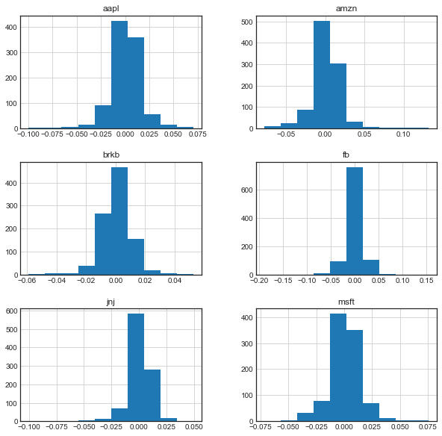
##histrogram
returns = prices.to_returns().dropna()
ax = returns.hist(figsize=(10,10))
###OR
figsize=(10,5)
%matplotlib inline
import numpy as np
import matplotlib.pyplot as plt
plt.style.use('seaborn-white')
#data = np.random.randn(1000)
plt.hist(returns['msft']);
plt.title('msft')
plt.hist(returns['amzn'])
plt.title('amzn')
plt.hist(returns['brkb'])
plt.title('brkb')
plt.hist(returns['fb'])
plt.title('fb')
https://towardsdatascience.com/optimizing-portfolios-with-modern-portfolio-theory-using-python-60ce9a597808
https://github.com/Poseyy/MarketAnalysis/blob/master/portfolios/PortfolioAnalysis.ipynb

Slide 11
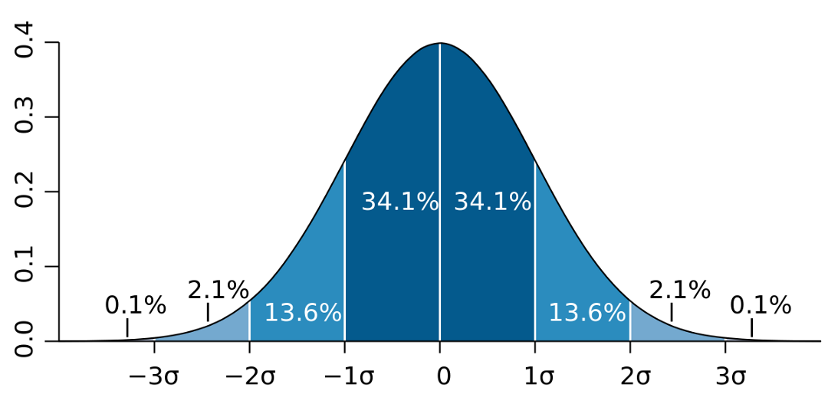
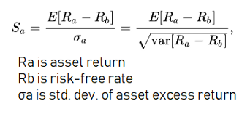
Risk
MPT (Modern Portfolio Theory) assumes investors are risk-averse. That is, it assumes investors will choose a less risky portfolio over a riskier one with the same return. For example, a portfolio that guarantees $50,000 profit would be preferable to a portfolio with a 50% chance of returning $100,000 and a 50% chance of returning $0. A risk-neutral person would say those portfolios are equal. But in MPT, we prefer the risk-averse portfolio. We can use many different methods for evaluating risk, but standard deviation of an asset’s price to evaluate risk is the most common method.
Here is what a plot of standard deviation might look like. The percentages can differ depending on the asset or portfolio (combination of assets):
We can use the popular financial functions (ffn) Python library to view all sorts of interesting stats, paying special attention to the ones relating to risk. We’ll view the six highest companies by market cap (as of June 3rd, 2019). The current risk free rate (10y treasury) is around 2.1%.
The Sharpe Ratio is another popular way for quantifying asset risk. It simply measures the expected average return in excess of the risk free rate (10-Yr Treasury Bond, currently ~2.2%). Sharpe Ratio can help us identify how much additional returns we can make as we add the volatility of riskier assets.
https://towardsdatascience.com/optimizing-portfolios-with-modern-portfolio-theory-using-python-60ce9a597808
https://github.com/Poseyy/MarketAnalysis/blob/master/portfolios/PortfolioAnalysis.ipynb

Slide 12

Understanding the Sharpe Ratio
“The Sharpe ratio tells us whether a portfolio's returns are due to smart investment decisions or a result of excess risk. Although one portfolio or fund can reap higher returns than its peers, it is only a good investment if those higher returns do not come with too much additional risk. The greater a portfolio's Sharpe ratio, the better its risk-adjusted performance has been. A negative Sharpe ratio indicates that a risk-less asset would perform better than the security being analyzed.”
The formula is the following:
Where Expected Return (P) is the expected return of the portfolio and “Standard Deviation (P)” is the standard deviation of the portfolio.
Sortino Ratio:
Sortino ratio measures excess return per unit of downside risk. It is calculated by dividing the difference between portfolio return and risk-free rate by the standard deviation of negative returns. A higher Sortino ratio is better.
Rational investors are inherently risk-averse and they take risk only if it is compensated by additional return. Sharpe ratio is a common measure of risk-return trade-off. It compares excess return with total standard deviation of the portfolio’s investment returns, a measure of both the deviations above the mean return and those below the mean return. But upside deviations are good for an investor, so the real risk which investors should worry about is the risk of returns falling below the mean. Sortino ratio defines risk as the risk of downside variation only and provides a better picture of risk-adjusted performance than the Sharpe ratio.
Formula
The following formula shows calculation of Sortino ratio:
Sortino Ratio = (Portfolio Return − Risk Free Rate)/
Portfolio Downside Standard Deviation
https://xplaind.com/262577/sortino-ratio
Sharpe ratio is the excess return of a portfolio above the risk-free rate relative to its standard deviation. Sortino ratio is the excess return of a portfolio above the risk-free rate relative to its downside deviation.
https://www.financewalk.com/sharpe-ratio-excel-formula-example/

Slide 13
Stat msft aapl amzn fb brkb jnj
------------------- ---------- ---------- ---------- ---------- ---------- ----------
Start 2015-12-31 2015-12-31 2015-12-31 2015-12-31 2015-12-31 2015-12-31
End 2019-11-05 2019-11-05 2019-11-05 2019-11-05 2019-11-05 2019-11-05
Risk-free rate 0.00% 0.00% 0.00% 0.00% 0.00% 0.00%
Total Return 181.39% 160.63% 166.57% 85.67% 67.28% 40.49%
Daily Sharpe 1.32 1.14 1.04 0.70 0.89 0.62
Daily Sortino 2.21 1.84 1.72 1.09 1.43 0.91
CAGR 30.86% 28.28% 29.03% 17.45% 14.31% 9.24%
Max Drawdown -18.23% -38.52% -34.10% -42.96% -16.09% -18.28%
Calmar Ratio 1.69 0.73 0.85 0.41 0.89 0.51
MTD 0.76% 3.36% 1.41% 1.39% 3.90% -1.23%
3m 9.63% 33.50% 2.07% 6.93% 11.71% 0.95%
6m 12.86% 22.36% -8.19% -0.59% 1.04% -6.84%
YTD 43.84% 64.96% 19.96% 48.23% 8.18% 3.20%
1Y 36.48% 29.53% 10.68% 30.70% 2.15% -5.75%
3Y (ann.) 36.40% 34.55% 32.00% 16.78% 14.60% 6.62%
5Y (ann.) 30.86% 28.28% 29.03% 17.45% 14.31% 9.24%
10Y (ann.) - - - - - -
Since Incep. (ann.) 30.86% 28.28% 29.03% 17.45% 14.31% 9.24%
Daily Sharpe 1.32 1.14 1.04 0.70 0.89 0.62
Daily Sortino 2.21 1.84 1.72 1.09 1.43 0.91
Daily Mean (ann.) 29.42% 27.98% 29.55% 20.41% 14.78% 10.21%
Daily Vol (ann.) 22.27% 24.61% 28.39% 29.18% 16.63% 16.43%
Daily Skew 0.02 -0.30 0.34 -0.48 -0.35 -1.53
Daily Kurt 3.83 4.64 6.84 19.54 5.16 12.83
Best Day 7.57% 7.04% 13.22% 15.52% 5.27% 4.96%
Worst Day -7.17% -9.96% -7.82% -18.96% -5.89% -10.04%
Monthly Sharpe 1.64 1.04 1.06 0.73 1.01 0.68
Monthly Sortino 3.43 1.95 2.06 1.66 2.09 1.17
Monthly Mean (ann.) 28.13% 28.36% 28.93% 19.05% 14.16% 9.70%
Monthly Vol (ann.) 17.15% 27.24% 27.31% 25.94% 13.97% 14.19%
Monthly Skew -0.32 -0.41 -0.18 0.82 -0.14 -0.51
Monthly Kurt 0.19 0.26 1.19 1.71 -0.30 1.36
Best Month 11.67% 20.04% 24.06% 27.16% 9.11% 9.21%
Worst Month -9.70% -18.12% -20.22% -11.19% -8.90% -12.15%
Yearly Sharpe 2.10 0.93 1.48 0.58 1.40 0.72
Yearly Sortino inf 11.18 inf 1.67 inf 3.68
Yearly Mean 30.11% 30.13% 28.82% 21.46% 14.06% 9.45%
Yearly Vol 14.31% 32.26% 19.45% 36.94% 10.03% 13.05%
Yearly Skew -0.10 -0.04 1.23 -0.72 -0.20 0.06
Yearly Kurt -5.00 -3.43 1.66 -1.83 -4.57 -2.20
Best Year 43.84% 64.96% 55.96% 53.38% 23.43% 24.43%
Worst Year 15.08% -5.39% 10.95% -25.71% 3.01% -5.13%
Avg. Drawdown -2.55% -3.69% -4.05% -3.96% -2.43% -2.37%
Avg. Drawdown Days 16.58 25.85 27.20 26.58 31.85 31.20
Avg. Up Month 4.61% 7.48% 7.40% 6.17% 3.88% 3.12%
Avg. Down Month -3.59% -5.18% -4.94% -5.17% -2.80% -3.27%
Win Year % 100.00% 75.00% 100.00% 75.00% 100.00% 75.00%
Win 12m % 100.00% 86.49% 94.59% 81.08% 86.49% 81.08%
alpha,beta = alpha_beta(msft,benchmark)
print(beta)
A Sharpe Ratio of 1 is generally considered “good,” while a Sharpe Ratio of 2 is considered “very good,” and above 3 is considered “excellent.”
https://towardsdatascience.com/optimizing-portfolios-with-modern-portfolio-theory-using-python-60ce9a597808
https://github.com/Poseyy/MarketAnalysis/blob/master/portfolios/PortfolioAnalysis.ipynb

Slide 14
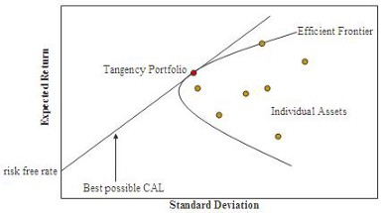
Efficient Frontier & Portfolio Optimization
We can plot all possible combinations of assets as risk vs expected return. This will show us the optimal portfolio, as our goal is to find the portfolio with the highest ratio of expected return to risk. For example, a wealth manager might have some formula for determining acceptable client risk. Someone nearing retirement may have especially low risk, while someone early-mid career may have a higher risk profile. We could then test all combinations of assets that involve the determined level of risk and pick the portfolio with the highest expected return. A portfolio with standard deviation of 4% and expected return of 5.5% is of course superior to a portfolio with standard deviation of 4% and expected return of 5%
There’s a library ,recently found that especially fond of known as PyPortfolioOpt that has some very useful methods for implementing portfolio optimization techniques. Here are some examples. The first example is optimizing a portfolio for maximum Sharpe Ratio. The output is an array of weights for each stock.
##Expected returns and sample covariance
mu = expected_returns.mean_historical_return(prices)
S = risk_models.sample_cov(prices)
#Optimise portfolio for maximum sharpe Ratio
ef = EfficientFrontier(mu,S)
raw_weights = ef.max_sharpe()
cleaned_weights =ef.clean_weights()
print(cleaned_weights)
ef.portfolio_performance(verbose = True)
{'msft': 0.56144, 'aapl': 0.28607, 'amzn': 0.05739, 'fb': 0.0, 'brkb': 0.04041, 'jnj': 0.0547}
Expected annual return: 27.6%
Annual volatility: 19.5%
Sharpe Ratio: 1.31
Out[5]: (0.2756937205996591, 0.1948678140001353, 1.3121393181917744)
##Efficient Frontier & Portfolio Optimization
returns = prices.pct_change()
#Mean daily return and covariance of daily returns
mean_daily_returns = returns.mean()
cov_matrix = returns.cov()
#Portfolio weigths
weigths = np.asarray([0.4,0.2,0.1,0.1,0.1,0.1])
portfolio_returns = round(np.sum(mean_daily_returns * weights) * 252,2)
portfolio_std_dev = round(np.sqrt(np.dot(weights.T,np.dot(cov_matrix,weights))) * np.sqrt(252),2)
print("Expected annualised return:" + str(portfolio_return))
print("Volatility:" + str(portfolio_std_dev))
#Expected annualised return:0.25
#Volatility:0.18
We can take this a step further with a function that given the above input and a cash value will even return the number of shares to buy of each stock to optimize Sharpe Ratio.
##
from pypfopt.discrete_allocation import DiscreteAllocation, get_latest_prices
latest_prices = get_latest_prices(prices)
da = DiscreteAllocation(cleaned_weights, latest_prices,total_portfolio_value = 20000)
allocation, leftover = da.lp_portfolio()
print(allocation)
print("Funds remaining : ${:.2f}".format(leftover))
1 out of 6 tickers were removed
{'msft': 77, 'aapl': 21, 'amzn': 1, 'brkb': 2, 'jnj': 8}
Funds remaining : $5.64
https://towardsdatascience.com/optimizing-portfolios-with-modern-portfolio-theory-using-python-60ce9a597808
https://github.com/Poseyy/MarketAnalysis/blob/master/portfolios/PortfolioAnalysis.ipynb

Slide 15
##Efficiency
ef = EfficientFrontier(mu, S, weight_bounds=(-1, 1))
ef.efficient_return(target_return=0.2, market_neutral=True)
{'msft': 0.8369001774050827,
'aapl': 0.32911853110622724,
'amzn': 0.14966283223701984,
'fb': -0.2623413119570849,
'brkb': -0.4829212859696921,
'jnj': -0.5704189428215528}
Conclusion
Thanks for reading. Hopefully this gave you some insight into ways fund managers, wealth advisers, or investors may optimize portfolios. Next we’ll take a look at some common hedging techniques such as delta hedging and continue to learn some more tricks of the trade
https://towardsdatascience.com/optimizing-portfolios-with-modern-portfolio-theory-using-python-60ce9a597808
https://github.com/Poseyy/MarketAnalysis/blob/master/portfolios/PortfolioAnalysis.ipynb

Slide 16
Case -3 Efficient Frontier Portfolio Optimization in Python
import pandas as pd
import numpy as np
import matplotlib.pyplot as plt
import seaborn as sns
import quandl
import scipy.optimize as sco
plt.style.use('fivethirtyeight')
np.random.seed(777)
%matplotlib inline
%config InlineBackend.figure_format = 'retina'
Modern Portfolio Theory
Agood portfolio is more than a long list of good stocks and bonds. It is a balanced whole, providing the investor with protections and opportunities with respect to a wide range of contingencies. – Harry Markowitz
Modern Portfolio Theory (MPT) is an investment theory developed by Harry Markowitz and published under the title “Portfolio Selection” in the Journal of Finance in 1952.
There are a few underlying concepts that can help you understand MPT. If you are familiar with finance, you might know what the acronym “TANSTAAFL” stands for. It is a famous acronym for “There Ain’t No Such Thing As A Free Lunch”. This concept is also closely related to ‘risk-return trade-off’.
Higher risk is associated with greater probability of higher return and lower risk with a greater probability of smaller return. MPT assumes that investors are risk-averse, meaning that given two portfolios that offer the same expected return, investors will prefer the less risky one. Thus, an investor will take on increased risk only if compensated by higher expected returns.
Another factor comes in to play in MPT is “diversification”. Modern portfolio theory says that it is not enough to look at the expected risk and return of one particular stock. By investing in more than one stock, an investor can reap the benefits of diversification — chief among them, a reduction in the riskiness of the portfolio.
What you need to understand is that “risk of a portfolio is not equal to average/weighted-average of individual stocks in the portfolio”. In terms of return, yes it is the average/weighted average of individual stock’s returns, but that’s not the case for risk. The risk is about how volatile the asset is, if you have more than one stock in your portfolio, then you have to take count of how these stocks movement correlates with each other. The beauty of diversification is that you can even get lower risk than a stock with the lowest risk in your portfolio, by optimising the allocation
First, let’s start by importing some libraries we need. “Quandl” is a financial platform which also offers Python library
In order to run the below code block, you will need your own API key. The stocks selected for this post is Apple, Amazon, Google, Facebook. Below code block will get daily adjusted closing price of each stock from 01/01/2016 to 31/12/2017 (2 years’ price data).
plt.style.use('fivethirtyeight')
np.random.seed(777)
%matplotlib inline
%config InlineBackend.figure_format = 'retina'
quandl.ApiConfig.api_key = ['AAPL','AMZN','GOOGL','FB']
stocks = ['AAPL','AMZN','GOOGL','FB']
data = quandl.get_table('WIKI/PRICES', ticker = stocks,
qopts = {'columns': ['date','ticker','adj_close']},
date = {'gte':'2017-01-01','lte': '2019-11-15'},
paginate = True)
data.info()
df =data.set_index('date')
table = df.pivot(columns = 'ticker')
#By specifying col[1] in below list comprehension
#you can select the stock names under multi-level column
table.columns = [col[1]] for col in table.columns]
table.head()
https://towardsdatascience.com/efficient-frontier-portfolio-optimisation-in-python-e7844051e7f

Slide 17
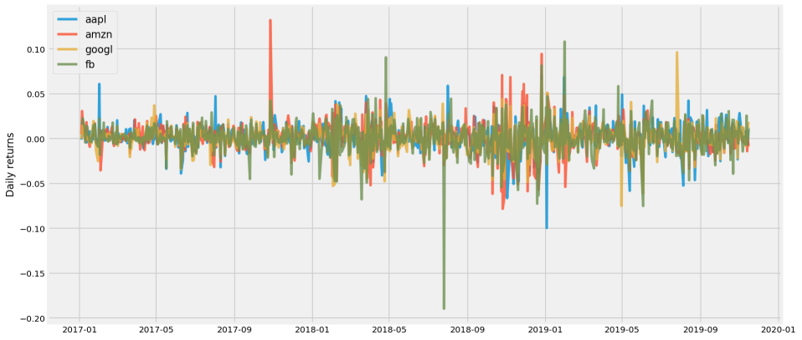
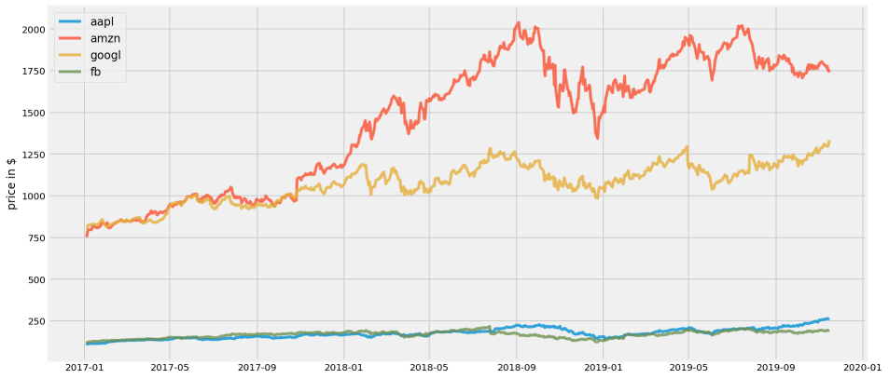
import ffn
df = ffn.get('aapl,amzn,googl,fb',start = '2017-01-01', end = '2019-11-15')
df = df.reset_index()
df = df.set_index('Date')
df.info()
df.head()
##Ploting
plt.figure(figsize=(14, 7))
for c in df.columns.values:
plt.plot(df.index, df[c], lw=3, alpha=0.8,label=c)
plt.legend(loc='upper left', fontsize=12)
plt.ylabel('price in $')
##Plotting volatility plot
returns = df.pct_change()
plt.figure(figsize = (14,7))
for c in returns.columns.values:
plt.plot(df.index, returns[c], lw=3, alpha =0.8, label = c)
plt.legend(loc = 'upper left', fontsize =12)
plt.ylabel('Daily returns')
Amazon has two distinctive positive spikes and a couple of negative ones. Facebook has one highest positive spike. And Apple also has some spikes stand out from the plot. From the above plot, we can roughly see that Amazon looks like a quite risky stock, and Google seems to be the most stable one among them.
It looks like that Amazon and Google’s stock price is relatively more expensive than those of Facebook and Apple. But since Facebook and Apple are squashed at the bottom, it is hard to see the movement of these two.
Another way to plot this is plotting daily returns (percent change compared to the day before). By plotting daily returns instead of actual prices, we can see the stocks’ volatility.
https://towardsdatascience.com/efficient-frontier-portfolio-optimisation-in-python-e7844051e7f

Slide 18

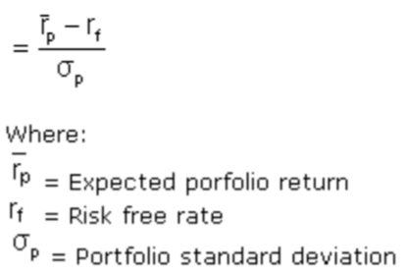
Random Portfolios Generation
We have 4 stocks in our portfolio. One decision we have to make is how we should allocate our budget to each of stock in our portfolio. If our total budget is 1, then we can decide the weights for each stock, so that the sum of weights will be 1. And the value for weights will be the portion of budget we allocate to a specific stock. For example, if weight is 0.5 for Amazon, it means that we allocate 50% of our budget to Amazon.
Let’s define some functions to simulate random weights to each stock in the portfolio, then calculate the portfolio’s overall annualized returns and annualized volatility.
“portfolio_annualised_performance” function will calculate the returns and volatility, and to make it as an annualised calculation I take into account 252 as the number of trading days in one year. “random_portfolios” function will generate portfolios with random weights assigned to each stock, and by giving num_portfolios argument, you can decide how many random portfolios you want to generate.
Portfolio standard deviation
The first is the calculation for portfolio’s volatility in “portfolio_annualised_performance” function. If you look up “portfolio standard deviation formula”, you will come across formulas as below.
This formula can be simplified if we make use of matrix notation.
Sharpe ratio
The second thing I would like to point out is the Sharpe ratio. In order to understand the Sharpe ratio, it is essential to understand the broader concept of risk-adjusted return. Risk-adjusted return refines an investment’s return by measuring how much risk is involved in producing that return, which is generally expressed as a number or rating. There could be a number of different methods of expressing risk-adjusted return, and the Sharpe ratio is one of them.
The Sharpe ratio was derived in 1966 by William Sharpe, another winner of a Nobel Memorial Prize in Economic Sciences.
The ratio describes how much excess return you are receiving for the extra volatility that you endure for holding a riskier asset. The Sharpe ratio can be expressed in below formula.
###Random Portfolio
def portfolio_annualised_performance(weights, mean_returns, cov_matrix):
returns = np.sum(mean_returns*weights ) *252
std = np.sqrt(np.dot(weights.T, np.dot(cov_matrix, weights))) * np.sqrt(252)
return std, returns
def random_portfolios(num_portfolios, mean_returns, cov_matrix, risk_free_rate):
results = np.zeros((3,num_portfolios))
weights_record = []
for i in range(num_portfolios):
weights = np.random.random(4)
weights /= np.sum(weights)
weights_record.append(weights)
portfolio_std_dev, portfolio_return = portfolio_annualised_performance(weights, mean_returns, cov_matrix)
results[0,i] = portfolio_std_dev
results[1,i] = portfolio_return
results[2,i] = (portfolio_return - risk_free_rate) / portfolio_std_dev
return results, weights_record
There are some criticisms on how the Sharpe ratio uses the standard deviation of returns as a denominator, which assumes the normal distribution of the returns. However, more often than not, the returns on financial assets tend to deviate from a normal distribution and may make interpretations of the Sharpe ratio misleading. It is for this reason that there are other methods which adjust or modify the original Sharpe ratio
https://towardsdatascience.com/efficient-frontier-portfolio-optimisation-in-python-e7844051e7f

Slide 19
def display_simulated_ef_with_random(mean_returns, cov_matrix, num_portfolios, risk_free_rate):
results, weights = random_portfolios(num_portfolios,mean_returns, cov_matrix, risk_free_rate)
max_sharpe_idx = np.argmax(results[2])
sdp, rp = results[0,max_sharpe_idx], results[1,max_sharpe_idx]
max_sharpe_allocation = pd.DataFrame(weights[max_sharpe_idx],index=table.columns,columns=['allocation'])
max_sharpe_allocation.allocation = [round(i*100,2)for i in max_sharpe_allocation.allocation]
max_sharpe_allocation = max_sharpe_allocation.T
min_vol_idx = np.argmin(results[0])
sdp_min, rp_min = results[0,min_vol_idx], results[1,min_vol_idx]
min_vol_allocation = pd.DataFrame(weights[min_vol_idx],index=table.columns,columns=['allocation'])
min_vol_allocation.allocation = [round(i*100,2)for i in min_vol_allocation.allocation]
min_vol_allocation = min_vol_allocation.T
#print "-"*80
print("Maximum Sharpe Ratio Portfolio Allocation")
print('Annualised Return:%.3f' % round(rp,2))
print('Annualised Volatility:%.3f' % round(sdp,2))
#print "\n"
print(max_sharpe_allocation)
#print "-"*80
print("Minimum Volatility Portfolio Allocation")
print('Annualised Return:%.3f' % round(rp_min,2))
print('Annualised Volatility: %.3f' % round(sdp_min,2))
#print "\n"
print(min_vol_allocation)
plt.figure(figsize=(10, 7))
plt.scatter(results[0,:],results[1,:],c=results[2,:],cmap='YlGnBu', marker='o', s=10, alpha=0.3)
plt.colorbar()
plt.scatter(sdp,rp,marker='*',color='r',s=500, label='Maximum Sharpe ratio')
plt.scatter(sdp_min,rp_min,marker='*',color='g',s=500, label='Minimum volatility')
plt.title('Simulated Portfolio Optimization based on Efficient Frontier')
plt.xlabel('annualised volatility')
plt.ylabel('annualised returns')
plt.legend(labelspacing=0.8)
display_simulated_ef_with_random(mean_returns, cov_matrix,num_portfolios,risk_free_rate)
Now let’s get the needed argument values for our functions. You can easily get daily returns by calling pct_change on the data frame with the price data. And the mean daily returns, the covariance matrix of returns are needed to calculate portfolio returns and volatility. We will generate 25,000 random portfolios. Finally, the risk-free rate has been taken from U.S. Department of The Treasury. The rate of 1.78% is the 52week treasury bill rates at the start of 2018. The rationale behind this is that the historical price data is from 2016~2017, and if I assume that I implement this analysis at the start of 2018, the most updated Treasury bill rate is from the start of 2018. And I also chose 52weeks treasury bill rates to match with the annualised return and risk I calculated.
Table = df.copy()
returns = table.pct_change()
mean_returns = returns.mean()
cov_matrix = returns.cov()
num_portfolios = 25000
risk_free_rate = 0.0178
Let me briefly explain what below function is doing. First, it generates random portfolio and gets the results (portfolio returns, portfolio volatility, portfolio Sharpe ratio) and weights for the corresponding result. Then by locating the one with the highest Sharpe ratio portfolio, it displays maximum Sharpe ratio portfolio as red star sign. And does similar steps for minimum volatility portfolio, and displays it as a green star on the plot. All the randomly generated portfolios will be also plotted with colour map applied to them based on the Sharpe ratio. Bluer, higher the Sharpe ratio.
And for these two optimal portfolios, it will also show how it allocates the budget within the portfolio.
https://towardsdatascience.com/efficient-frontier-portfolio-optimisation-in-python-e7844051e7f

Slide 20
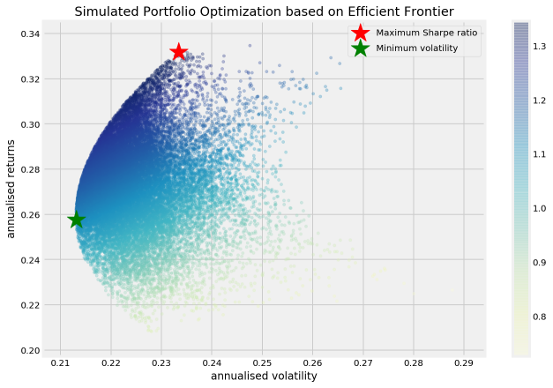
Maximum Sharpe Ratio Portfolio Allocation
Annualised Return:0.330
Annualised Volatility:0.230
aapl amzn googl fb
allocation 63.46 36.09 0.25 0.2
Minimum Volatility Portfolio Allocation
Annualised Return:0.260
Annualised Volatility: 0.210
aapl amzn googl fb
allocation 36.74 4.69 46.58 11.99
Efficient Frontier
From the plot of the randomly simulated portfolios, we can see it forms a shape of an arch line on the top of clustered blue dots. This line is called efficient frontier. Why is it efficient? Because points along the line will give you the lowest risk for a given target return. All the other dots right to the line will give you higher risk with same returns. If the expected returns are the same
The way we found the two kinds of optimal portfolio above was by simulating many possible random choices and pick the best ones (either minimum risk or maximum risk-adjusted return). We can also implement this by using Scipy’s optimize function.
If you are an advanced Excel user, you might be familiar with ‘solver’ function in excel. Scipy’s optimize function is doing the similar task when given what to optimize, and what are constraints and bounds.
Below functions are to get the maximum Sharpe ratio portfolio. In Scipy’s optimize function, there’s no ‘maximize’, so as an objective function you need to pass something that should be minimized. That is why the first “neg_sharpe_ratio” is computing the negative Sharpe ratio. Now we can use this as our objective function to minimize. In “max_sharpe_ratio” function, you first define arguments (this should not include the variables you would like to change for optimisation, in this case, “weights”). At first, the construction of constraints was a bit difficult for me to understand, due to the way it is stated.
For minimum risk portfolio, we can see that more than half of our budget is allocated to Google. If you take another look at the daily return plot from earlier, you can see that Google is the least volatile stock of four, so allocating a large percentage to Google for minimum risk portfolio makes intuitive sense.
If we are willing to take higher risk for higher return, one that gives us the best risk-adjusted return is the one with maximum Sharpe ratio. In this scenario, we are allocating a significant portion to Amazon and Facebook, which are quite volatile stocks from the previous plot of daily returns. And Google which had more than 50% in the case of minimum risk portfolio, has less than 1% budget allocated to it.
constraints = ({‘type’: ‘eq’, ‘fun’: lambda x: np.sum(x) — 1})
The above constraint is saying that sum of x should be equal to 1. You can think of the ‘fun’ part construction as ‘1’ on the right side of equal sign has been moved to the left side of the equal sign.
np.sum(x) == 1 has become np.sum(x)-1
It simply means that the sum of all the weights should be equal to 1. You cannot allocate more than 100% of your budget in total.
“bounds” is giving another limit to assign random weights, by saying any weight should be inclusively between 0 and 1. You cannot give minus budget allocation to a stock or more than 100% allocation to a stock.
https://towardsdatascience.com/efficient-frontier-portfolio-optimisation-in-python-e7844051e7f

Slide 21
##Efficient Frontier
def neg_sharpe_ratio(weights, mean_returns, cov_matrix, risk_free_rate):
p_var, p_ret = portfolio_annualised_performance(weights, mean_returns, cov_matrix)
return -(p_ret - risk_free_rate) / p_var
def max_sharpe_ratio(mean_returns, cov_matrix, risk_free_rate):
num_assets = len(mean_returns)
args = (mean_returns, cov_matrix, risk_free_rate)
constraints = ({'type': 'eq', 'fun': lambda x: np.sum(x) - 1})
bound = (0.0,1.0)
bounds = tuple(bound for asset in range(num_assets))
result = sco.minimize(neg_sharpe_ratio, num_assets*[1./num_assets,], args=args,
method='SLSQP', bounds=bounds, constraints=constraints)
return result
we can also draw a line which depicts where the efficient portfolios for a given risk rate should be. This is called “efficient frontier”. Below define other functions to compute efficient frontier. The first function “efficient_return” is calculating the most efficient portfolio for a given target return, and the second function “efficient_frontier” will take a range of target returns and compute efficient portfolio for each return level.
def efficient_return(mean_returns, cov_matrix, target):
num_assets = len(mean_returns)
args = (mean_returns, cov_matrix)
def portfolio_return(weights):
return portfolio_annualised_performance(weights, mean_returns, cov_matrix)[1]
constraints = ({'type': 'eq', 'fun': lambda x: portfolio_return(x) - target},
{'type': 'eq', 'fun': lambda x: np.sum(x) - 1})
bounds = tuple((0,1) for asset in range(num_assets))
result = sco.minimize(portfolio_volatility, num_assets*[1./num_assets,], args=args, method='SLSQP', bounds=bounds, constraints=constraints)
return result
def efficient_frontier(mean_returns, cov_matrix, returns_range):
efficients = []
for ret in returns_range:
efficients.append(efficient_return(mean_returns, cov_matrix, ret))
return efficients
We can also define an optimising function for calculating minimum volatility portfolio. This time we really do minimise objective function. What do we want to minimise? We want to minimise volatility by trying different weights. “constraints” and “bounds” are same as the above.
def portfolio_volatility(weights, mean_returns, cov_matrix):
return portfolio_annualised_performance(weights, mean_returns, cov_matrix)[0]
def min_variance(mean_returns, cov_matrix):
num_assets = len(mean_returns)
args = (mean_returns, cov_matrix)
constraints = ({'type' : 'eq', 'fun' : lambda x:np.sum(x)-1})
bound =(0.0,1.0)
bounds = tuple(bound for asset in range(num_assets))
result = sco.minimize(portfolio_volatility,
num_assets*[1./num_assets,],args = args,
method = 'SLSQP', bounds = bounds, constraints = constraints)
return result
Let’s try to plot the portfolio choices with maximum Sharpe ratio and minimum volatility also with all the randomly generated portfolios. But this time, we are not picking the optimal ones from the randomly generated portfolios, but we are actually calculating by using Scipy’s ‘minimize’ function. And the below function will also plot the efficient frontier line.
https://towardsdatascience.com/efficient-frontier-portfolio-optimisation-in-python-e7844051e7f

Slide 22
def display_calculated_ef_with_random(mean_returns, cov_matrix, num_portfolios, risk_free_rate):
results,_ = random_portfolios(num_portfolios,mean_returns, cov_matrix, risk_free_rate)
max_sharpe = max_sharpe_ratio(mean_returns, cov_matrix, risk_free_rate)
sdp, rp = portfolio_annualised_performance(max_sharpe['x'], mean_returns, cov_matrix)
max_sharpe_allocation = pd.DataFrame(max_sharpe.x,index=table.columns,columns=['allocation'])
max_sharpe_allocation.allocation = [round(i*100,2)for i in max_sharpe_allocation.allocation]
max_sharpe_allocation = max_sharpe_allocation.T
min_vol = min_variance(mean_returns, cov_matrix)
sdp_min, rp_min = portfolio_annualised_performance(min_vol['x'], mean_returns, cov_matrix)
min_vol_allocation = pd.DataFrame(min_vol.x,index=table.columns,columns=['allocation'])
min_vol_allocation.allocation = [round(i*100,2)for i in min_vol_allocation.allocation]
min_vol_allocation = min_vol_allocation.T
#print "-"*80
print("Maximum Sharpe Ratio Portfolio Allocation/n")
print('Annualised Return: %.3f' % round(rp,2))
print("Annualised Volatility: %.3f" % round(sdp,2))
print("\n")
print(max_sharpe_allocation)
#print "-"*80
print("Minimum Volatility Portfolio Allocation/n")
print("Annualised Return: %.3f" % round(rp_min,2))
print("Annualised Volatility: %.3f" % round(sdp_min,2))
print("\n")
print(min_vol_allocation)
display_calculated_ef_with_random(mean_returns, cov_matrix, num_portfolios, risk_free_rate)
Maximum Sharpe Ratio Portfolio Allocation/n
Annualised Return: 0.330
Annualised Volatility: 0.230
aapl amzn googl fb
allocation 65.3 34.7 0.0 0.0
Minimum Volatility Portfolio Allocation/n
Annualised Return: 0.260
Annualised Volatility: 0.210
aapl amzn googl fb
allocation 37.26 3.62 46.28 12.85
We have almost the same result as what we have simulated by picking from the randomly generated portfolios. The slight difference is that the Scipy’s “optimize” function has not allocated any budget at all for Google on maximum Sharpe ratio portfolio, while one we chose from the randomly generated samples has 0.45% of allocation for Google. There are some differences in the decimal places but more or less same.
Instead of plotting every randomly generated portfolio, we can plot each individual stocks on the plot with the corresponding values of each stock’s annual return and annual risk. This way we can see and compare how diversification is lowering the risk by optimising the allocation.
https://towardsdatascience.com/efficient-frontier-portfolio-optimisation-in-python-e7844051e7f

Slide 23
def display_ef_with_selected(mean_returns, cov_matrix, risk_free_rate):
max_sharpe = max_sharpe_ratio(mean_returns, cov_matrix, risk_free_rate)
sdp, rp = portfolio_annualised_performance(max_sharpe['x'], mean_returns, cov_matrix)
max_sharpe_allocation = pd.DataFrame(max_sharpe.x,index=table.columns,columns=['allocation'])
max_sharpe_allocation.allocation = [round(i*100,2)for i in max_sharpe_allocation.allocation]
max_sharpe_allocation = max_sharpe_allocation.T
min_vol = min_variance(mean_returns, cov_matrix)
sdp_min, rp_min = portfolio_annualised_performance(min_vol['x'], mean_returns, cov_matrix)
min_vol_allocation = pd.DataFrame(min_vol.x,index=table.columns,columns=['allocation'])
min_vol_allocation.allocation = [round(i*100,2)for i in min_vol_allocation.allocation]
min_vol_allocation = min_vol_allocation.T
an_vol = np.std(returns) * np.sqrt(252)
an_rt = mean_returns * 252
#print("-"*80)
print("Maximum Sharpe Ratio Portfolio Allocation\n")
print('Annualised Return: %.3f' % round(rp,2))
print("Annualised Volatility: %.3f" % round(sdp,2))
#print("\n")
print(max_sharpe_allocation)
#print "-"*80
print("Minimum Volatility Portfolio Allocation\n")
print("Annualised Return: %.3f" % round(rp_min,2))
print("Annualised Volatility: %.3f" % round(sdp_min,2))
#print("\n")
print(min_vol_allocation)
#print("-"*80)
print("Individual Stock Returns and Volatility\n")
for i, txt in enumerate(table.columns):
print(txt,":","annuaised return %.3f" % round(an_rt[i],2),",annualised volatility: %.3f" % round(an_vol[i],2))
print("-"*80)
fig, ax = plt.subplots(figsize=(10, 7))
ax.scatter(an_vol,an_rt,marker='o',s=200)
for i, txt in enumerate(table.columns):
ax.annotate(txt, (an_vol[i],an_rt[i]), xytext=(10,0), textcoords='offset points')
ax.scatter(sdp,rp,marker='*',color='r',s=500, label='Maximum Sharpe ratio')
ax.scatter(sdp_min,rp_min,marker='*',color='g',s=500, label='Minimum volatility')
target = np.linspace(rp_min, 0.34, 50)
efficient_portfolios = efficient_frontier(mean_returns, cov_matrix, target)
ax.plot([p['fun'] for p in efficient_portfolios], target, linestyle='-.', color='black', label='efficient frontier')
ax.set_title('Portfolio Optimization with Individual Stocks')
ax.set_xlabel('annualised volatility')
ax.set_ylabel('annualised returns')
ax.legend(labelspacing=0.8)
display_ef_with_selected(mean_returns, cov_matrix, risk_free_rate)
Maximum Sharpe Ratio Portfolio Allocation
Annualised Return: 0.330
Annualised Volatility: 0.230
aapl amzn googl fb
allocation 65.3 34.7 0.0 0.0
Minimum Volatility Portfolio Allocation
Annualised Return: 0.260
Annualised Volatility: 0.210
aapl amzn googl fb
allocation 37.26 3.62 46.28 12.85
Individual Stock Returns and Volatility
aapl : annuaised return 0.340 ,annualised volatility: 0.250
amzn : annuaised return 0.330 ,annualised volatility: 0.280
googl :annuaised return 0.200 ,annualised volatility: 0.230
fb : annuaised return 0.220 ,annualised volatility: 0.290
-------------------------------------------------------------------------
https://towardsdatascience.com/efficient-frontier-portfolio-optimisation-in-python-e7844051e7f

Slide 24
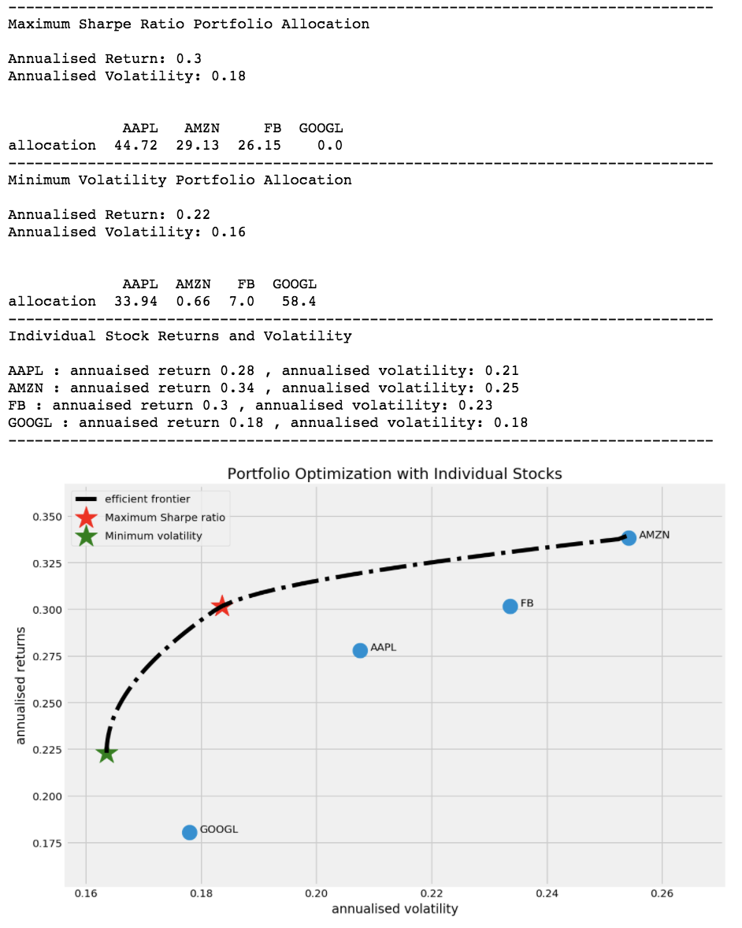
As you can see from the above plot, the stock with the least risk is Google at around 0.18. But with portfolio optimisation, we can achieve even lower risk at 0.16, and still with a higher return than Google. And if we are willing to take slightly more risk at around the similar level of risk of Google, we can achieve a much higher return of 0.30 with portfolio optimisation.
Considering how vast and the deep the finance field is, I’ve probably only scratched the surface. But I had fun going through coding and trying to understand the concept. And I’m learning every day. After finishing this implementation, I definitely know better than yesterday’s me. And if I keep on going and learning, in about a couple of year’s time, I will know a whole lot more than today’s me. If you have any comments or questions, feel free to leave a comment. Any feedback would be appreciated.
https://towardsdatascience.com/efficient-frontier-portfolio-optimisation-in-python-e7844051e7f

Slide 25
Case -4 Modeling and optimization of a weekly workforce with Python and Pyomo
Step-by-step modeling and optimization of a workforce design and assignation problem using Python and Pyomo.
In this post, we will go through the modeling and solution finding of a scheduling problem where workers have to be assigned to shifts to optimize given criteria, satisfying diverse imposed constraints to the working conditions.
When starting a new project, planning to open a new store or even preparing the schedule for the classes at the university, the person in charge of the task has two options: solving it by hand or modeling and solving it as an optimization problem.
Even if there was a great workforce planner, dealing with the problem using the optimization framework can have multiple benefits:
Scaling: the problem might become as big as the proper environment, which may exceed the capabilities of a person.
Unbalances: there are lots of situations where unbalances among staff will be unavoidable. In this case, the decision will not be personal.
Pyomo as optimization modeling environment
To solve this problem we will make use of Pyomo, in their own words a “Python-based, open-source optimization modeling language with a diverse set of optimization capabilities”. For the ones that already use Python, modeling and solving a problem with Pyomo would be straightforward.
Pyomo allows to choosing among a variety of solvers, both open-source and commercial. Moreover, the user can choose to solve problems in Neos Server, a free internet-based solver which can be used directly from Pyomo
Problem description
A new food store has been opened at the University Campus which will be open 24 hours a day, 7 days a week. Each day, there are three eight-hour shifts. Morning shift is from 6:00 to 14:00, evening shift is from 14:00 to 22:00 and night shift is from 22:00 to 6:00 of the next day.
During the night there is only one worker while during the day there are two, except on Sunday that there is only one for each shift. Each worker will not exceed a maximum of 40 hours per week and have to rest for 12 hours between two shifts.
As for the weekly rest days, an employee who rests one Sunday will also prefer to do the same that Saturday.
In principle, there are available ten employees, which is clearly over-sized. The less the workers are needed, the more the resources for other stores.
Model formulation
To use Pyomo and solve the problem some packages are imported.
from pyomo.environ import *
from pyomo.opt import SolverFactory
The first step is to enter the data, this means to provide the model, in this case, the days we are considering, workers, shifts… We could not define them explicitly and feed the data later by using AbstractModel(), but for this post continue with ConcreteModel() so all data must be available during the modeling step.
#Define days (1 week)
days = ['Mon','Tue', 'Wed','Thu','Fri', 'Sat','Sun']
#Enter shifts of each day
shifts = ['morning','evening', 'night'] # 3 shits for 8hours
days_shifts = {day: shifts for day in days} # dict with day as key and list of its shits as values
#Enter workers ids (name, number)
workers = ['w' + str(i) for i in range(1,11)] # 10 workers available more than needed
https://towardsdatascience.com/modeling-and-optimization-of-a-weekly-workforce-with-python-and-pyomo-29484ba065bb

Slide 26
Case -4 Modeling and optimization of a weekly workforce with Python and Pyomo
We have added all data needed for the model. We will be able to call these elements when defining constraints, without the need of manually inserting each element or considering if, else clauses.
To build the model, we need to initialize the model and create the decision variables.
The objective is to find a schedule that minimizes the number of workers and once this is achieved, also the number of workers that work on Sundays but not on Saturdays. We multiplied the part of the number of workers by a constant big enough so that minimizing the weekend preference is considered only after deciding the optimal number of workers.
We also need to add the constraints, creating first a container of constraints calling ConstraintList() and then adding whatever constraints we want to the container with the function add. Code for the constraints is the following, with the explanation of each one as inline comments:
#Initialize model
model = ConcreteModel()
#Binary variables representing if a worker is scheduled somewhere
model.works = Var(((worker, day, shift) for worker in workers for day in days for shift in days_shifts[day]),within=Binary, initialize =0)
After the initialization of the model as an object, elements such as variables constraints and objective function are added as attributes. As it was explained before, we create a ConcreteModel() because data is being provided at the moment. We add with Var() variables to the model, indexed by lists.
works: binary variable indexed by workers, days and shifts. 1 if the worker has to work that day on that shift.
needed: binary variable indexed by workers. 1 if the worker is necessary to include in the workforce.
no_pref: binary variable indexed by workers. 1 if it does not work on Sunday but it does on Saturday.
#Objective function
#Define an objective fucntion with model as input to pass later
def obj_rule(m):
c = len(workers)
return sum(m.no_prefer[worker] for worker in workers) + sum(c*m.needed[worker] for worker in workers)
# we multiply the second term by a constant to make sure that it is the primary objective
# since sum(m.no_prefer) is at most len(workers), len(workers) + 1 is a valid constant.
# add objective function to the model. rule (pass function) or expr (pass expression directly)
model.obj = Objective(rule = obj_rule, sense = minimize)
https://towardsdatascience.com/modeling-and-optimization-of-a-weekly-workforce-with-python-and-pyomo-29484ba065bb

Slide 27
Case -5 Portfolio Optimization Using Monte Carlo Simulation
By portfolio optimization, we mean getting a portfolio that meets any of the three conditions based on the investor’s requirements.
Conditions of Portfolio Optimization
A portfolio which has the minimum risk for the desired level of expected return.
A portfolio which gives the maximum expected return at the desired level of risk (risk as measured in terms of standard deviation or variance).
A portfolio which has the maximum return to risk ratio (or Sharpe ratio).
What is Sharpe Ratio?
Sharpe ratio is a measure for calculating risk-adjusted return. It is the ratio of the excess expected return of investment (over risk-free rate) per unit of volatility or standard deviation.
Let us see the formula for Sharpe ratio which will make things much clearer. The sharpe ratio calculation is done in the following manner
Sharpe Ratio = (Rx – Rf) / StdDev(x)
Where,
x is the investment
Rx is the average rate of return of x
Rf is the risk-free rate of return
StdDev(x) is the standard deviation of Rx
the Sharpe ratio helps us in identifying which strategy gives better returns in comparison to the volatility. There, that is all when it comes to sharpe ratio calculation.
Limitations of Sharpe ratio
There are several limitations with the usage of Sharpe Ratio, due to certain assumptions and the way it has been defined. Some of the important limitations have been listed below:
The calculation of Sharpe ratio pivots on the assumption that returns are normally distributed, but in real market scenarios, the distribution might suffer from kurtosis and fatter tails, which decreases the relevance of its use.
Sharpe ratio cannot differentiate between intermittent and consecutive losses as the risk measure is independent of the order of various data points. Thus, while it is good for long term analysis, it might be counterproductive if we decide on a portfolio which has a significant share of stocks which are losing value in the past few trading periods.
Another notable drawback of Sharpe ratio is that it cannot distinguish between upside and downside and focuses on volatility but not its direction. The ratio would penalize a system which exhibited sporadic sharp increases in equity, even if equity retracements were small.
As with most parameters, Sharpe ratios is backwards-looking and accounts for historical returns and volatility. The decisions based on the ratio assume future performance will be similar to the past.
It can be manipulated by individuals to present their best side. If the three-year Sharpe ratio of a portfolio does not present an interesting proposition, the fund manager could, in theory, calculate a 5 year time period knowing that the portfolio had performed well before.
Sharpe ratio vs Sortino ratio
 | Portfolio A | Portfolio B
Rate of return | 11 | 8
Risk-free rate of return | 3 | 3
Volatility | 8 | 4
Sharpe Ratio | (11-3)/8 = 1 | (8-3)/4 = 1.25
At a portfolio of stocks and going long at all of them, you would not account for the deviation of the returns above the expected return of the portfolio when you are trying to find the risk. If your expected return is 10%, the returns of 15% is not a risk which we shouldn’t account for when we calculate the standard deviation. The fact that we factor in only the times the price goes downwards, means we are only taking into account the downside risk.
Thus, according to the Sharpe Ratio calculation, we should consider Portfolio B because even though the expected return is less than portfolio B, the volatility of portfolio B is less than portfolio A and thus, is less risky.
https://blog.quantinsti.com/portfolio-optimization-maximum-return-risk-ratio-python/

Slide 28
Case -5 Portfolio Optimization Using Monte Carlo Simulation
While calculating the standard deviation for the Sortino ratio, we take into account the downside risk only and thus, get a clearer picture than the Sharpe ratio.
For example, if we take into account the above example and after calculating the downside deviation only, we see that the downside deviation in Portfolio A is only 2% while of portfolio B is the same ie 4, we will get the following updated table:
Annual Returns and Standard Deviation
To simplify our analysis in this blog, we will deal with daily returns and standard deviation and will consider only 1 month of stock data (Dec 2017). However, in practice, we work with annual returns and standard deviation. The formulae for converting daily returns and standard deviation to an annual basis are as shown (assuming 252 trading days in a year):
Annual Return = Daily Return * 252 Annual Standard Deviation = Daily Standard Deviation * 252
Let us consider a portfolio consisting of four stocks in banking/financial services sector, namely: SBIN.BO,ITC.NS,ICICIBANK.NS,HDFCBANK.NS.
we’ll assign random weights to all four stocks, keeping the sum of the weights to be 1. We will compute the return and standard deviation of the portfolio. We will then run Monte Carlo Simulations on our portfolio to get the optimal weights for the stocks
Mante Carlo
Monte Carlo (MC) simulations are models used to model the probability of complex events by compiling thousands - millions of various outcomes with a pre-determined ‘random’ (changing) variable. Essentially you run 10k iterations with random values for a speciﬁc variable, in hopes of ﬁnding an optimum value or determining a range of possible outcomes — i.e. using randomness to solve a complex problem. A simple example is modelling the Maximum Sharpe Ratio of a Portfolio, based on ‘random’ security weights
The other more common scenario is using Monte Carlo simulations to determine the probability of outcomes — for example % Risk of Ruin with a portfolio, given its return characteristics (Mean, Std), and initial balance. This is where Monte Carlo simulations have applications in virtually every ﬁeld from Finance and Engineering to Logistics or Social Sciences. Many common metrics such as VaR and CVaR (Conditional Value at Risk) are derived at their core from Monte Carlo simulations, and have proven to be a valuable tool in a Quant’s toolkit.
The number of iterations depends on the error that the trader is willing to accept. Higher the number of iterations, higher will be the accuracy of the optimization but at the cost of computation and time. For the purpose of this blog, we will restrict ourselves to 10000 such iterations. Out of these 10000 results for returns and corresponding standard deviation, we can then achieve portfolio optimization by identifying a portfolio that satisfies on any of the 3 conditions discussed above.
 | Portfolio A | Portfolio B
Rate of return | 11 | 8
Risk-free rate of return | 3 | 3
Volatility | 8 | 4
Sharpe Ratio | (11-3)/8 = 1 | (8-3)/4 = 1.25
Downside risk | 2 | 4
Sortino Ratio | (11-3)/2 = 4 | (8-3)/4 = 1.25
Thus, we now realize that Portfolio A is a better investment than Portfolio B.
As you have seen above, the Sortino ratio can be written as:
Sortino Ratio: (Rx – Rf) / StdDev(d)
Where,
x is the investment
Rx is the average rate of return of x
Rf is the risk-free rate of return
StdDev(d) is the standard deviation of the downside.
Thus, in this manner, the Sortino ratio overcomes some of the limitations of the Sharpe ratio and is comparatively better for the investors or fund managers.
https://blog.quantinsti.com/portfolio-optimization-maximum-return-risk-ratio-python/

Slide 29
Case -5 Portfolio Optimization Using Monte Carlo Simulation
import pandas as pd
import numpy as np
import pandas_datareader.data as web
import matplotlib.pyplot as plt
##Fetch data from yahoo and save under dataframe
stock = ['SBIN.BO','ITC.NS','ICICIBANK.NS','HDFCBANK.NS']
data = web.DataReader(stock, data_source = "yahoo",
start = '2018-01-01', end = '2020-03-31')['Adj Close']
##Arrange the data in ascending order
data = data.iloc[::-1]
print(data.round(2))
##compute stock returns and print the reutns in percentage
stock_ret = data.pct_change()
print(stock_ret.round(4)*100)
##Covariance matrix
mean_returns = stock_ret.mean()
cov_matrix = stock_ret.cov()
print(mean_returns)
print(cov_matrix)
##Set the number of iterations to 10000 and define an array to hold the simulation
num_iterations = 10000
simulation_res = np.zeros((4+len(stock)-1, num_iterations))
for i in range(num_iterations):
#select random weights and normalize to set the sum to a
weights = np.array(np.random.random(4))
weights /= np.sum(weights)
#calculate the return and standard deviation for every step
portfolio_return = np.sum(mean_returns * weights)
portfolio_std_dev = np.sqrt(np.dot(weights.T, np.dot(cov_matrix, weights)))
#store all results in defined array
simulation_res[0,i] = simulation_res[0,i]/simulation_res[1,i]
#Save the weights in the array
for j in range(len(weights)):
simulation_res[j+3,i] = weights[j]
##save
sim_frame = pd.DataFrame(simulation_res.T, columns = ['ret','stdev','sharpe',
stock[0],stock[1],stock[2],stock[3]])
print(sim_frame.head(5))
print(sim_frame.tail(5))
SBIN.BO 0.001102
ITC.NS 0.000861
ICICIBANK.NS 0.000139
HDFCBANK.NS 0.000222
ret stdev sharpe SBIN.BO ITC.NS ICICIBANK.NS HDFCBANK.NS
0 NaN 0.0 0.0 0.171190 0.178914 0.474133 0.175762
1 NaN 0.0 0.0 0.113587 0.258552 0.344798 0.283063
2 NaN 0.0 0.0 0.169238 0.223616 0.358852 0.248294
3 NaN 0.0 0.0 0.208628 0.349339 0.379196 0.062837
4 NaN 0.0 0.0 0.202881 0.259205 0.249191 0.288723
Symbols SBIN.BO ITC.NS ICICIBANK.NS HDFCBANK.NS
SBIN.BO 0.000596 0.000204 0.000366 0.000185
ITC.NS 0.000204 0.000325 0.000178 0.000138
ICICIBANK.NS 0.000366 0.000178 0.000518 0.000195
HDFCBANK.NS 0.000185 0.000138 0.000195 0.000260
ret stdev sharpe SBIN.BO ITC.NS ICICIBANK.NS HDFCBANK.NS
9995 NaN 0.0 0.0 0.103232 0.638864 0.237536 0.020368
9996 NaN 0.0 0.0 0.352636 0.331993 0.025636 0.289735
9997 NaN 0.0 0.0 0.086482 0.779649 0.037137 0.096733
9998 NaN 0.0 0.0 0.188992 0.298494 0.385687 0.126828
9999 NaN 0.0 0.0 0.412627 0.378231 0.067846 0.141295
The array will hold the returns, standard deviation, Sharpe ratio and weights for each step in the iteration. We will define one result array initially containing all zeroes and will save the simulation results in this array. The number of columns in the array is 7 to hold portfolio return, standard deviation, Sharpe Ratio and the weights of all stocks. The number of columns will change with the number of stocks in the portfolio as we have to store the weights for all the stocks. That's why we use the 'len function' while defining the array. The number of rows in the array is equal to the number of iterations
The above output shows some rows of the simulation results. We can now compute the portfolios having maximum Sharpe ratio or minimum risk.
https://blog.quantinsti.com/portfolio-optimization-maximum-return-risk-ratio-python/

Slide 30
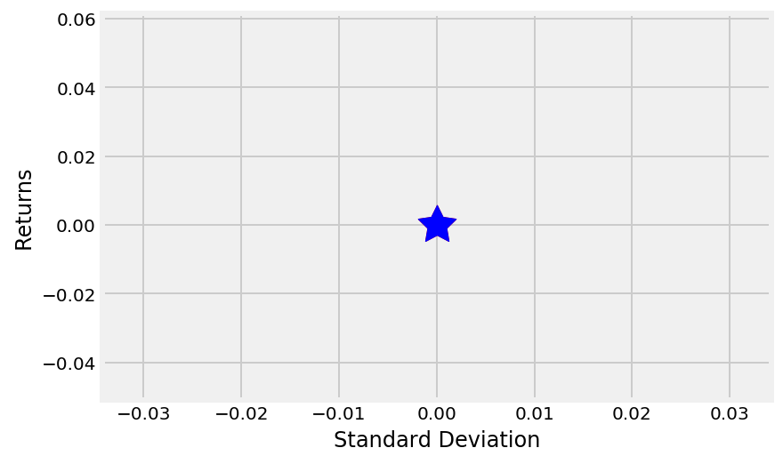
Case -5 Portfolio Optimization Using Monte Carlo Simulation
#Spot the position of the portfolio with highest sharpe ratio
max_sharpe = sim_frame.iloc[sim_frame['sharpe'].idxmax()]
#Spot the position of the portfolio with minimu standard deviation
min_std = sim_frame.iloc[sim_frame['stdev'].idxmin()]
print("The portfolio for max Sharpe Ratio:\n", max_sharpe)
print("The portfolio for min_std risk:\n", min_std)
The portfolio for max Sharpe Ratio:
ret NaN
stdev 0.000000
sharpe 0.000000
SBIN.BO 0.171190
ITC.NS 0.178914
ICICIBANK.NS 0.474133
HDFCBANK.NS 0.175762
The portfolio for min_std risk:
NaN
0.000000
0.000000
0.171190
0.178914
0.474133
0.175762
From the above curve, we can get the composition for the required optimal portfolio based on any of the three conditions as discussed above. We can select the portfolio with maximum return for a given risk or a portfolio with minimum risk for a given return or we can simply select the portfolio with maximum Sharpe ratio.
we first downloaded the stock price data for one month and computed the mean return of all the stocks and the covariance matrix (which is used in computing the standard deviation of the portfolio). We then ran a Monte Carlo Simulation to compute the risk and return of the portfolio by randomly selecting the weights of the portfolio. We then identify the optimal portfolio based on the Sharpe ratio or other conditions
##SCatter plot coloured by various sharpe ratio with stddev
plt.scatter(sim_frame.stdev, sim_frame.ret, c = sim_frame.sharpe, cmap = 'RdYlBu')
plt.xlabel('Standard Deviation')
plt.ylabel('Returns')
#plt.ylim(0,0.003)
#plt.xlim(0.0075,0.03)
#Plot a red star to highlight position of the portfolio with highest sharpe Ratio
plt.scatter(max_sharpe[1],max_sharpe[1],marker=(5,1,0),color='r',s=600)
#Plot a blue star to highlight position of the portfolio with minimum Variance
plt.scatter(min_std[1],min_std[1],marker=(5,1,0),color='b',s=600)
plt.show()
In the output, the red star shows the portfolio with the maximum Sharpe ratio and the blue star depicts the point with the minimum standard deviation.
https://blog.quantinsti.com/portfolio-optimization-maximum-return-risk-ratio-python/

Slide 31
Case -6 Efficient Frontier & Portfolio Optimization with Python
import pandas as pd
import numpy as np
import pandas_datareader.data as web
import matplotlib.pyplot as plt
import os
##Fetch data from yahoo and save under dataframe
select = ['CNP', 'F', 'WMT', 'GE','TSLA']
#select = ['SBIN.BO','ITC.NS','ICICIBANK.NS','HDFCBANK.NS','IRCTC.NS']
data = web.DataReader(select, data_source = "yahoo",
start = '2014-1-1', end = '2016-12-31')['Adj Close']
table = data
#Calculate daily and annual returns of the stocks
returns_daily = data.pct_change()
returns_annual = returns_daily.mean() * 250
##Get daily and covraince of returns of the stock
cov_daily = returns_daily.cov()
cov_annual = cov_daily * 250
##Empty lists to store returns, volatility and weights of imiginary portfolios
port_returns = []
port_volatility = []
sharpe_ratio = []
stock_weights = []
##set the number of combinations for imaginary portfolios
num_assets = len(select)
num_portfolios = 50000
##set random seed for reproduction's sake
np.random.seed(101)
#Populate the empty lists with each portfolios returns, risk and weights
for single_portfolio in range(num_portfolios):
weights = np.random.random(num_assets)
weights /= np.sum(weights)
returns = np.dot(weights, returns_annual)
volatility = np.sqrt(np.dot(weights.T,np.dot(cov_annual, weights)))
sharpe = returns / volatility
sharpe_ratio.append(sharpe)
port_returns.append(returns)
port_volatility.append(volatility)
stock_weights.append(weights)
##a dictionary for returns and Risk values of each portfolio
portfolio = {'Returns' : port_returns,
'Volatility' : port_volatility,
'Sharpe Ratio' : sharpe_ratio}
##extend original dictionary to accommodate each ticker and weights in in the portfolio
for counter, symbol in enumerate(select):
portfolio[symbol + ' Weight'] = [Weight[counter] for Weight in stock_weights]
# make a nice dataframe of the extended dictionary
df = pd.DataFrame(portfolio)
##Get better labels for desired arrangement of columns
column_order = ['Returns','Volatility','Sharpe Ratio'] + [stock + ' Weight' for stock in select]
##reorder dataframe columns
df = df[column_order]
https://medium.com/python-data/efficient-frontier-portfolio-optimization-with-python-part-2-2-2fe23413ad94

Slide 32
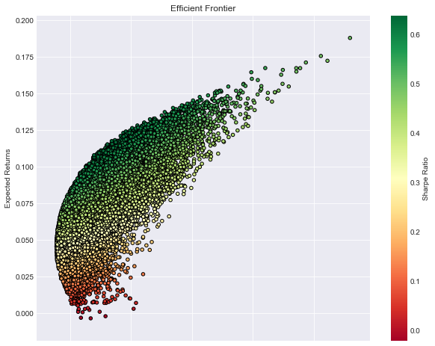
Case -6 Efficient Frontier & Portfolio Optimization with Python
#Plot frontier max sharpe * min volatility values with a scatterplot
plt.style.use('seaborn-dark')
df.plot.scatter(x='Volatility', y = 'Returns', c = 'Sharpe Ratio',
cmap = 'RdYlGn', edgecolors = 'black', figsize = (10,8), grid = True)
plt.xlabel('Volatility (Std. Deviation)')
plt.ylabel('Expected Returns')
plt.title('Efficient Frontier')
plt.show()
An Efficient Frontier with a highlight of the optimal (as per the risk-adjusted return metric) portfolio and a portfolio with the minimum volatility.
##Plot frontier max sharpe & min volatility values with a scatterplot
plt.style.use('seaborn-dark')
df.plot.scatter(x='Volatility', y='Returns', c='Sharpe Ratio',
cmap='RdYlGn', edgecolors='black', figsize=(10, 8), grid=True)
plt.scatter(x= sharpe_portfolio['Volatility'], y = sharpe_portfolio['Returns'], c = 'red', marker = 'D', s=200)
plt.scatter(x = min_variance_port['Volatility'], y = min_variance_port['Returns', c ='blue', markder = 'D', s= 200)
plt.xlabel('Volatility (Std. Deviation)')
plt.ylabel('Expected Returns')
plt.title('Efficient Frontier')
plt.show()
###
print(min_variance_port.T)
print(sharpe_portfolio.T)
let’s try to locate the optimal portfolio and another portfolio with the minimum volatility for the most risk-averse investor out there:
##find min Volatility and max sharpe value in the dataframe
min_volatility = df['Volatility'].min()
max_sharpe = df['Sharpe Ratio'].max()
##Use the min, max values to locate and create the two special portfolio
sharpe_portfolio = df.loc[df['Sharpe Ratio'] == max_sharpe]
min_variance_port = df.loc[df['Volatility'] == min_volatility]
https://medium.com/python-data/efficient-frontier-portfolio-optimization-with-python-part-2-2-2fe23413ad94

Slide 33
Case -6 Efficient Frontier & Portfolio Optimization with Python
 | min_variance_port | sharpe_portfolio
Returns | 0.0455 | 0.11527
Volatility | 0.1386 | 0.18052
Sharpe Ratio | 0.3288 | 0.63851
CNP Weight | 0.2342 | 0.42241
F Weight | 0.107 | 0.00048
WMT Weight | 0.3697 | 0.00554
GE Weight | 0.2833 | 0.33354
TSLA Weight | 0.0055 | 0.23801
The most risk-averse investor would construct the minimum variance portfolio which has an expected return of 4.58% with an accompanying expected volatility of 13.86%.
Investors seeking the maximum risk-adjusted return would opt for portfolio that with the maximum Sharpe Ratio which has an expected return of 11.61% with expected volatility pegged at 17.50%
https://medium.com/python-data/efficient-frontier-portfolio-optimization-with-python-part-2-2-2fe23413ad94

Slide 34
Reference
Stock Market
https://www.kdnuggets.com/2019/06/optimization-python-money-risk.html
https://www.datacamp.com/community/tutorials/finance-python-trading
https://towardsdatascience.com/optimizing-portfolios-with-modern-portfolio-theory-using-python-60ce9a597808
https://towardsdatascience.com/linear-programming-and-discrete-optimization-with-python-using-pulp-449f3c5f6e99
https://towardsdatascience.com/efficient-frontier-portfolio-optimisation-in-python-e7844051e7f
http://www.bradfordlynch.com/blog/2015/12/04/InvestmentPortfolioOptimization.html
##Formula
https://www.financewalk.com/sharpe-ratio-excel-formula-example/
https://corporatefinanceinstitute.com/resources/templates/excel-modeling/sharpe-ratio-calculator/
http://investexcel.net/calculate-the-sortino-ratio-with-excel/
https://xplaind.com/262577/sortino-ratio
https://www.mlq.ai/python-for-finance-portfolio-optimization/
https://blog.quantinsti.com/portfolio-management-strategy-python/
https://blog.quantinsti.com/portfolio-optimization-maximum-return-risk-ratio-python/
https://medium.com/python-data/efficient-frontier-portfolio-optimization-with-python-part-2-2-2fe23413ad94
#Resource optimization
https://towardsdatascience.com/scheduling-with-ease-cost-optimization-tutorial-for-python-c05a5910ee0d
https://developers.google.com/optimization/scheduling/employee_scheduling
https://towardsdatascience.com/optimization-with-scipy-and-application-ideas-to-machine-learning-81d39c7938b8
https://towardsdatascience.com/modeling-and-optimization-of-a-weekly-workforce-with-python-and-pyomo-29484ba065bb
https://www.analyticsvidhya.com/blog/2017/10/linear-optimization-in-python/

