Slide 1
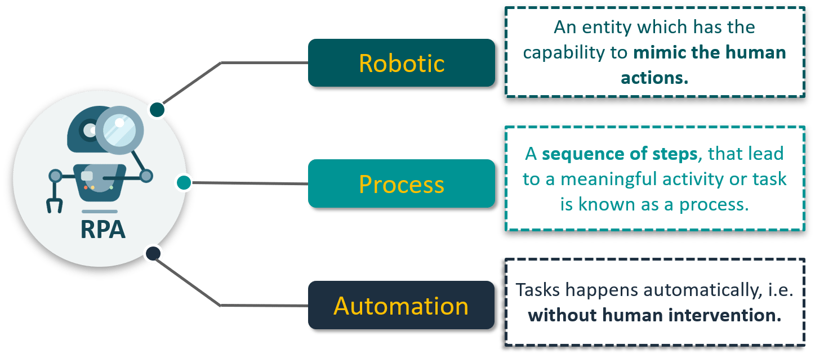
RPA (Robotic Process Automation)
What is Robotic Process Automation?

Slide 2
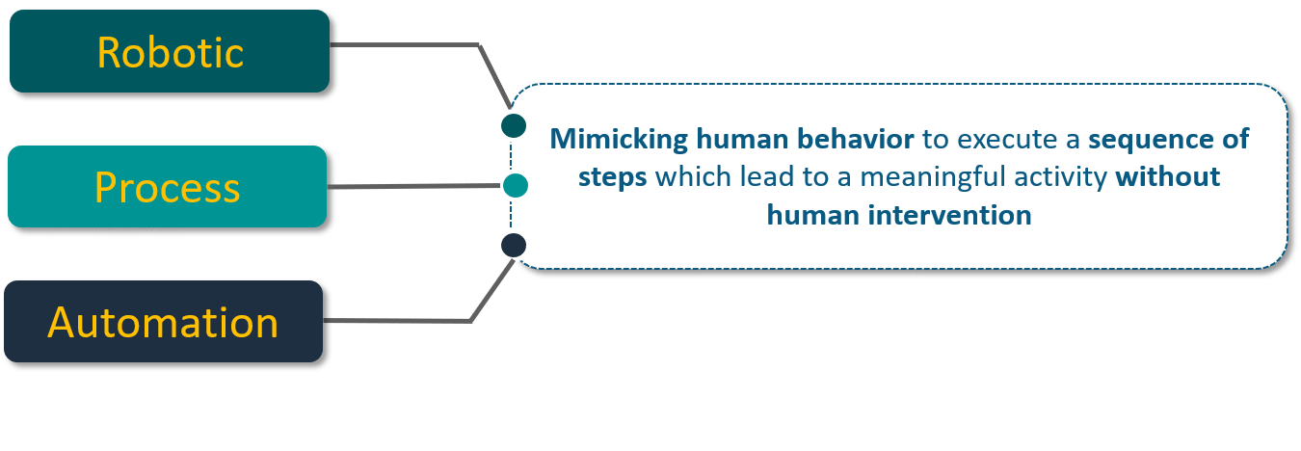
Robotic Process Automation
Summarizing all these terms together:

Slide 3
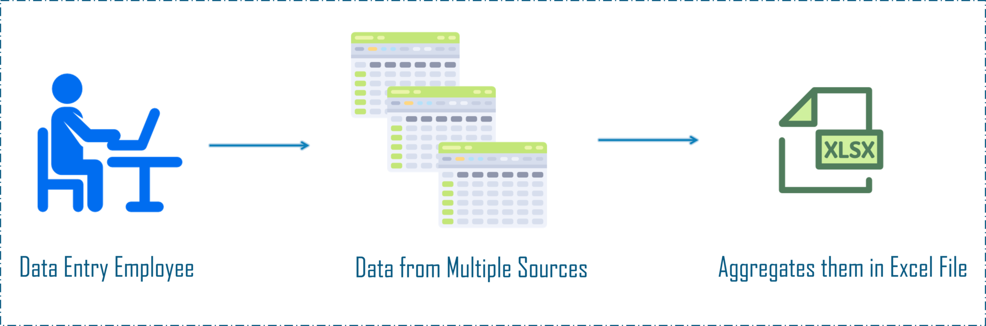
Why Robotic Process Automation?
Consider a scenario where a person’s job is to collect data from multiple sources and then aggregate them in an Excel file. Refer to the below image.

Slide 4




Why Robotic Process Automation?
Now, do you think :
This person should do this job on a daily basis or
Instead automate this task to use his talents in a better way?
Obviously, the second option sounds better.
So, a person can just automate this task of collecting data from various sources and aggregating them into a single file by using Robotic Process Automation.

Slide 5
Tools for RPA
There are various tools available for RPA; however, following are some most popular robotic process automation tools −
UiPath - https://www.uipath.com
Blue Prism - https://www.blueprism.com
Automation Anywhere - https://www.automationanywhere.com
WorkFusion - https://www.workfusion.com
The most popular tool for automation i.e. UiPath

Slide 6
What is UiPath?
UiPath is a Robotic Process Automation tool.
It is used to automate repetitive/redundant tasks and eliminates human intervention
The tool is simple to use and has a drag and drop functionality of activities.
UiPath has a standard Studio version which has a trial period of 60 days.
The best part is, UiPath also comes with a Community Edition which is free for lifetime and has most of the functionality of the Studio version.

Slide 7
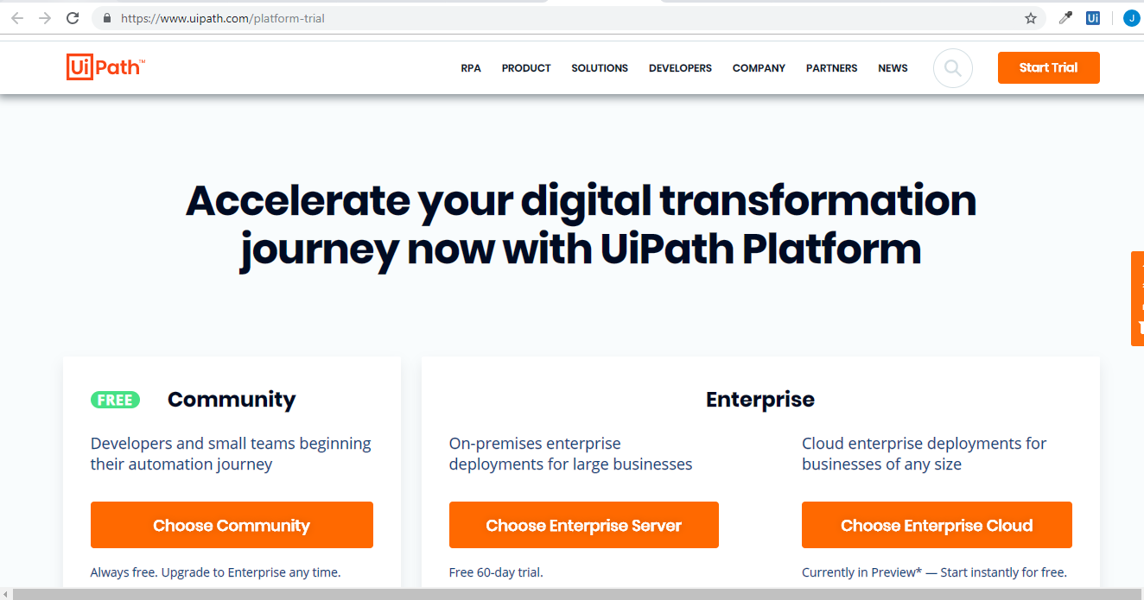
Steps to install UiPath Studio
Step 1 − First to install UiPath, follow the link https://www.uipath.com/platform-trial and click on “Choose Community Edition”.

Slide 8
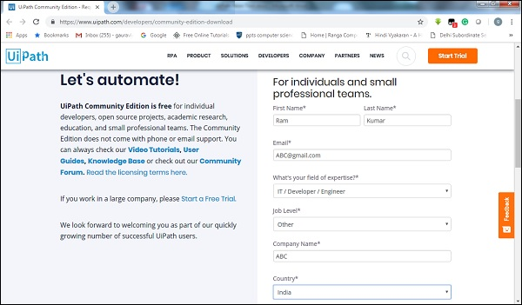
Steps to install UiPath Studio
Step 2 − Next, we need to fill the credentials in the form.

Slide 9
Steps to install UiPath Studio
Step 3: Now, open your registered email to get the instructions to download UiPath.

Slide 10
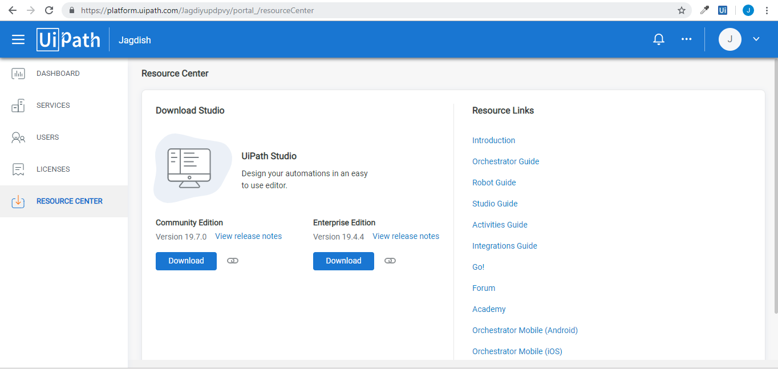
Steps to install UiPath Studio
Step 4: Login to portal with your login detail (https://platform.uipath.com) and download the UiPath Studio from menu “Resource Center” and install the UiPathStudio.exe file.

Slide 11
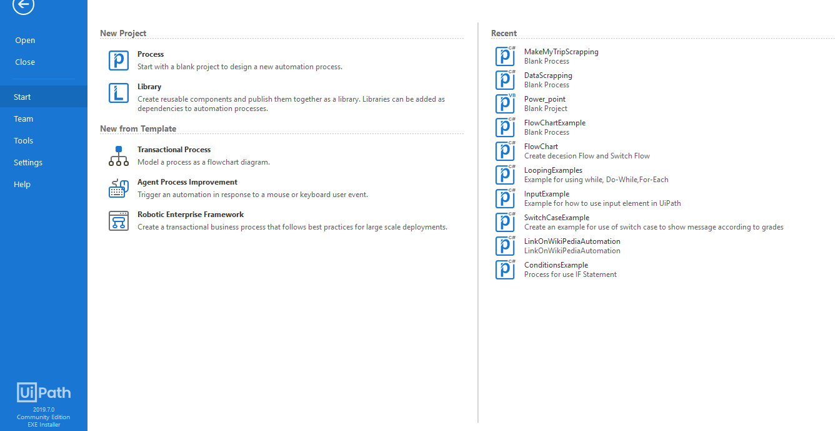
Steps to install UiPath Studio
This is how it looks like after opening the UiPath Studio

Slide 12
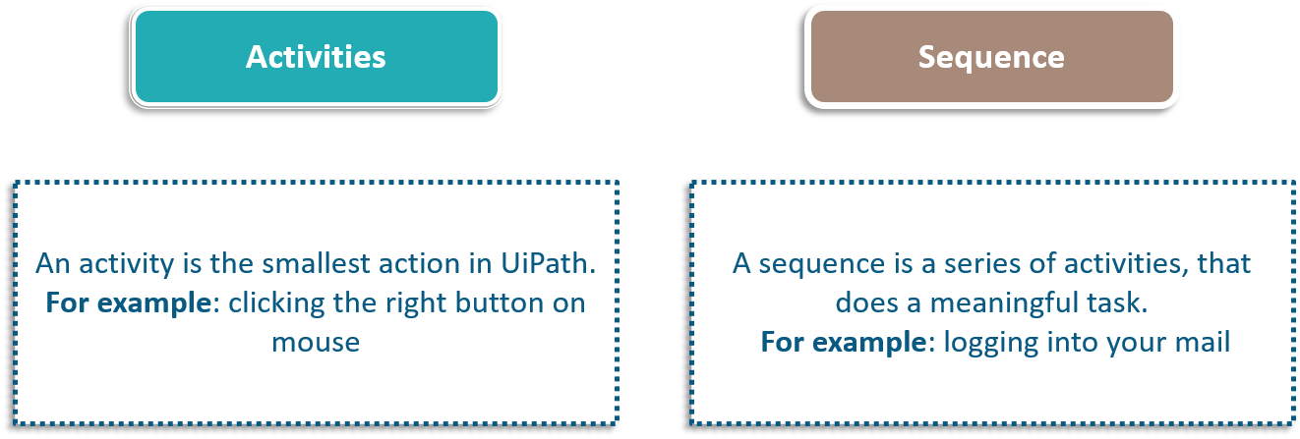
Important Concepts in UiPath Studio
Let’s discuss some of the important terms/concepts in UiPath i.e. Sequence and Activities.

Slide 13
UiPath Components
Before creating projects let us understand the various components of UiPath platform
UiPath is generally divided into 2 components:
UiPath Platform Components
UiPath Studio Components
UiPath Platform Components
UiPath Platform consists of three main components:
UiPath Studio
UiPath Robot
UiPath Orchestrator

Slide 14
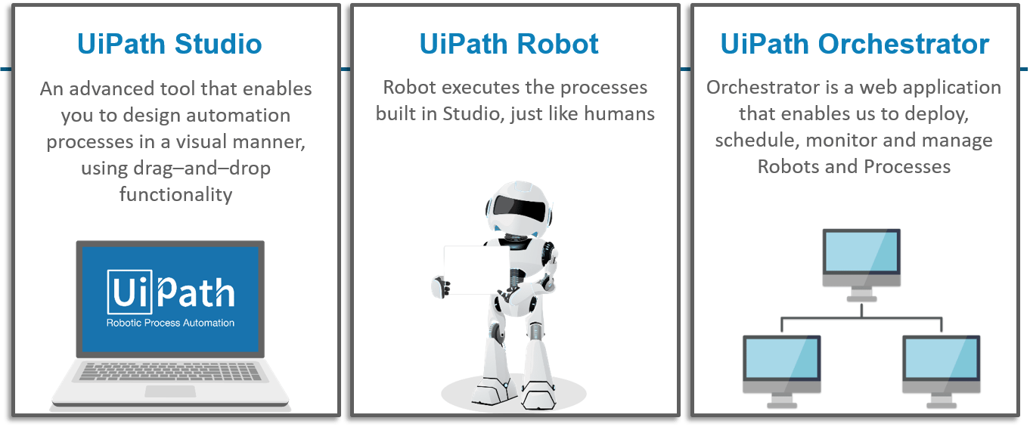
UiPath Platform Components

Slide 15
UiPath Studio Components
UiPath Studio Components :
Ribbon
Activity Pane
Properties Pane
Control Bar/Pane

Slide 16
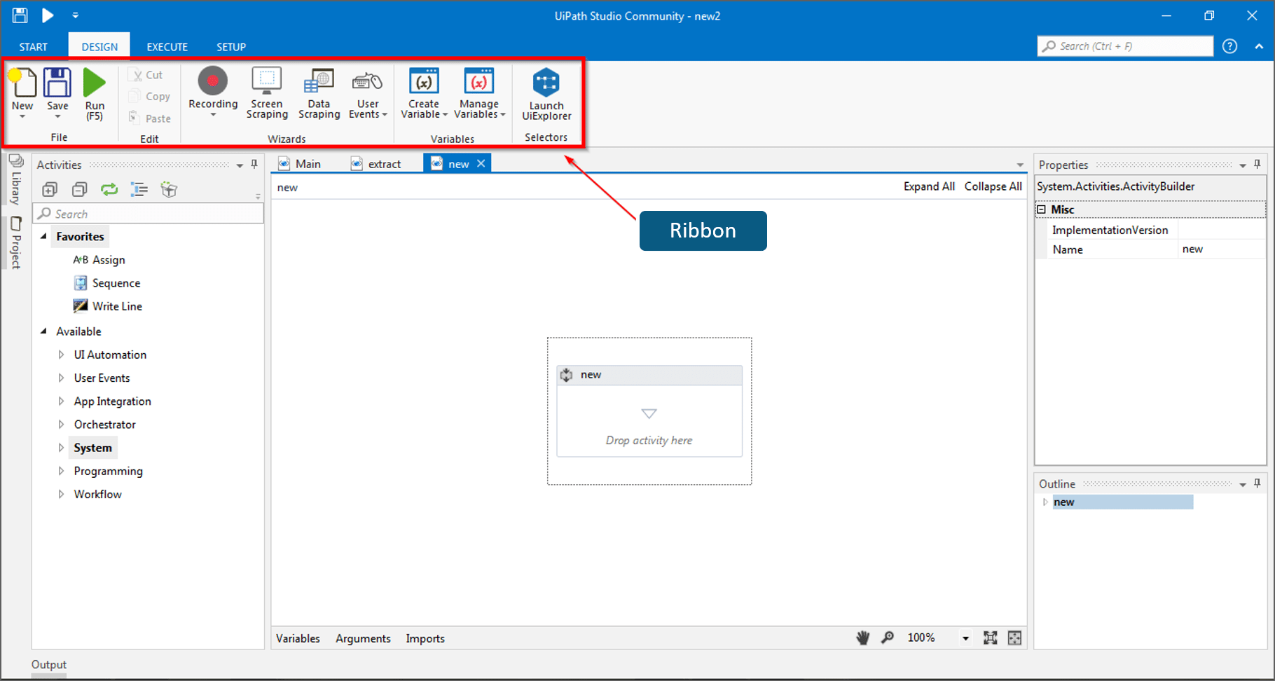
Ribbon

Slide 17
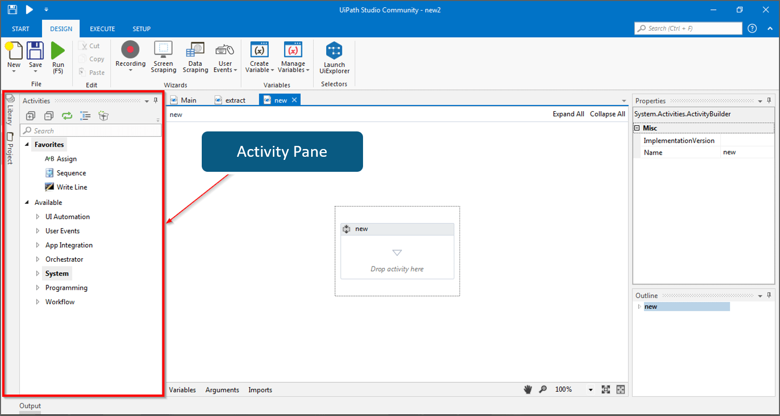
Activity Pane

Slide 18
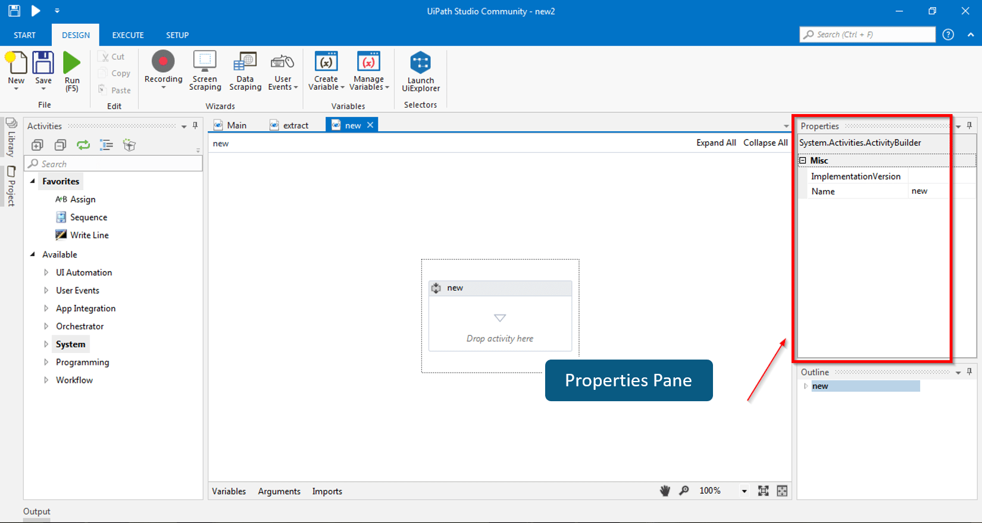
Properties Pane

Slide 19
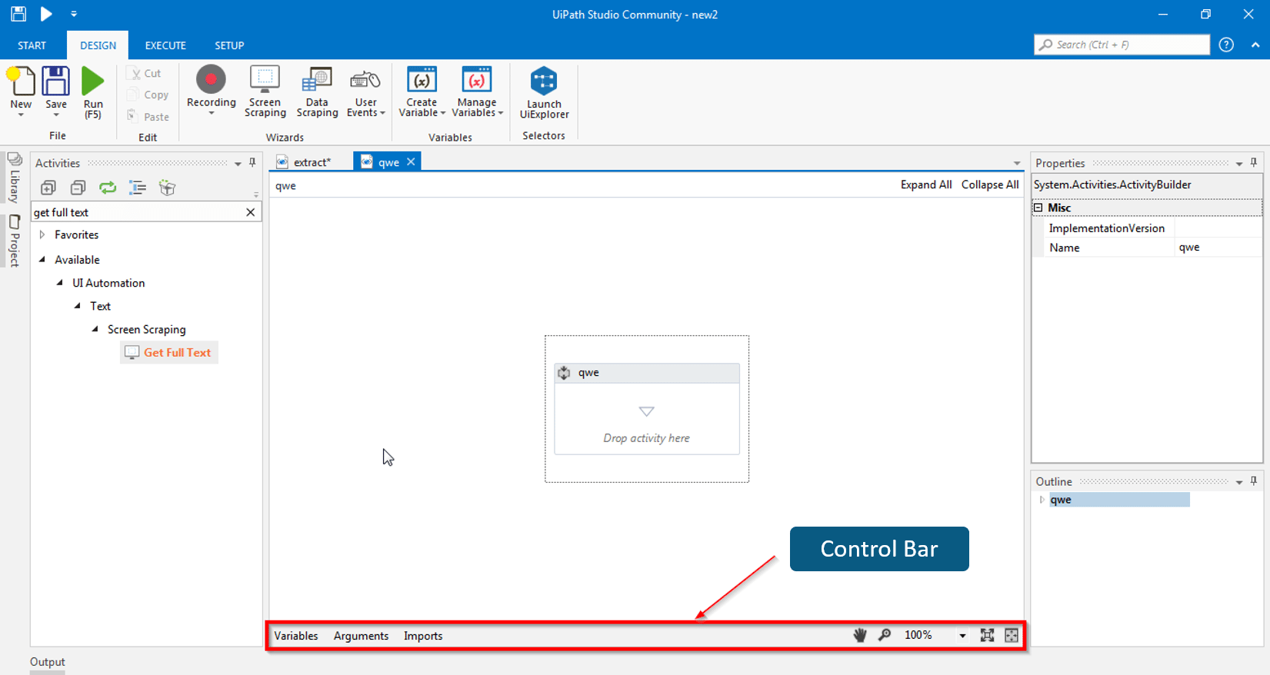
Control Bar/Pane

Slide 20
What you’ll learn
UIPath Introductions , Basics
Sequence, Variables, Datatypes
Conditions
Understanding Switch Condition
User Input
Loops
Flowchart
UIPath Studio
UIPath Robot
UIPath Orchestrator
Email, Excel, Word, PDF, Application, Websites Automation
Data Entry and Data Scraping
EMail Automation

Slide 21
References
https://studio.uipath.com/docs/introduction
https://www.tutorialspoint.com/uipath/
https://www.guru99.com/robotic-process-automation-tutorial.html#9
https://www.uipath.com/blog/learning-robotic-process-automation-through-video-tutorials
https://intellipaat.com/tutorial/rpa-tutorial/robotic-process-automation-introduction/

Slide 22
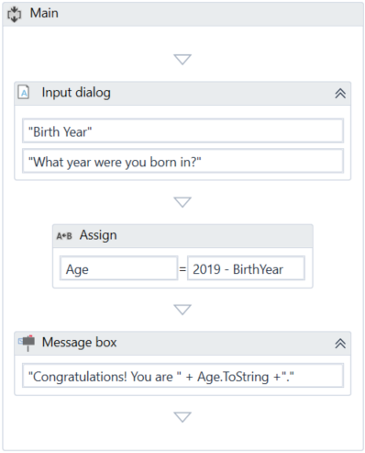
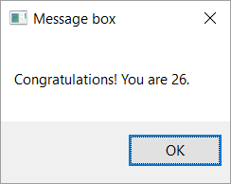
Example of Using a Number Variable
Create an automation that asks the user for the year in which he or she was born and displays the age in a window.
Project should look as in the following screenshot.

Slide 23
Example of Using a Number Variable
Steps:
Create a new sequence.
Create two Int32 variables, BirthYear and Age. The first stores the user’s birth year and the second, the user’s age.
Add an Input Dialog activity to the sequence.
In the Properties window, type an appropriate title and label
In the Result field, add the BirthYear variable.
Add an Assign activity under the Input Dialog.
In the Properties panel, in the To field, add the Age variable

Slide 24
Example of Using a Number Variable
Steps:
8. In the Value field, type 2019 – BirthYear. This assigns the value of the subtraction (2019 minus the user’s birth year) to the Age variable
9. Add a Message Box activity under the Assign one.
10. In the Properties panel, in the Text field, type "Congratulations! You are " + Age.ToString + ".".
11. Press F5. The automation is executed. Message Box displays your age, as expected.

