Slide 1

Jenkins Plugins

Slide 2
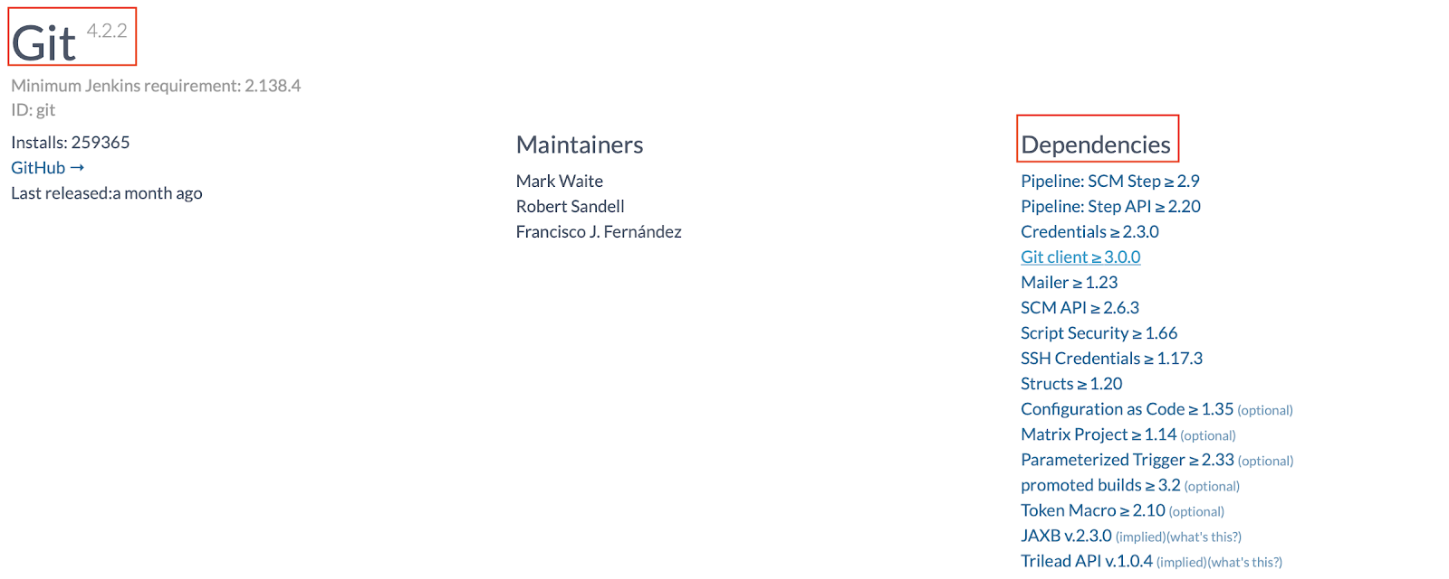
What Exactly Are Plugins?
Jenkins uses plugins to provide much of the user-needed functionality. Many Jenkins features such as integrating source code management tools, build tools, reporting tools, code coverage, static analysis, notifications are all implemented as plugins.
Essentially, all the Jenkins plugins are Java Archive (JAR) files with either an .hpi or .jpi extension. For example, Git plugin (git.hpi), Maven plugin (maven-plugin.jpi).
They may have optional or required dependencies on other plugins, and they can be upgraded or downgraded (although this is generally not recommended).

Slide 3
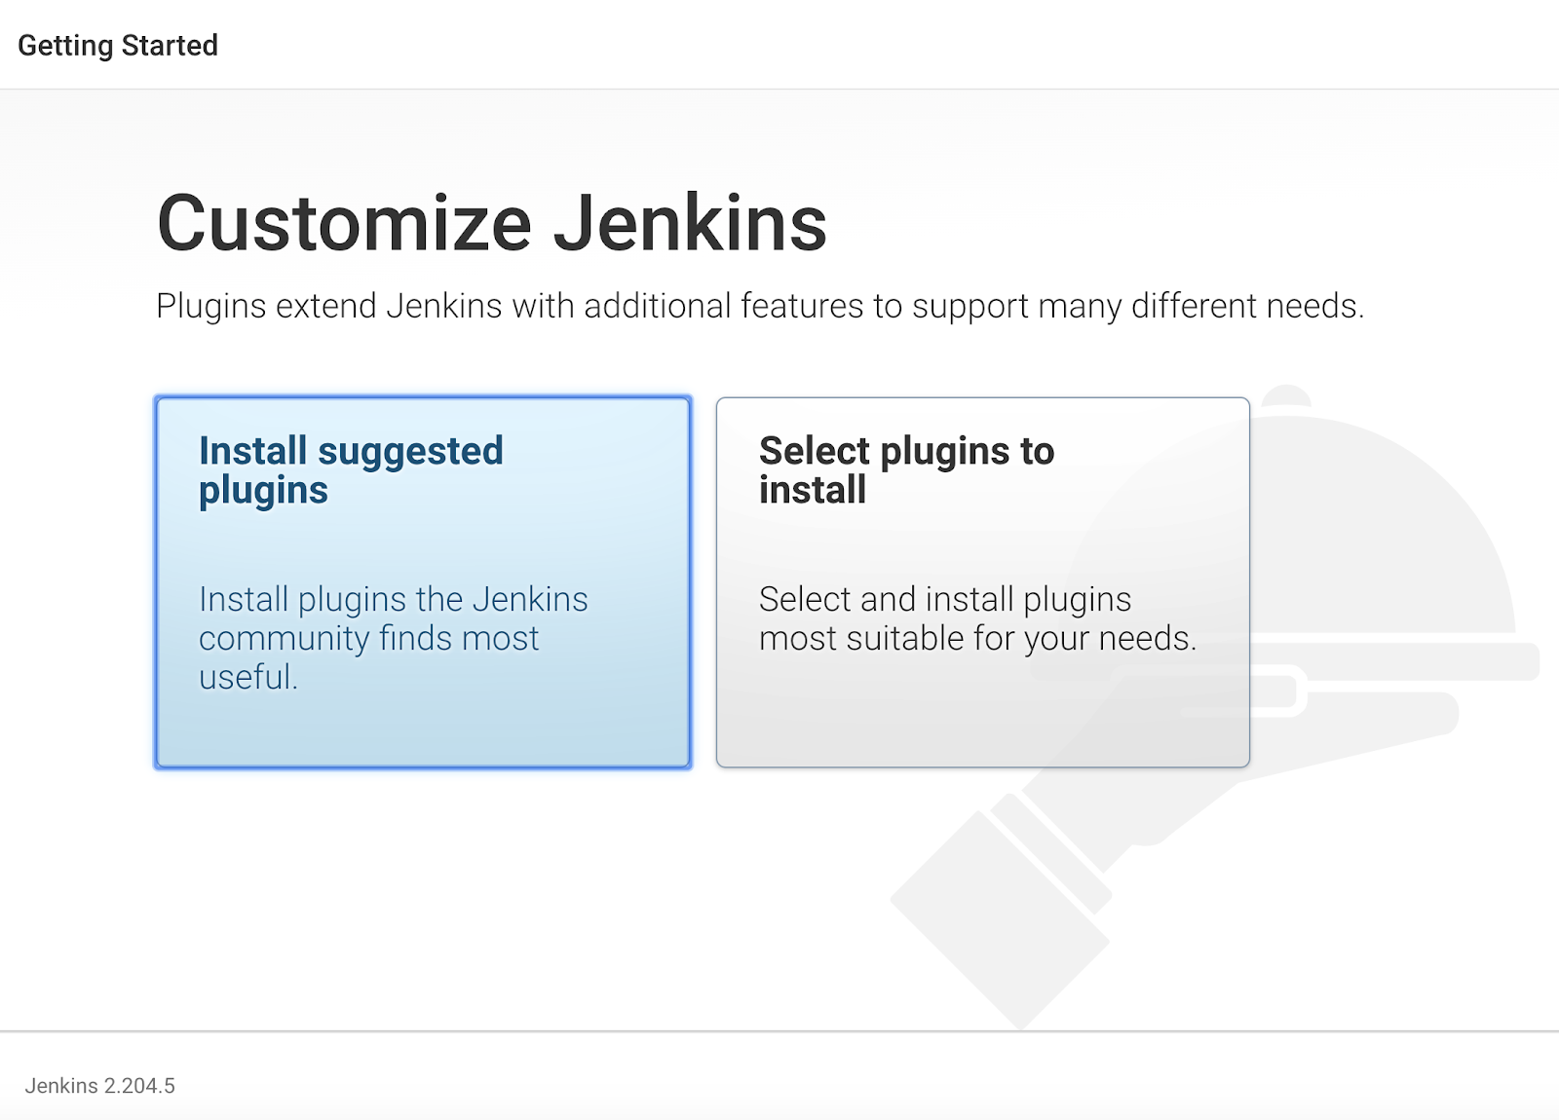
Currently, there are 1000+ plugins available for use. You can view a list of all the available plugins on the Jenkins Plugins Index page.
The long list of plugins can be overwhelming for new Jenkin users. With Jenkins versions 2.0 and above, the post-install wizard automatically recommends plugins that have been validated, and the ones that the Jenkins community finds most useful for CI/CD workflow. We strongly recommend that you select this option as this will set up all the essential plugins for you right off the bat.
The one-time post-install wizard setup gets you started with essential plugins. This is great. But what if you need to install a new plugin for a new functionality that you are looking for, or upgrade an existing plugin to work with newer Jenkins core versions? Or maybe you no longer need a plugin that is already installed? Let us explore how to manage plugins on your Jenkins server.

Slide 4
GitHub Setup for Jenkins
Jenkins is a CI (Continuous Integration) server and this means that it needs to check out source code from a source code repository and build code. Jenkins has outstanding support for various source code management systems like Subversion, CVS etc.
Github is the fast becoming one of the most popular source code management systems. It is a web based repository of code which plays a major role in DevOps. GitHub provides a common platform for many developers working on the same code or project to upload and retrieve updated code, thereby facilitating continuous integration. Jenkins works with Git through the Git plugin.
Connecting a GitHub private repository to a private instance of Jenkins can be tricky.

Slide 5
Maven Setup
Maven is a powerful project management and comprehension tool that provides complete build life cycle framework to assist developers. It is based on the concept of a POM (Project Object Model) that includes project information and configuration information for Maven such as construction directory, source directory, test source directory, dependency, Goals, plugins etc.
Maven is build automation tool used basically for Java projects, though it can also be used to build and manage projects written in C#, Scala, Ruby, and other languages. Maven addresses two aspects of building software: 1st it describes how software is build and 2nd it describes its dependencies.

Slide 6
What Is Selenium?
Selenium is an open source automation tool that has been widely used for testing web applications. It is easy to use, and it provides support forums, which makes it popular among the testing community. Selenium has four main components: Selenium IDE, Selenium RC, Selenium WebDriver, and Selenium Grid, designed and used for different purposes. Selenium provides cross-browser testing and parallel testing features, which allows the testers to execute their test cases in different operating systems and browsers, which ensures browser compatibility of the web application.

Slide 7
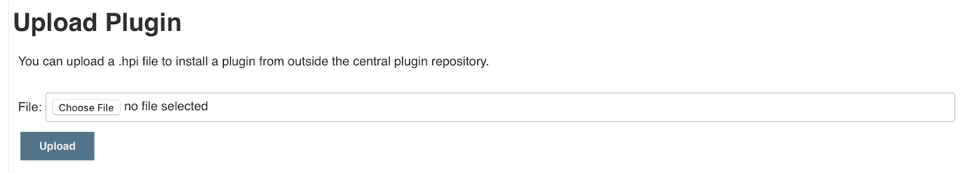
Manual Upload
Another way to install plugins is to manually upload an .hpi or .jpi file using the upload plugin option on the Advanced tab.
So, when should you use this option? This is especially useful for cases where you are using an older version of a plugin not currently available on the Jenkins update site, or if you developed your own custom plugin.
If your plugin has dependencies on some other plugins, be sure to install those plugins as well. Otherwise, your plugin may not work as expected.

Slide 8
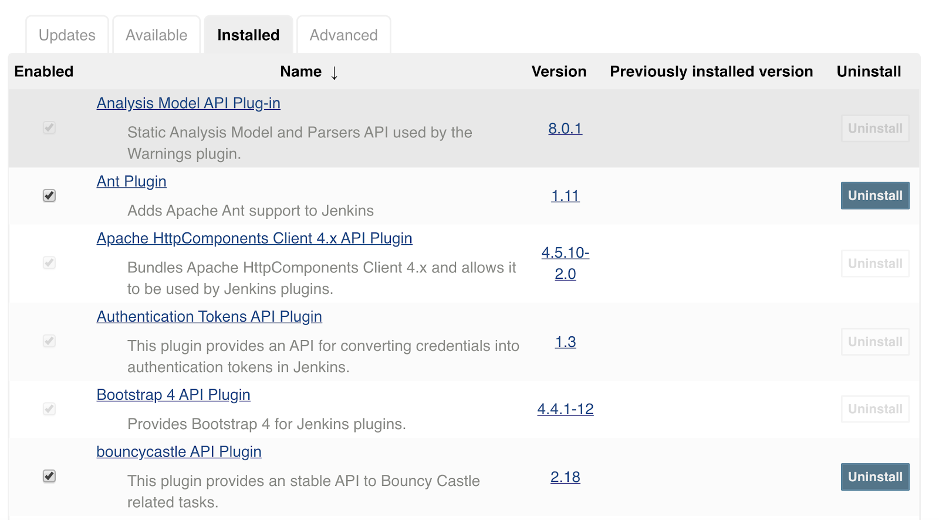
Installed Plugins
The Installed tab under Plugin Manager lists all the plugins installed on your Jenkins instance. It can be used to quickly verify if a specific plugin is already installed, or if you need to confirm which version of a plugin is installed, etc.

Slide 9
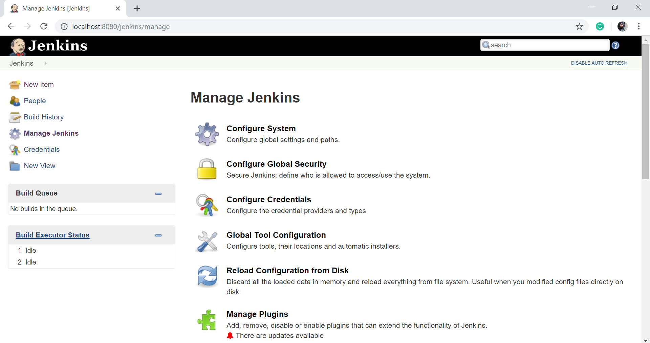
Jenkins Configuration
On the Manage Jenkins page, you will see the following options:

Slide 10
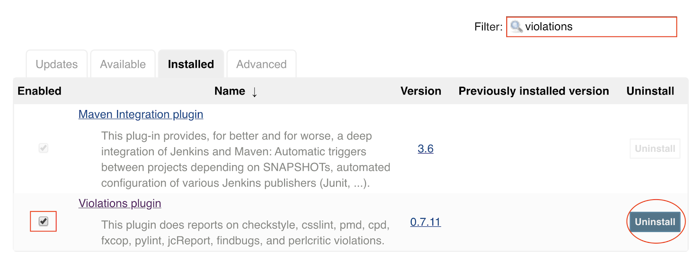
Uninstall Plugins
If you no longer need a plugin, you can uninstall it by selecting the specific plugin on the Installed tab and clicking the Uninstall button.
Here is an example of uninstalling a plugin. Let's say you want to remove the Violations plugin as it is deprecated. Use the filter on the Installed tab to search for Violations plugin, ensure that the box adjacent to Violations plugin is checked, and click Uninstall.

Slide 11
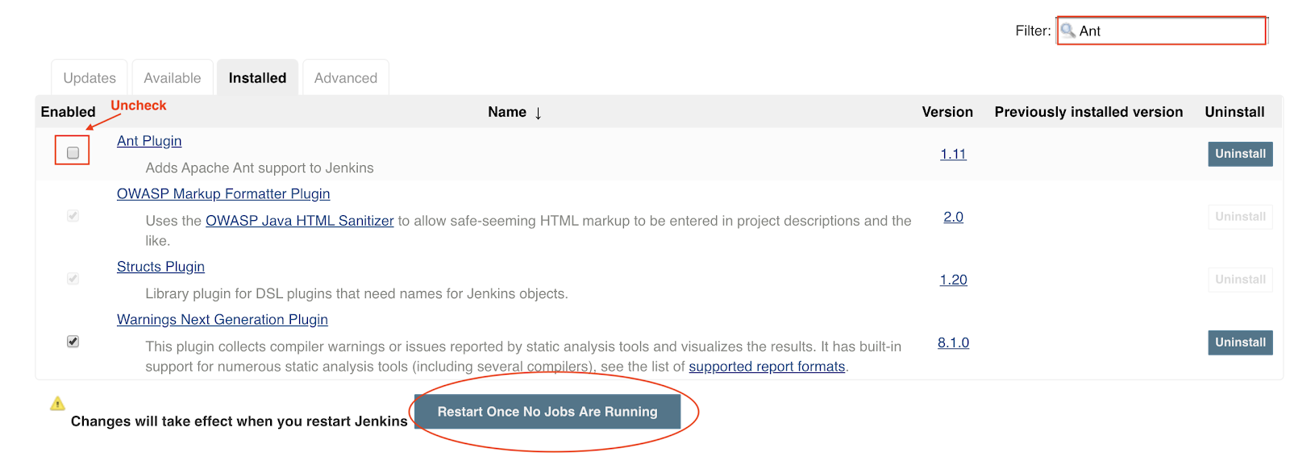
Disable Plugins
Sometimes you may not want to remove a plugin altogether, but you just want to be able to disable its functionality. You can do so on the Installed tab by searching for the plugin, and unchecking the toggle under the Enabled column.
You might want to note that when you disable a plugin, it will still show up under the list of installed plugins. However, Jenkins does not really start the plugin, and any extensions contributed by this plugin are not visible.
If you need to re-enable the plugin at a later time, you just need to check the toggle under the Enabled column and restart your Jenkins server to make the plugin operational.

Slide 12
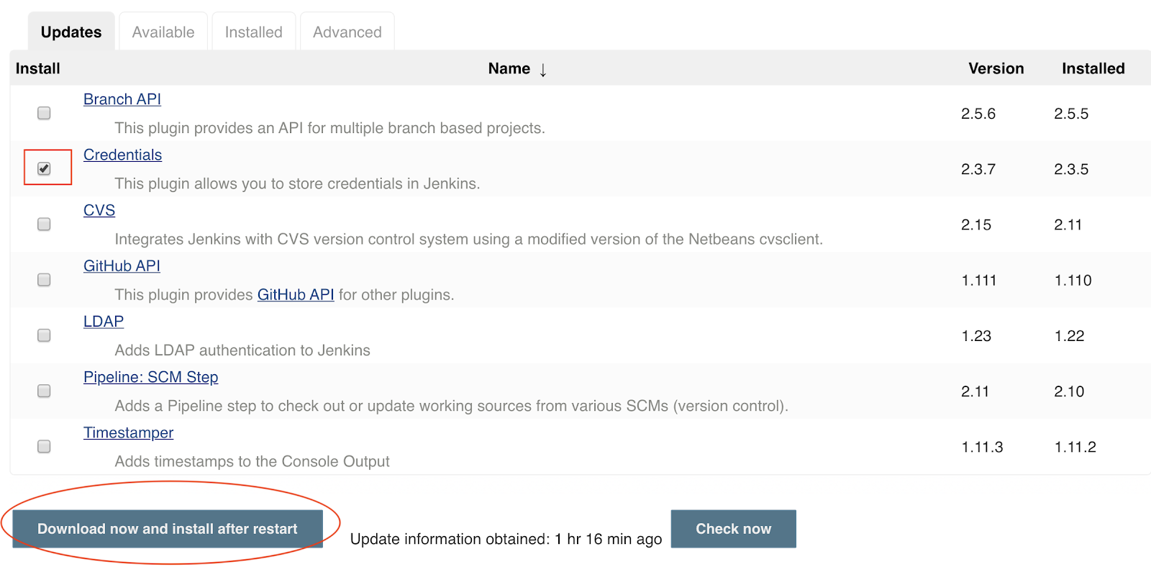
Update Plugins
It is always a good practice to update the plugins frequently. New releases of plugins add enhanced functionality, security fixes, etc. Also, older versions of plugins may not be compatible with newer versions of Jenkins core.
The Updates tab lists all the installed plugins for which an update is available. You can update a specific plugin by checking the toggle under the Installed column, and clicking Download now and install after restart button.
Here is an example of upgrading Credentials plugin. The Installed column shows the version of the plugin that is currently installed on your Jenkins server. The Version column shows which version is available for upgrade. Check the box adjacent to Credentials and click Download now and install after restart button.

Slide 13
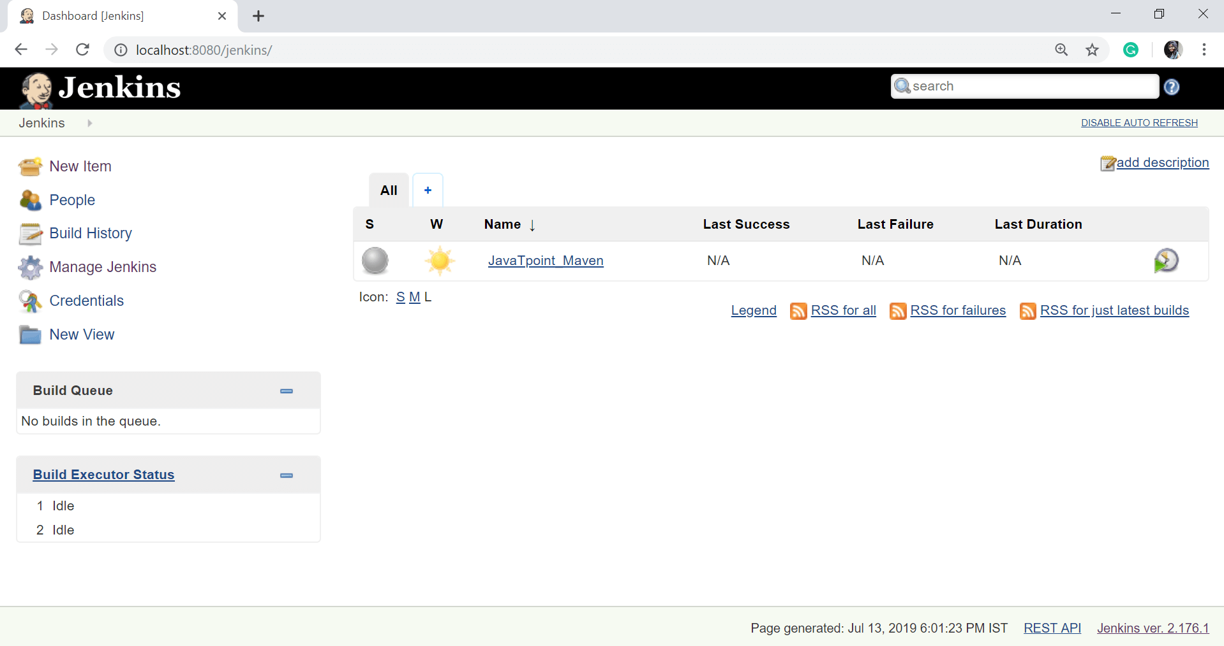
Jenkins – Management
To manage Jenkins, click on the "Manage Jenkins" option from the left hand of the Jenkins Dashboard page.

Slide 14

Create and Manage Users in Jenkins
Generally, in a large organization, there are multiple separate teams to run and manage jobs in Jenkins. But managing this crowd of users and assigning roles to them is too difficult.
By default, when you create a user in Jenkins, it can access almost everything. In this, you can create multiple users but can only assign the same global roles and privileges to them. This is not ideal, especially for large organizations.
To enable you to assign different roles and privileges to different users in Jenkins, you should have to install the Role Strategy Plugin.

Slide 15
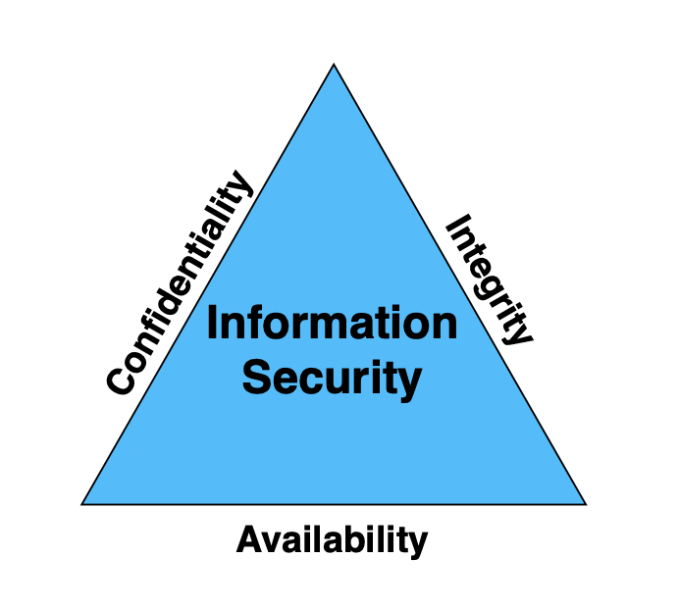
Why Security?
For any organization, their intellectual property (IP) is a valuable data and it is important to protect it. Confidentiality, availability, and integrity, also known as the CIA triad, are the fundamental principles of information security.
Confidentiality determines the secrecy of your IP, and prevents unauthorized access to restricted data.
Integrity ensures that your IP is accurate and reliable, and it has not been modified from its original state while in transit or at rest.
Availability is the ability of the users to access your IP. Information is of no use if it cannot be accessed.
Your Jenkins server hosts your organizational intellectual property (IP) such as your source code, build artifacts, etc. Your Jenkins environment is also a fully distributed build system with Jenkins server and agents (more on this in a later section of this course) and each network connection is a potential point of entry. A malicious user could access your Jenkins environment to launch a Distributed Denial of Service (DDoS) attack or a bot or do any other mischief.
Let's explore some of the key Jenkins security features built upon the CIA triad, and how these can be used to mitigate potential threats.

Slide 16
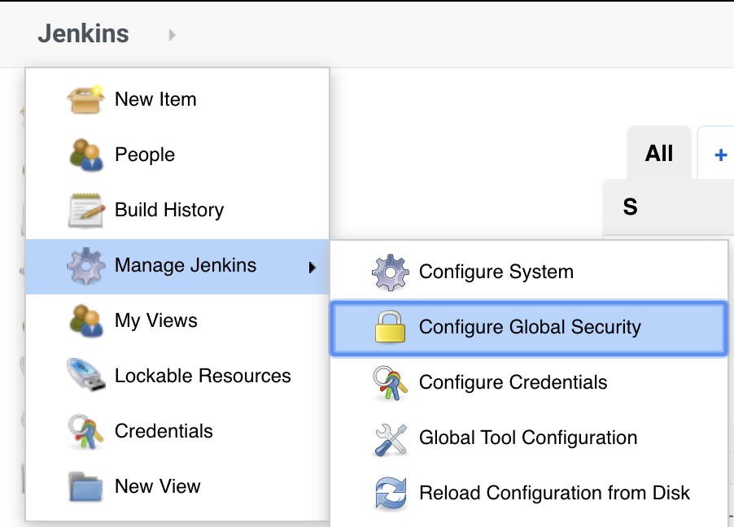
Securing Jenkins
Starting with Jenkins v2.0, security is enabled by default, and you are required to create an administrator user account in order to be able to login to Jenkins. This is set up as part of the Post Install Setup Wizard.
Many of the global security features are configured on the Configure Global Security page.

Slide 17
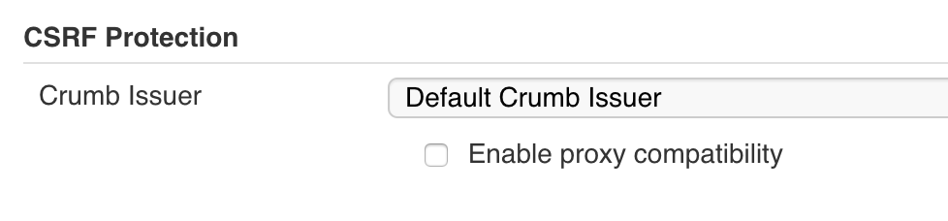
CSRF Protection
According to OWASP,
"Cross-Site Request Forgery (CSRF) is an attack that forces an end user to execute unwanted actions on a web application in which they are currently authenticated".
Enabling CSRF protection will protect your Jenkins environment from malicious attacks.

Slide 18
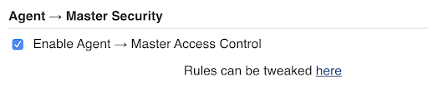
Agent-to-Master Security
In a distributed build environment where Jenkins server leverages additional resources (Agents) for running the builds, the agents can request any information from the server. Enabling Agent > Master Access Control allows a Jenkins administrator to control what specific information is allowed by the Agents.

Slide 19
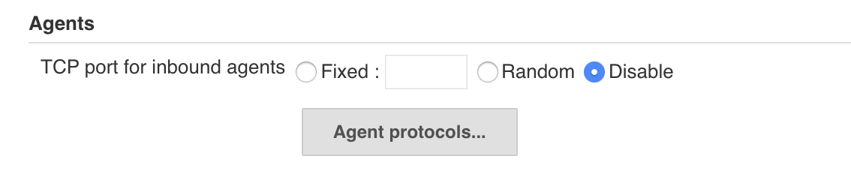
JNLP Port
In a distributed set up, Jenkins uses a TCP port to communicate with the Agents. This port is disabled by default. If needed, you can enable it by selecting either a fixed port or a random port.

Slide 20
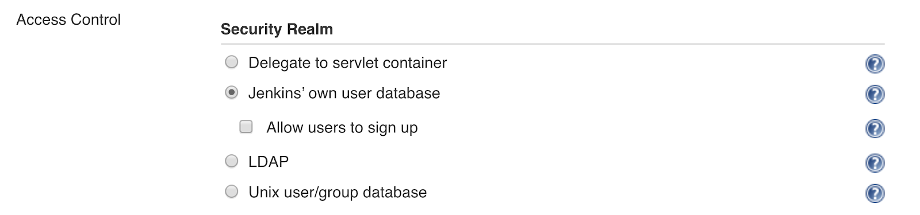
Authentication
Authentication is an act of validating that users are who they claim to be, essentially confirming the identity of users. Usernames and passwords are the most basic form of authentication.
Jenkins supports many different authentication systems through security realms. A security realm tells Jenkins which referential to use for authentication.
There are four security realms which are supported out of the box. These are:
Delegate to servlet container
Jenkins' own user database
LDAP
Unix user/group database

Slide 21
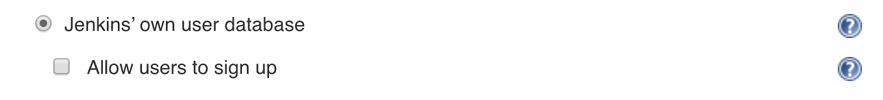
Authentication
Delegate to servlet container
This realm delegates authentication to the servlet engine running Jenkins. For instance, Tomcat, JBoss, websphere, etc., have their own authentication mechanisms. If using this realm, you will need to look into the servlet container’s authentication documentation.
Jenkins’ own user database
This security realm uses Jenkins local database and is enabled by default when you initially install Jenkins.
If you select this security realm, you do have the option of letting your users sign up. However, please refrain from assigning any significant privileges, such as edit, administrator, etc., to authenticated users, as this can pose a big security risk.
Note that if you deselect the sign up option, only users with overall administrator privileges can create users.

Slide 22

LDAP
This realm delegates authentication to an external LDAP service. Most companies already have a Directory Service for authentication. This option is more common for larger installations in organizations which already have configured an external identity provider such as LDAP. This also supports Active Directory, OpenLDAP installations.
Key features of LDAP include:
It is highly tunable.
Its binding can be sub-authenticated.
You can take advantage of the caching mechanism to leverage load on LDAP servers.
There's support available for LDAP replicas.
There are various other security realms available through plugins such as Github Authentication, Active Directory and BitBucket OAuth, to name a few. You can search these on the plugins page.

Slide 23
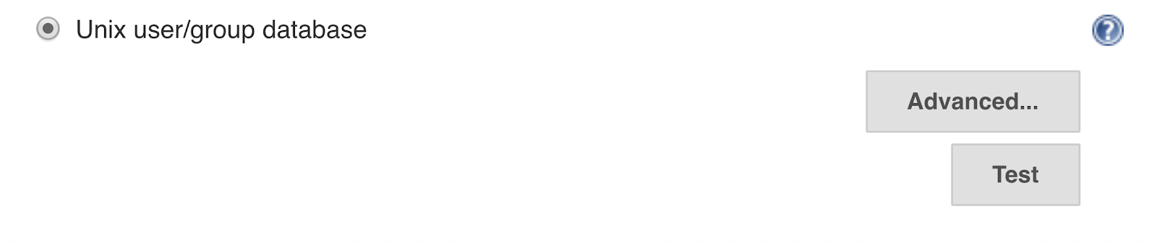
Unix user/group database
This realm delegates authentication to the underlying Unix/Linux machine, and it only works if you are running Jenkins on a Unix server.
If you enable this realm, your end users will have to login to Jenkins by entering their operating system username and password.

Slide 24
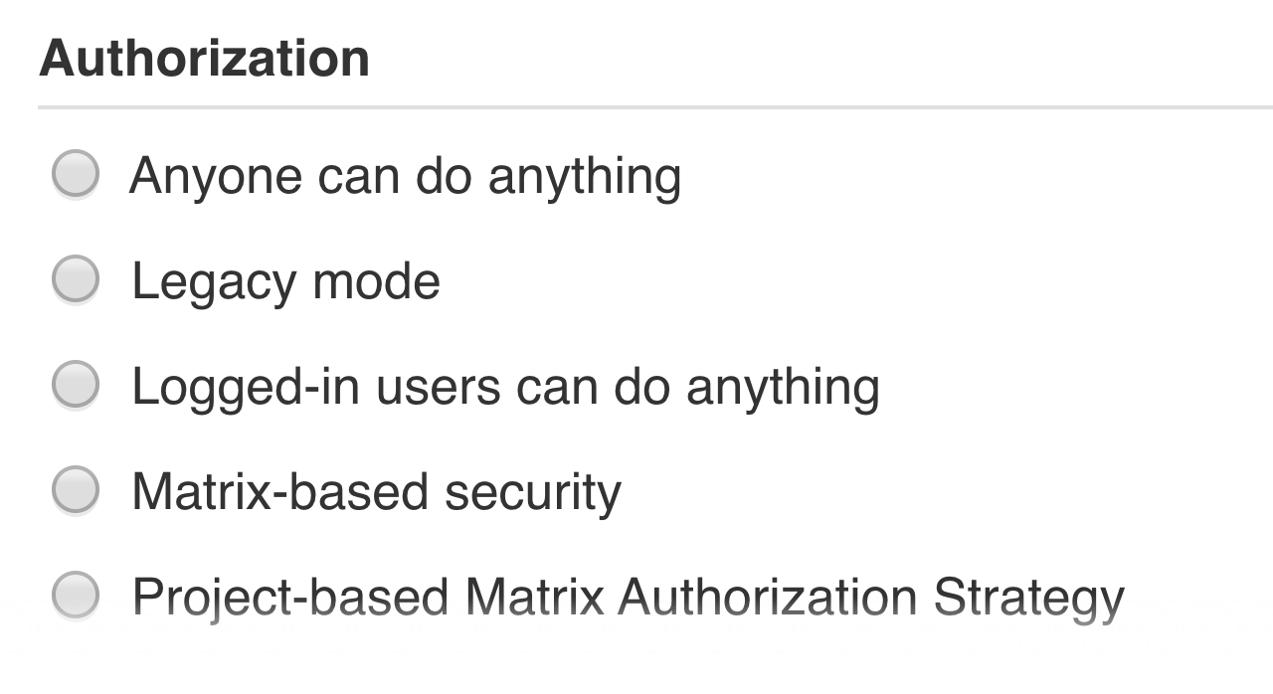
Authorization
Once a user/group is authenticated, you need to determine the actions this user/group should be able to perform. Authorization always occurs in the context of authentication.

Slide 25

Lightweight Authorization
Anyone can do anything This allows both authenticated and anonymous users to do anything.
Legacy mode This allows administrators to perform any action. All other users are restricted to read only mode.
Logged-in users can do anything This is the default authorization strategy. It allows all authenticated users to perform any action.
As you can see, all of these options solely rely on the Authentication and provide no fine-grained access control.

Slide 26
Credentials
Jenkins needs to authenticate itself against other services:
SCM repositories for retrieving source code (or pushing it)
Binary repositories for storing artifacts or fetching dependencies
Remote secured services for authentication such as LDAP
Deploy to secured environments.
With Credentials plugin, you can centrally manage credentials to authenticate to various services. When a credential is needed, Jenkins knows it and allows for easy selection.

Slide 27
Jenkins - Notification
Emails have been an important aspect in every organization due to its ease of use, and availability.
Several plugins are available in the market that allows you to configure every aspect of email notifications, one of which we are going to see now in Jenkins.
Jenkins email notification is a Java-based plugin tool to automate notification alert whenever an email is received. It will be useful for the CI (Continuous Integration) code.

Slide 28
Jenkins - Reporting
In Jenkins, a report is a structured and graphical way where we can see the execution results or output of the test. Reports are also useful when we have to communicate the results with our team members or with other stakeholders. There are many plugins available for reporting in Jenkins. It is easy, convenient, and recommended.
In Jenkins, Test results are generated in the form of Graphical Reports. These reports are just not graphical but can produce the detail written reports. This written report can be in different formats, and we can manage it by specifying along with the build command.

Slide 29
Jenkins - Code Analysis
Now a day we are writing code. So it is important that the quality of the code must be good to have better performance.
The implementation of static analysis job within Jenkins, the most popular open- source tool for Continuous Integration (CI), and Continuous Deployment made it more interesting.
Why Code Analysis?
Sometimes there may be a situation when compilers often fail to identify all the bugs. Static code analysis helps in improving the position a little.

Slide 30
Jenkins - Metrics and Trends
Jenkins provides many plugins to present the metrics for builds which are carried out over a period of time. These metrics are useful to see the build and to understand how frequently they fail/pass over time.
Let's see the "Build History Metrics Plugin", this plugin is used to calculate the following metrics for all of the builds once installed:
MTTF (Metrics Time to Failure)
MTTR (Mean Time to Recovery)
Standard Deviation of Build Times

Slide 31
Jenkins - Server Maintenance
The following are the basic activities that you will carry out, some of which are best practices for Jenkins server maintenance.
URL Options
Append the following commands to the Jenkins URL to perform the following operations:
http://localhost:8080/jenkins/exit - shutdown jenkins
http://localhost:8080/jenkins/restart - restart jenkins
http://localhost:8080/jenkins/reload - to reload the configuration

Slide 32
Jenkins - Managing Plugins
Jenkins provides a variety of plugins for a different task. To see the list of all available plugins in Jenkins, open the following link: https://plugins.jenkins.io/

Slide 33
Jenkins Backup Plugins
It is important to have a Jenkins backup with its data and configurations. It includes job configs, plugins, build logs, plugin configuration, etc.
Jenkins provides a backup plugin which can be used to get backup critical configuration settings related to Jenkins.

