Slide 1

Jenkins Job

Slide 2
What Is a Jenkins Job?
A Jenkins job is a sequential set of tasks that are defined by a user. Typical steps include retrieving the latest source code from version control, compiling it, running unit tests, building and storing the artifacts, and notifying the end users of the outcome of the build.
On the Jenkins UI, the term "job" is used synonymously with "project". Note that both of these are runnable tasks controlled and monitored by Jenkins.

Slide 3
Jenkins Job Types
There are many different job types available in Jenkins including:
Freestyle Project This is the default project type, most flexible to configure, and is included as part of the core Jenkins.
Maven Project This one is useful for building Maven projects. It requires the Maven Integration plugin to be installed.
Pipeline and Multibranch Pipeline These are useful for creating end-end CI/CD pipelines. These require Pipeline and Multibranch plugins to be installed.
External Job It is useful when you want to monitor a process that is running outside of Jenkins, and you would like to track its progress from the Jenkins dashboard.
Multi-Configuration Project This is useful for projects with a large number of configurations. It requires the Matrix Project plugin to be installed

Slide 4
Anatomy of a Jenkins Job
A Jenkins job typically includes the following components.
Global Project Options
Source Code Management
Build Triggers
Build
Post-build Actions

Slide 5
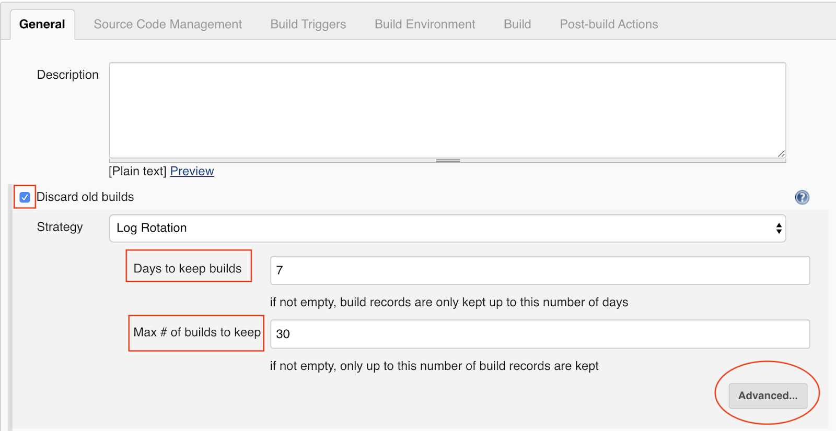
Anatomy of a Jenkins Job: Global Project Options
The General section lists the global project options for each Jenkins job. Let's discuss what information is included.
Meta-information
Meta-information is basically information about the job. For a Jenkins job, job name and job description are meta-information. Be sure not to input any JavaScript in the description field as it can pose a security risk.
Build history management
Every time you run a Jenkins job, it stores the build log, artifacts, metadata, etc., on the disk. Over a period of time, this can take up a lot of disk space. To cap disk space consumption, you can set a build log retention by clicking the box adjacent to Discard old builds. Then you will be presented with two options of setting a policy for discarding builds:
Days to keep builds
Max # of builds to keep

Slide 6
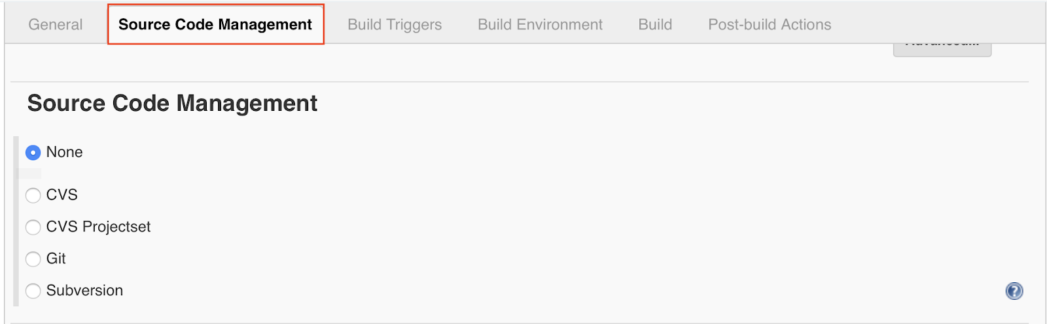
Anatomy of a Jenkins Job: Source Code Management
This is the section where you specify the details of the version control repository for building your source code. You have the flexibility to select the SCM tool of your choice, but be sure to install the necessary plugin.

Slide 7
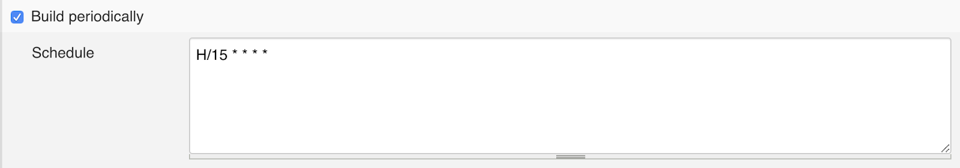
Anatomy of a Jenkins Job: Build Triggers
Jenkins allows you to trigger builds automatically. Let's take a look at some of the options under the Build Triggers section.
Build periodically
You can schedule periodic builds using cron-like syntax. Here is an example of scheduling a build every 15 minutes.

Slide 8
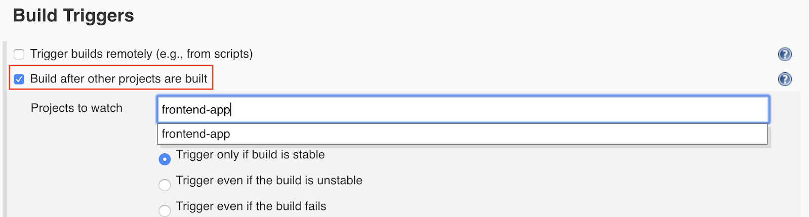
Build after other projects are built
You can also automatically build a project after another dependent project has been built successfully.

Slide 9
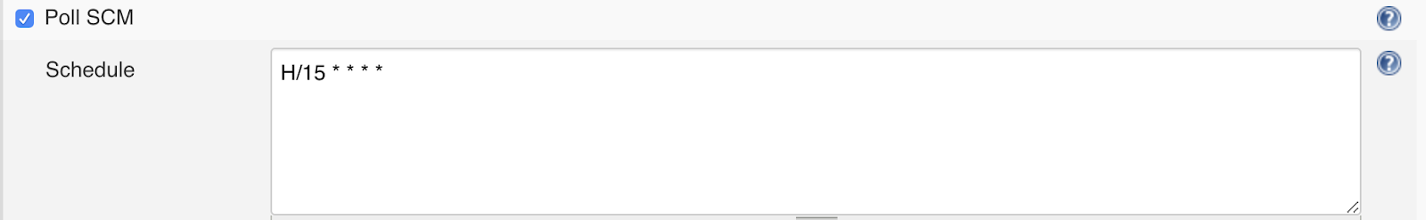
Poll SCM
You can poll SCM at a certain frequency using cron-like syntax. Jenkins will poll SCM at the set times to detect new commits. If there are any, then Jenkins will go ahead and run the build.

Slide 10
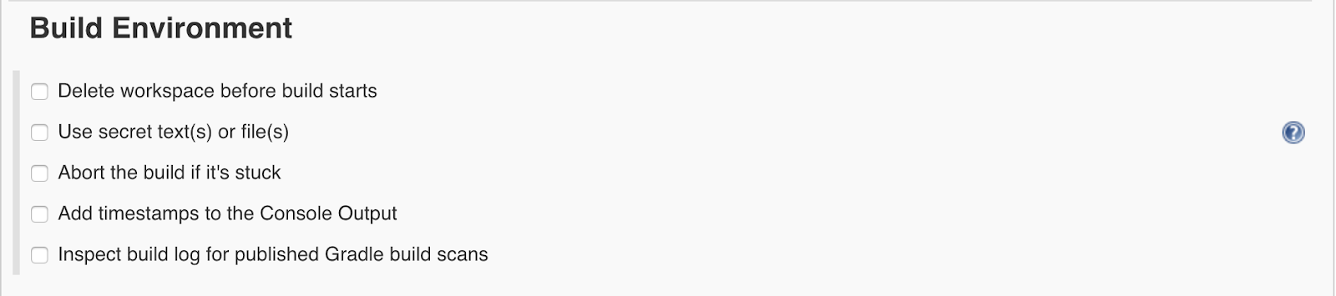
Anatomy of a Jenkins Job: Build Environment
The Build Environment section allows you to specify additional options for your builds - cleaning up the workspace prior to starting a build, setting up the required environment variables used in the build, aborting builds that are stuck, adding timestamps to the build logs, etc.
These options are provided by various plugins - Workspace Cleanup, Credentials Binding, Build Timeout and Timestamper to name a few. The more plugins you install, the more options you will see under this section.

Slide 11
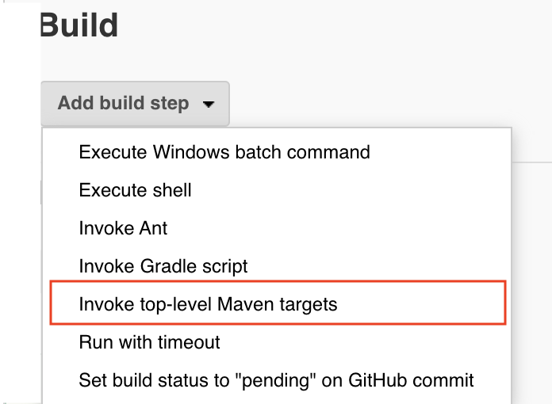
Anatomy of a Jenkins Job: Build
The Build section comprises the actual steps to build your source code, run various tests (unit, integration, etc.), code quality, code coverage, and many more.
Note: Your source code should include the test cases, and your build tool should be able to generate the required report for it. Jenkins can be used to display build tool generated test reports and trends.

Slide 12
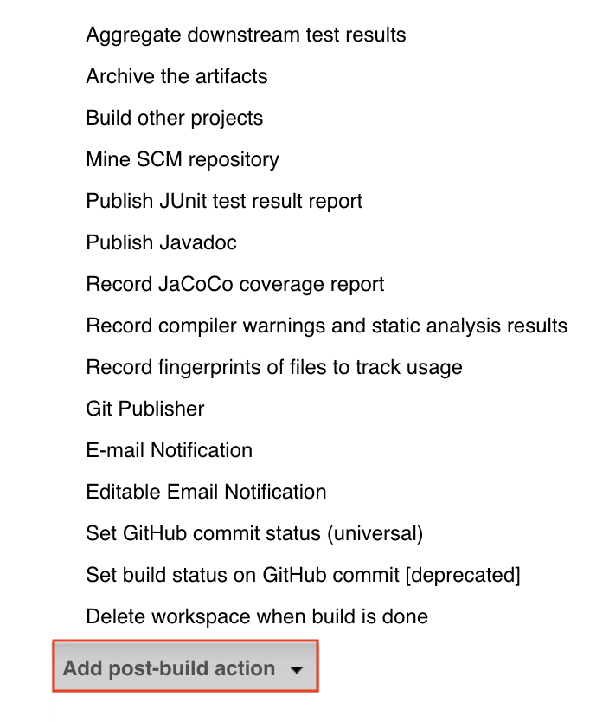
Anatomy of a Jenkins Job: Post-Build Actions
Post-build actions are performed based on the result of the build status. Examples include notifying developers, publishing test reports, archiving build artifacts, triggering other build projects, automated deployment, etc.

Slide 13

What Is a Jenkins Freestyle Job?
A Freestyle job is by far the most versatile of all the Jenkins job types. It allows you to build any type of project (Ant, Maven, Gradle, shell script, Makefile), and it is included in Jenkins by default without the need to install additional plugins.

Slide 14

Create a New Freestyle Job
For our example Freestyle job, we will use a small Java application. We will configure all the necessary tasks for this job such as retrieving the Java source code from version control, compiling and building it, running tests, publishing the code coverage and static analysis reports and notifying the team about the status of the build.
Let’s get started.

