Slide 1
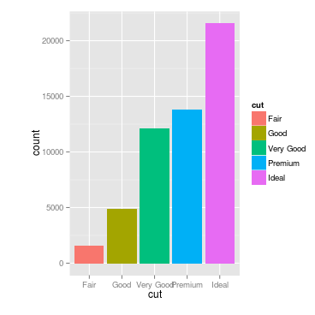
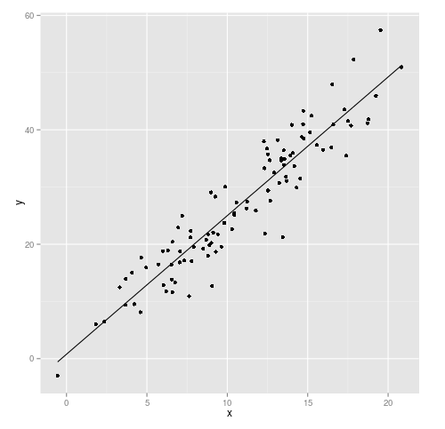
What makes an effective graph?
Facilitate comparisons
Reveal trends
Creating more effective graphs by Robbins
ggplot2 by Wickham

Slide 2
What makes an effective graph?
Conveys the right information with distorting facts
Is simple but elegant
Aesthetics support information instead of overshadow it
Is not overloaded with information

Slide 3
Eight categories of graphs

Slide 4
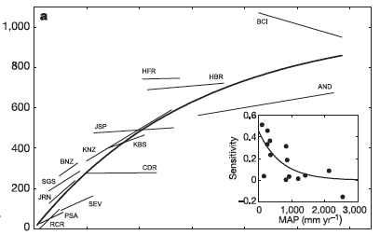
Correlation
ANPP (g/m²)
Precipitation (mm/year)
Huxman et al. 2004

Slide 5
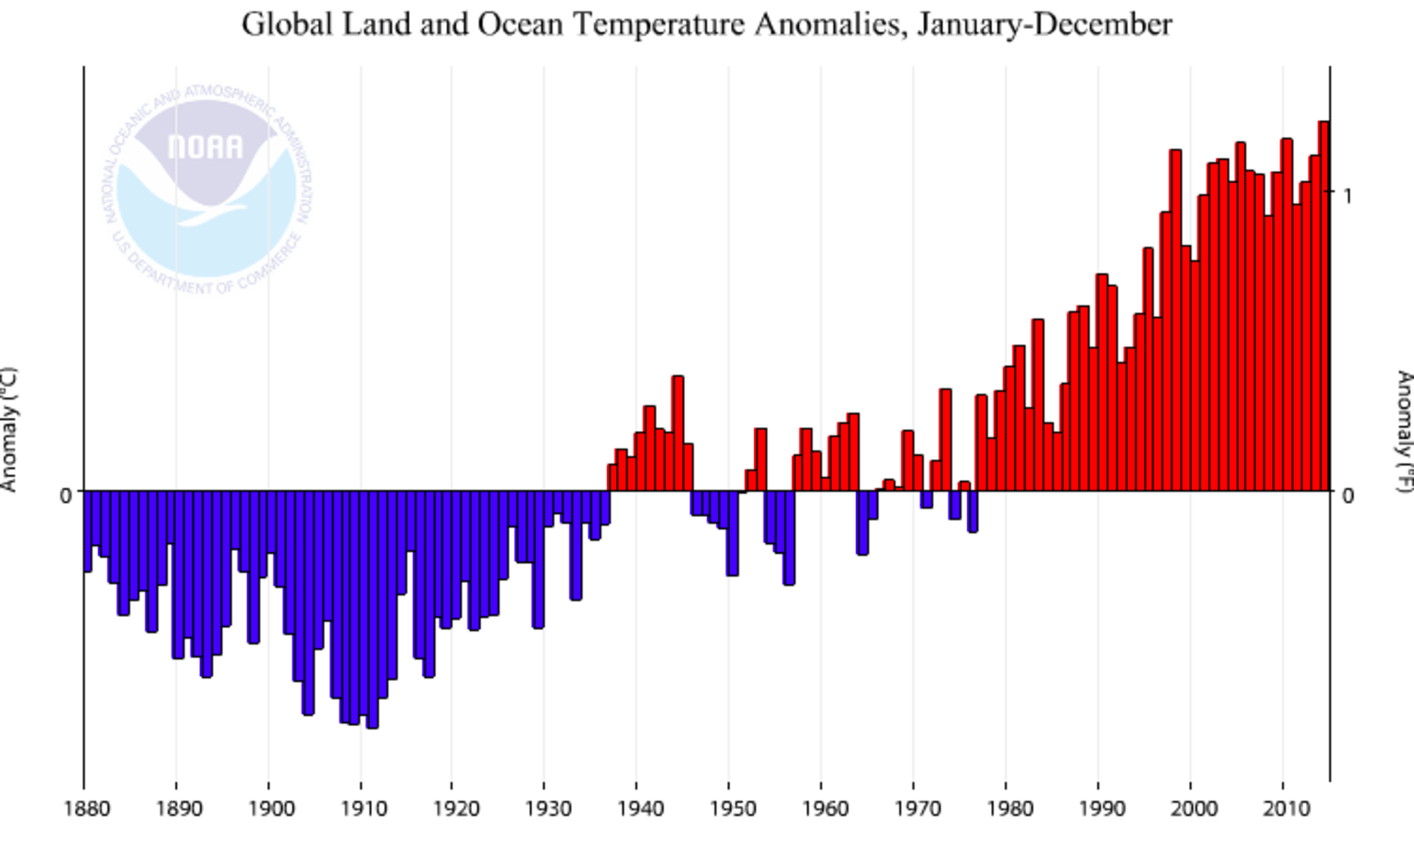
Deviation

Slide 6
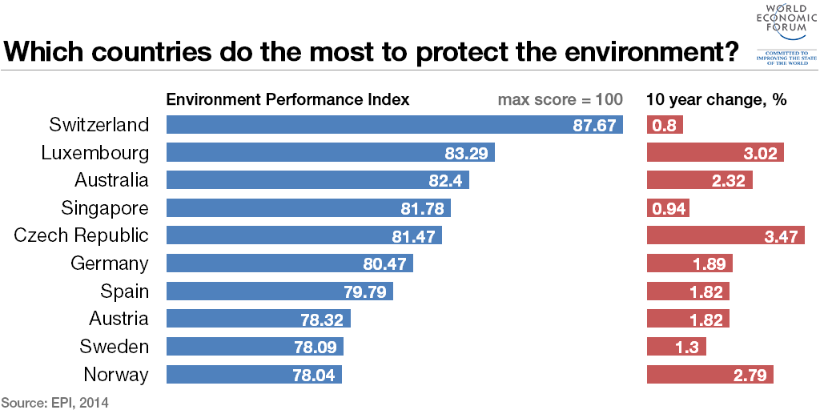
Ranking
2014 EPI

Slide 7
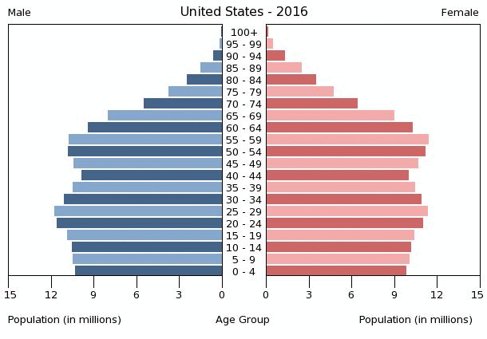
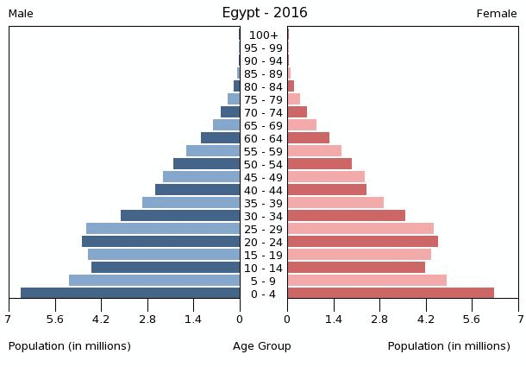
Distribution

Slide 8
Distribution

Slide 9
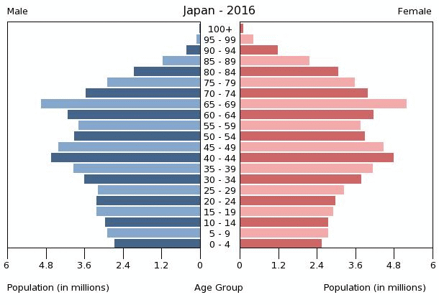
Distribution

Slide 10
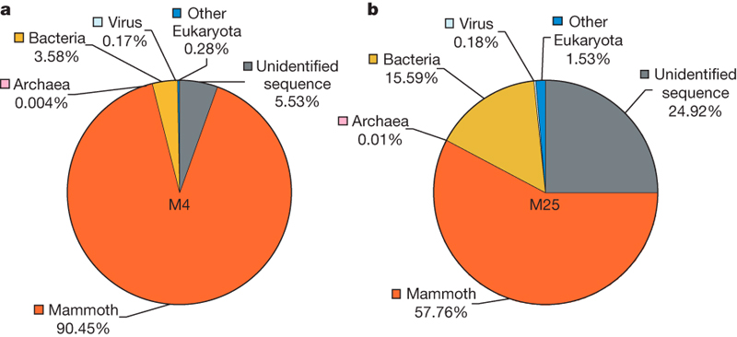
Composition
Miller et al. 2008

Slide 11
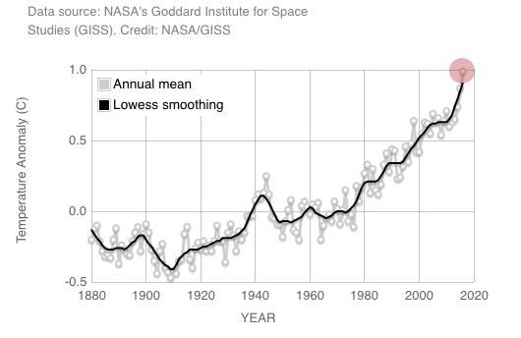
Change

Slide 12
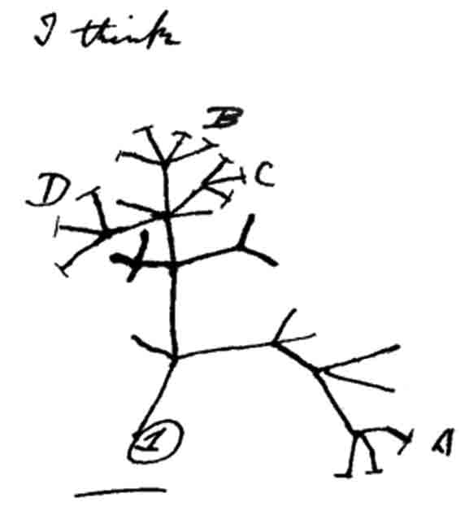
Groups
Darwin

Slide 13
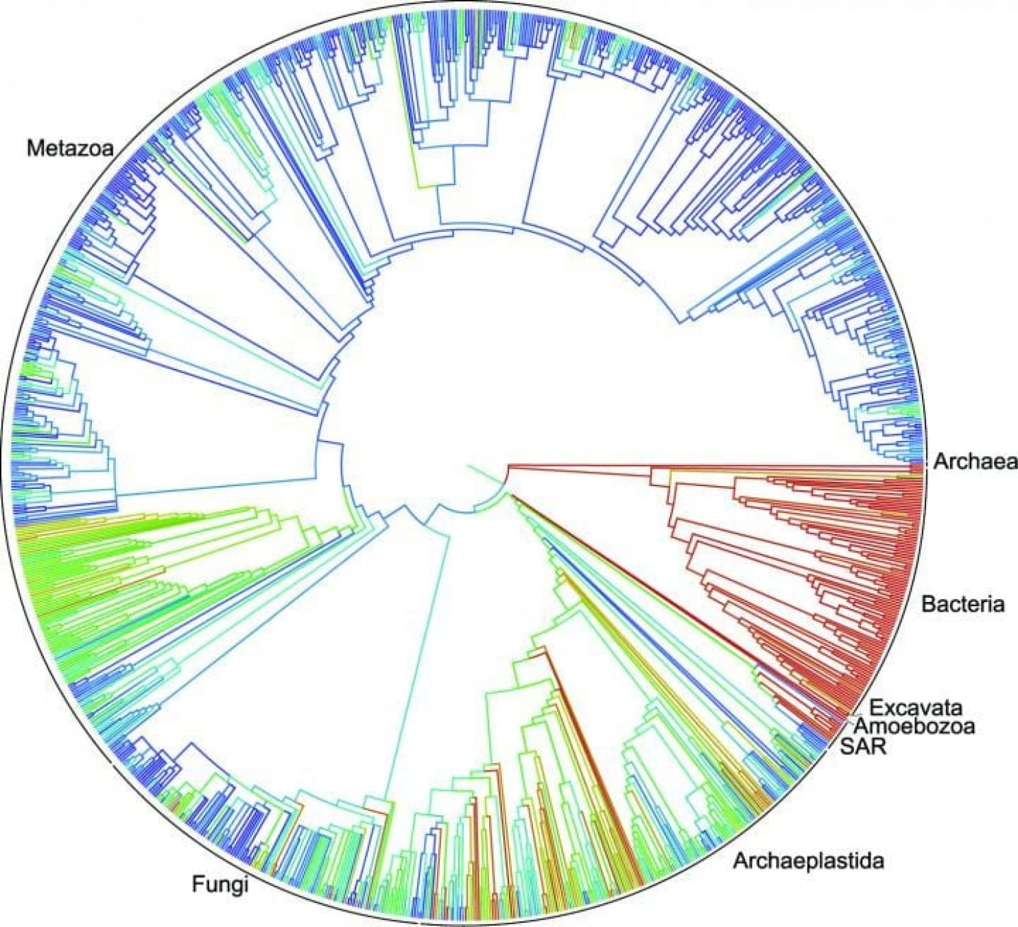
Groups
Hinchliff et al 2015

Slide 14

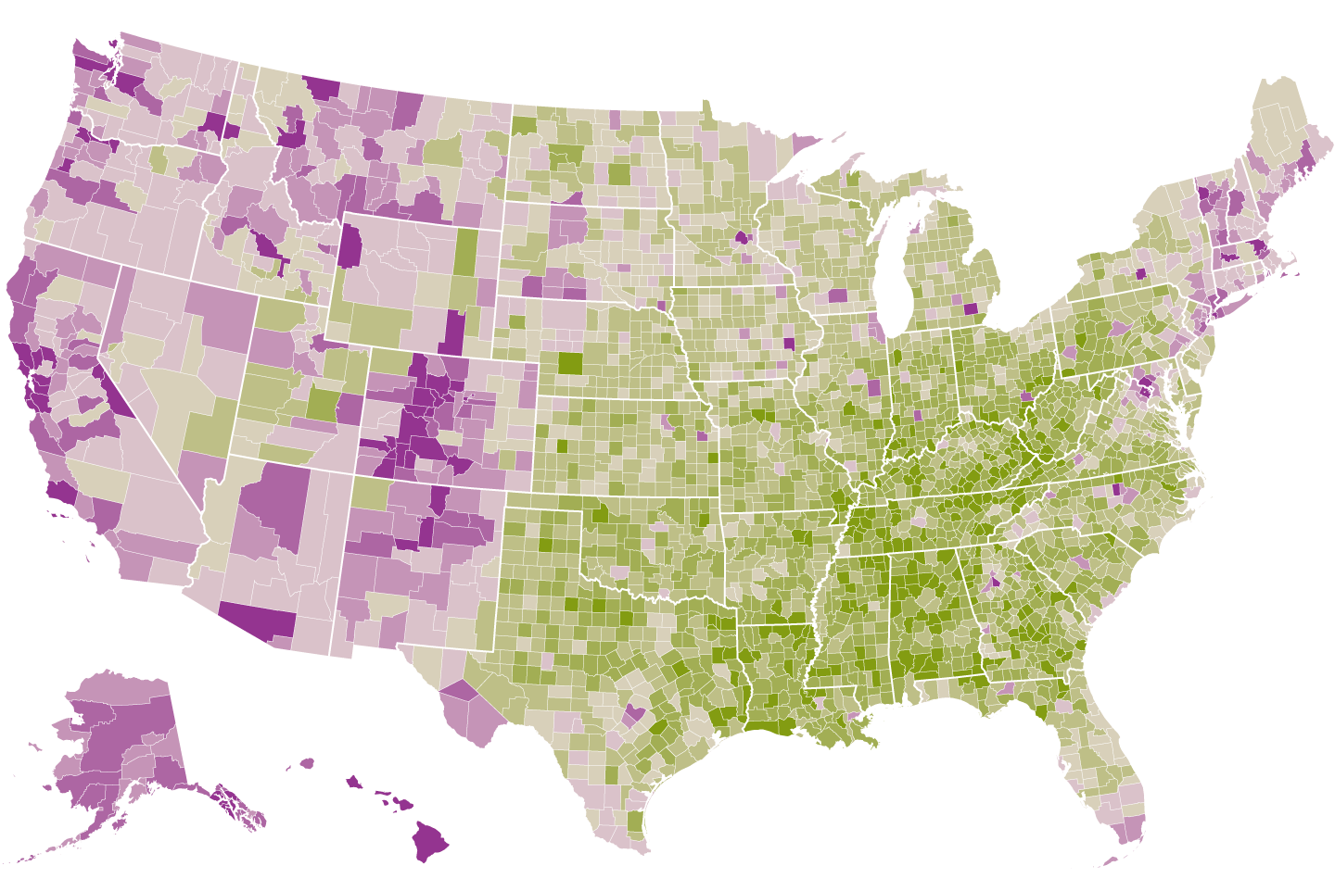
Spatial
Counties where adults discuss global warming at least occasionally
NYTimes

