Slide 1
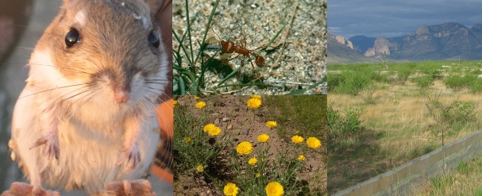
Working with relational databases using The Portal Project

Slide 2
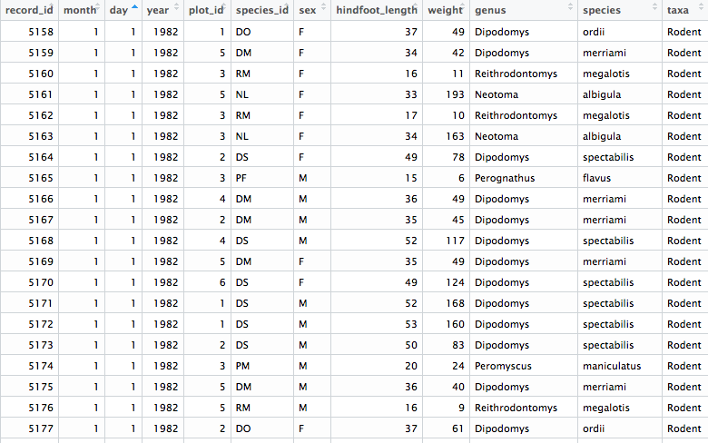
Why might this data structure be a problem?

Slide 3
A better way: Each row is a unique observation

Slide 4
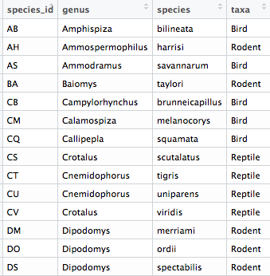
A better way: Each row is a unique observation

Slide 5
Data frames can be connected with keys

Slide 6
Data frames can be connected with keys

Slide 7
Data frames can be connected with keys
Primary key for this data frame

Slide 8
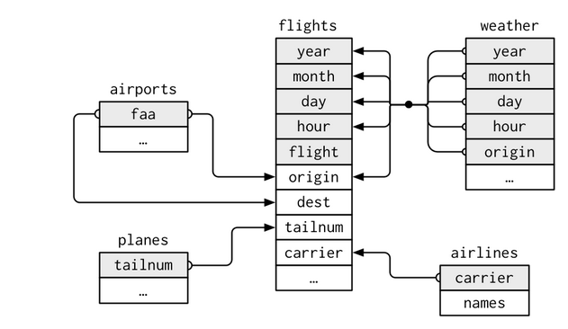
R for Data Science

Slide 9
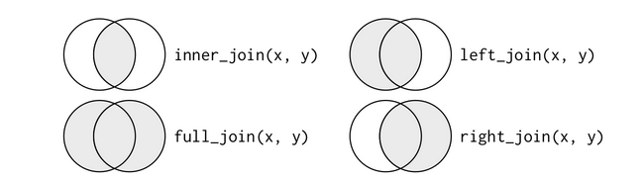

Slide 10


Slide 11
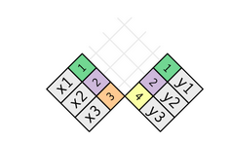

Slide 12
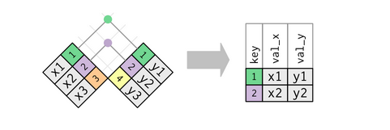

Slide 13
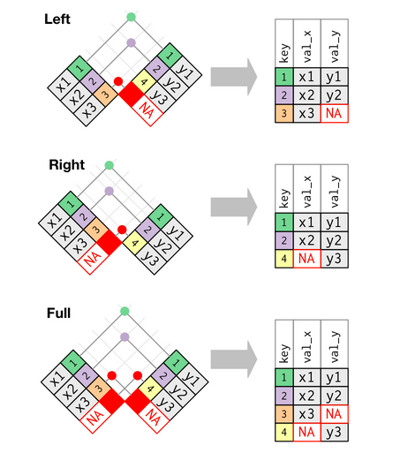

Slide 14
