Slide 1
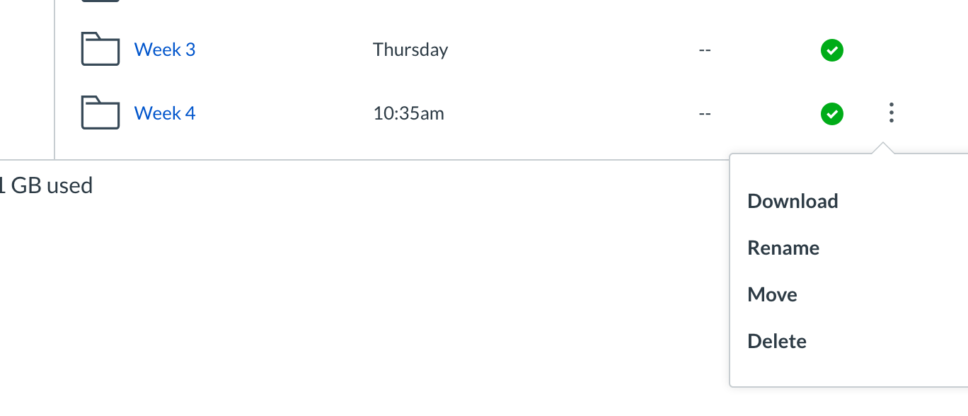
Stickies!
Download the entire Week 4 Folder!
Install the DT and leaflet packages
Midway course survey
Today:
- Finish up geoms (open your script from Friday)
Learn about Rmarkdown
Problem set 2 is due on Monday – Friday is a “work day”

Slide 2
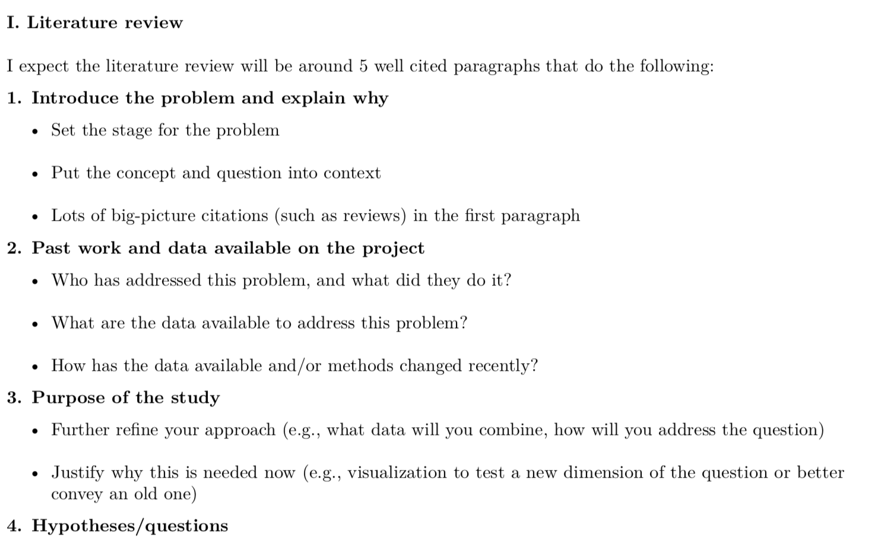
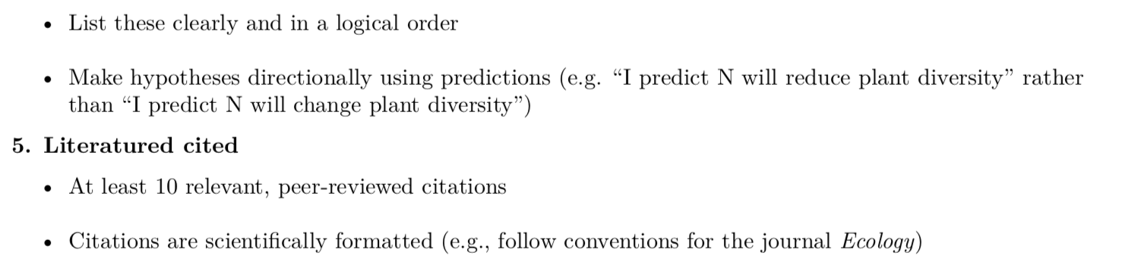

Slide 3
